Slide 1
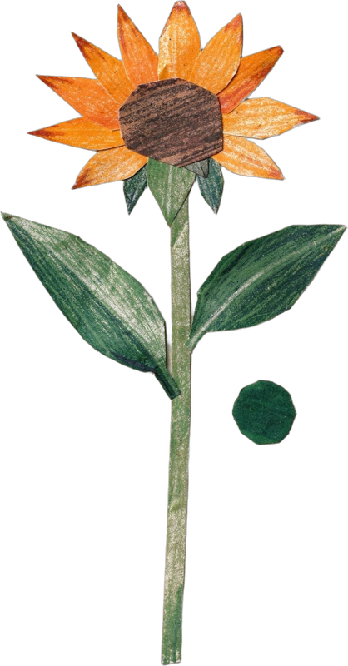
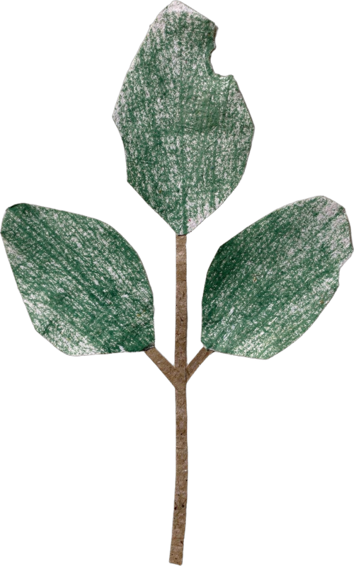

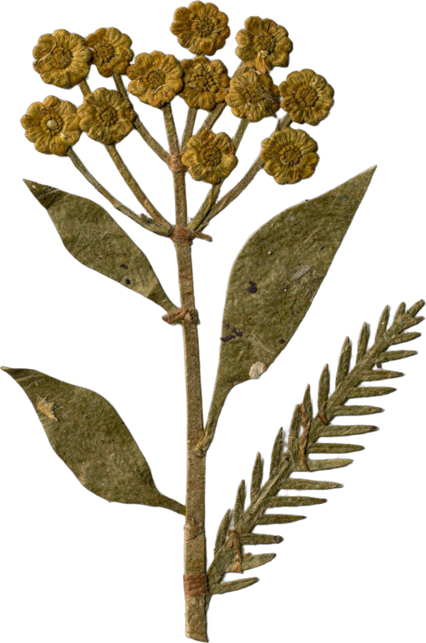
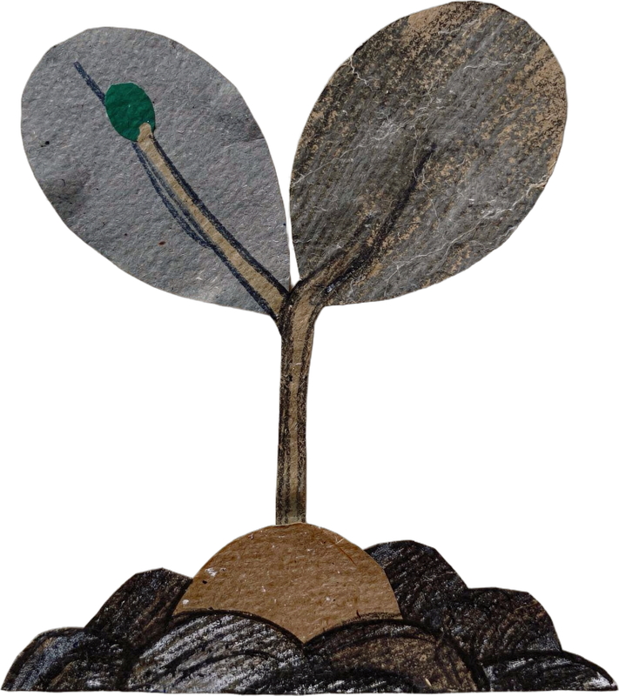

WORLD TEACHERS' DAY · 5 OCTOBER
Happy World Teachers' Day.
Meet the mentors who teach our students to see soil.
Notes:
Cover. World Teachers' Day, 5 October.

Slide 2
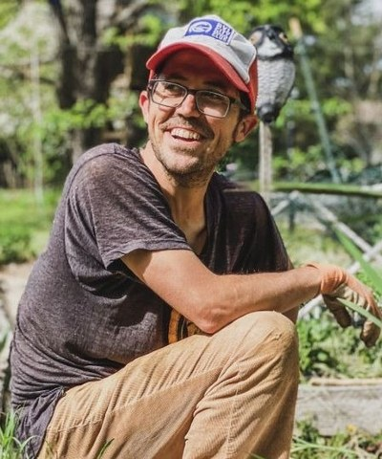
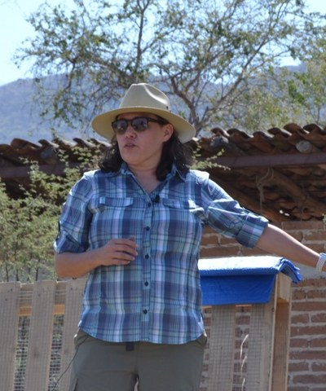
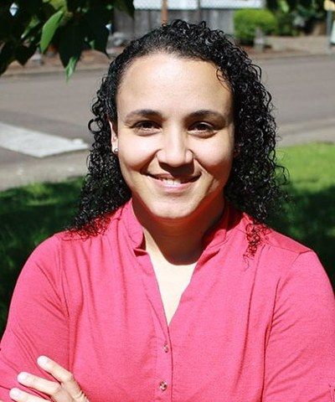
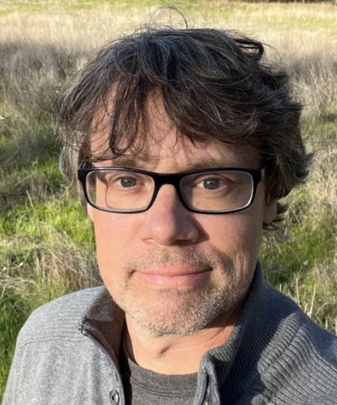
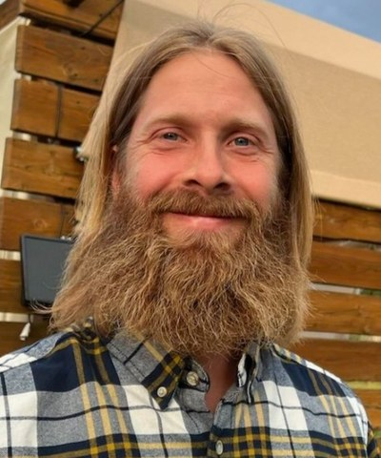
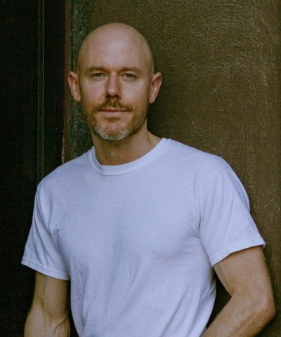
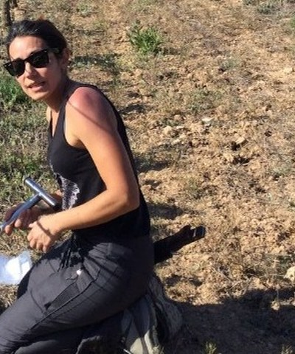
OUR MENTORS
Tommy Tepper
Loida Vasquez
Carla Portugal
Wesley Sanders
Director of Education
Advanced Programs Lead
Science Lead
Farmer, journalist, first lab tech
Casey Williams
Brian Daubenspeck
Isadora Schmidt
Ten years farming and gardening
Orchards in California
From Florianópolis, now in Spain
soilfoodweb.com
Notes:
Team grid 1: Tommy, Loida, Carla, Wesley, Casey, Brian, Isadora.

Slide 3
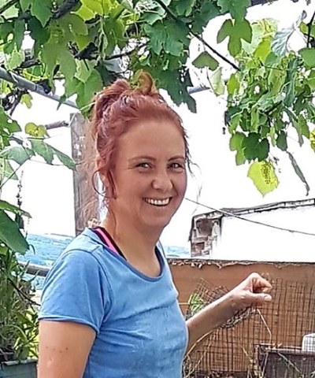
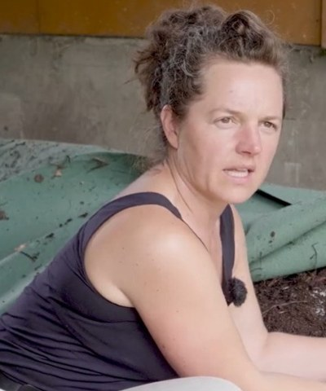
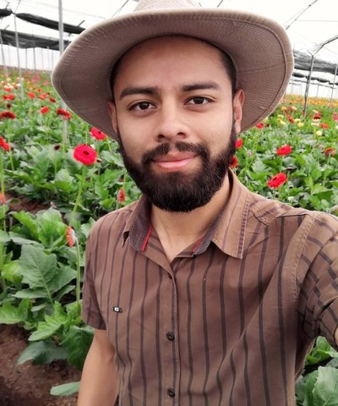
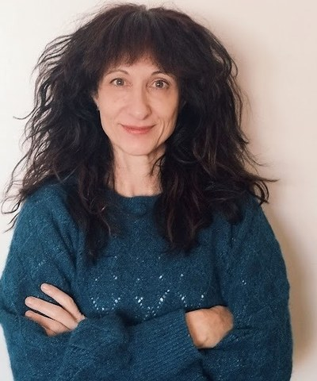
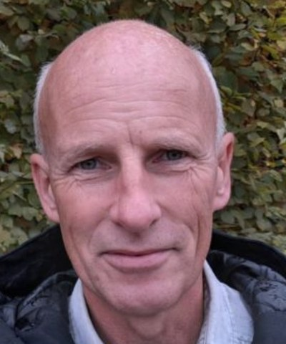
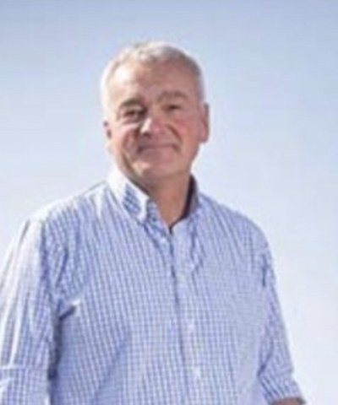
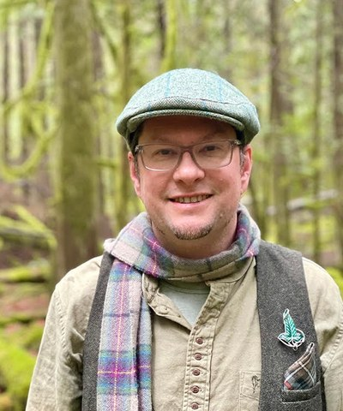
OUR MENTORS
Aysen Ustunay
Dora Tkalec
Gerald Ramirez
Elena Kalli
Loves flagellates
Advanced Programs Mentor
Agronomist, Costa Rica
Advanced Programs Admin
Ib Borup Pederson
Nick Padwick
Delvin Solkinson
Advanced Programs Mentor
Ken Hill Estate, Norfolk
Permaculture Lead Teacher
soilfoodweb.com
Notes:
Team grid 2: Aysen, Dora, Gerald, Elena, Ib, Nick, Delvin.

Slide 4
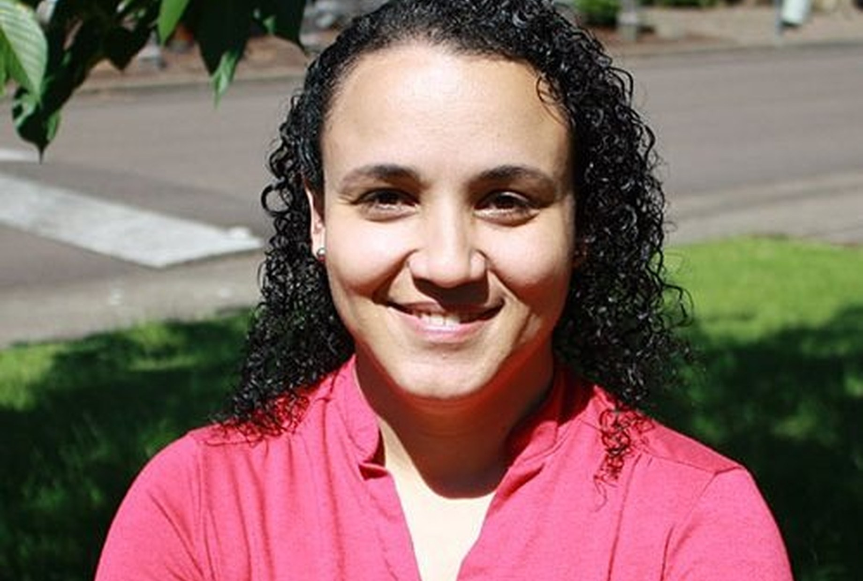
Dr. Carla Portugal
Science Lead & Mentor
“Bare soil erodes. Living roots and cover hold the aggregates together.”
soilfoodweb.com
Notes:
Advice: Carla Portugal. From the mentor bios, 30 Sep 2026: confirm with Carla.

Slide 5
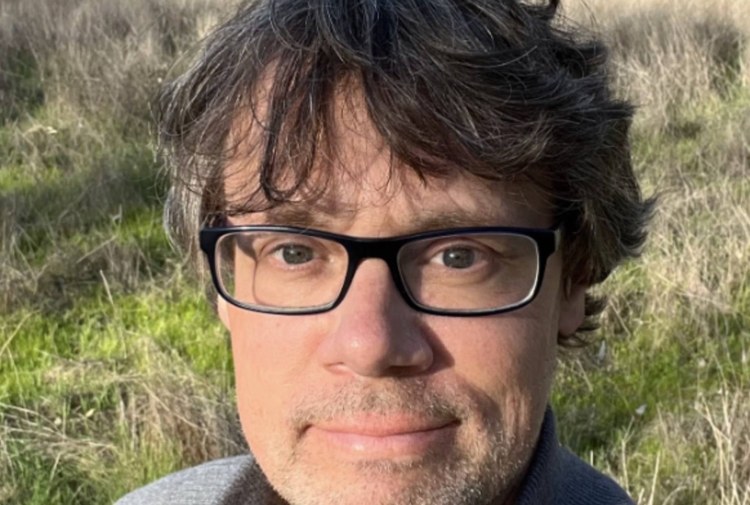
Wesley Sanders
Advanced Programs Mentor
“Compost can look finished and still lack the biology you need. Check it under the microscope before you apply it.”
soilfoodweb.com
Notes:
Advice: Wesley Sanders. From the mentor bios, 30 Sep 2026: confirm with Wesley.

Slide 6
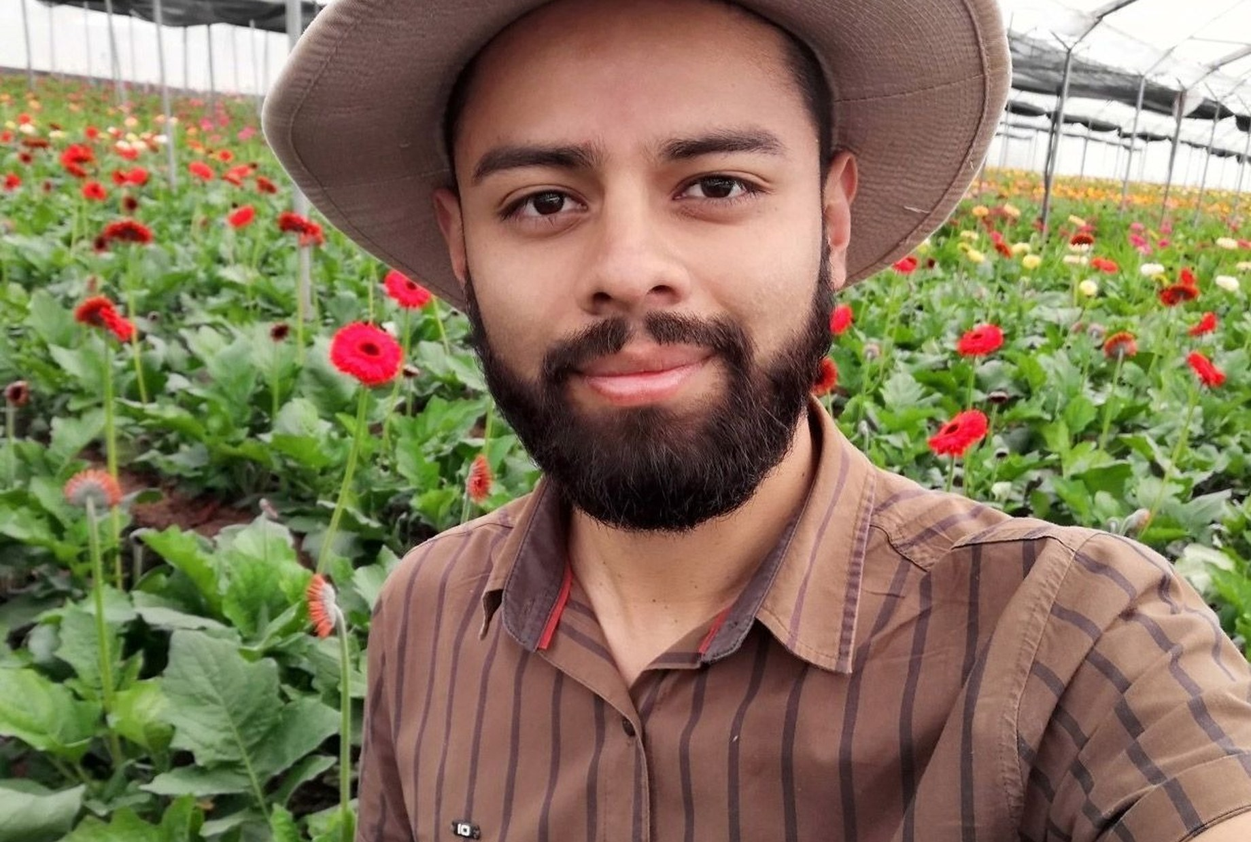
Gerald Ramirez
Advanced Programs Mentor
“Extracts pull organisms off the compost into solution, so you can apply biology across a whole field.”
soilfoodweb.com
Notes:
Advice: Gerald Ramirez. From the mentor bios, 30 Sep 2026: confirm with Gerald.

Slide 7
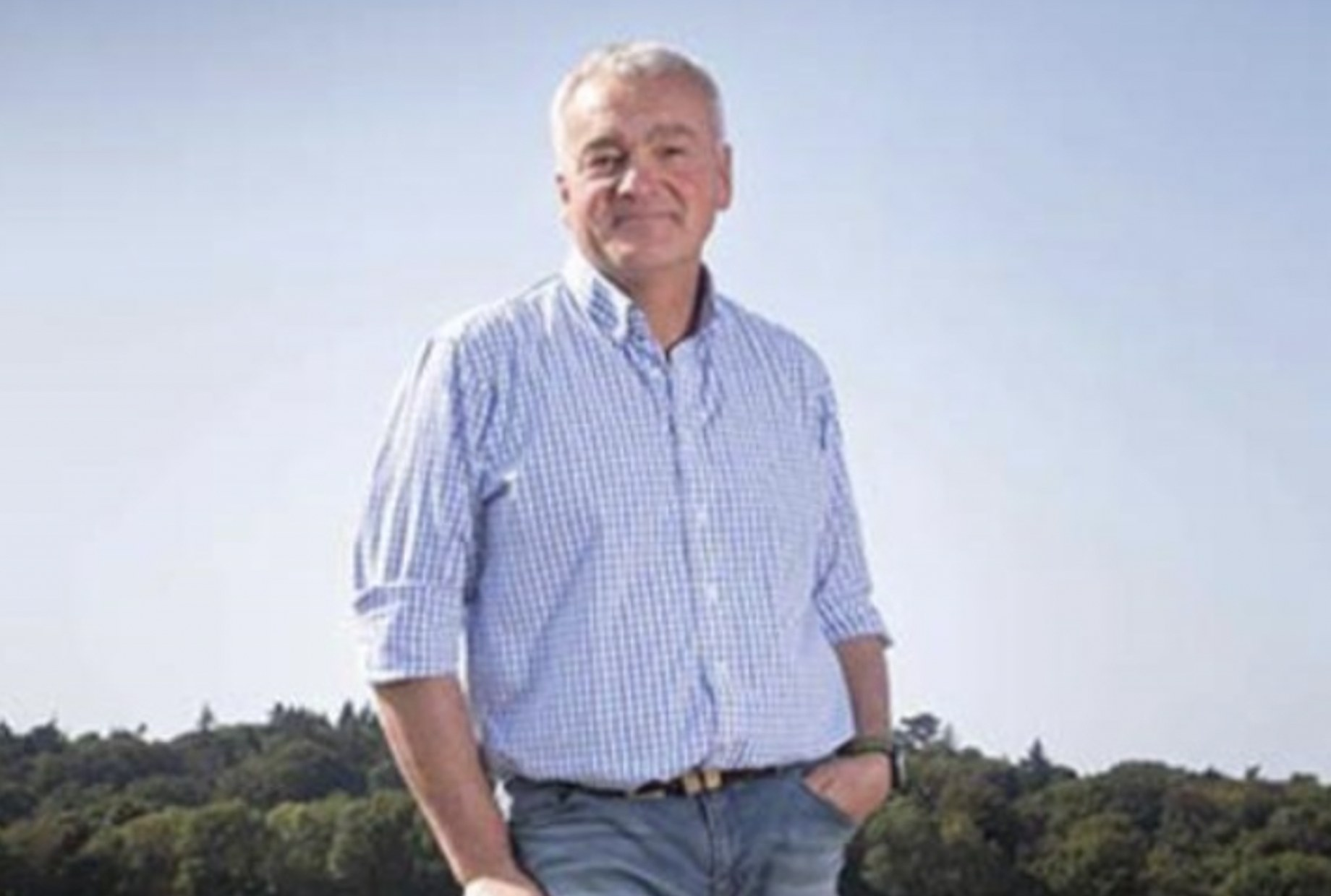
Nick Padwick
Advanced Programs Mentor
“I make 750 tons of compost a year. Biology works at any scale.”
soilfoodweb.com
Notes:
Advice: Nick Padwick. From the mentor bios, 30 Sep 2026: confirm with Nick.

Slide 8
Thank you to every mentor who teaches our students to see soil.
Tommy Tepper · Loida Vasquez · Carla Portugal · Wesley Sanders · Casey Williams · Brian Daubenspeck · Isadora Schmidt · Aysen Ustunay · Dora Tkalec · Gerald Ramirez · Elena Kalli · Ib Borup Pederson · Nick Padwick · Delvin Solkinson
Notes:
Closing: every mentor on the roster thanked by name.

