Slide 1













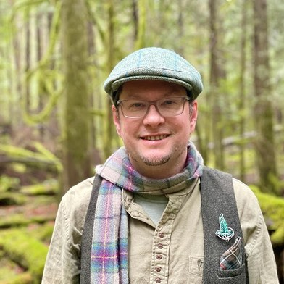

OUR MENTORS
Tommy Tepper
Loida Vasquez
Carla Portugal
Wesley Sanders
Casey Williams
Brian Daubenspeck
Isadora Schmidt
Aysen Ustunay
Dora Tkalec
Gerald Ramirez
Elena Kalli
Ib Borup Pederson
Nick Padwick
Delvin Solkinson
soilfoodweb.com
Notes:
Slide 1: all fourteen mentors, round portraits, names under each.

Slide 2
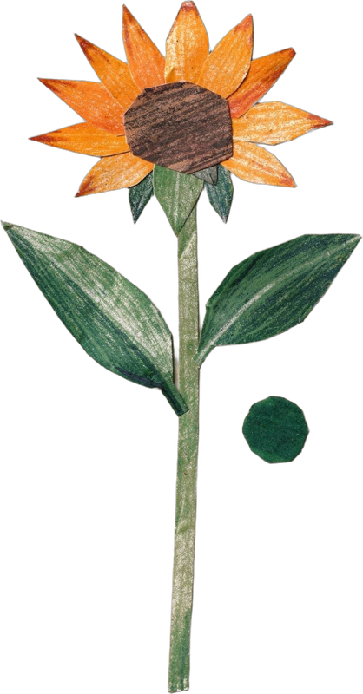



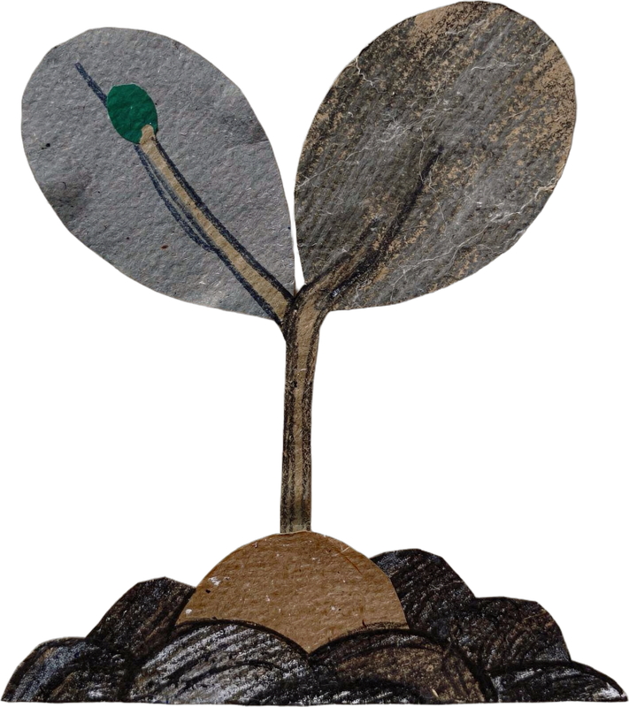

OCTOBER 5
Happy World Teachers' Day
Thank you to the mentors who teach our students to see soil.
Notes:
Slide 2: celebration card. Cut-paper flowers as a bouquet, confetti dots drawn as shapes.

