Slide 1


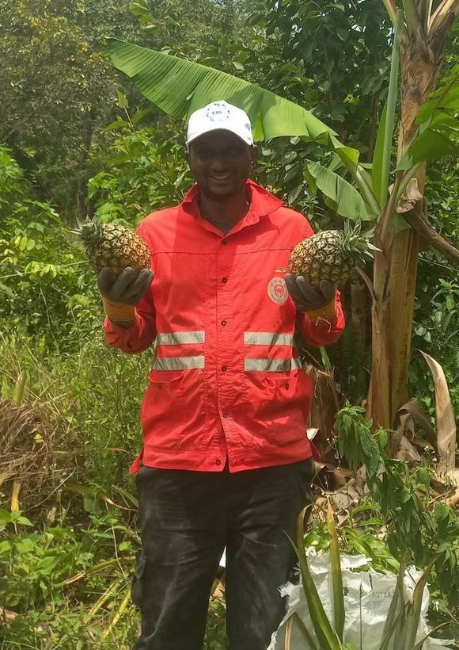
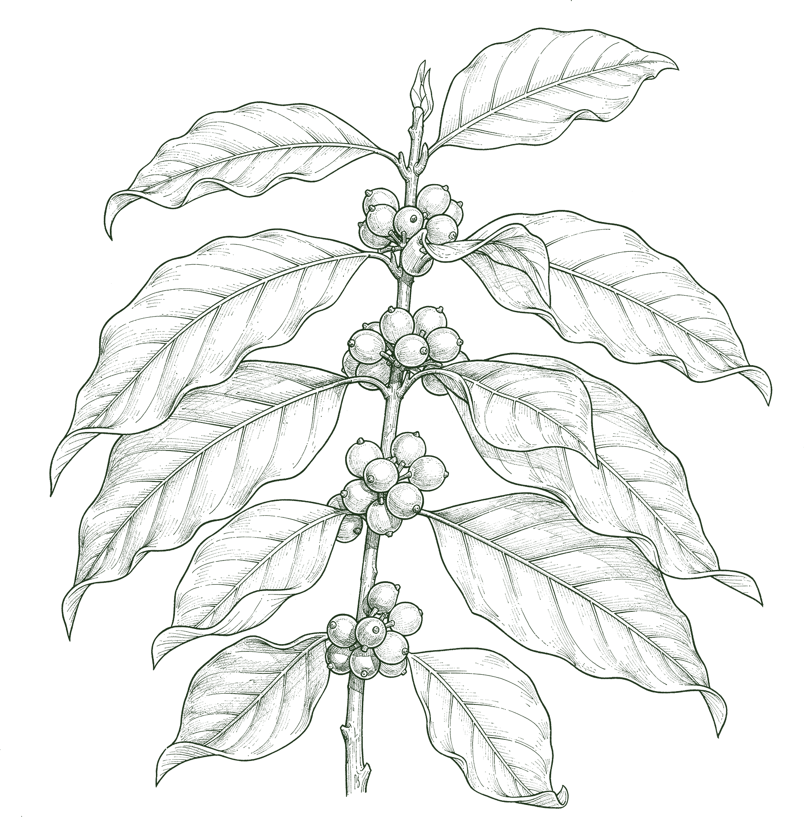
HAPPY INTERNATIONAL COFFEE DAY
Boubacar Tidiane
Diallo
Guinea-Conakry
→
Notes:
Cover. Line-art version: realistic botanical line drawings made with flux-2-pro (no style reference, objects only, never Boubacar or his farm), recoloured Deep Green. Call to action: his YouTube channel (his Instagram @tidia.diallo.1 is private). Sources: Impact story sheet, Boubacar Tidiane Diallo: https://docs.google.com/spreadsheets/d/10UHLwzJLBQAsmJqmg4hiCQRjBKXPAx7UnOudU-Vsg5U/edit; Email from Boubacar to Allison, 30 September 2026; Instagram: https://www.instagram.com/tidia.diallo.1/; YouTube: https://www.youtube.com/@boubacartidianediallo; Facebook: https://www.facebook.com/btidja; Photos: sent by Boubacar to Stephanie on WhatsApp, 17 August 2026, and to Allison, September 2026. [TAG @Stephanie] Send Boubacar the final caption and slides to approve before posting, and confirm he studied on a scholarship. Photo: boubacar-portrait-bananas-closer.jpg.

Slide 2
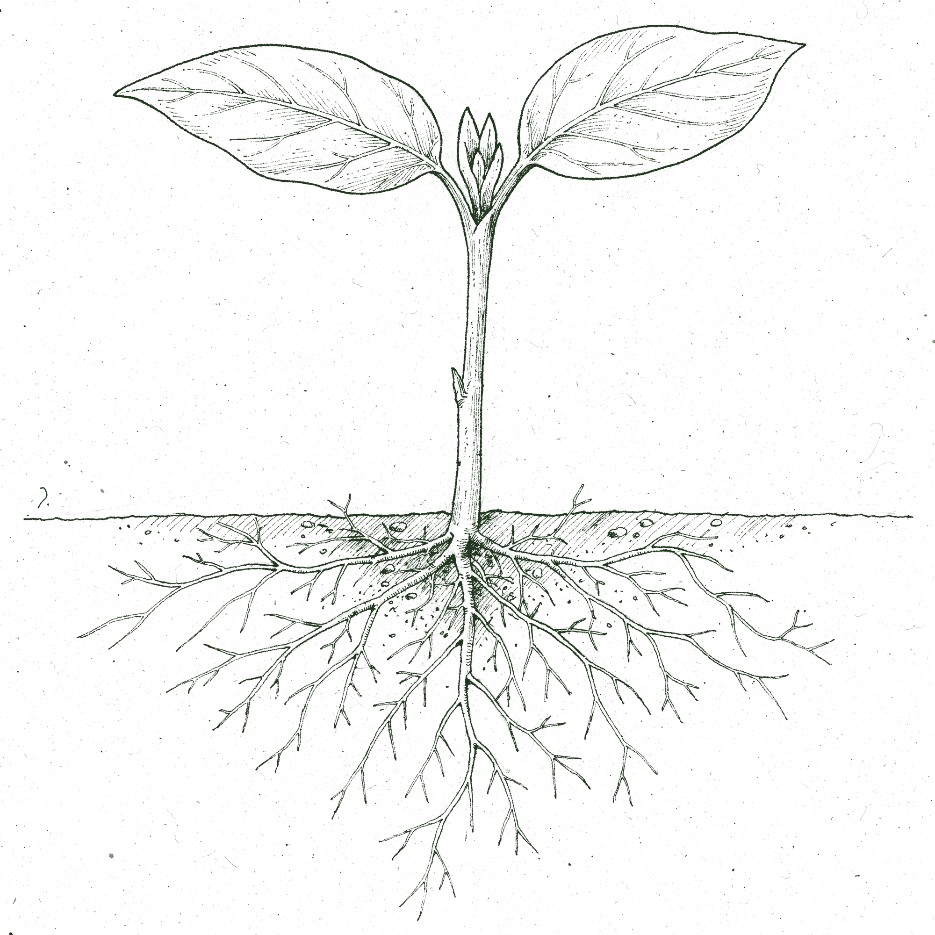
02 THE QUESTION
He used to ask what nutrients his plants needed.
“
Today, I ask a different question: What does the soil food web need to thrive?
soilfoodweb.com
→
Notes:
The hook. Setup line from the approved caption ('Back then, he told us, he mostly thought about what nutrients his plants needed'), shortened; then his quote. Chapter labels are new, short connective words. Line-art version: realistic botanical line drawings made with flux-2-pro (no style reference, objects only, never Boubacar or his farm), recoloured Deep Green.

Slide 3
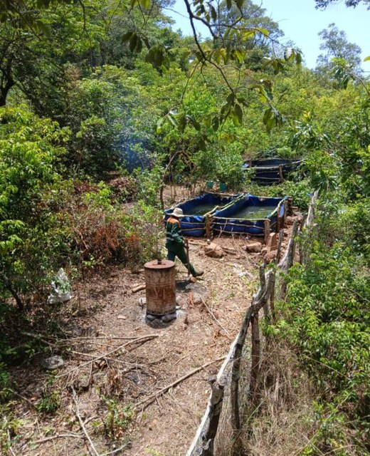
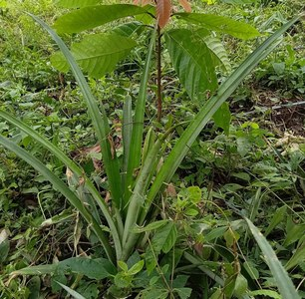
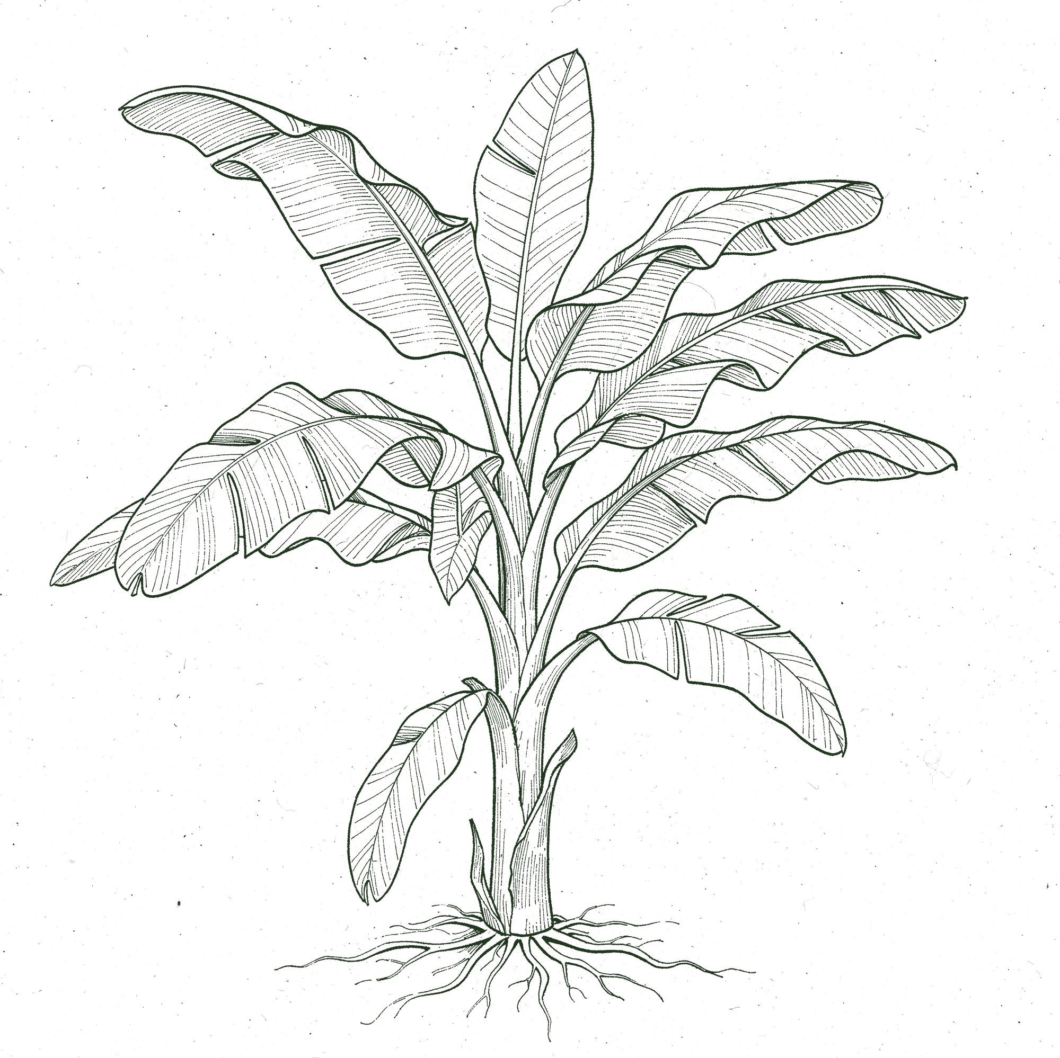
03 THE LAND
Gnaly Coffee & AgroÉcole Bio
Fouta Djallon, Guinea-Conakry. When he started, the soil had been degraded and poorly managed for years.
soilfoodweb.com
→
Notes:
The land. Photos: farm-overview-with-tanks.jpeg, young-tree-with-pineapples.jpg. Degraded-soil line from the approved caption ('When he started, the soil had been degraded and poorly managed for years'). Line-art version: realistic botanical line drawings made with flux-2-pro (no style reference, objects only, never Boubacar or his farm), recoloured Deep Green.

Slide 4
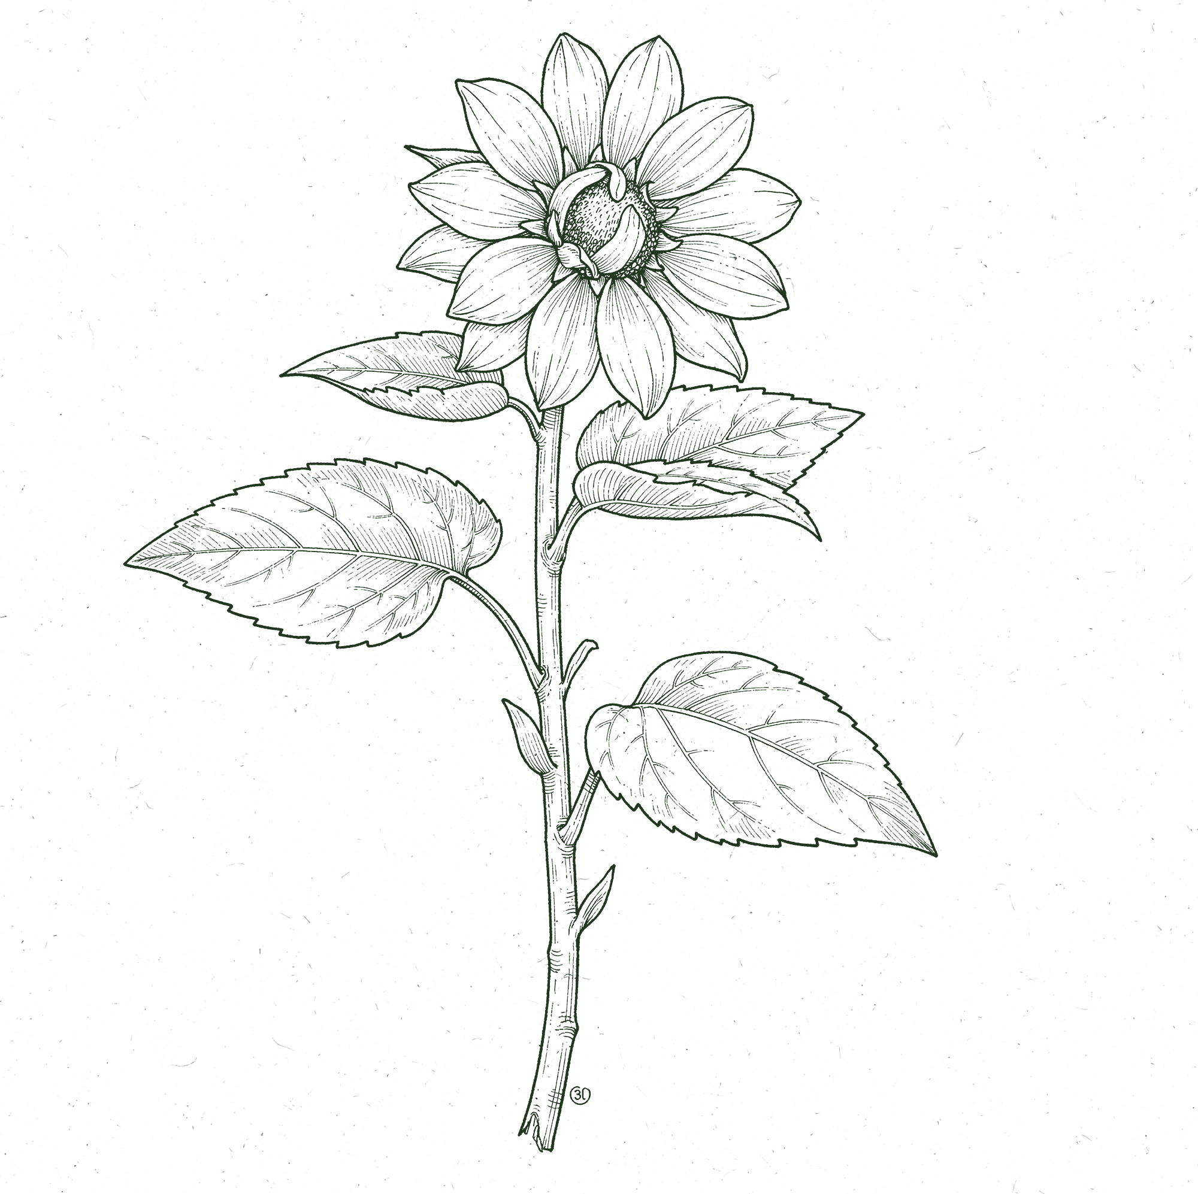
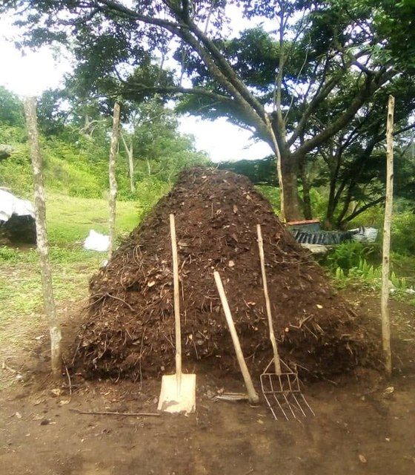
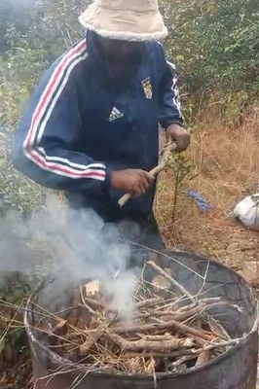
04 FEEDING THE SOIL
How he feeds his soil:
living groundcover, mulch from his farm and the forest, and compost with biochar activated with fish hydrolysate and compost tea.
soilfoodweb.com
→
Notes:
Photos: boubacar-compost-pile.jpeg; still-biochar-kiln-smoke-73s.png (making-biochar-in-barrel-kiln.mp4 at 1:13). Line-art version: realistic botanical line drawings made with flux-2-pro (no style reference, objects only, never Boubacar or his farm), recoloured Deep Green.

Slide 5
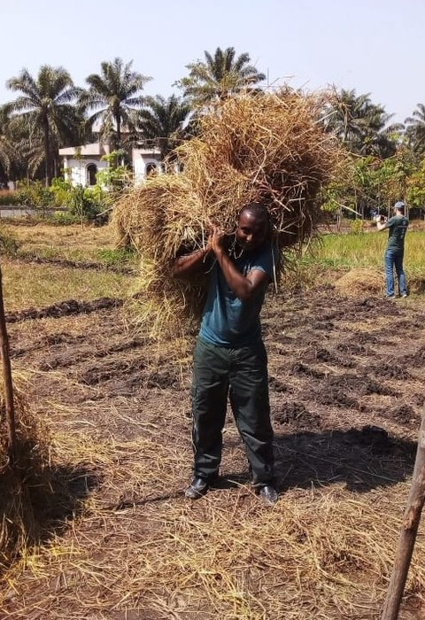
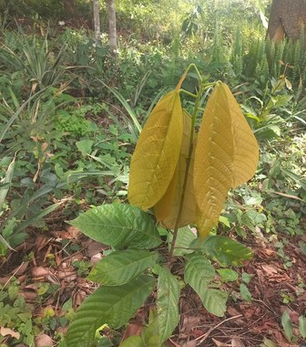
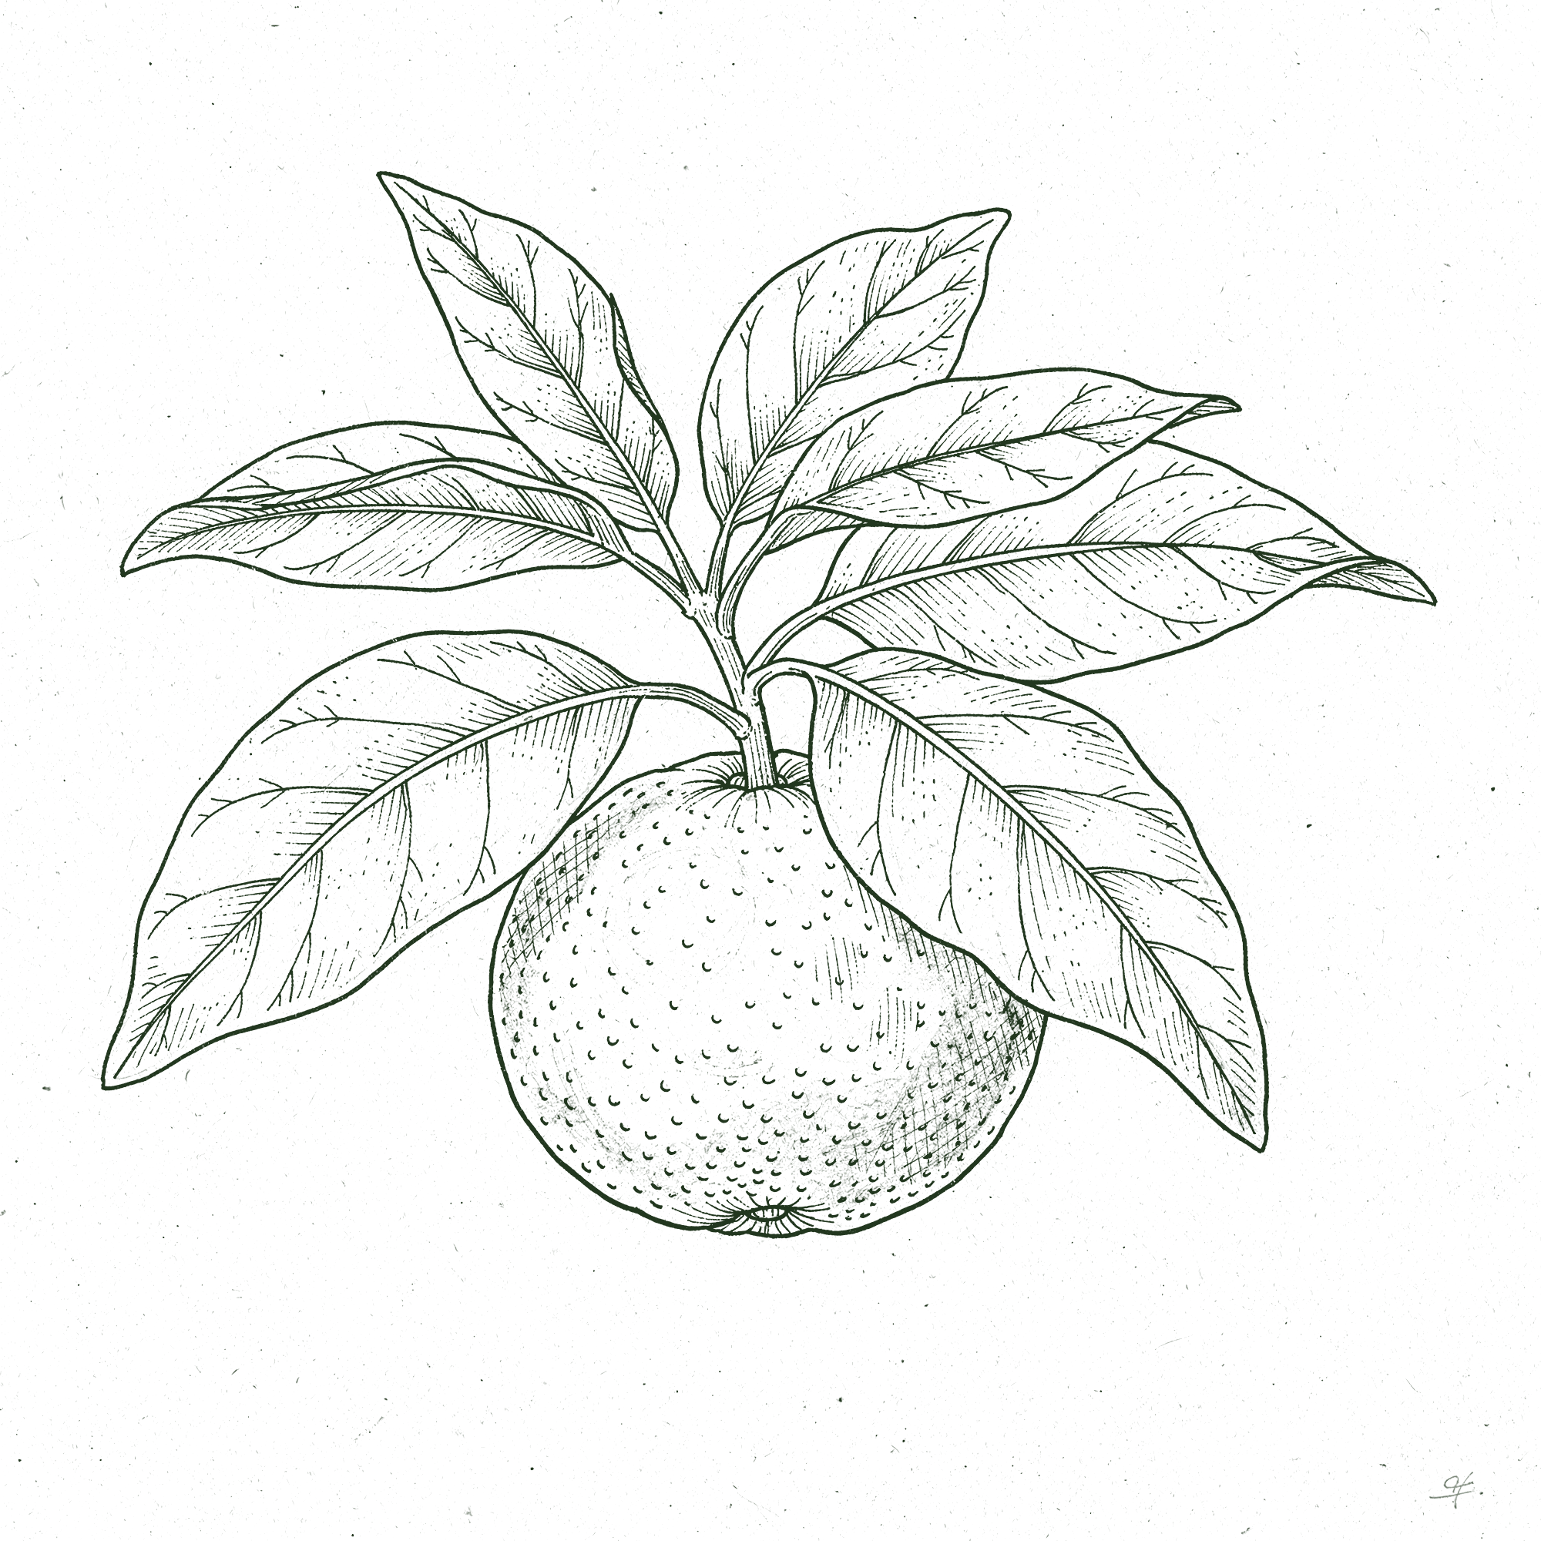
05 IN PRACTICE
“
I apply compost regularly around young trees and whenever I add new mulch.
soilfoodweb.com
→
Notes:
His words (email to Allison, 30 Sep 2026). Photos: carrying-mulch.jpg, young-tree-yellow-new-leaves.jpg. Line-art version: realistic botanical line drawings made with flux-2-pro (no style reference, objects only, never Boubacar or his farm), recoloured Deep Green.

Slide 6
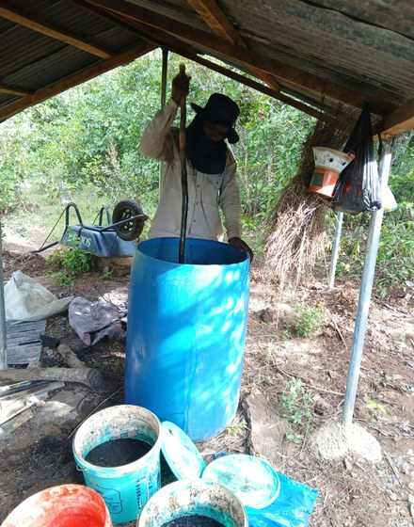
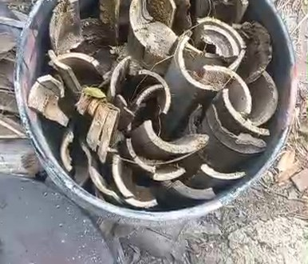
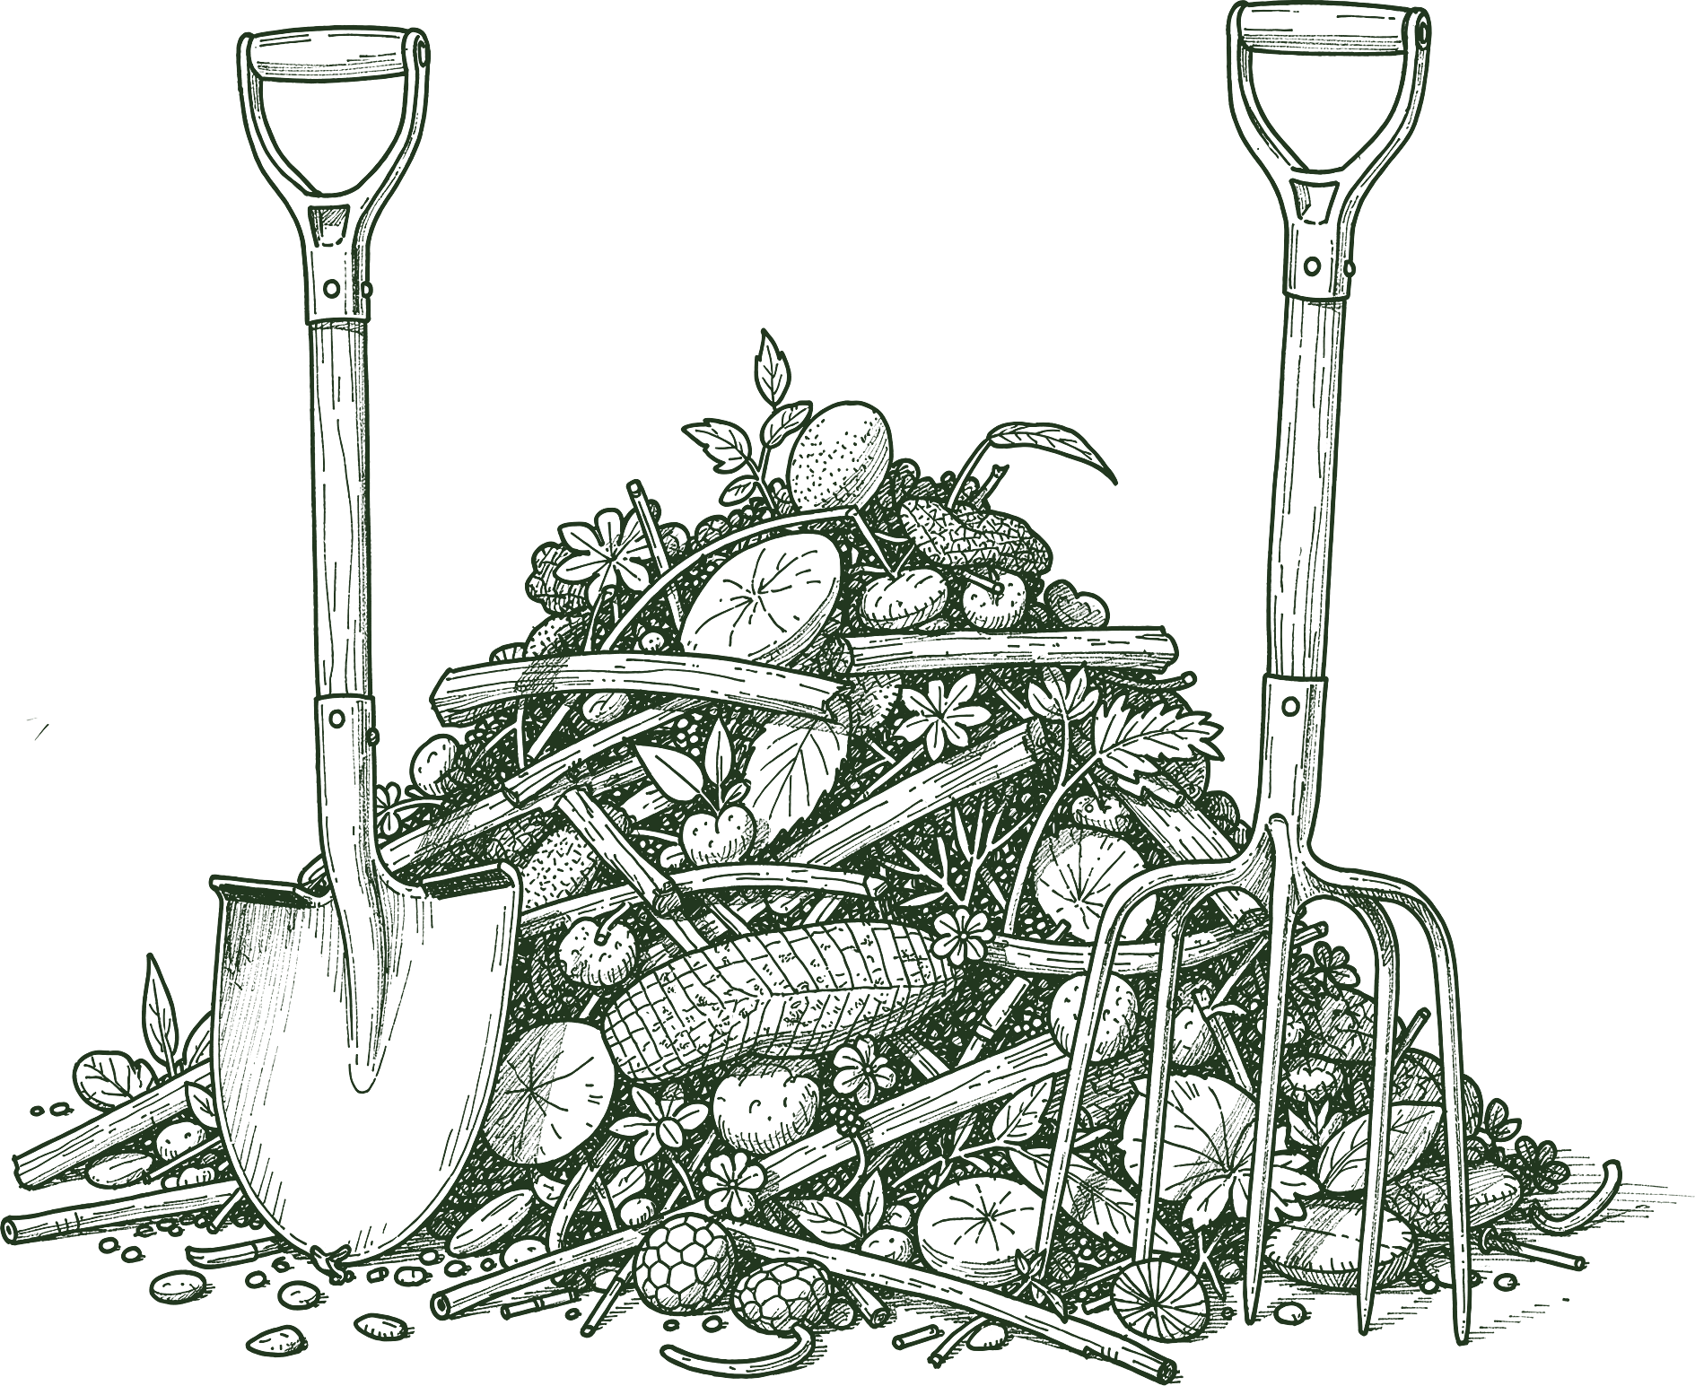
06 HIS COMPOST
“
My compost includes plant residues, animal manure when available, biochar activated with fish hydrolysate and compost tea, and local organic materials.
soilfoodweb.com
→
Notes:
His words (email to Allison, 30 Sep 2026). Photos: barrel-brew-under-shelter.jpeg, still-biochar-charcoal-16s.png (making-biochar-in-barrel-kiln.mp4 at 0:16). Line-art version: realistic botanical line drawings made with flux-2-pro (no style reference, objects only, never Boubacar or his farm), recoloured Deep Green.

Slide 7
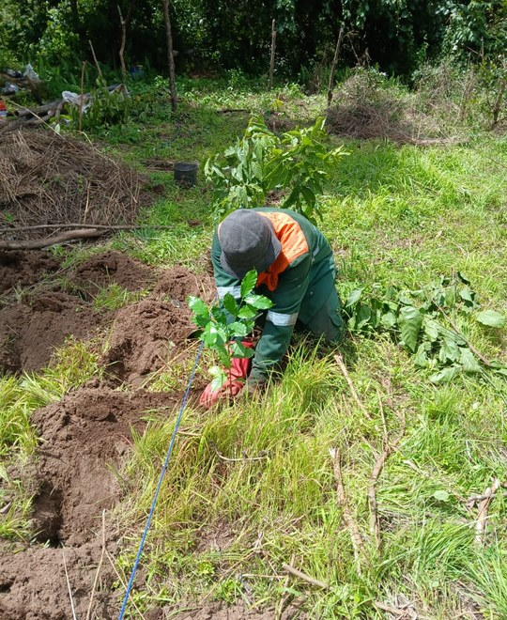
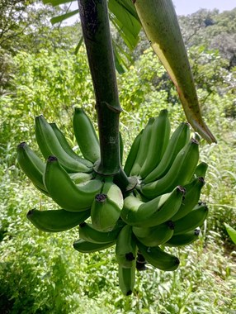
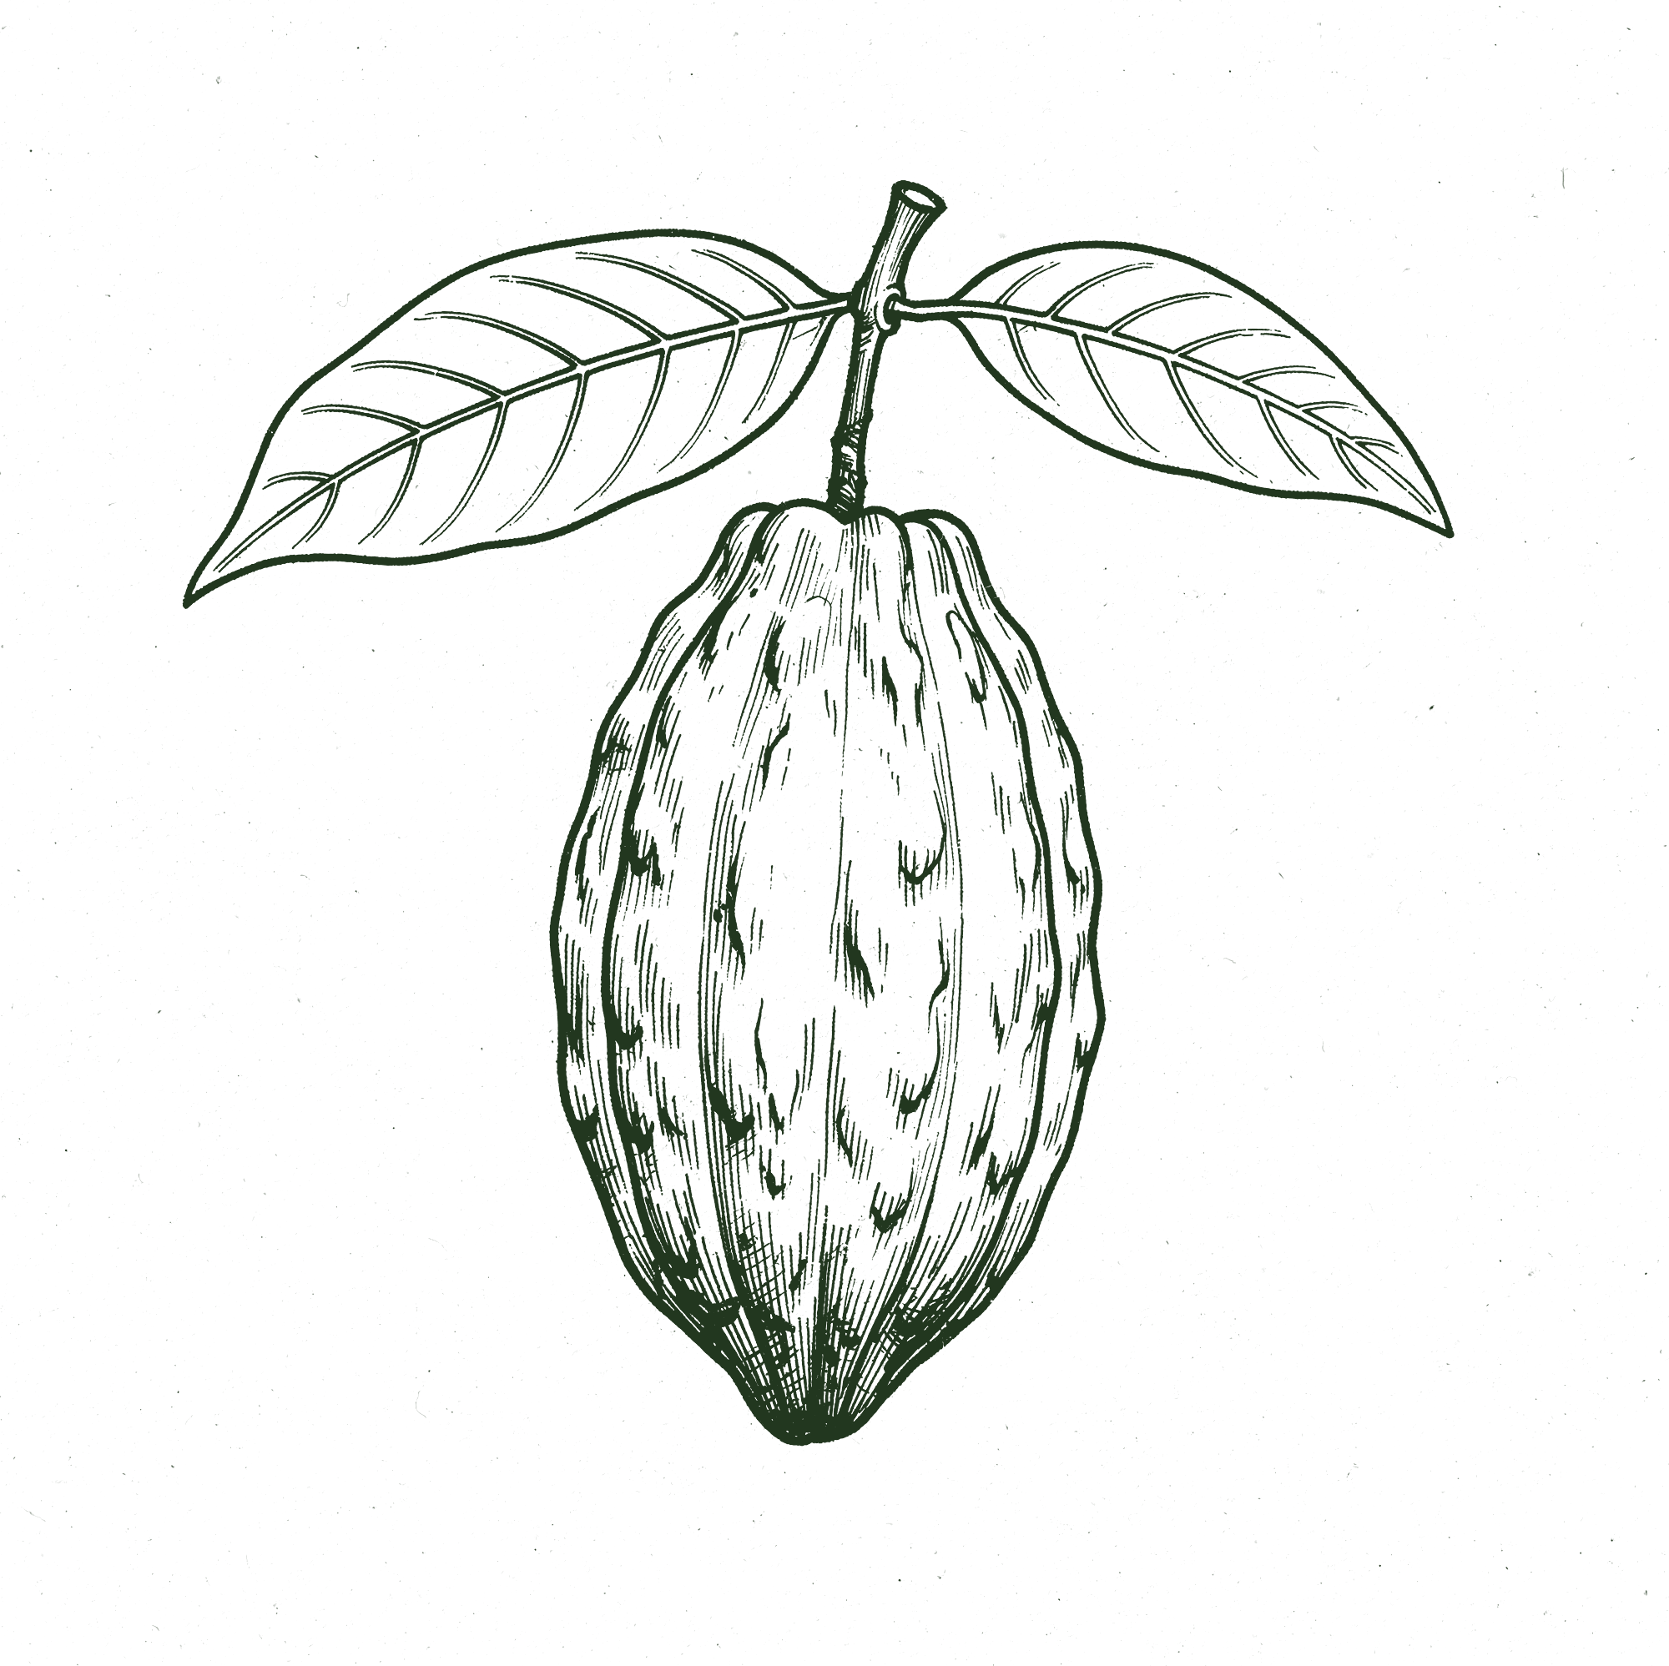
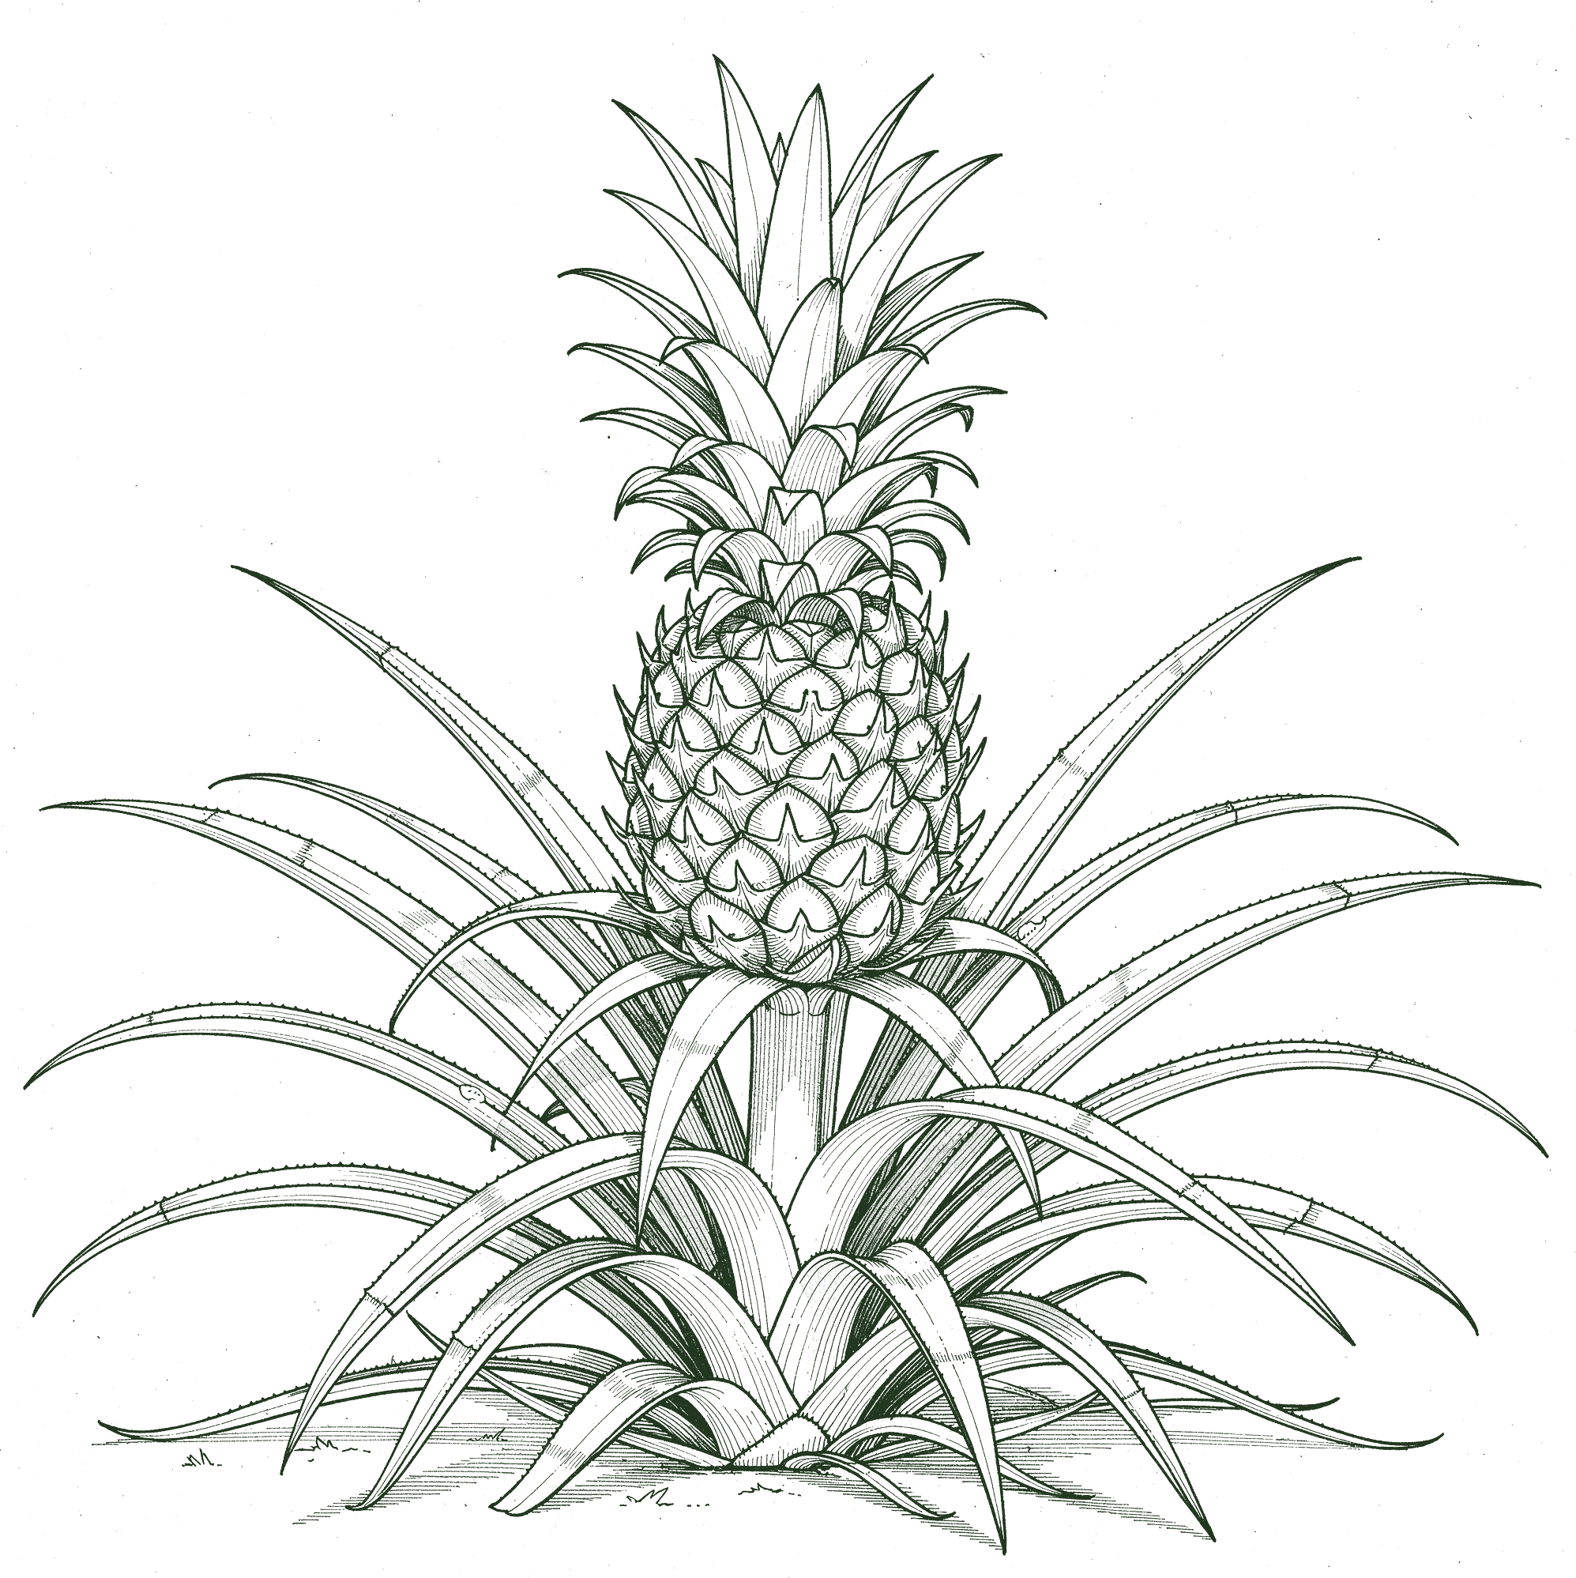
07 WHAT GROWS
What he grows together:
coffee, cacao, bananas, citrus, and pineapple.
soilfoodweb.com
→
Notes:
Photos: planting-seedling-in-agroforest.jpeg, banana-bunch.jpg. Line-art version: realistic botanical line drawings made with flux-2-pro (no style reference, objects only, never Boubacar or his farm), recoloured Deep Green.

Slide 8
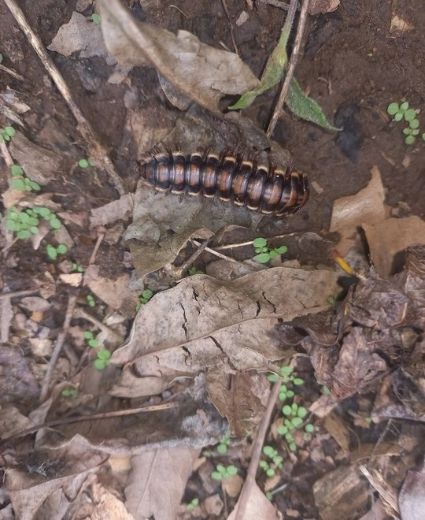
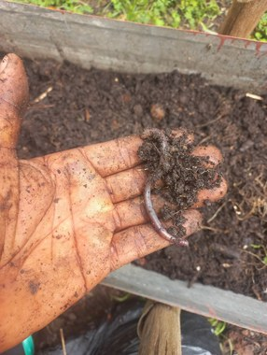
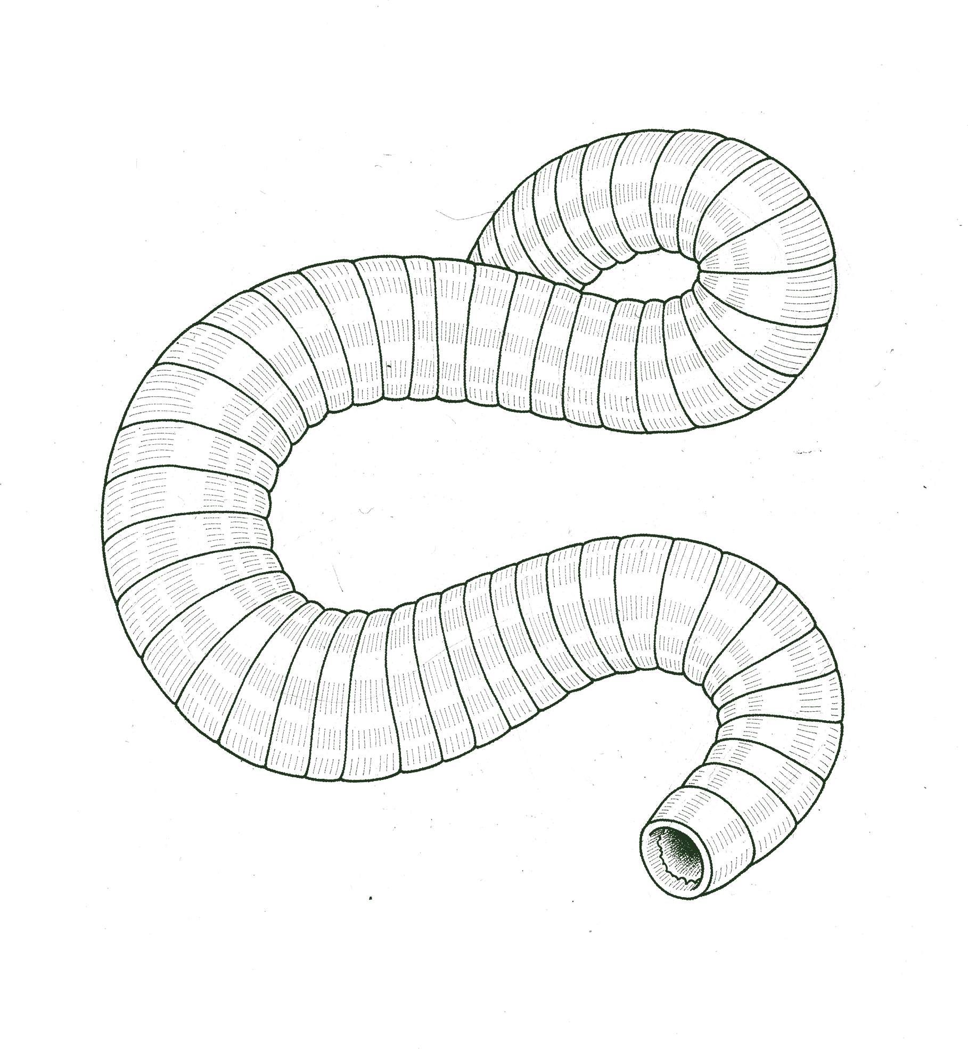
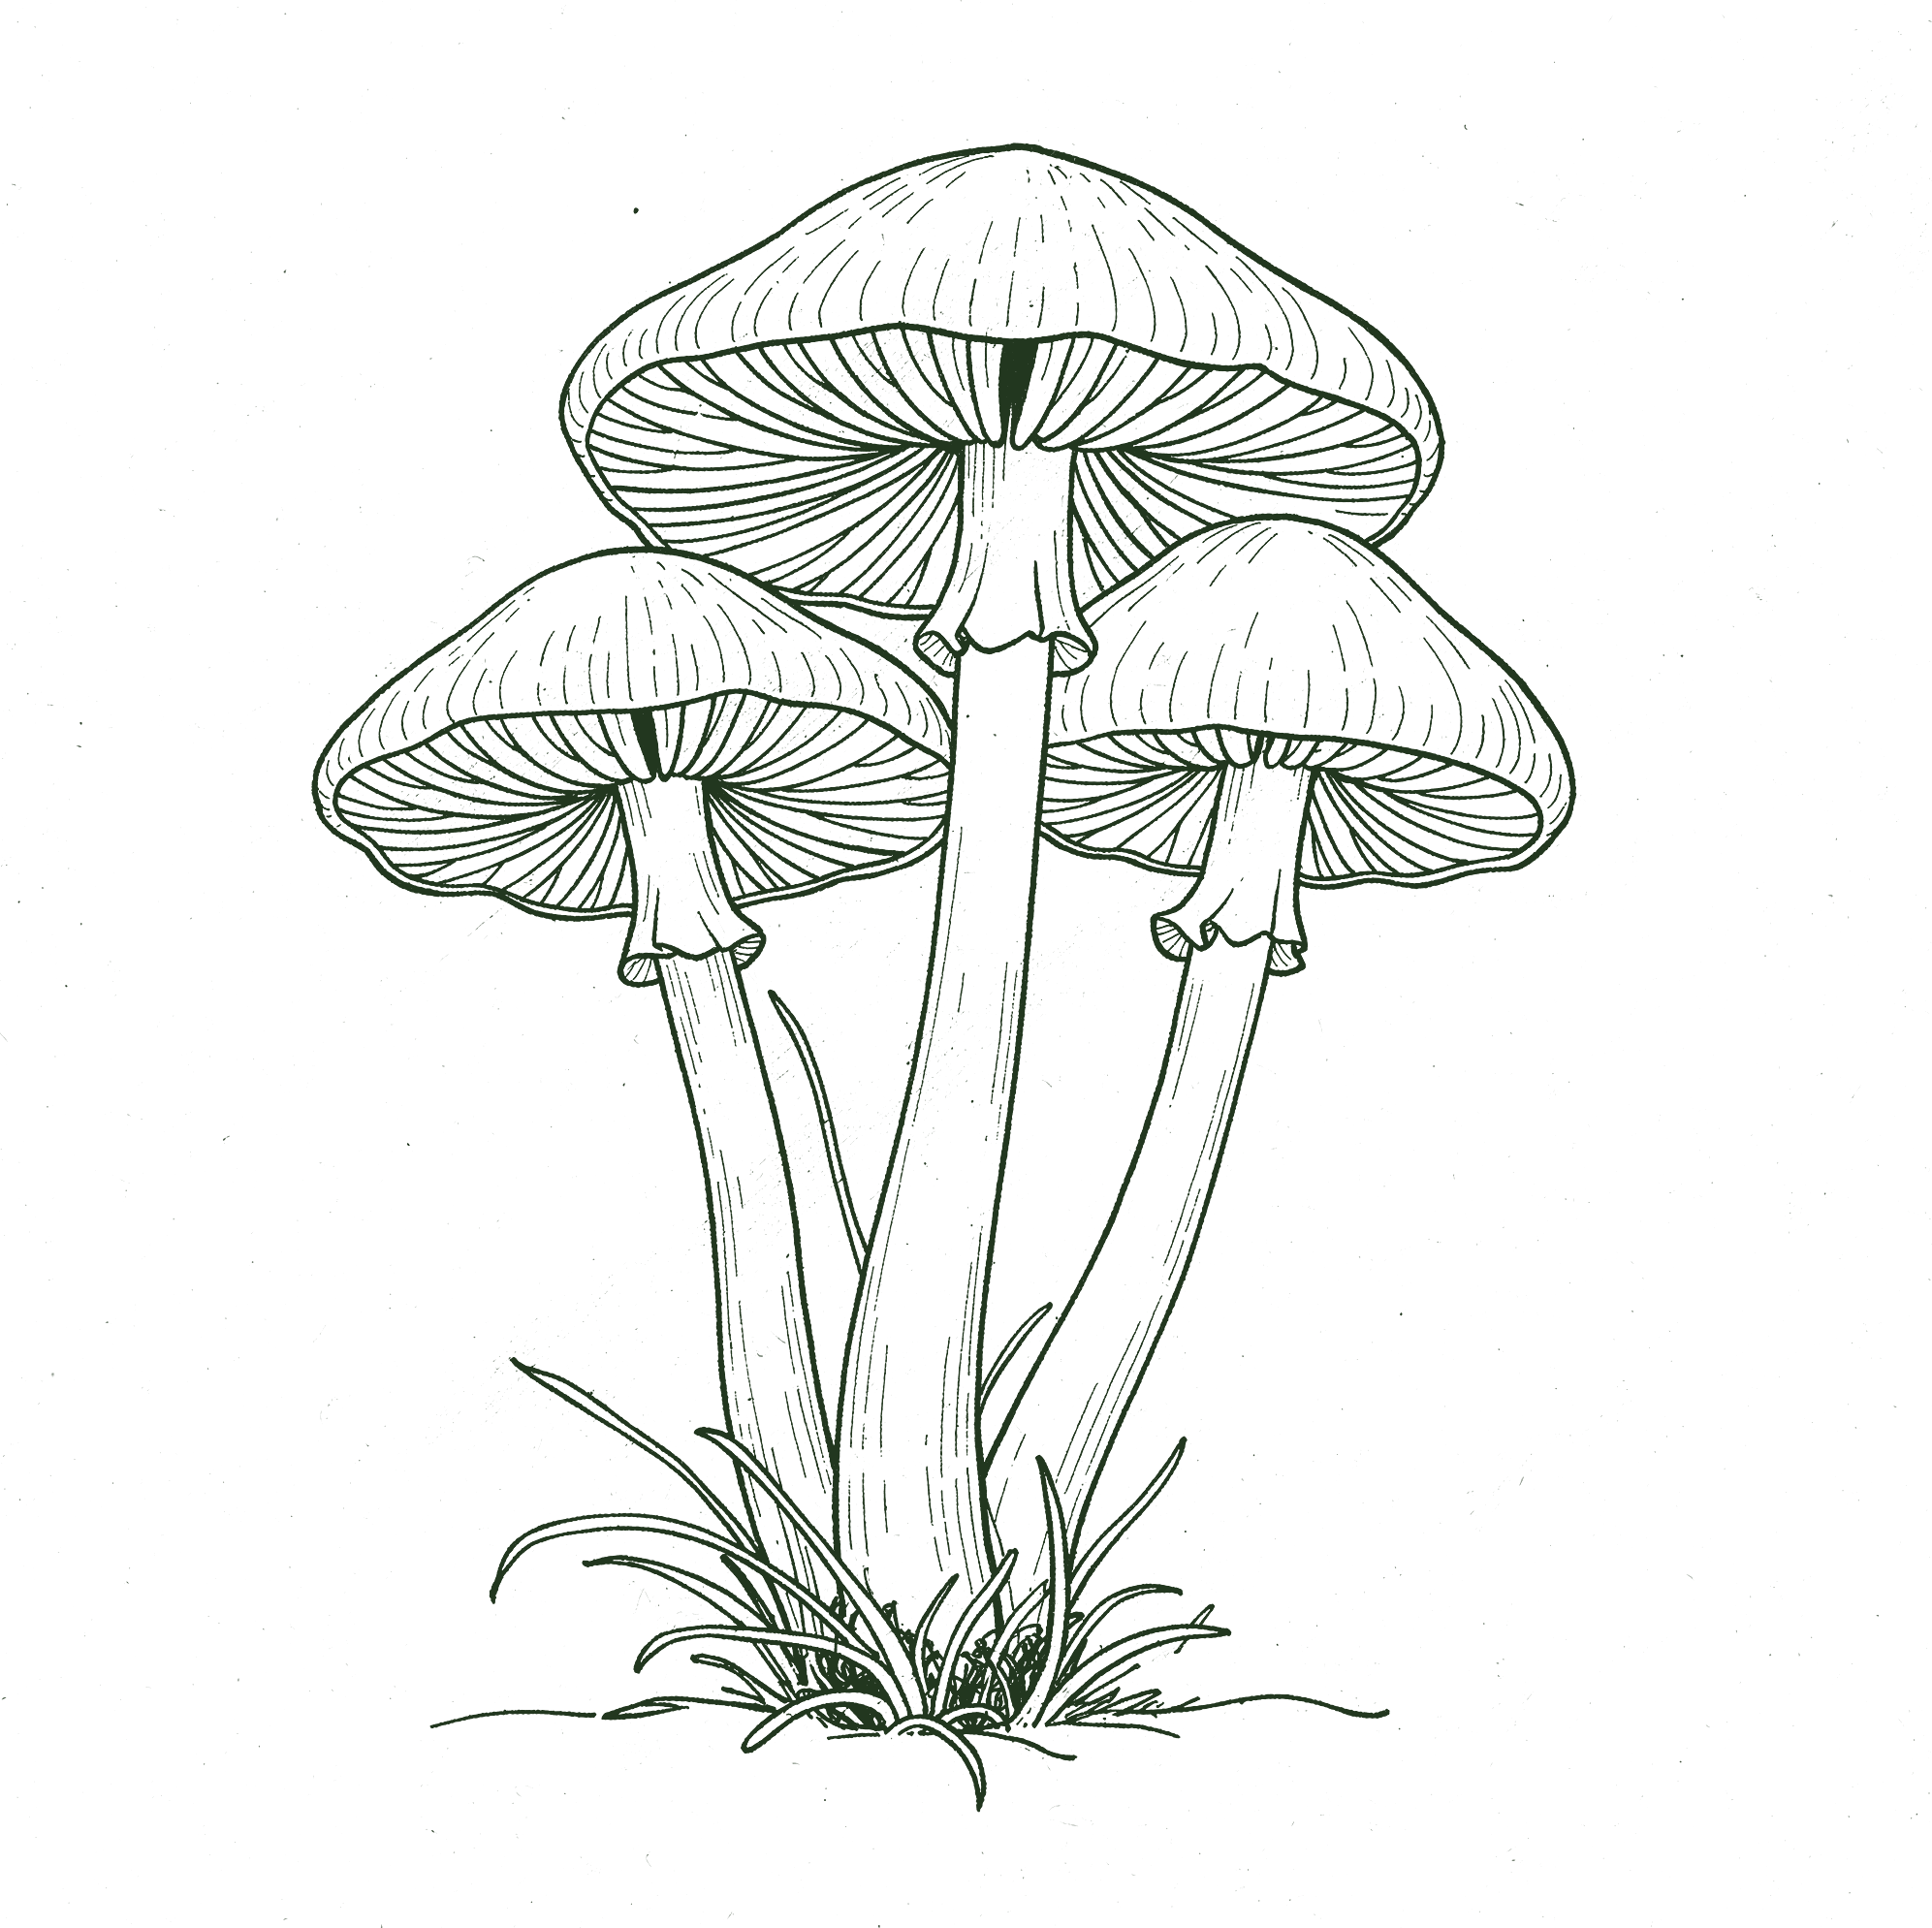
08 WHAT'S CHANGING
What he's seeing:
more earthworms, more mushrooms, active decomposition, and better soil structure.
soilfoodweb.com
→
Notes:
Photos: millipede-leaf-litter.jpg, boubacar-hand-compost-worm.jpg. Line-art version: realistic botanical line drawings made with flux-2-pro (no style reference, objects only, never Boubacar or his farm), recoloured Deep Green.

Slide 9
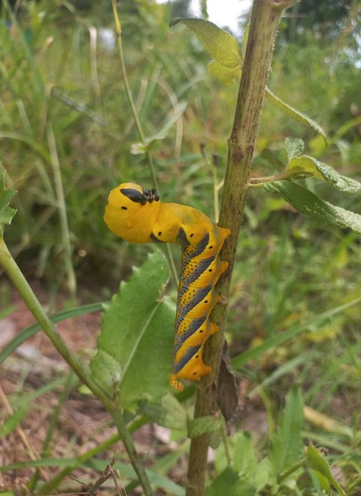
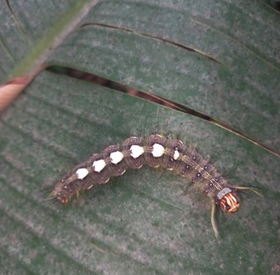
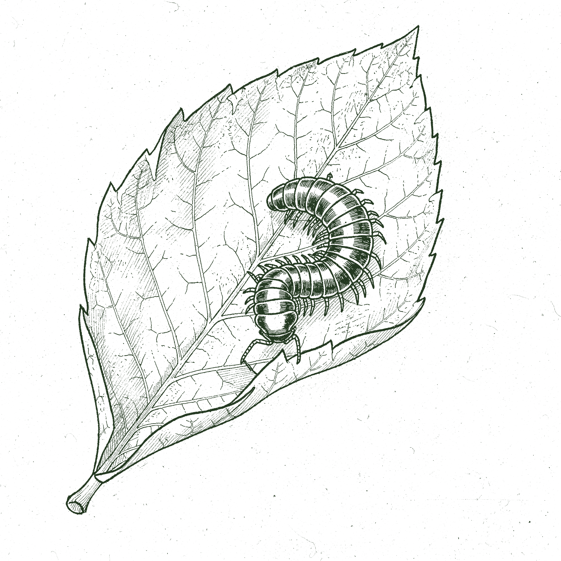
09 LIFE RETURNS
“
I can already see signs of healthier soil in the field, including more earthworms, mushrooms, and active decomposition.
soilfoodweb.com
→
Notes:
His words (email to Allison, 30 Sep 2026). Photos: yellow-caterpillar-on-stem.jpg, caterpillar-on-leaf.jpg. Line-art version: realistic botanical line drawings made with flux-2-pro (no style reference, objects only, never Boubacar or his farm), recoloured Deep Green.

Slide 10
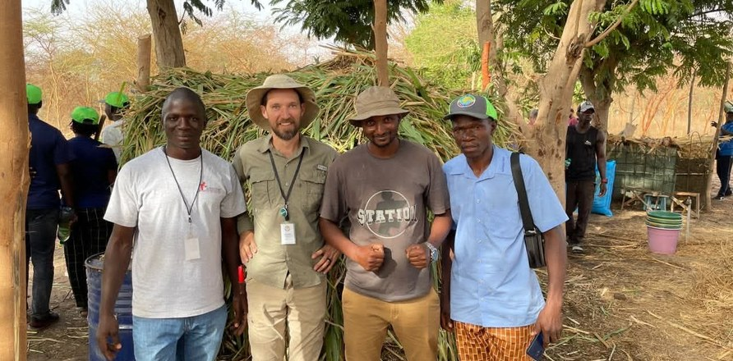
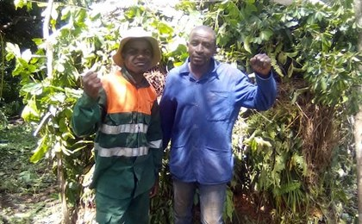
10 PASSING IT ON
“
Your training changed the way I see agriculture. I now believe that agriculture is biology, not chemical fertilizer.
soilfoodweb.com
→
Notes:
His words (email to Allison, 30 Sep 2026). Photos: group-of-five-farmers.jpeg, two-men-at-shade-house.jpeg [VERIFY who, where, when]. Line-art version: realistic botanical line drawings made with flux-2-pro (no style reference, objects only, never Boubacar or his farm), recoloured Deep Green.

Slide 11
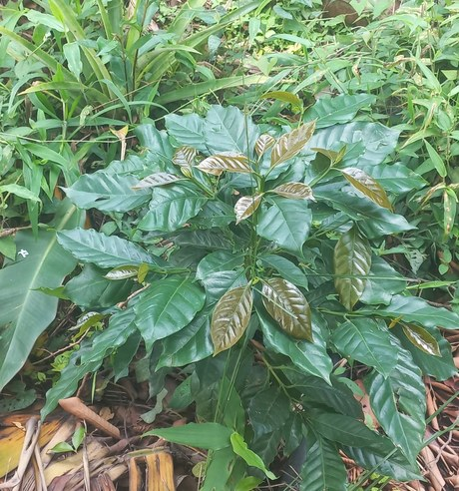
11 THE DREAM
“
My dream is to restore degraded land in the Fouta Djallon and help my community learn living-soil practices.
Subscribe on YouTube: @boubacartidianediallo
Notes:
The dream and the call to action (YouTube). Line-art version: realistic botanical line drawings made with flux-2-pro (no style reference, objects only, never Boubacar or his farm), recoloured Deep Green. Photo: young-coffee-plant.jpg.

