Slide 1
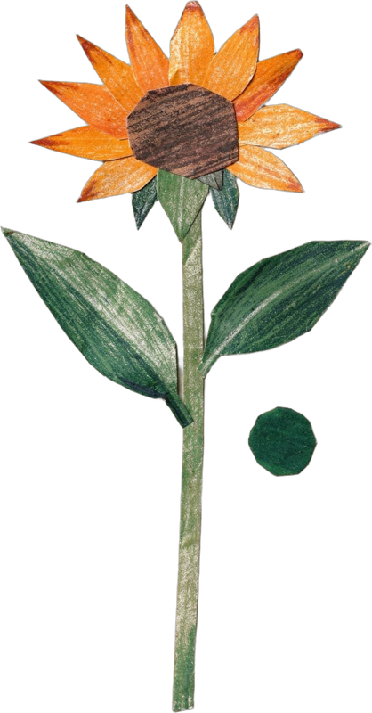


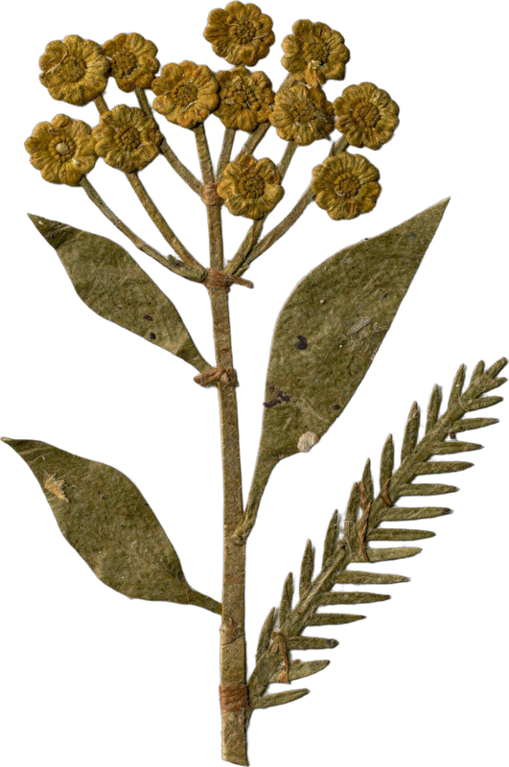
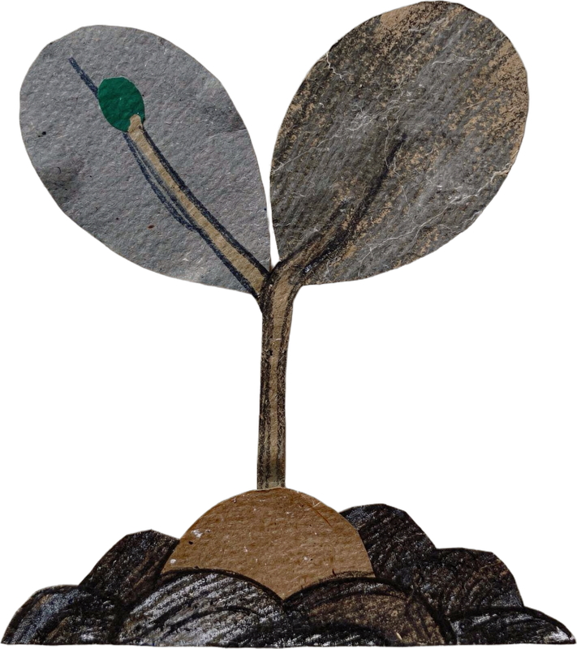

WORLD TEACHERS' DAY · 5 OCTOBER
Happy World Teachers' Day.
Meet the mentors who teach our students to see soil.
Notes:
Cover. World Teachers' Day, 5 October. Cut-paper flowers from the collage library.

Slide 2
Tommy Tepper
Director of Education & Mentor
soilfoodweb.com
Notes:
Mentor card: Tommy Tepper, Director of Education & Mentor. About line: draft from the team notes, confirm with Allison and Tommy. No photo yet: flower arrangement. [ABOUT LINE NEEDED from Allison; the card shows name and role until then]

Slide 3
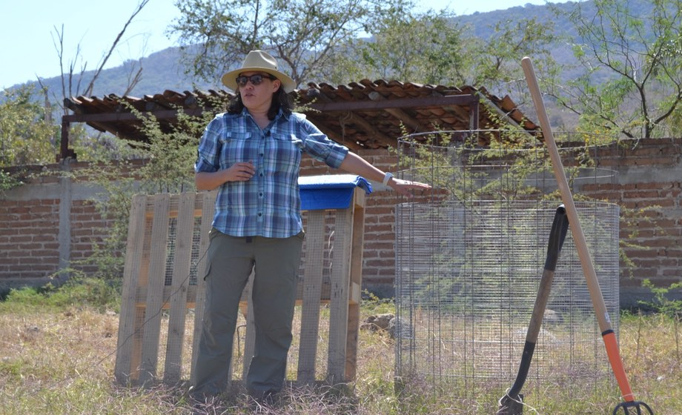
Loida Vasquez
Advanced Programs Lead & Mentor
soilfoodweb.com
Notes:
Mentor card: Loida Vasquez, Advanced Programs Lead & Mentor. About line: draft from the team notes, confirm with Allison and Loida. Photo: assets/photo/loida-teaching-3.jpg (written consent needed). [ABOUT LINE NEEDED from Allison; the card shows name and role until then]

Slide 4
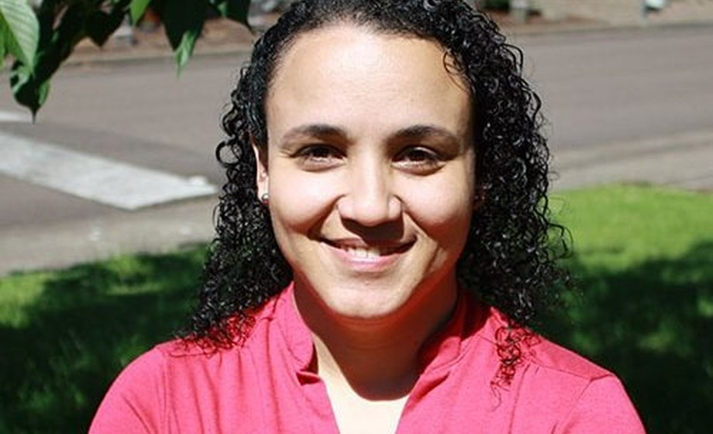
Dr. Carla Portugal
Science Lead & Mentor
“Bare soil erodes. Living roots and cover hold the aggregates together.”
PhD in Environmental Sciences. 20 years of environmental and farm consulting. Mentoring since 2019.
soilfoodweb.com
Notes:
Mentor card: Dr. Carla Portugal, Science Lead & Mentor. About line: draft from the team notes, confirm with Allison and Carla. Advice line from the mentor bios, 30 Sep 2026: confirm with Carla. Photo: assets/mentors-teachers-day/carla-portugal.jpg (written consent needed).

Slide 5
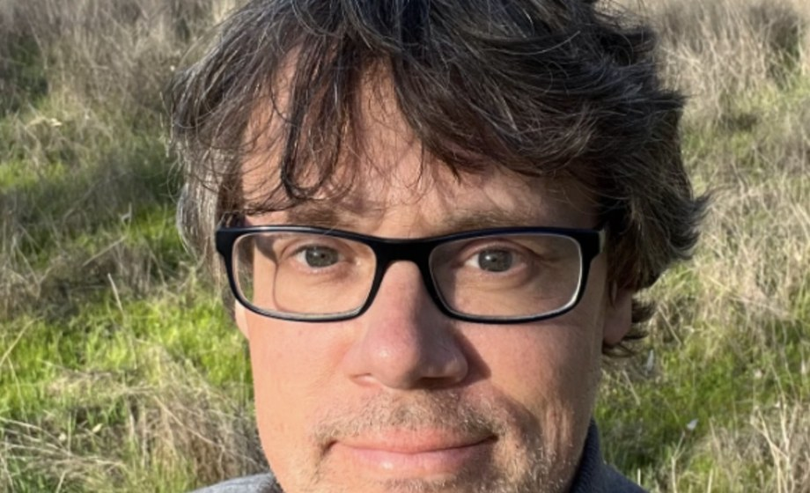
Wesley Sanders
Advanced Programs Mentor
“Compost can look finished and still lack the biology you need. Check it under the microscope before you apply it.”
A farmer and agricultural journalist, then our first lab tech. Runs Foothill Biological Soil Health Services in California's Sierra Nevada foothills.
soilfoodweb.com
Notes:
Mentor card: Wesley Sanders, Advanced Programs Mentor. About line: draft from the team notes, confirm with Allison and Wesley. Advice line from the mentor bios, 30 Sep 2026: confirm with Wesley. Photo: assets/mentors-teachers-day/wes-sander.jpg (written consent needed).

Slide 6
Casey Williams
Advanced Programs Mentor
Around ten years of farming and gardening. A long-time student, now teaching. Favourite microbe: rotifers.
soilfoodweb.com
Notes:
Mentor card: Casey Williams, Advanced Programs Mentor. About line: draft from the team notes, confirm with Allison and Casey. No photo yet: flower arrangement.

Slide 7
Brian Daubenspeck
Advanced Programs Mentor
Manages orchards in California, after years in New Mexico. Favourite microbes: the small underdogs.
soilfoodweb.com
Notes:
Mentor card: Brian Daubenspeck, Advanced Programs Mentor. About line: draft from the team notes, confirm with Allison and Brian. No photo yet: flower arrangement.

Slide 8
Isadora Schmidt
Advanced Programs Mentor
From Florianópolis, Brazil, now living in Spain. Favourite: lichens, though she loves all her microbes equally.
soilfoodweb.com
Notes:
Mentor card: Isadora Schmidt, Advanced Programs Mentor. About line: draft from the team notes, confirm with Allison and Isadora. No photo yet: flower arrangement.

Slide 9
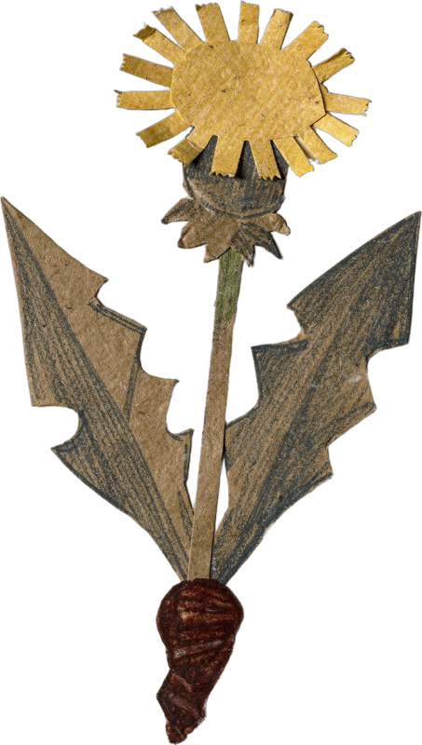
Aysen Ustunay
Advanced Programs Mentor
Favourite microbe: flagellates. She loves watching them as babies, running around.
soilfoodweb.com
Notes:
Mentor card: Aysen Ustunay, Advanced Programs Mentor. About line: draft from the team notes, confirm with Allison and Aysen. No photo yet: flower arrangement.

Slide 10
Dora Tkalec
Advanced Programs Mentor
soilfoodweb.com
Notes:
Mentor card: Dora Tkalec, Advanced Programs Mentor. About line: draft from the team notes, confirm with Allison and Dora. No photo yet: flower arrangement. [ABOUT LINE NEEDED from Allison; the card shows name and role until then]

Slide 11
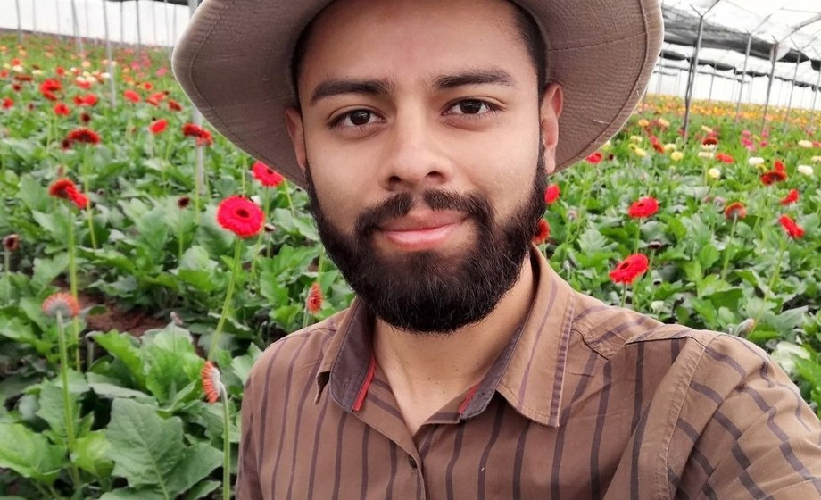
Gerald Ramirez
Advanced Programs Mentor
“Extracts pull organisms off the compost into solution, so you can apply biology across a whole field.”
An agronomist from the University of Costa Rica, who went looking for Dr. Elaine's teaching. Now he teaches it, from compost extracts to teas.
soilfoodweb.com
Notes:
Mentor card: Gerald Ramirez, Advanced Programs Mentor. About line: draft from the team notes, confirm with Allison and Gerald. Advice line from the mentor bios, 30 Sep 2026: confirm with Gerald. Photo: assets/mentors-teachers-day/gerald-ramirez.jpg (written consent needed).

Slide 12
Elena Kalli
Advanced Programs Admin
soilfoodweb.com
Notes:
Mentor card: Elena Kalli, Advanced Programs Admin. About line: draft from the team notes, confirm with Allison and Elena. No photo yet: flower arrangement. [ABOUT LINE NEEDED from Allison; the card shows name and role until then]

Slide 13
Ib Borup Pederson
Advanced Programs Mentor
soilfoodweb.com
Notes:
Mentor card: Ib Borup Pederson, Advanced Programs Mentor. About line: draft from the team notes, confirm with Allison and Ib. No photo yet: flower arrangement. [ABOUT LINE NEEDED from Allison; the card shows name and role until then]

Slide 14
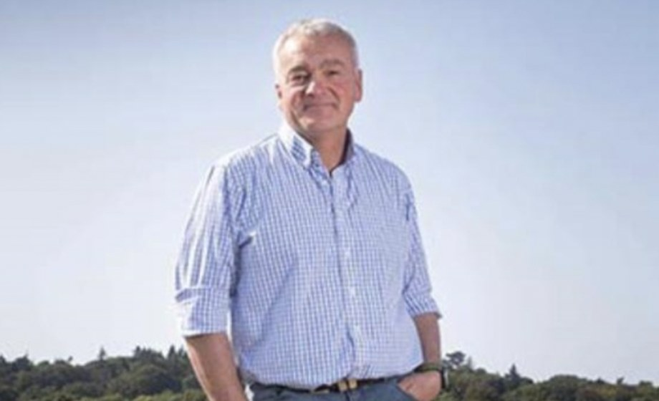
Nick Padwick
Advanced Programs Mentor
“I make 750 tons of compost a year. Biology works at any scale.”
Manages Ken Hill Estate, home of Wild Ken Hill, in West Norfolk, England. Farmers Weekly Farmer of the Year, 2009.
soilfoodweb.com
Notes:
Mentor card: Nick Padwick, Advanced Programs Mentor. About line: draft from the team notes, confirm with Allison and Nick. Advice line from the mentor bios, 30 Sep 2026: confirm with Nick. Photo: assets/mentors-teachers-day/Nick.png (written consent needed).

Slide 15
Delvin Solkinson
Permaculture Lead Teacher
soilfoodweb.com
Notes:
Mentor card: Delvin Solkinson, Permaculture Lead Teacher. About line: draft from the team notes, confirm with Allison and Delvin. No photo yet: flower arrangement. [ABOUT LINE NEEDED from Allison; the card shows name and role until then]

Slide 16
Thank you to every mentor who teaches our students to see soil.
Tommy Tepper · Loida Vasquez · Carla Portugal · Wesley Sanders · Casey Williams · Brian Daubenspeck · Isadora Schmidt · Aysen Ustunay · Dora Tkalec · Gerald Ramirez · Elena Kalli · Ib Borup Pederson · Nick Padwick · Delvin Solkinson
Notes:
Closing: every mentor on the roster thanked by name.

