Slide 1


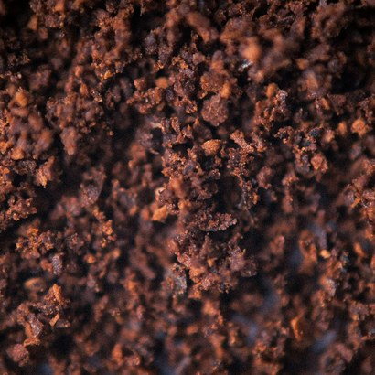

Photo: Stacy on Unsplash
Photo: Klim Sergeev on Unsplash
Myth:
“Coffee grounds
acidify your soil.”
Happy International Coffee Day ☕ Let's spill the beans.
Notes:
Myth slide. Sources: Hardgrove and Livesley, Urban Forestry and Urban Greening, 2016, https://doi.org/10.1016/j.ufug.2016.02.015; Summers et al., Journal of Bacteriology, 2012, https://doi.org/10.1128/JB.06637-11; US EPA, 40 CFR Part 503, https://www.ecfr.gov/current/title-40/chapter-I/subchapter-O/part-503. Photos: Photo by Stacy on Unsplash (https://unsplash.com/@stacysuxx?utm_source=sfw_social&utm_medium=referral). Photo by Klim Sergeev on Unsplash (https://unsplash.com/@klimsergeev?utm_source=sfw_social&utm_medium=referral). Stickers (lemon, cup, beans, seedlings, bacteria, pH strip, thermometer) are drawn PowerPoint shapes, grouped and editable.

Slide 2
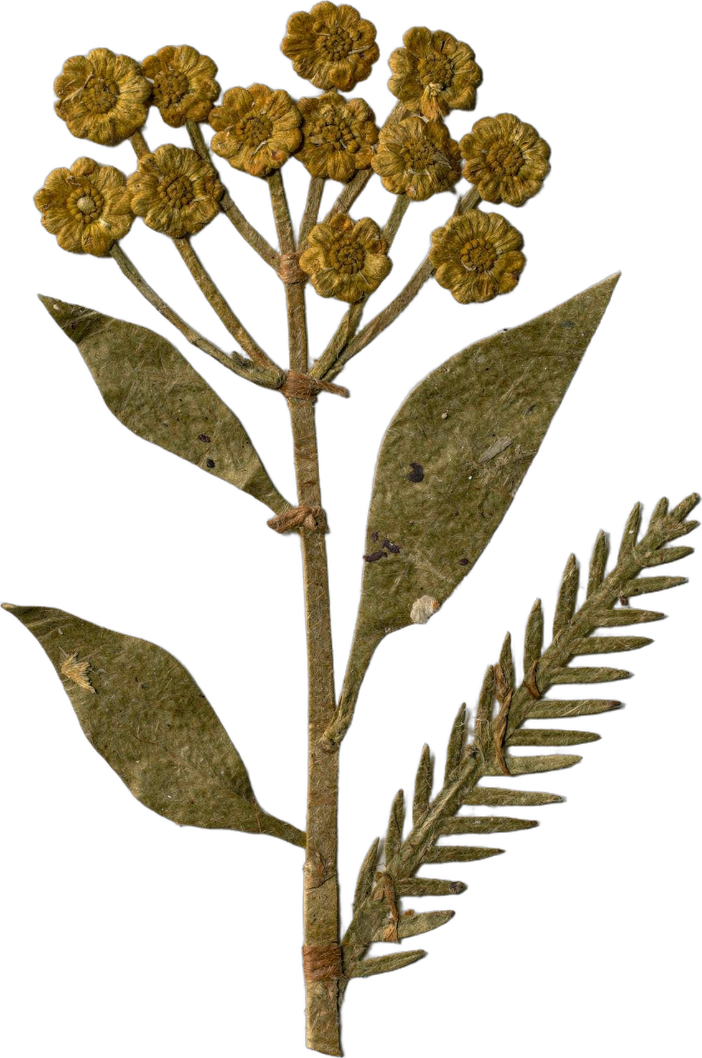
Plot twist: your coffee took the acid with it.
Brewing pulls most of the acids into your cup. The spent grounds left behind sit close to neutral pH.
0
7
14
Notes:
pH strip: universal indicator colours, 0 to 14. Lemon marks the acid end; the cup sits near neutral, as the slide says. Stickers (lemon, cup, beans, seedlings, bacteria, pH strip, thermometer) are drawn PowerPoint shapes, grouped and editable.

Slide 3
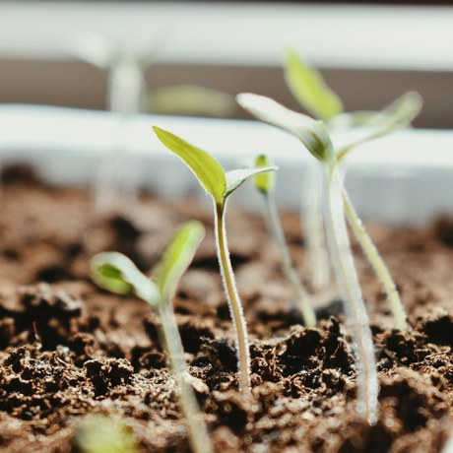
So what's the catch? Caffeine. 😬
Leftover caffeine and chlorogenic acids are allelopathic: plant-speak for chemicals that stop seeds sprouting and roots growing.
Photo: Bianca Pătrașcu on Unsplash
Notes:
Photo: Photo by Bianca Pătrașcu on Unsplash (https://unsplash.com/@bianncapatrascu?utm_source=sfw_social&utm_medium=referral). Stickers (lemon, cup, beans, seedlings, bacteria, pH strip, thermometer) are drawn PowerPoint shapes, grouped and editable.

Slide 4
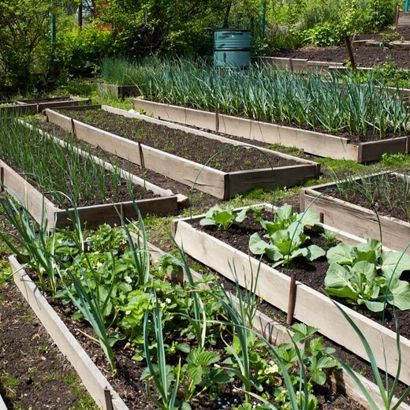
Sprinkled straight on the garden?
In trials, fresh grounds spread on beds actually slowed plant growth. 🥀
Foundation library
Notes:
Photo: assets/photo/garden-vegetable-beds.jpg (Foundation library). Stickers (lemon, cup, beans, seedlings, bacteria, pH strip, thermometer) are drawn PowerPoint shapes, grouped and editable.

Slide 5
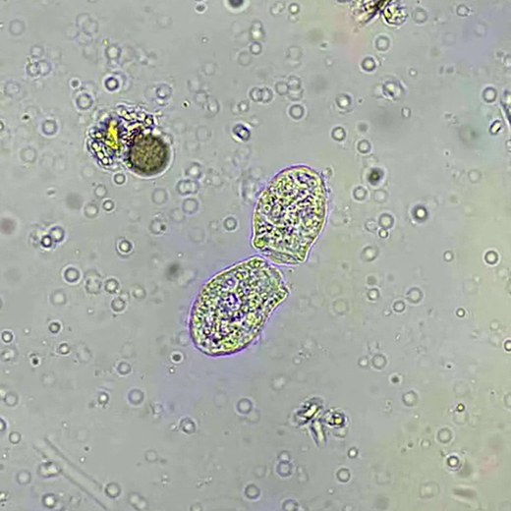
Soil Food Web Foundation
Enter the compost crew. 🦠
Composting breaks caffeine down. Some soil bacteria eat it for breakfast, lunch and dinner: Pseudomonas putida CBB5 uses caffeine as its only carbon and nitrogen source.
Notes:
Microscopy: assets/microscopy/sfw-amoeba-still-square.jpg (Foundation). The library has no bacteria-only image; this still shows an amoeba, a bacteria feeder. Swap in a bacteria micrograph if Wes has one [IMAGE NEEDED]. The drawn bacteria are rods with a flagellum, like Pseudomonas. Stickers (lemon, cup, beans, seedlings, bacteria, pH strip, thermometer) are drawn PowerPoint shapes, grouped and editable.

Slide 6
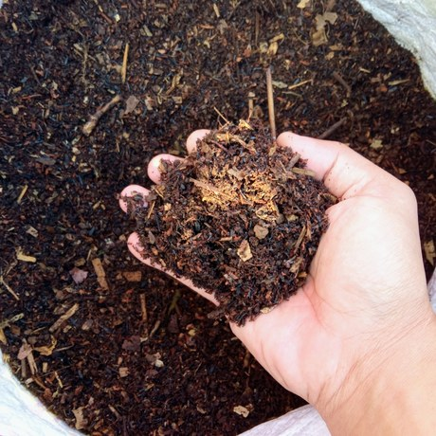
The fix: compost them first. 🔥
Grounds are a nitrogen-rich green. Mix them with woody browns like leaves or wood chips, and keep the pile hot: 55°C (131°F) or more.
55°C
Foundation library
Notes:
Photo: assets/photo/hand-of-compost.jpg (Foundation library). Thermometer marks 55°C, from the slide text. Stickers (lemon, cup, beans, seedlings, bacteria, pH strip, thermometer) are drawn PowerPoint shapes, grouped and editable.

Slide 7
Sources.
Hardgrove and Livesley, Urban Forestry and Urban Greening, 2016: https://doi.org/10.1016/j.ufug.2016.02.015
Summers et al., Journal of Bacteriology, 2012: https://doi.org/10.1128/JB.06637-11
US EPA, 40 CFR Part 503: https://www.ecfr.gov/current/title-40/chapter-I/subchapter-O/part-503
Save this for your next coffee run. ☕
Notes:
Sources slide.

