Slide 1
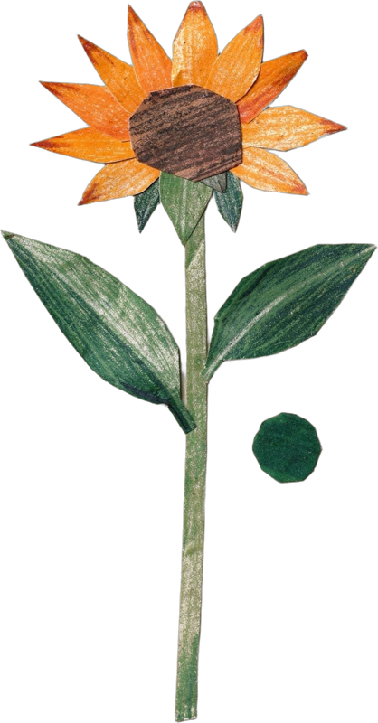


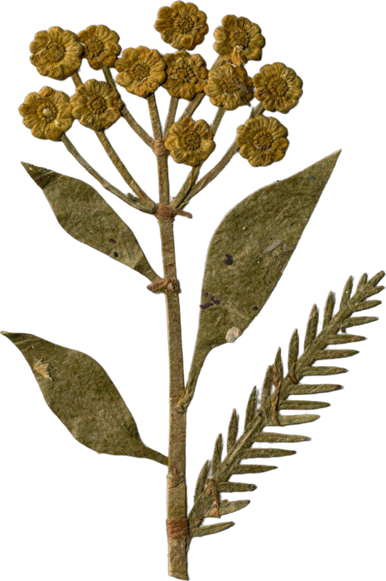
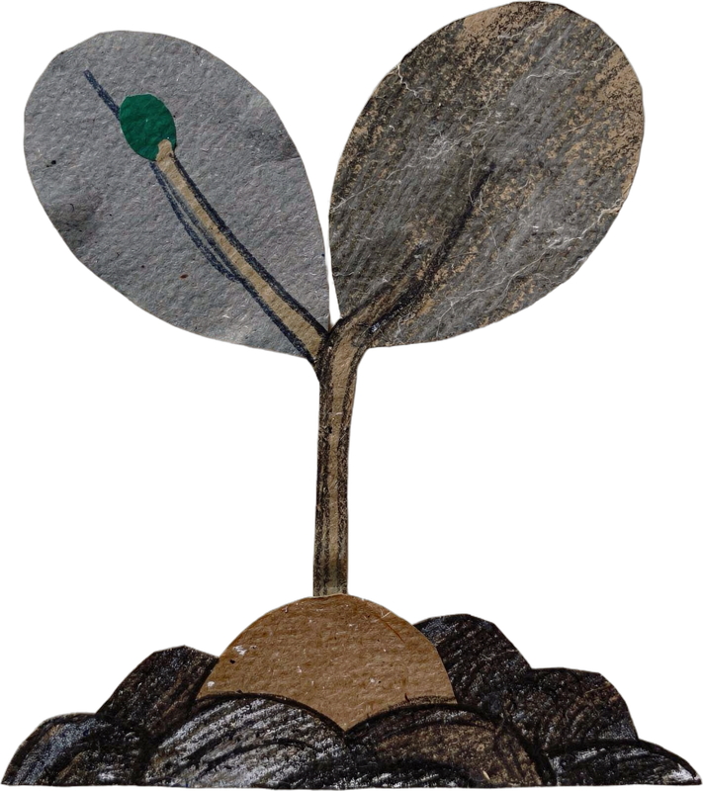

WORLD TEACHERS' DAY · 5 OCTOBER
Happy World Teachers' Day.
Meet the mentors who teach our students to see soil.
Notes:
Cover. World Teachers' Day, 5 October. Cut-paper flowers from the collage library.

Slide 2
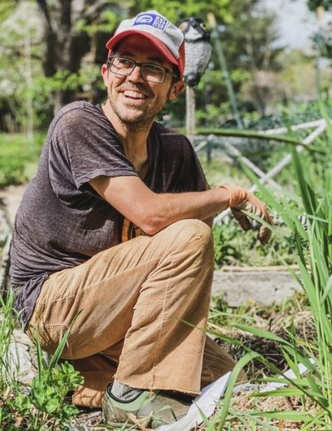
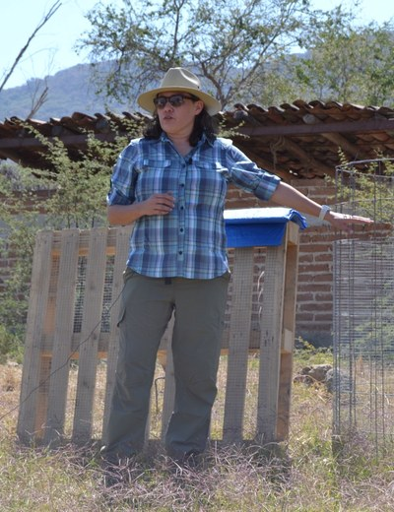
Tommy Tepper
Director of Education & Mentor
Loida Vasquez
Advanced Programs Lead & Mentor
soilfoodweb.com
Notes:
Mentors: Tommy Tepper, Loida Vasquez. About and advice lines: drafts from the team notes, confirm with each mentor (05-10-2026-mon-ig-teachers-day-mentors.md). Photo boxes marked PHOTO NEEDED: drop the mentor's photo in (written consent).

Slide 3
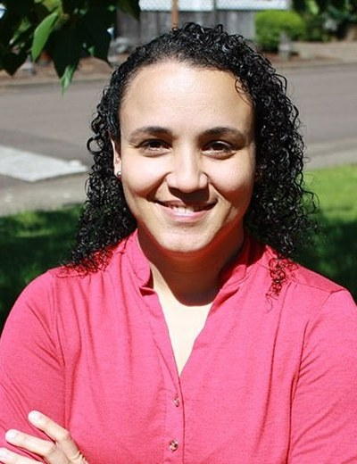
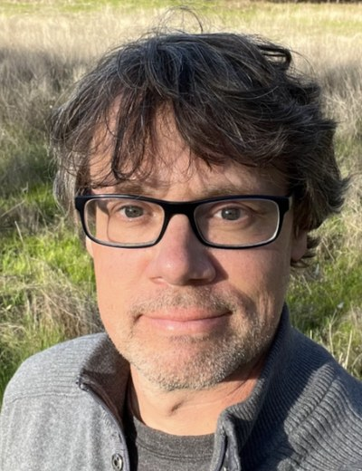
Dr. Carla Portugal
Science Lead & Mentor
“Bare soil erodes. Living roots and cover hold the aggregates together.”
PhD in Environmental Sciences. 20 years of environmental and farm consulting. Mentoring since 2019.
Wesley Sanders
Advanced Programs Mentor
“Compost can look finished and still lack the biology you need. Check it under the microscope before you apply it.”
A farmer and agricultural journalist, then our first lab tech. Runs Foothill Biological Soil Health Services in California's Sierra Nevada foothills.
soilfoodweb.com
Notes:
Mentors: Carla Portugal, Wesley Sanders. About and advice lines: drafts from the team notes, confirm with each mentor (05-10-2026-mon-ig-teachers-day-mentors.md). Photo boxes marked PHOTO NEEDED: drop the mentor's photo in (written consent).

Slide 4
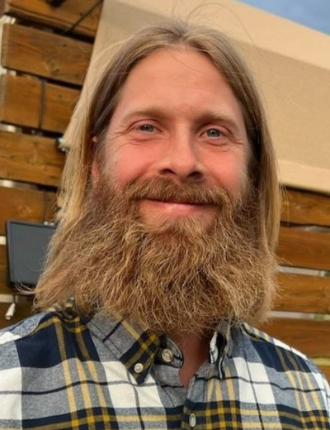
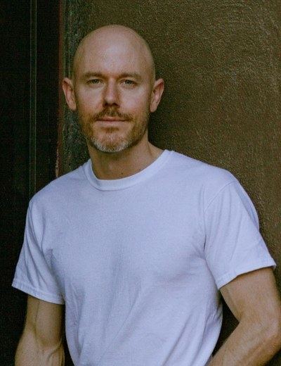
Casey Williams
Advanced Programs Mentor
Around ten years of farming and gardening. A long-time student, now teaching. Favourite microbe: rotifers.
Brian Daubenspeck
Advanced Programs Mentor
Manages orchards in California, after years in New Mexico. Favourite microbes: the small underdogs.
soilfoodweb.com
Notes:
Mentors: Casey Williams, Brian Daubenspeck. About and advice lines: drafts from the team notes, confirm with each mentor (05-10-2026-mon-ig-teachers-day-mentors.md). Photo boxes marked PHOTO NEEDED: drop the mentor's photo in (written consent).

Slide 5
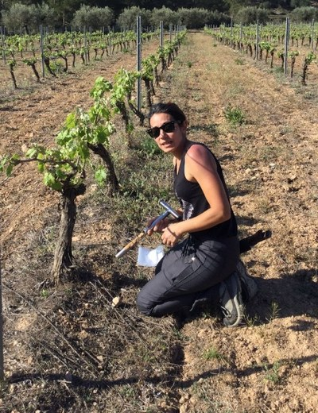
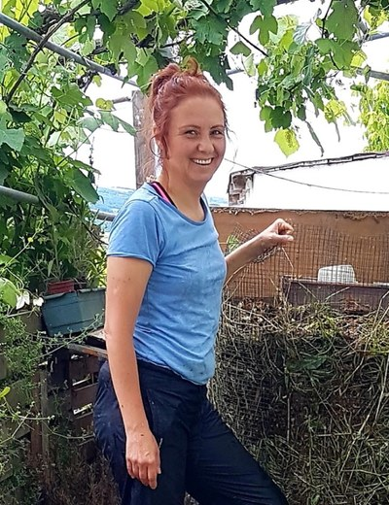
Isadora Schmidt
Advanced Programs Mentor
From Florianópolis, Brazil, now living in Spain. Favourite: lichens, though she loves all her microbes equally.
Aysen Ustunay
Advanced Programs Mentor
Favourite microbe: flagellates. She loves watching them as babies, running around.
soilfoodweb.com
Notes:
Mentors: Isadora Schmidt, Aysen Ustunay. About and advice lines: drafts from the team notes, confirm with each mentor (05-10-2026-mon-ig-teachers-day-mentors.md). Photo boxes marked PHOTO NEEDED: drop the mentor's photo in (written consent).

Slide 6
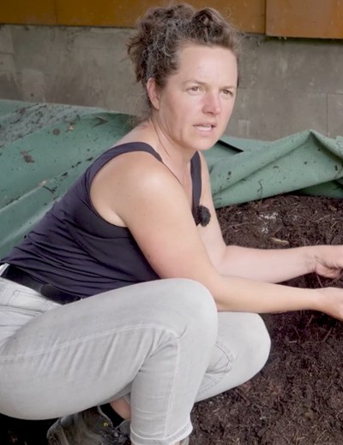
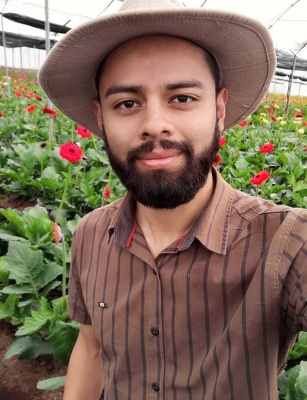
Dora Tkalec
Advanced Programs Mentor
Gerald Ramirez
Advanced Programs Mentor
“Extracts pull organisms off the compost into solution, so you can apply biology across a whole field.”
An agronomist from the University of Costa Rica, who went looking for Dr. Elaine's teaching. Now he teaches it, from compost extracts to teas.
soilfoodweb.com
Notes:
Mentors: Dora Tkalec, Gerald Ramirez. About and advice lines: drafts from the team notes, confirm with each mentor (05-10-2026-mon-ig-teachers-day-mentors.md). Photo boxes marked PHOTO NEEDED: drop the mentor's photo in (written consent).

Slide 7
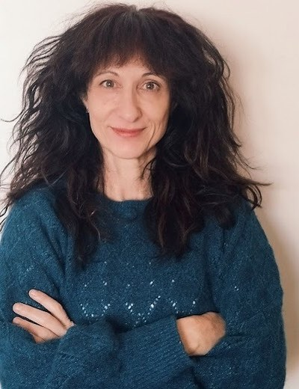
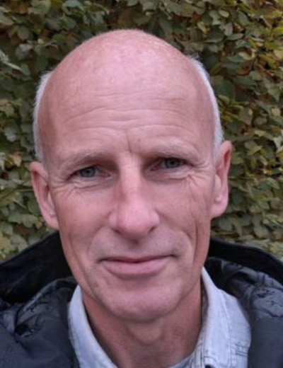
Elena Kalli
Advanced Programs Admin
Ib Borup Pederson
Advanced Programs Mentor
soilfoodweb.com
Notes:
Mentors: Elena Kalli, Ib Borup Pederson. About and advice lines: drafts from the team notes, confirm with each mentor (05-10-2026-mon-ig-teachers-day-mentors.md). Photo boxes marked PHOTO NEEDED: drop the mentor's photo in (written consent).

Slide 8
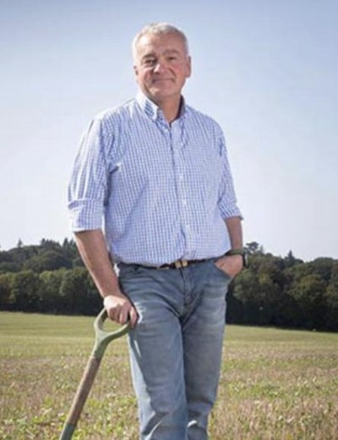
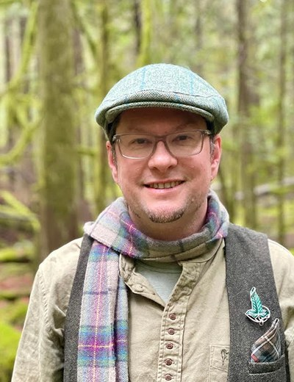
Nick Padwick
Advanced Programs Mentor
“I make 750 tons of compost a year. Biology works at any scale.”
Manages Ken Hill Estate, home of Wild Ken Hill, in West Norfolk, England. Farmers Weekly Farmer of the Year, 2009.
Delvin Solkinson
Permaculture Lead Teacher
soilfoodweb.com
Notes:
Mentors: Nick Padwick, Delvin Solkinson. About and advice lines: drafts from the team notes, confirm with each mentor (05-10-2026-mon-ig-teachers-day-mentors.md). Photo boxes marked PHOTO NEEDED: drop the mentor's photo in (written consent).

Slide 9
Thank you to every mentor who teaches our students to see soil.
Tommy Tepper · Loida Vasquez · Carla Portugal · Wesley Sanders · Casey Williams · Brian Daubenspeck · Isadora Schmidt · Aysen Ustunay · Dora Tkalec · Gerald Ramirez · Elena Kalli · Ib Borup Pederson · Nick Padwick · Delvin Solkinson
Notes:
Closing: every mentor on the roster thanked by name.

