Slide 1
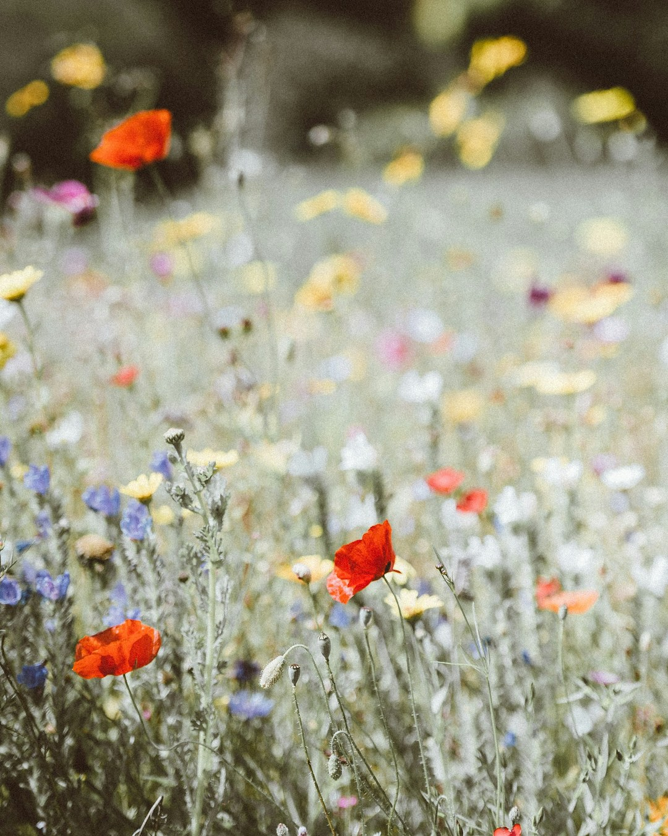

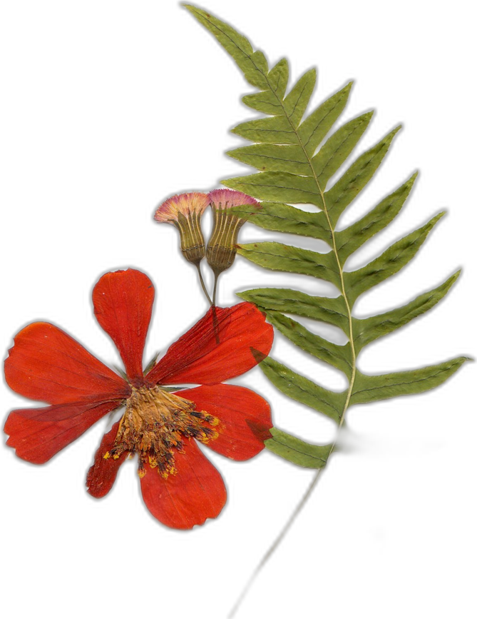




OCTOBER 5
Happy World Teachers' Day
Thank you to everyone who teaches and mentors our students.
Swipe →
Meadow: Annie Spratt on Unsplash. Pressed flowers: Evie S. on Unsplash
Notes:
Cover: meadow photo (Annie Spratt, Unsplash) under a brown gradient; cream card. Mentor photos: Linnea's Drive folder (5 Oct 2026). Pressed flowers and meadow: Unsplash, credits in assets/unsplash-flowers/CREDITS.md. Line art: SFW collage pieces (assets/collage/).

Slide 2



Ib Borup Pedersen
Farmer, Consultant & Mentor
On the team since ____
Brian Daubenspeck
Consultant & Mentor
On the team since ____
Pressed flowers: Evie S. and Angèle Kamp on Unsplash
Notes:
Mentors: Ib Borup Pedersen, Brian Daubenspeck. Mentor photos: Linnea's Drive folder (5 Oct 2026). Pressed flowers and meadow: Unsplash, credits in assets/unsplash-flowers/CREDITS.md. Line art: SFW collage pieces (assets/collage/).

Slide 3
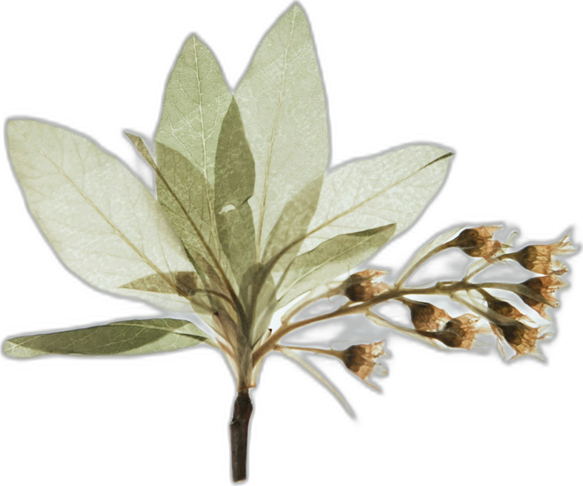



Elena Kalli
School Administration Officer
On the team since ____
Nick Padwick
Farmer, Consultant & Mentor
On the team since ____
Pressed flowers: Evie S. and Angèle Kamp on Unsplash
Notes:
Mentors: Elena Kalli, Nick Padwick. Mentor photos: Linnea's Drive folder (5 Oct 2026). Pressed flowers and meadow: Unsplash, credits in assets/unsplash-flowers/CREDITS.md. Line art: SFW collage pieces (assets/collage/).

Slide 4
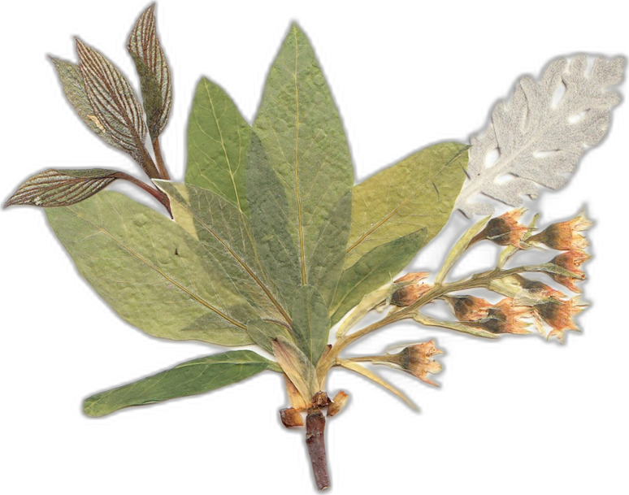


Dr. Carla Ribeiro Machado e Portugal
Mentor & Science Lead
On the team since 2019
Gerald Ramírez
Mentor
On the team since ____
Pressed flowers: Evie S. and Angèle Kamp on Unsplash
Notes:
Mentors: Carla Ribeiro Machado e Portugal, Gerald Ramírez. Mentor photos: Linnea's Drive folder (5 Oct 2026). Pressed flowers and meadow: Unsplash, credits in assets/unsplash-flowers/CREDITS.md. Line art: SFW collage pieces (assets/collage/).

Slide 5
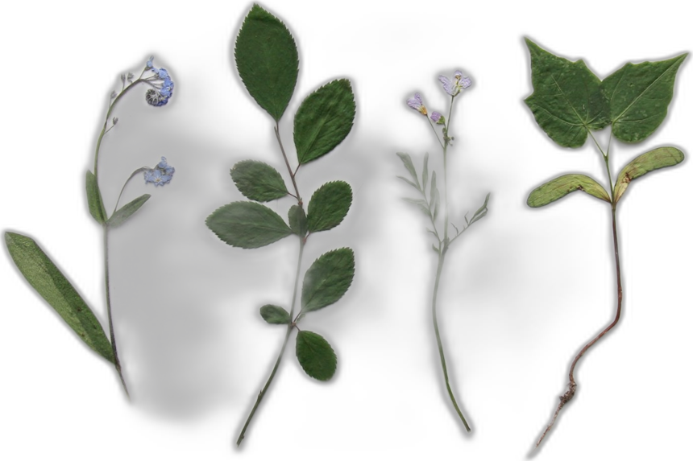



Wesley Sander
Consultant & Mentor
On the team since 2020
Isadora Schmidt
Consultant & Mentor
On the team since ____
Pressed flowers: Evie S. and Angèle Kamp on Unsplash
Notes:
Mentors: Wesley Sander, Isadora Schmidt. Mentor photos: Linnea's Drive folder (5 Oct 2026). Pressed flowers and meadow: Unsplash, credits in assets/unsplash-flowers/CREDITS.md. Line art: SFW collage pieces (assets/collage/).

Slide 6



Delvin Solkinson
Permaculture Lead
On the team since ____
Tommy Tepper
Education Department Director & Mentor
On the team since ____
Pressed flowers: Evie S. and Angèle Kamp on Unsplash
Notes:
Mentors: Delvin Solkinson, Tommy Tepper. Mentor photos: Linnea's Drive folder (5 Oct 2026). Pressed flowers and meadow: Unsplash, credits in assets/unsplash-flowers/CREDITS.md. Line art: SFW collage pieces (assets/collage/).

Slide 7


Dora Tkalec
Consultant & Mentor
On the team since ____
Ayşen Üstünay
Consultant & Mentor
On the team since ____
Pressed flowers: Evie S. and Angèle Kamp on Unsplash
Notes:
Mentors: Dora Tkalec, Ayşen Üstünay. Mentor photos: Linnea's Drive folder (5 Oct 2026). Pressed flowers and meadow: Unsplash, credits in assets/unsplash-flowers/CREDITS.md. Line art: SFW collage pieces (assets/collage/).

Slide 8


Loida Vasquez
Advanced Programs Lead
On the team since 2019
Casey Williams
Consultant & Mentor
On the team since ____
Pressed flowers: Evie S. and Angèle Kamp on Unsplash
Notes:
Mentors: Loida Vasquez, Casey Williams. Mentor photos: Linnea's Drive folder (5 Oct 2026). Pressed flowers and meadow: Unsplash, credits in assets/unsplash-flowers/CREDITS.md. Line art: SFW collage pieces (assets/collage/).

Slide 9














Happy World Teachers' Day
Delvin Solkinson
Brian Daubenspeck
Elena Kalli
Nick Padwick
Carla Portugal
Gerald Ramírez
Wesley Sander
Isadora Schmidt
Ib Borup Pedersen
Tommy Tepper
Dora Tkalec
Ayşen Üstünay
Loida Vasquez
Casey Williams
Pressed flowers: Evie S. on Unsplash
Notes:
All fourteen on one card. Mentor photos: Linnea's Drive folder (5 Oct 2026). Pressed flowers and meadow: Unsplash, credits in assets/unsplash-flowers/CREDITS.md. Line art: SFW collage pieces (assets/collage/).

Slide 10
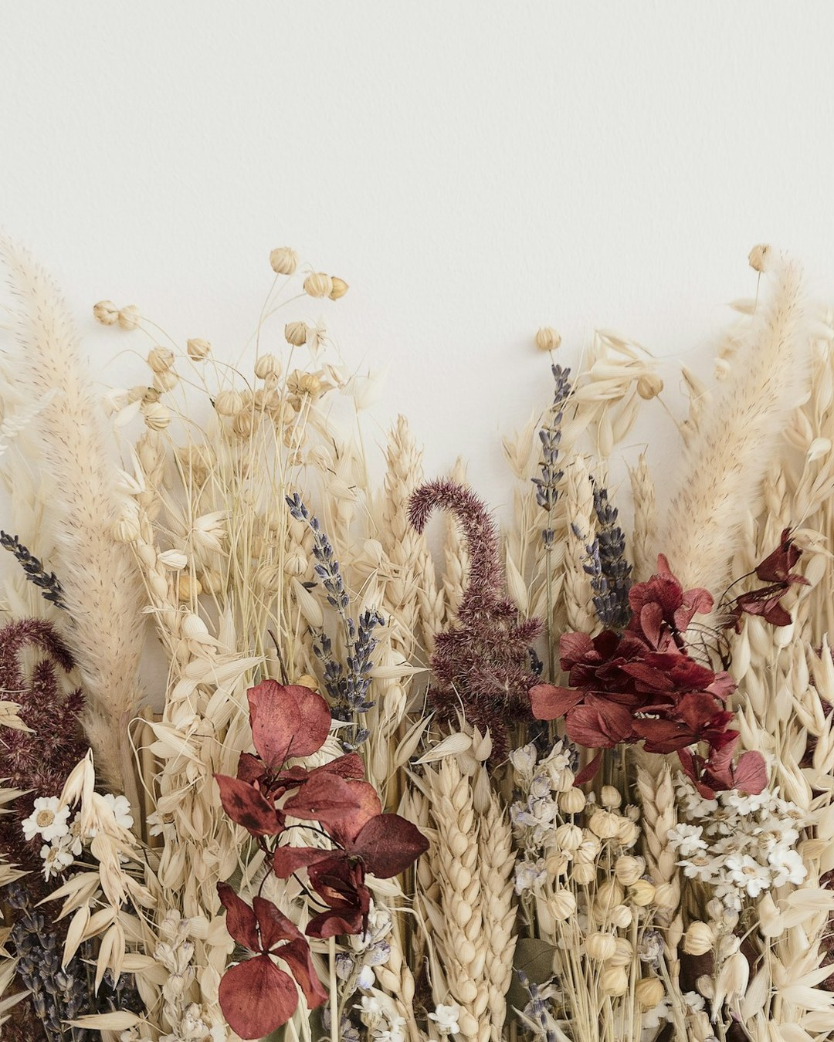
OCTOBER 5
Happy World Teachers' Day
soilfoodweb.com
Dried flowers: Katsia Jazwinska on Unsplash
Notes:
Closing: dried flowers (Katsia Jazwinska, Unsplash) under a brown gradient; big logo. Mentor photos: Linnea's Drive folder (5 Oct 2026). Pressed flowers and meadow: Unsplash, credits in assets/unsplash-flowers/CREDITS.md. Line art: SFW collage pieces (assets/collage/).

