Slide 1
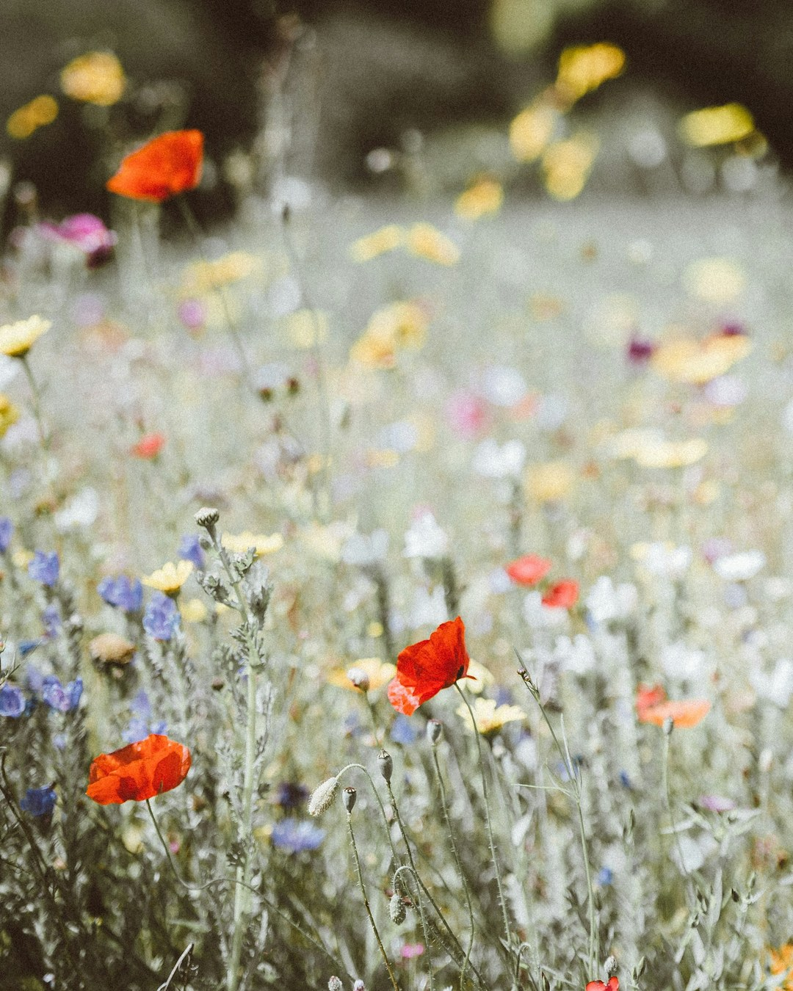
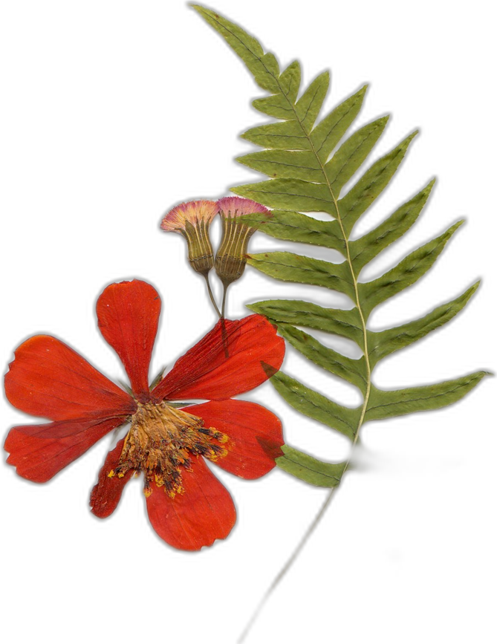

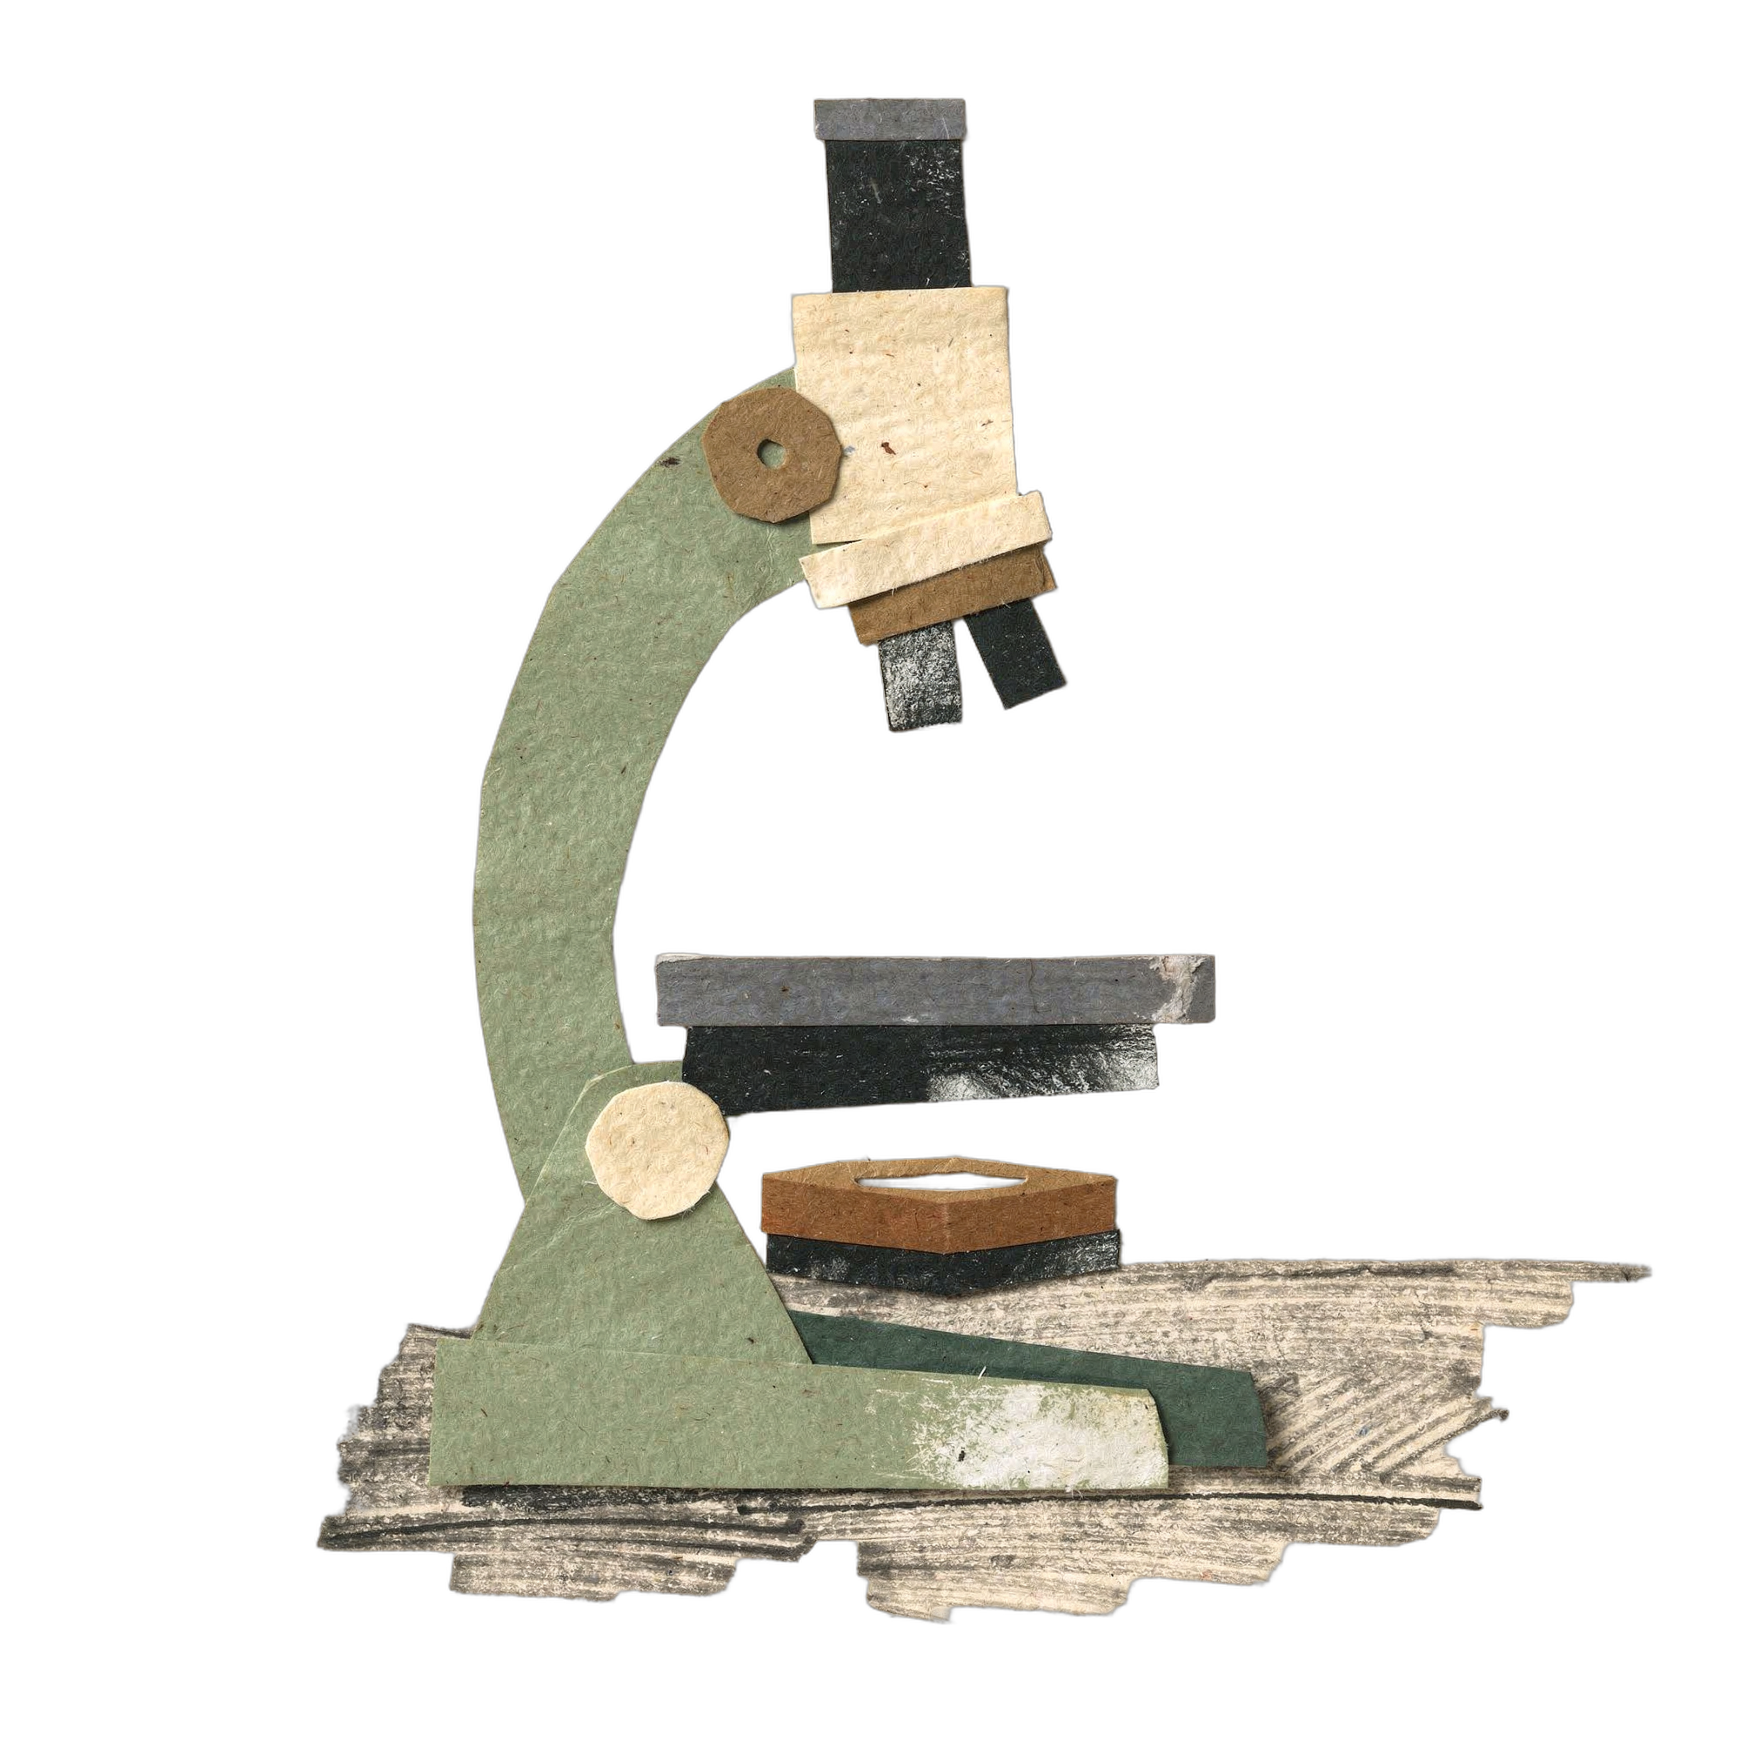

OCTOBER 5
Happy World Teachers' Day
Thank you to everyone who teaches and mentors our students.
Swipe →
Meadow: Annie Spratt on Unsplash. Pressed flowers: Evie S. on Unsplash
Notes:
Cover: meadow photo (Annie Spratt, Unsplash) under a brown gradient; cream card. Mentor photos: Linnea's Drive folder (5 Oct 2026). Pressed flowers and meadow: Unsplash, credits in assets/unsplash-flowers/CREDITS.md. Microscope and line art: SFW collage pieces (assets/collage/).

Slide 2


Ib Borup Pedersen
Farmer, SFW Consultant & Mentor
Brian Daubenspeck
SFW Consultant & Mentor
Pressed flowers: Evie S. and Angèle Kamp on Unsplash
Notes:
Mentors: Ib Borup Pedersen, Brian Daubenspeck. Mentor photos: Linnea's Drive folder (5 Oct 2026). Pressed flowers and meadow: Unsplash, credits in assets/unsplash-flowers/CREDITS.md. Microscope and line art: SFW collage pieces (assets/collage/).

Slide 3
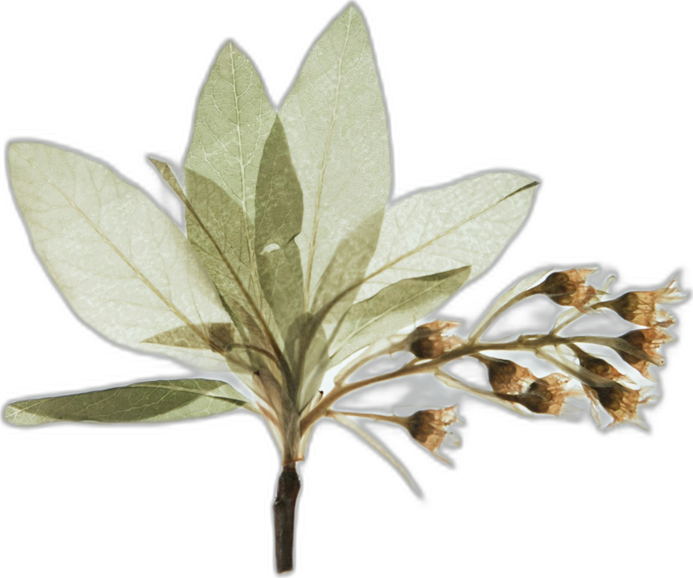




Elena Kalli
School Administration Officer
Nick Padwick
Farmer, SFW Consultant & Mentor
Pressed flowers: Evie S. and Angèle Kamp on Unsplash
Notes:
Mentors: Elena Kalli, Nick Padwick. Mentor photos: Linnea's Drive folder (5 Oct 2026). Pressed flowers and meadow: Unsplash, credits in assets/unsplash-flowers/CREDITS.md. Microscope and line art: SFW collage pieces (assets/collage/).

Slide 4
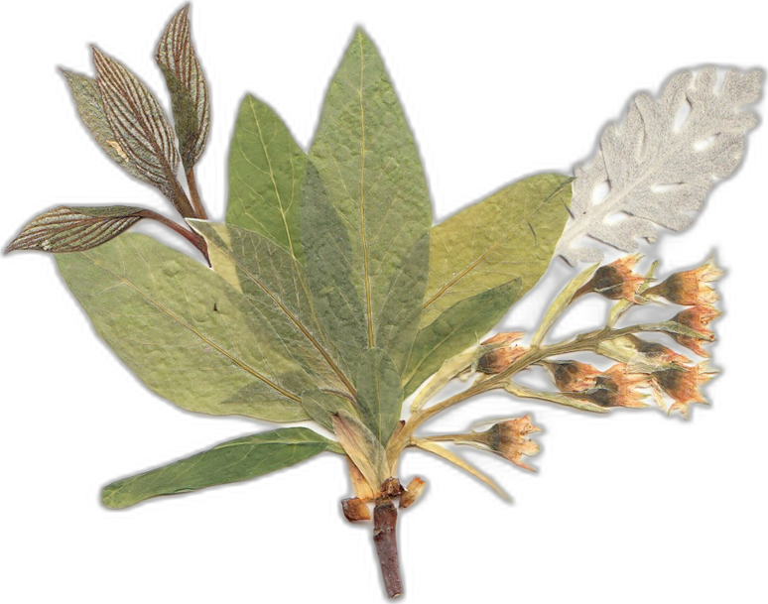



Dr. Carla Ribeiro Machado e Portugal
SFW Mentor
Gerald Ramírez
SFW Mentor
Pressed flowers: Evie S. and Angèle Kamp on Unsplash
Notes:
Mentors: Carla Ribeiro Machado e Portugal, Gerald Ramírez. Mentor photos: Linnea's Drive folder (5 Oct 2026). Pressed flowers and meadow: Unsplash, credits in assets/unsplash-flowers/CREDITS.md. Microscope and line art: SFW collage pieces (assets/collage/).

Slide 5
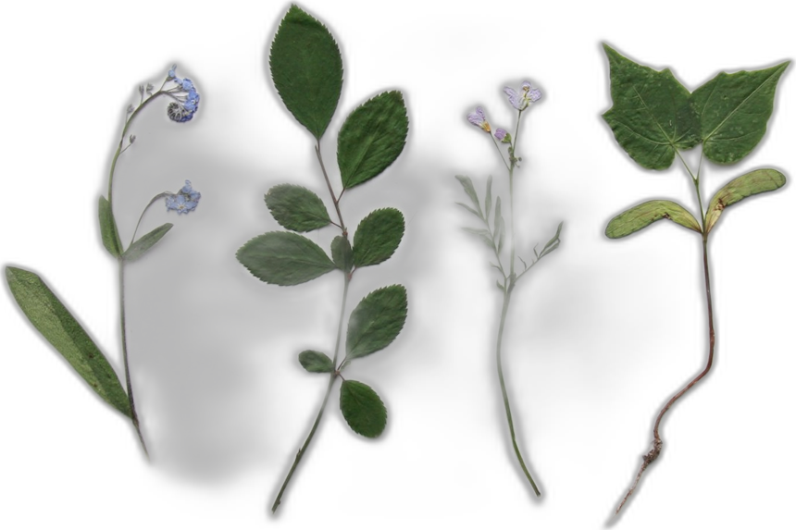



Wesley Sander
SFW Consultant & Mentor
Isadora Shmidt
SFW Consultant & Mentor
Pressed flowers: Evie S. and Angèle Kamp on Unsplash
Notes:
Mentors: Wesley Sander, Isadora Shmidt. Mentor photos: Linnea's Drive folder (5 Oct 2026). Pressed flowers and meadow: Unsplash, credits in assets/unsplash-flowers/CREDITS.md. Microscope and line art: SFW collage pieces (assets/collage/).

Slide 6



Delvin Solkinson
SFW Permaculture Lead
Tommy Tapper
Instructor
Pressed flowers: Evie S. and Angèle Kamp on Unsplash
Notes:
Mentors: Delvin Solkinson, Tommy Tapper. Mentor photos: Linnea's Drive folder (5 Oct 2026). Pressed flowers and meadow: Unsplash, credits in assets/unsplash-flowers/CREDITS.md. Microscope and line art: SFW collage pieces (assets/collage/).

Slide 7


Dora Tkalec
SFW Consultant & Mentor
Ayşen Üstünay
SFW Consultant & Mentor
Pressed flowers: Evie S. and Angèle Kamp on Unsplash
Notes:
Mentors: Dora Tkalec, Ayşen Üstünay. Mentor photos: Linnea's Drive folder (5 Oct 2026). Pressed flowers and meadow: Unsplash, credits in assets/unsplash-flowers/CREDITS.md. Microscope and line art: SFW collage pieces (assets/collage/).

Slide 8


Loida Vasquez
Advanced Programs Lead
Casey Williams
SFW Consultant & Mentor
Pressed flowers: Evie S. and Angèle Kamp on Unsplash
Notes:
Mentors: Loida Vasquez, Casey Williams. Mentor photos: Linnea's Drive folder (5 Oct 2026). Pressed flowers and meadow: Unsplash, credits in assets/unsplash-flowers/CREDITS.md. Microscope and line art: SFW collage pieces (assets/collage/).

Slide 9














Happy World Teachers' Day
Delvin Solkinson
Brian Daubenspeck
Elena Kalli
Nick Padwick
Carla Portugal
Gerald Ramírez
Wesley Sander
Isadora Shmidt
Ib Borup Pedersen
Tommy Tapper
Dora Tkalec
Ayşen Üstünay
Loida Vasquez
Casey Williams
Pressed flowers: Evie S. on Unsplash
Notes:
All fourteen on one card. Mentor photos: Linnea's Drive folder (5 Oct 2026). Pressed flowers and meadow: Unsplash, credits in assets/unsplash-flowers/CREDITS.md. Microscope and line art: SFW collage pieces (assets/collage/).

Slide 10
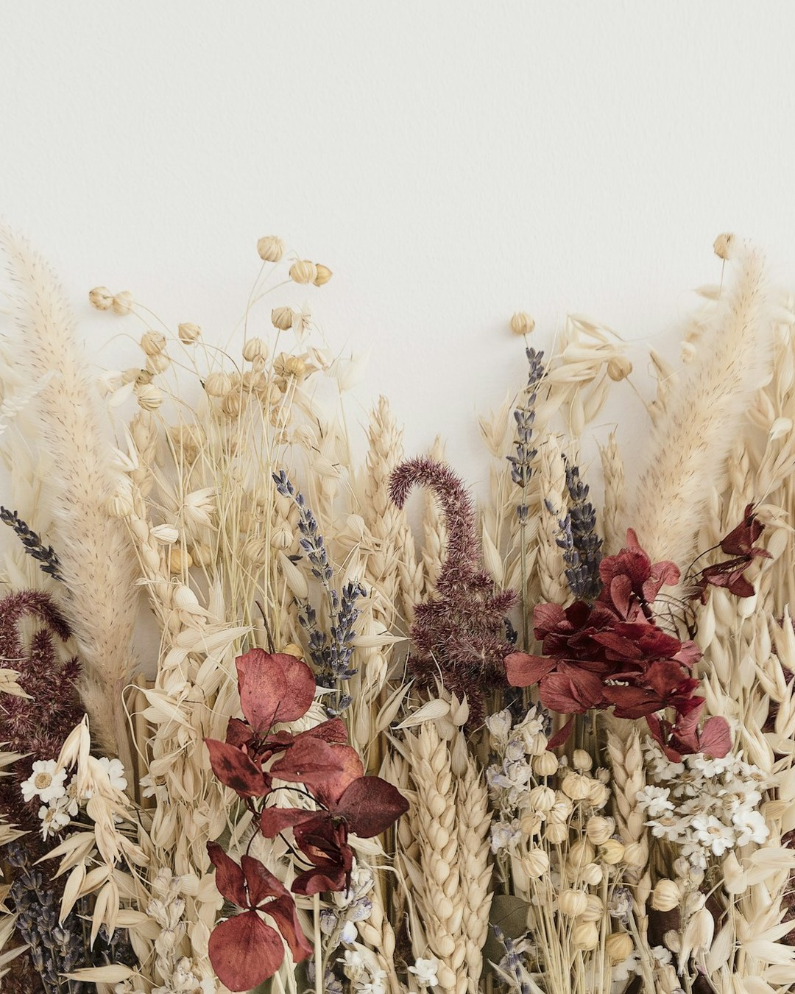
OCTOBER 5
Happy World Teachers' Day
soilfoodweb.com
Dried flowers: Katsia Jazwinska on Unsplash
Notes:
Closing: dried flowers (Katsia Jazwinska, Unsplash) under a brown gradient; big logo. Mentor photos: Linnea's Drive folder (5 Oct 2026). Pressed flowers and meadow: Unsplash, credits in assets/unsplash-flowers/CREDITS.md. Microscope and line art: SFW collage pieces (assets/collage/).

