Slide 1








Loida Vasquez
Advanced Programs Lead & Mentor
Casey Williams
Mentor & Consultant
Notes:
Version 1: ripped paper. Mentor photos: Linnea's Drive folder (5 Oct 2026). Soil: cut from assets/photo/hand-of-compost.jpg. Names and titles: Stephanie McDaniel, 6 Oct 2026.

Slide 2


Loida Vasquez
Advanced Programs Lead & Mentor
Casey Williams
Mentor & Consultant
Notes:
Version 2: gold brush stroke. Mentor photos: Linnea's Drive folder (5 Oct 2026). Soil: cut from assets/photo/hand-of-compost.jpg. Names and titles: Stephanie McDaniel, 6 Oct 2026.

Slide 3


Loida Vasquez
Advanced Programs Lead & Mentor
Casey Williams
Mentor & Consultant
Notes:
Version 3: light leak and film grain. Mentor photos: Linnea's Drive folder (5 Oct 2026). Soil: cut from assets/photo/hand-of-compost.jpg. Names and titles: Stephanie McDaniel, 6 Oct 2026.

Slide 4

Loida Vasquez
Advanced Programs Lead & Mentor
Casey Williams
Mentor & Consultant
Notes:
Version 4: blurry brand gradient. Mentor photos: Linnea's Drive folder (5 Oct 2026). Soil: cut from assets/photo/hand-of-compost.jpg. Names and titles: Stephanie McDaniel, 6 Oct 2026.

Slide 5
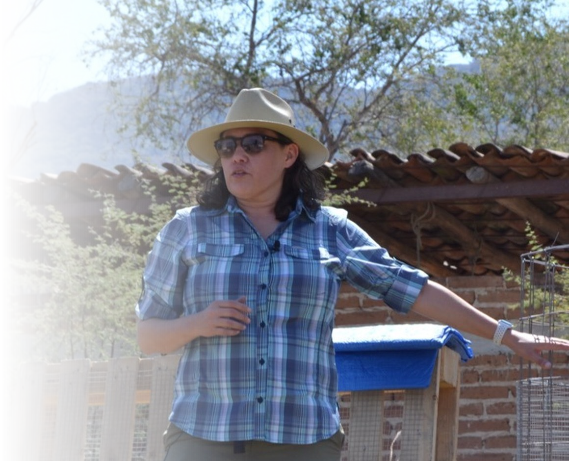
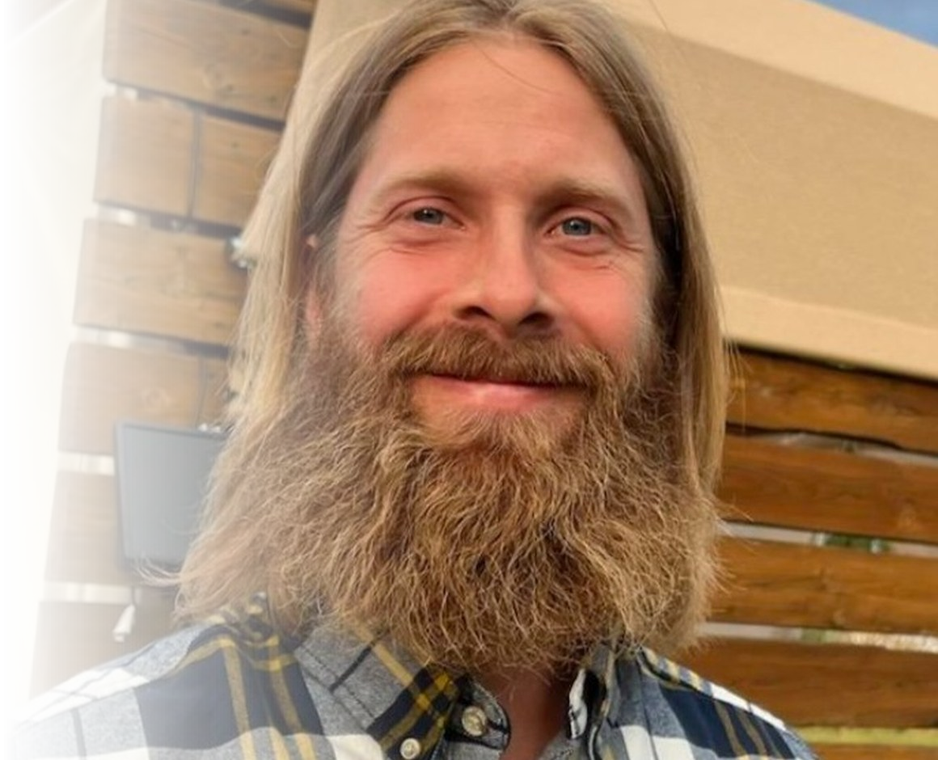
Loida Vasquez
Advanced Programs Lead & Mentor
Casey Williams
Mentor & Consultant
Notes:
Version 5: gradient fade on the photos. Mentor photos: Linnea's Drive folder (5 Oct 2026). Soil: cut from assets/photo/hand-of-compost.jpg. Names and titles: Stephanie McDaniel, 6 Oct 2026.

Slide 6

Loida Vasquez
Advanced Programs Lead & Mentor
Casey Williams
Mentor & Consultant
Notes:
Version 6: halftone dots. Mentor photos: Linnea's Drive folder (5 Oct 2026). Soil: cut from assets/photo/hand-of-compost.jpg. Names and titles: Stephanie McDaniel, 6 Oct 2026.

Slide 7

Loida Vasquez
Advanced Programs Lead & Mentor
Casey Williams
Mentor & Consultant
Notes:
Version 7: gold sparkles. Mentor photos: Linnea's Drive folder (5 Oct 2026). Soil: cut from assets/photo/hand-of-compost.jpg. Names and titles: Stephanie McDaniel, 6 Oct 2026.

Slide 8
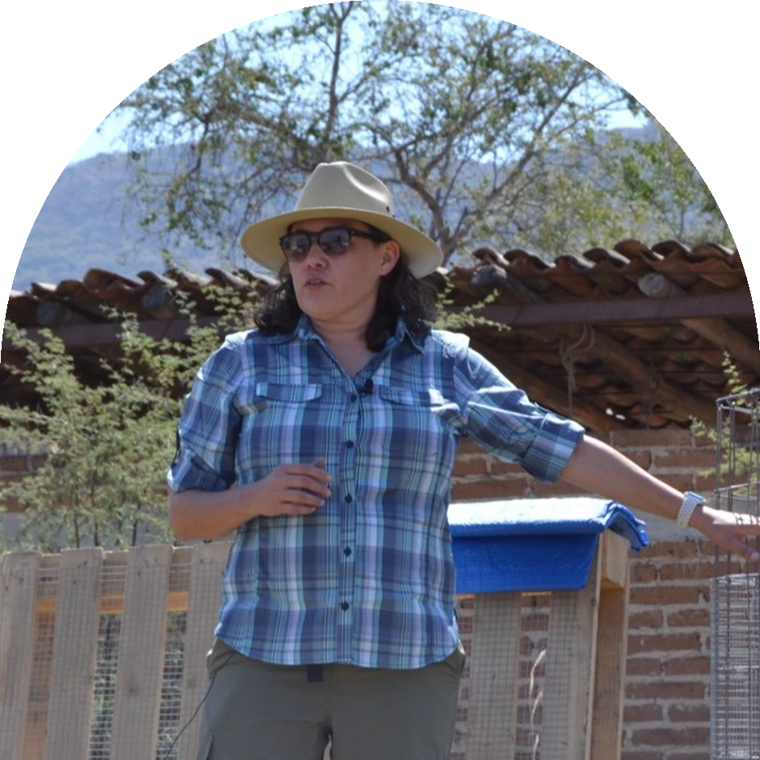
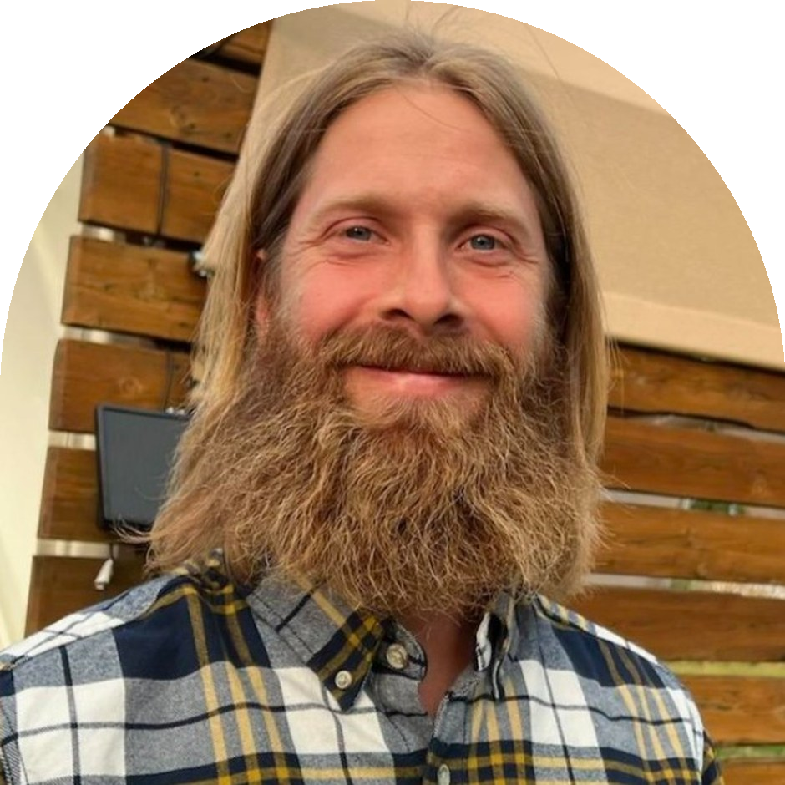
Loida Vasquez
Advanced Programs Lead & Mentor
Casey Williams
Mentor & Consultant
Notes:
Version 8: arch frames. Mentor photos: Linnea's Drive folder (5 Oct 2026). Soil: cut from assets/photo/hand-of-compost.jpg. Names and titles: Stephanie McDaniel, 6 Oct 2026.

Slide 9
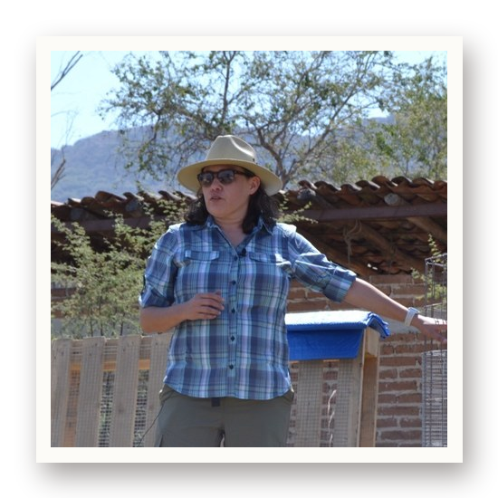
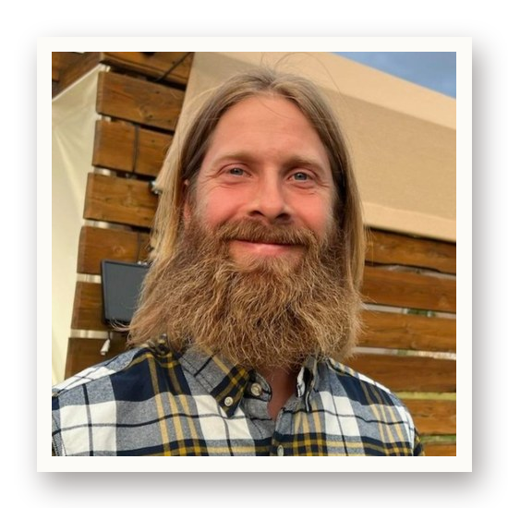
Loida Vasquez
Advanced Programs Lead & Mentor
Casey Williams
Mentor & Consultant
Notes:
Version 9: drop shadow and white border. Mentor photos: Linnea's Drive folder (5 Oct 2026). Soil: cut from assets/photo/hand-of-compost.jpg. Names and titles: Stephanie McDaniel, 6 Oct 2026.

Slide 10

Loida Vasquez
Advanced Programs Lead & Mentor
Casey Williams
Mentor & Consultant
Notes:
Version 10: brand terrazzo. Mentor photos: Linnea's Drive folder (5 Oct 2026). Soil: cut from assets/photo/hand-of-compost.jpg. Names and titles: Stephanie McDaniel, 6 Oct 2026.

