Slide 1







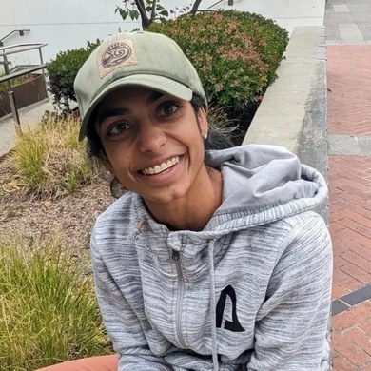


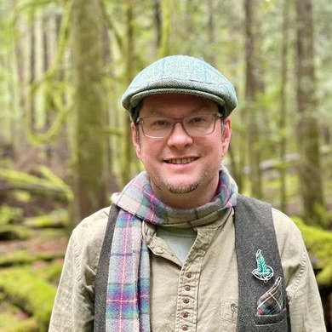





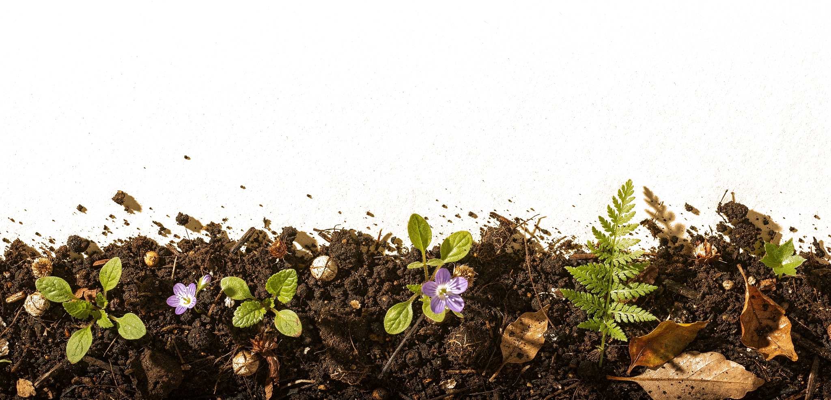
Happy World Teachers' Day
Ib Borup Pedersen
Brian Daubenspeck
Elena Kalli
Nick Padwick
Carla Portugal
Gerald Ramírez
Kavi Reddy
Wesley Sander
Isadora Schmidt
Delvin Solkinson
Tommy Tepper
Dora Tkalec
Ayşen Üstünay
Loida Vasquez
Casey Williams
Notes:
Grid A 5 x 3 squares, names under. Photos: Linnea's Drive folder (5 Oct 2026). Compost: assets/photo/hand-of-compost.jpg. Soil strip: Replicate flat-lay, assets/collage/cutouts/soil-flatlay-border.png. Pressed sprig: Evie S. on Unsplash.

Slide 2















Happy World Teachers' Day
Ib Borup Pedersen
Brian Daubenspeck
Elena Kalli
Nick Padwick
Carla Portugal
Gerald Ramírez
Kavi Reddy
Wesley Sander
Isadora Schmidt
Delvin Solkinson
Tommy Tepper
Dora Tkalec
Ayşen Üstünay
Loida Vasquez
Casey Williams
Notes:
Grid B 5 x 3 squares, names on the photo, bigger. Photos: Linnea's Drive folder (5 Oct 2026). Compost: assets/photo/hand-of-compost.jpg. Soil strip: Replicate flat-lay, assets/collage/cutouts/soil-flatlay-border.png. Pressed sprig: Evie S. on Unsplash.

Slide 3
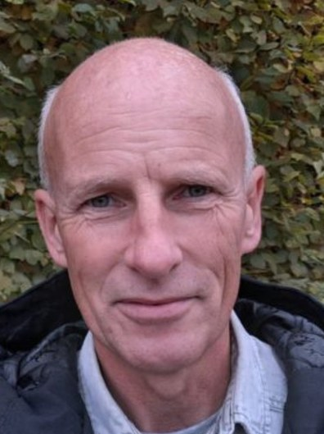
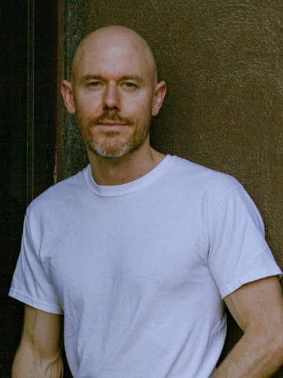
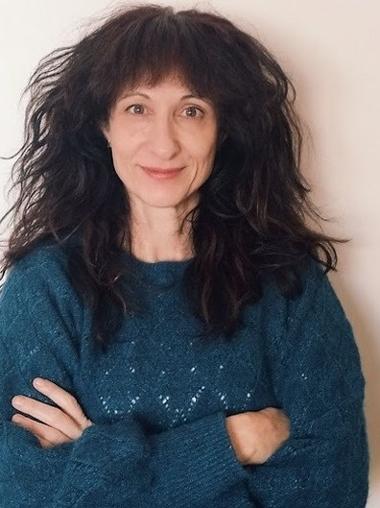
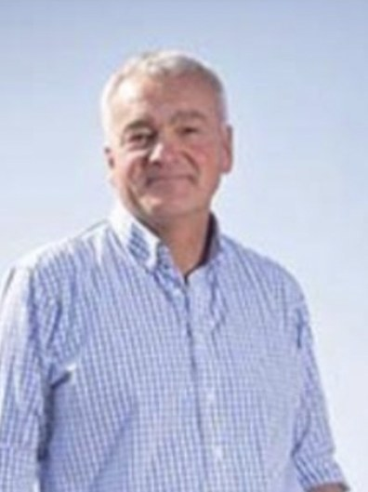
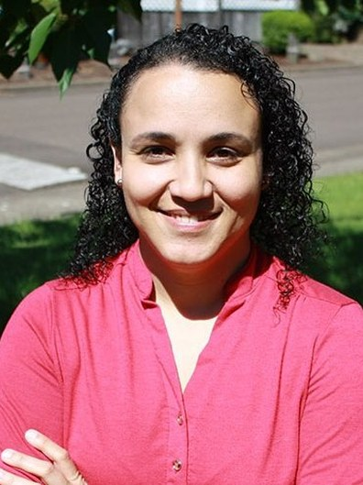
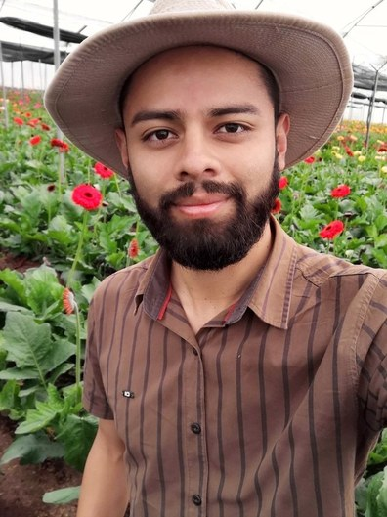
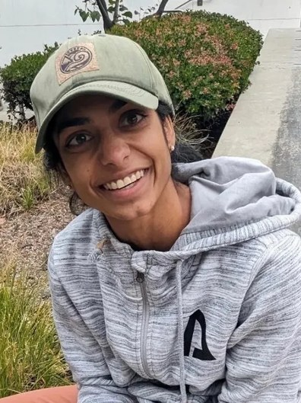
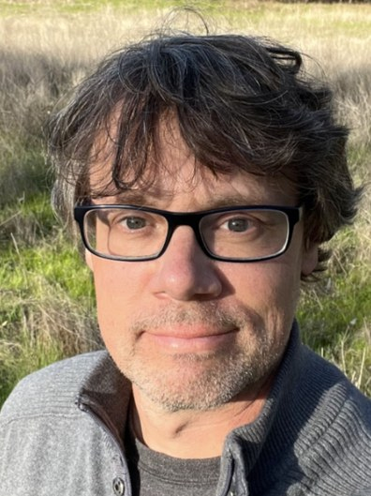
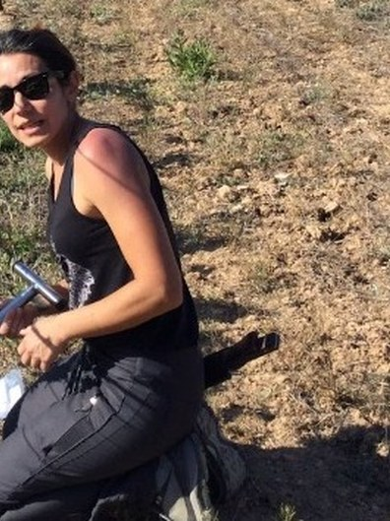
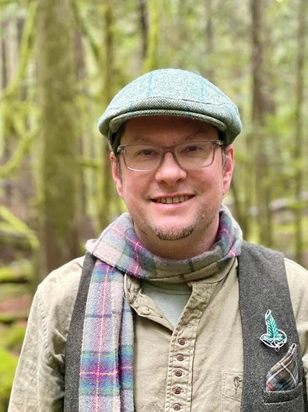
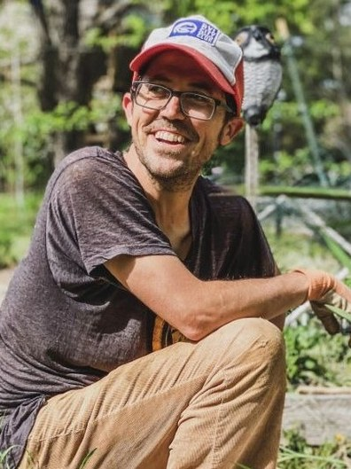
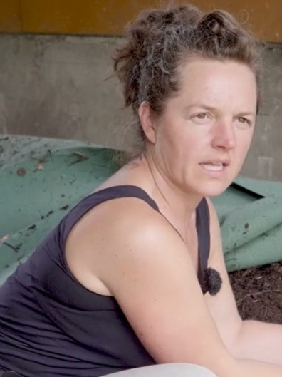
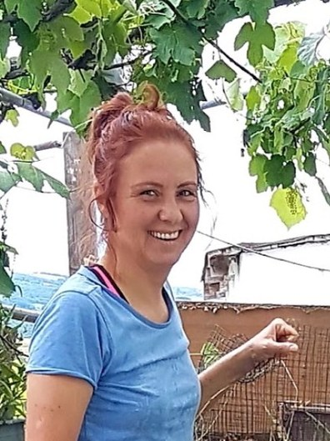
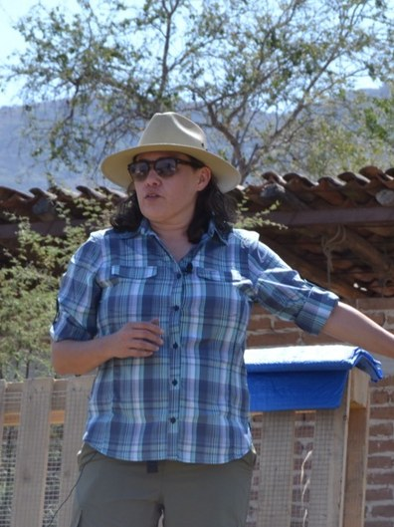
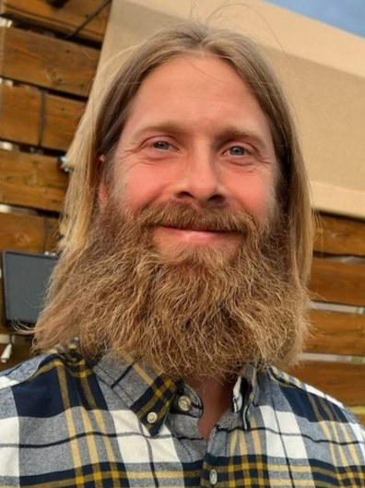
Happy World Teachers' Day
Ib Borup Pedersen
Brian Daubenspeck
Elena Kalli
Nick Padwick
Carla Portugal
Gerald Ramírez
Kavi Reddy
Wesley Sander
Isadora Schmidt
Delvin Solkinson
Tommy Tepper
Dora Tkalec
Ayşen Üstünay
Loida Vasquez
Casey Williams
Notes:
Grid C 5 x 3 tall photos (3:4), names on the photo, fills the space. Photos: Linnea's Drive folder (5 Oct 2026). Compost: assets/photo/hand-of-compost.jpg. Soil strip: Replicate flat-lay, assets/collage/cutouts/soil-flatlay-border.png. Pressed sprig: Evie S. on Unsplash.

Slide 4















Happy World Teachers' Day
Ib Borup Pedersen
Brian Daubenspeck
Elena Kalli
Nick Padwick
Carla Portugal
Gerald Ramírez
Kavi Reddy
Wesley Sander
Isadora Schmidt
Delvin Solkinson
Tommy Tepper
Dora Tkalec
Ayşen Üstünay
Loida Vasquez
Casey Williams
Notes:
Grid D 4-4-4-3 squares, names on the photo. Photos: Linnea's Drive folder (5 Oct 2026). Compost: assets/photo/hand-of-compost.jpg. Soil strip: Replicate flat-lay, assets/collage/cutouts/soil-flatlay-border.png. Pressed sprig: Evie S. on Unsplash.

Slide 5


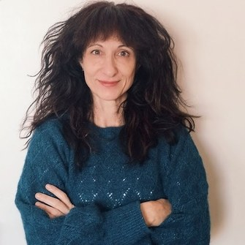
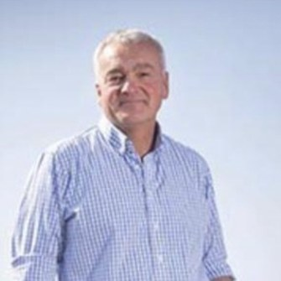









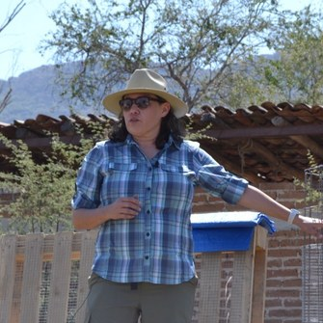

Happy World Teachers' Day
Ib Borup Pedersen
Brian Daubenspeck
Elena Kalli
Nick Padwick
Carla Portugal
Gerald Ramírez
Kavi Reddy
Wesley Sander
Isadora Schmidt
Delvin Solkinson
Tommy Tepper
Dora Tkalec
Ayşen Üstünay
Loida Vasquez
Casey Williams
Notes:
Grid E 4-4-4-3 squares, names under. Photos: Linnea's Drive folder (5 Oct 2026). Compost: assets/photo/hand-of-compost.jpg. Soil strip: Replicate flat-lay, assets/collage/cutouts/soil-flatlay-border.png. Pressed sprig: Evie S. on Unsplash.

Slide 6









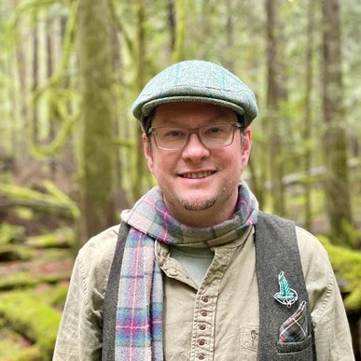





Happy World Teachers' Day
Ib Borup Pedersen
Brian Daubenspeck
Elena Kalli
Nick Padwick
Carla Portugal
Gerald Ramírez
Kavi Reddy
Wesley Sander
Isadora Schmidt
Delvin Solkinson
Tommy Tepper
Dora Tkalec
Ayşen Üstünay
Loida Vasquez
Casey Williams
Notes:
Grid F 5 x 3 circles, names under. Photos: Linnea's Drive folder (5 Oct 2026). Compost: assets/photo/hand-of-compost.jpg. Soil strip: Replicate flat-lay, assets/collage/cutouts/soil-flatlay-border.png. Pressed sprig: Evie S. on Unsplash.

