Slide 1
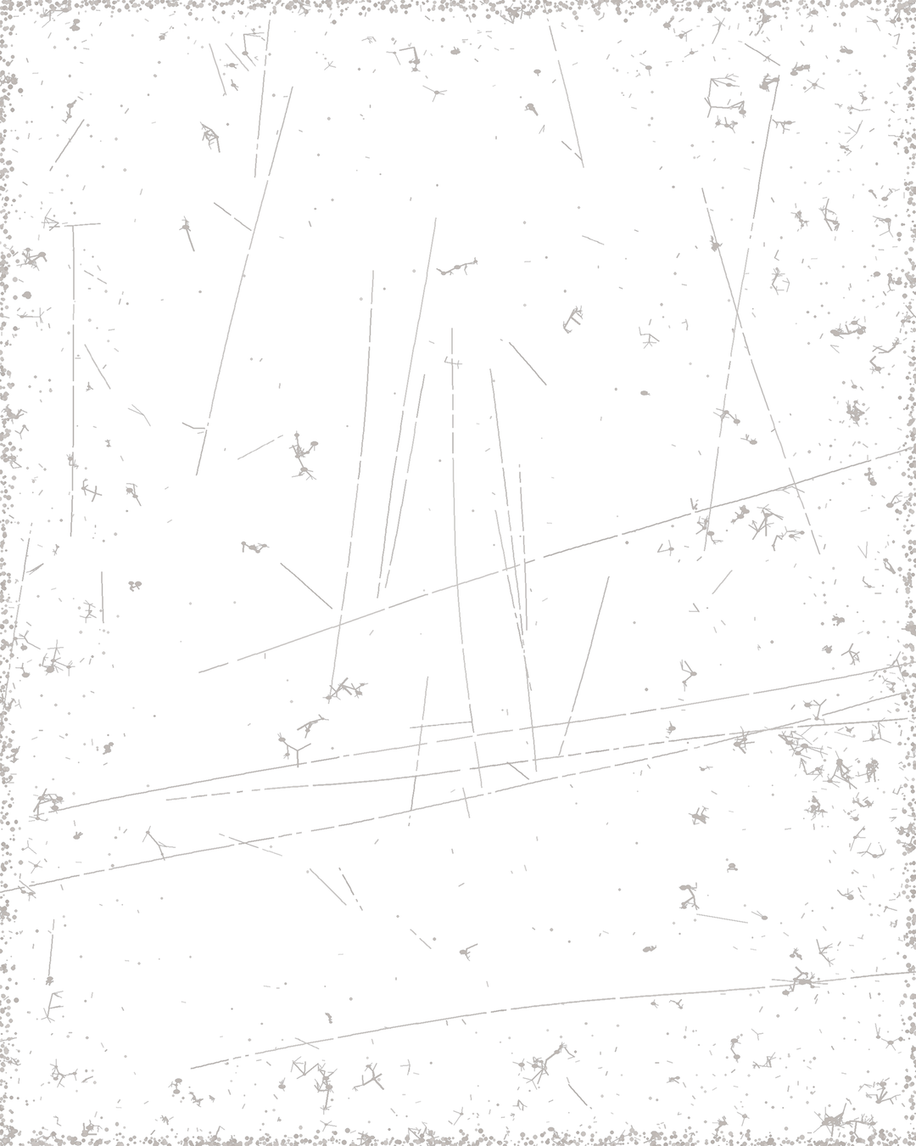


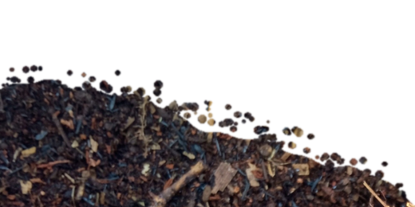

Loida Vasquez
Advanced Programs Lead & Mentor
Casey Williams
Mentor & Consultant
Notes:
Version A: compost mound bottom right. Mentor photos: Linnea's Drive folder (5 Oct 2026). Soil: cut from assets/photo/hand-of-compost.jpg. Names and titles: Stephanie McDaniel, 6 Oct 2026.

Slide 2
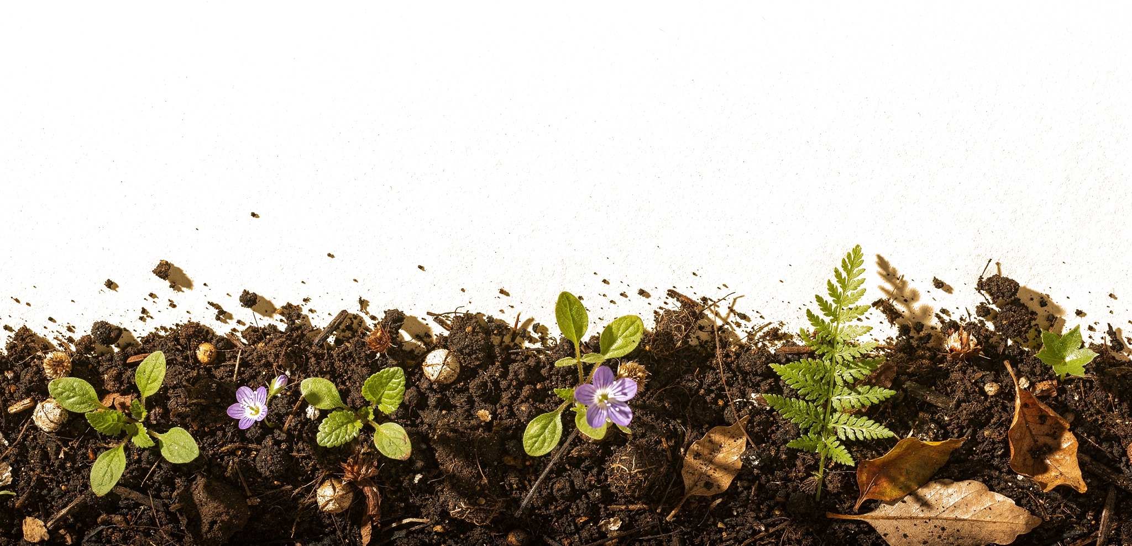
Loida Vasquez
Advanced Programs Lead & Mentor
Casey Williams
Mentor & Consultant
Notes:
Version B: flat-lay soil border (Replicate). Mentor photos: Linnea's Drive folder (5 Oct 2026). Soil: cut from assets/photo/hand-of-compost.jpg. Names and titles: Stephanie McDaniel, 6 Oct 2026.

Slide 3
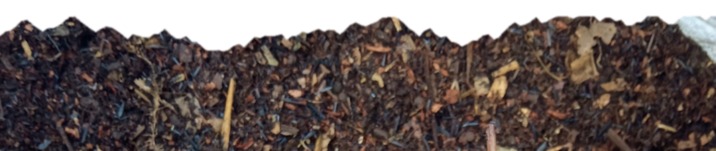
Loida Vasquez
Advanced Programs Lead & Mentor
Casey Williams
Mentor & Consultant
Notes:
Version C: torn soil strip. Mentor photos: Linnea's Drive folder (5 Oct 2026). Soil: cut from assets/photo/hand-of-compost.jpg. Names and titles: Stephanie McDaniel, 6 Oct 2026.

Slide 4
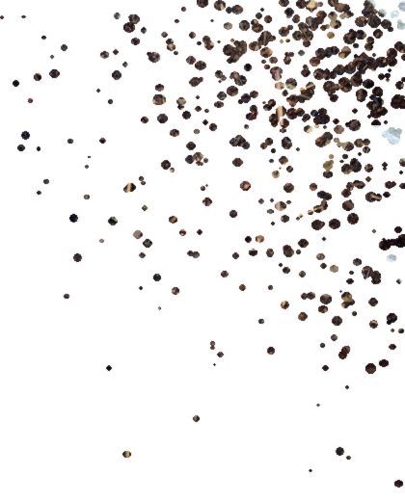
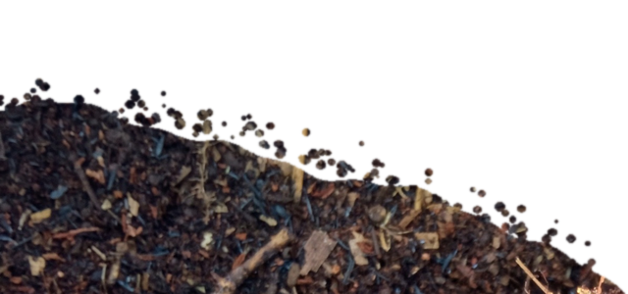
Loida Vasquez
Advanced Programs Lead & Mentor
Casey Williams
Mentor & Consultant
Notes:
Version D: crumbs top right, small mound bottom left. Mentor photos: Linnea's Drive folder (5 Oct 2026). Soil: cut from assets/photo/hand-of-compost.jpg. Names and titles: Stephanie McDaniel, 6 Oct 2026.

