Slide 1


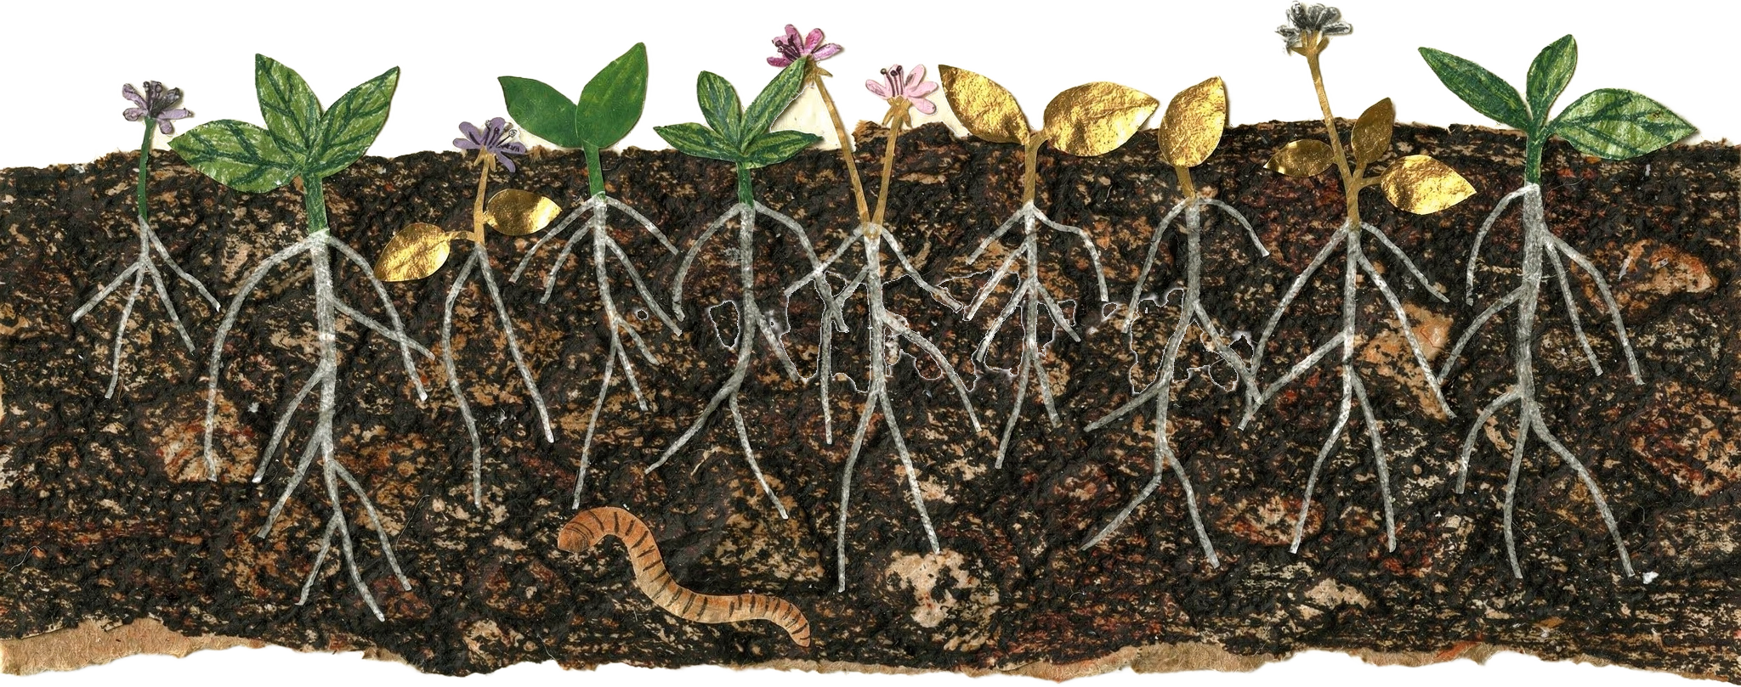
OCTOBER 5
Happy World Teachers' Day
Thank you to our instructors and education staff.
Swipe →
Notes:
Test cover: cut-paper soil strip made with Replicate (flux-2-pro, style-reference.png). Mentor photos: Linnea's Drive folder (5 Oct 2026). Soil: cut from assets/photo/hand-of-compost.jpg. Names and titles: Stephanie McDaniel, 6 Oct 2026.

