Slide 1


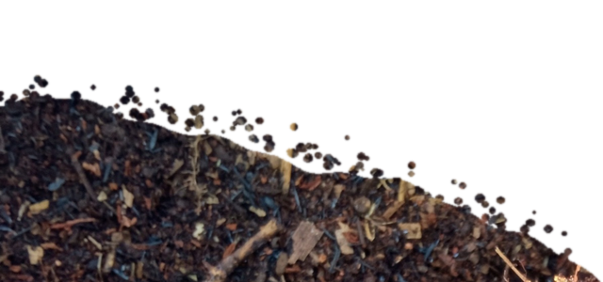
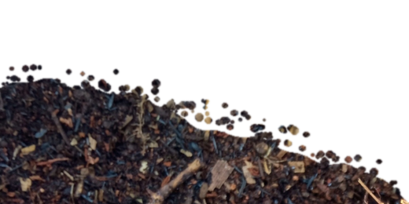
OCTOBER 5
Happy World Teachers' Day
Thank you to our instructors and education staff.
Swipe →
Notes:
Cover / closing: bunting, balloons, stars, soil (PowerPoint shapes and cut photo). Mentor photos: Linnea's Drive folder (5 Oct 2026). Soil: cut from assets/photo/hand-of-compost.jpg. Names and titles: Stephanie McDaniel, 6 Oct 2026.

Slide 2



Ib Borup Pedersen
Farmer, Mentor & Consultant
Brian Daubenspeck
Mentor & Consultant
Elena Kalli
School Administration Officer
Notes:
People: Ib Borup Pedersen, Brian Daubenspeck, Elena Kalli. Mentor photos: Linnea's Drive folder (5 Oct 2026). Soil: cut from assets/photo/hand-of-compost.jpg. Names and titles: Stephanie McDaniel, 6 Oct 2026.

Slide 3



Nick Padwick
Farmer, Mentor & Consultant
Dr. Carla Ribeiro Machado e Portugal
Mentor & Science Lead
Gerald Ramírez
Mentor
Notes:
People: Nick Padwick, Carla Ribeiro Machado e Portugal, Gerald Ramírez. Mentor photos: Linnea's Drive folder (5 Oct 2026). Soil: cut from assets/photo/hand-of-compost.jpg. Names and titles: Stephanie McDaniel, 6 Oct 2026.

Slide 4


Kavi Reddy
Permaculture Instructor
Wesley Sander
Mentor & Consultant
Isadora Schmidt
Mentor & Consultant
Notes:
People: Kavi Reddy, Wesley Sander, Isadora Schmidt. Mentor photos: Linnea's Drive folder (5 Oct 2026). Soil: cut from assets/photo/hand-of-compost.jpg. Names and titles: Stephanie McDaniel, 6 Oct 2026.

Slide 5



Delvin Solkinson
Graham Bell Legacy PDC Permaculture Lead Instructor
Tommy Tepper
Education Department Director & Mentor
Dora Tkalec
Mentor & Consultant
Notes:
People: Delvin Solkinson, Tommy Tepper, Dora Tkalec. Mentor photos: Linnea's Drive folder (5 Oct 2026). Soil: cut from assets/photo/hand-of-compost.jpg. Names and titles: Stephanie McDaniel, 6 Oct 2026.

Slide 6



Ayşen Üstünay
Mentor & Consultant
Loida Vasquez
Advanced Programs Lead
Casey Williams
Mentor & Consultant
Notes:
People: Ayşen Üstünay, Loida Vasquez, Casey Williams. Mentor photos: Linnea's Drive folder (5 Oct 2026). Soil: cut from assets/photo/hand-of-compost.jpg. Names and titles: Stephanie McDaniel, 6 Oct 2026.

Slide 7














Happy World Teachers' Day
Ib Borup Pedersen
Brian Daubenspeck
Elena Kalli
Nick Padwick
Carla Portugal
Gerald Ramírez
Kavi Reddy
Wesley Sander
Isadora Schmidt
Delvin Solkinson
Tommy Tepper
Dora Tkalec
Ayşen Üstünay
Loida Vasquez
Casey Williams
Notes:
Everyone in one grid. Mentor photos: Linnea's Drive folder (5 Oct 2026). Soil: cut from assets/photo/hand-of-compost.jpg. Names and titles: Stephanie McDaniel, 6 Oct 2026.

Slide 8
OCTOBER 5
Happy World Teachers' Day
soilfoodweb.com
Notes:
Cover / closing: bunting, balloons, stars, soil (PowerPoint shapes and cut photo). Mentor photos: Linnea's Drive folder (5 Oct 2026). Soil: cut from assets/photo/hand-of-compost.jpg. Names and titles: Stephanie McDaniel, 6 Oct 2026.

