Slide 1

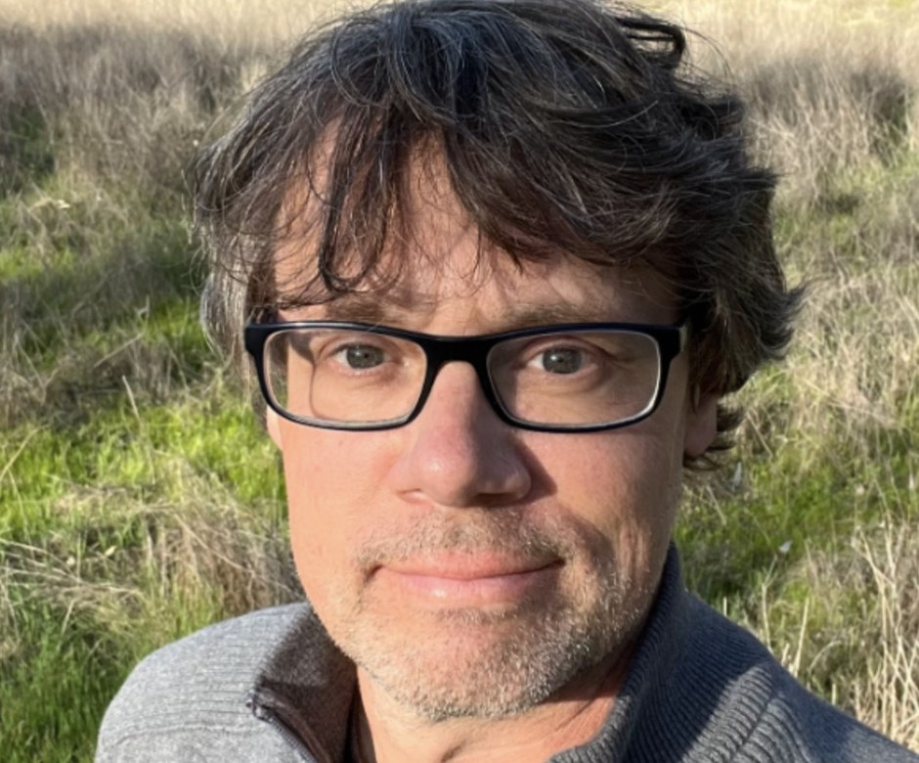


Meet our mentors
Wesley Sanders
AP Mentor
Notes:
Photo: assets/mentors-teachers-day/wes-sander.jpg (headshot outdoors). No photo of Wes at his microscope and no soil comparison video of his in assets/video/, so no still was used [PHOTO NEEDED: Wes at his microscope]. Name as given in the brief; the website and earlier posts spell it 'Wes Sander' [VERIFY]. Stickers are drawn shapes.

