Slide 1
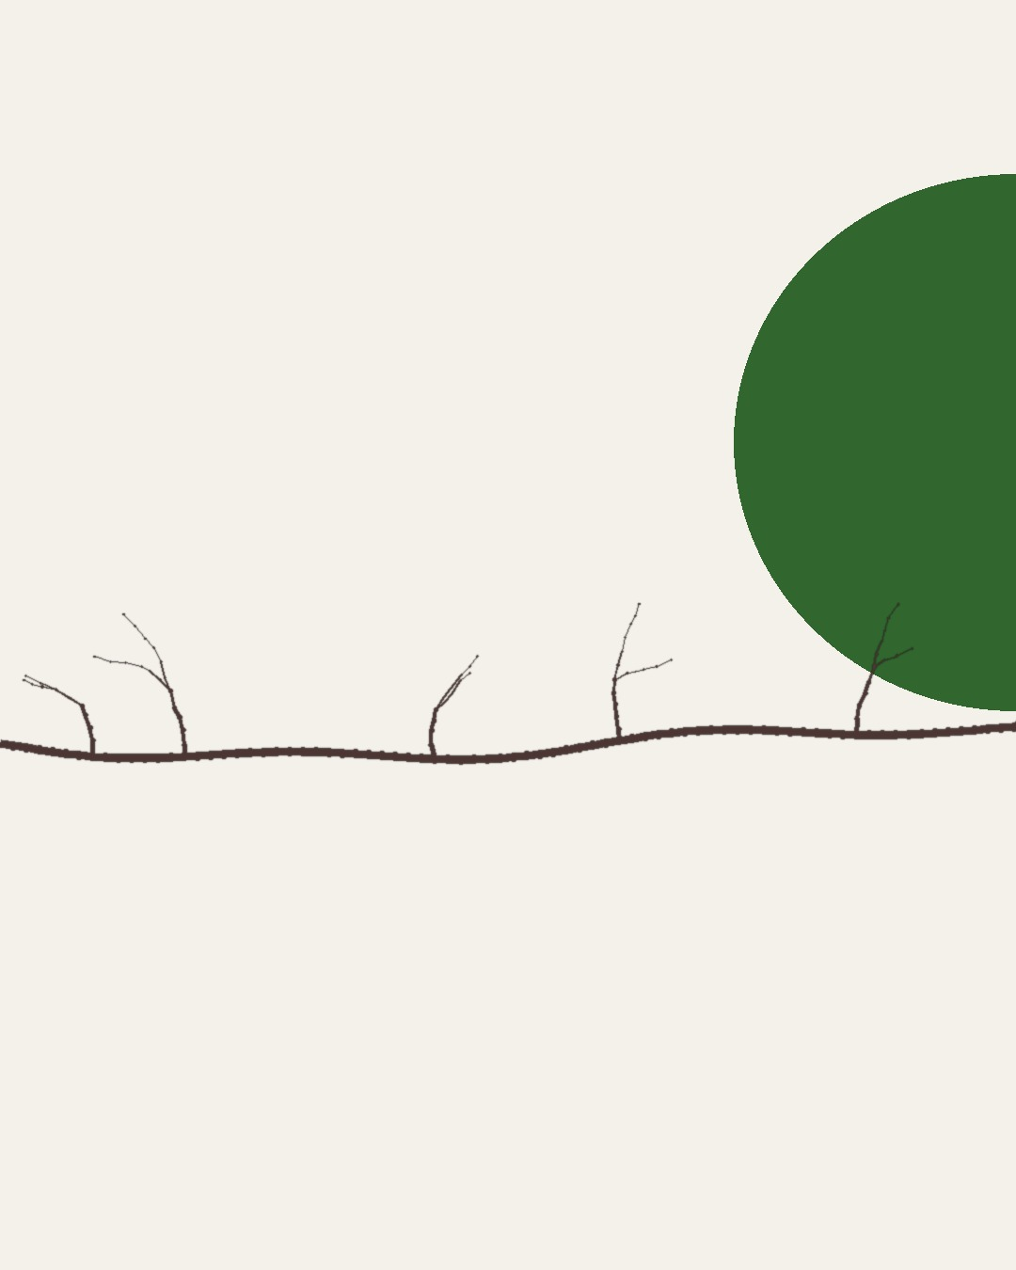

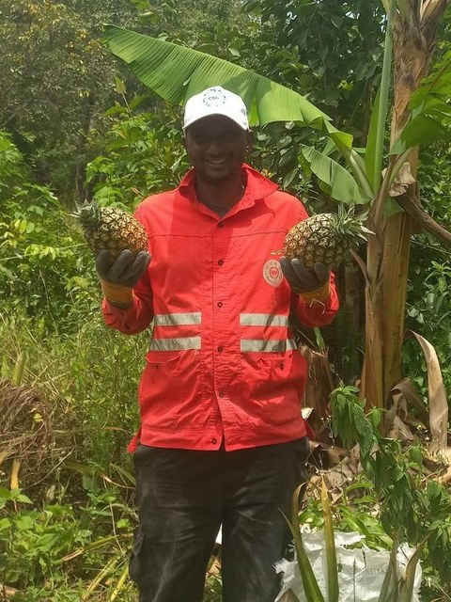
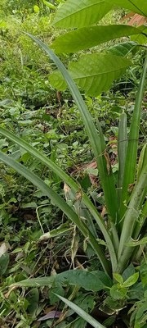
HAPPY INTERNATIONAL COFFEE DAY
Boubacar Tidiane Diallo
Guinea-Conakry
Graduated from the Soil Food Web School in July 2026
Notes:
Bridges seamless carousel (no fades): photos straddle the seams. Background assets/collage/boubacar-bridges/ (drawn by code, brand colours). Main photo: boubacar-portrait-bananas-closer.jpg. Bridge to next slide: young-tree-with-pineapples.jpg. Call to action: his YouTube channel (his Instagram @tidia.diallo.1 is private). Sources: Impact story sheet, Boubacar Tidiane Diallo: https://docs.google.com/spreadsheets/d/10UHLwzJLBQAsmJqmg4hiCQRjBKXPAx7UnOudU-Vsg5U/edit; Email from Boubacar to Allison, 30 September 2026; Instagram: https://www.instagram.com/tidia.diallo.1/; YouTube: https://www.youtube.com/@boubacartidianediallo; Facebook: https://www.facebook.com/btidja; Photos: sent by Boubacar to Stephanie on WhatsApp, 17 August 2026, and to Allison, September 2026. [TAG @Stephanie] Send Boubacar the final caption and slides to approve before posting, and confirm he studied on a scholarship.

Slide 2
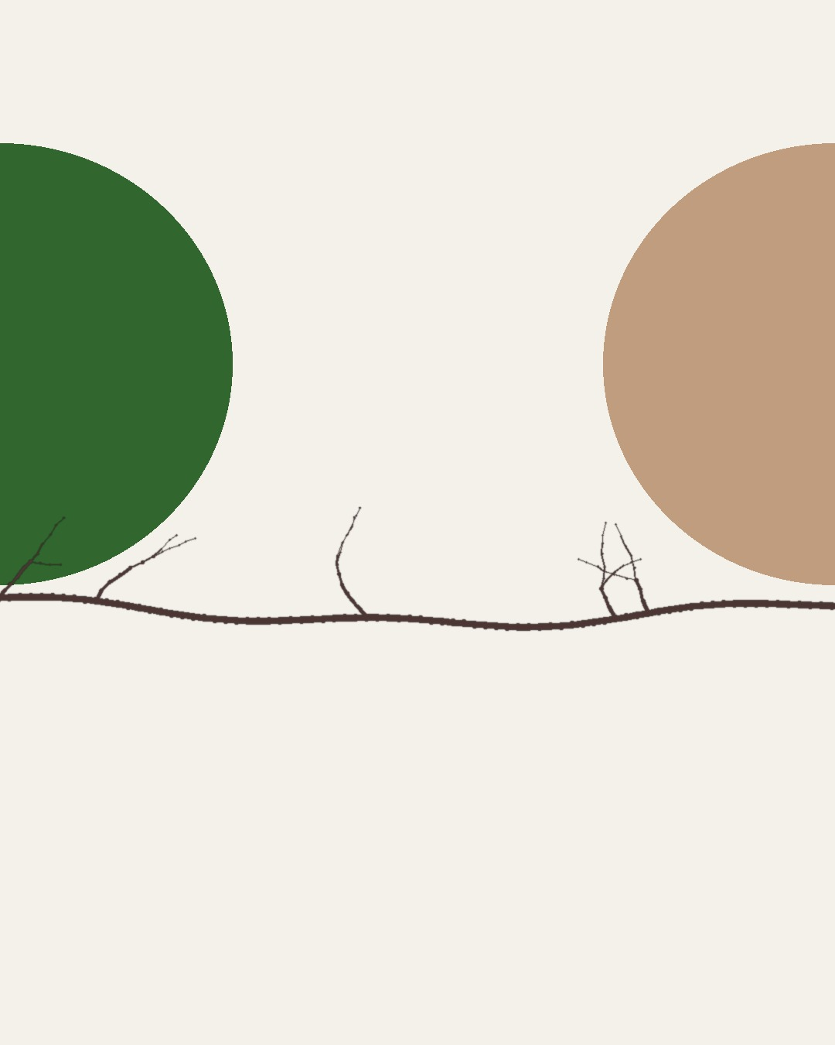
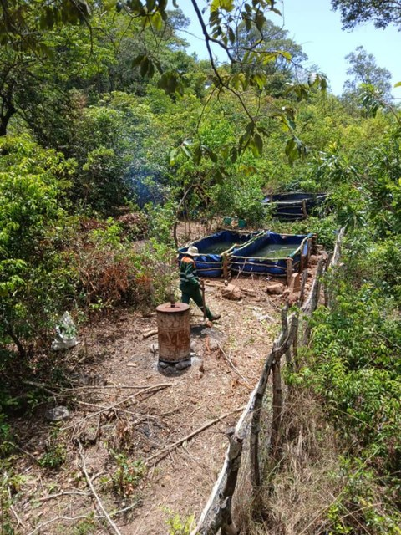
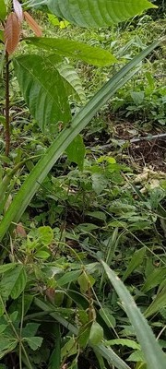
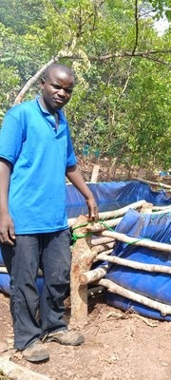
When he started, the land was worn out.
The soil at Gnaly Coffee & AgroÉcole Bio, in the Fouta Djallon highlands of Guinea-Conakry, had been degraded and poorly managed for years.
soilfoodweb.com
Notes:
Bridges seamless carousel (no fades): photos straddle the seams. Background assets/collage/boubacar-bridges/ (drawn by code, brand colours). Main photo: farm-overview-with-tanks.jpeg. Bridge to next slide: man-by-water-tanks.jpeg.

Slide 3

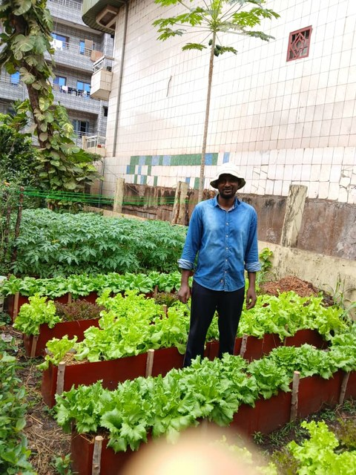
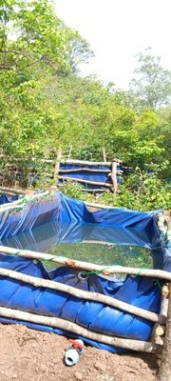
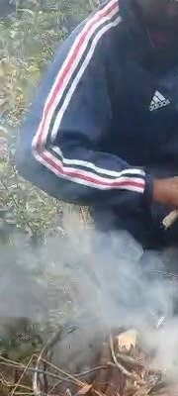
So he changed the question:
“Today, I ask a different question: What does the soil food web need to thrive?”
soilfoodweb.com
Notes:
Bridges seamless carousel (no fades): photos straddle the seams. Background assets/collage/boubacar-bridges/ (drawn by code, brand colours). Main photo: vegetable-beds-by-building.jpeg. Bridge to next slide: still-biochar-kiln-smoke-73s.png. His words from his email to Allison, 30 Sep 2026.

Slide 4

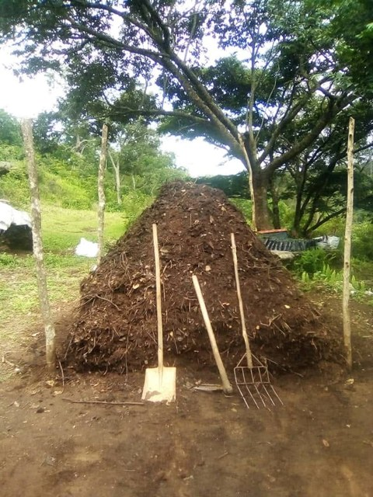
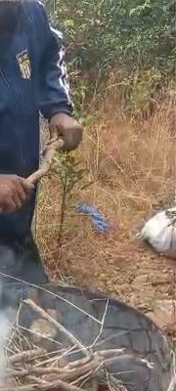
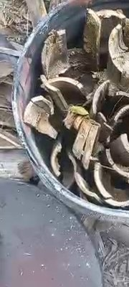
How he feeds his soil:
living groundcover, mulch from his farm and the forest, and compost with biochar activated with fish hydrolysate and compost tea.
soilfoodweb.com
Notes:
Bridges seamless carousel (no fades): photos straddle the seams. Background assets/collage/boubacar-bridges/ (drawn by code, brand colours). Main photo: boubacar-compost-pile.jpeg. Bridge to next slide: still-biochar-charcoal-16s.png.

Slide 5
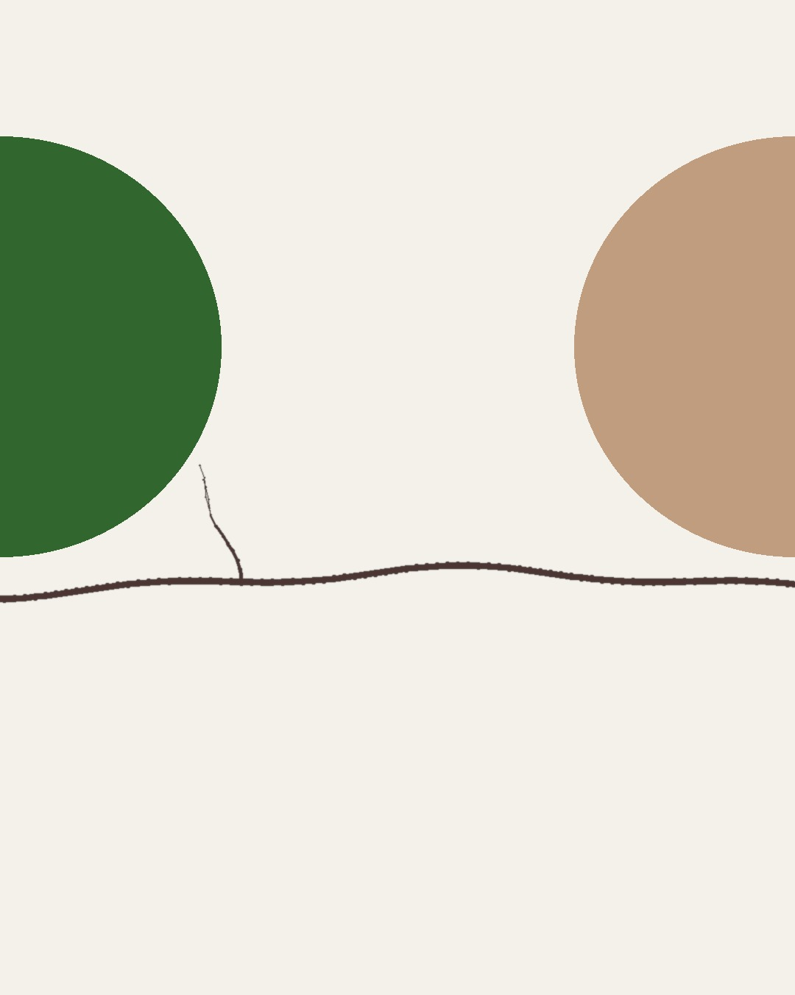
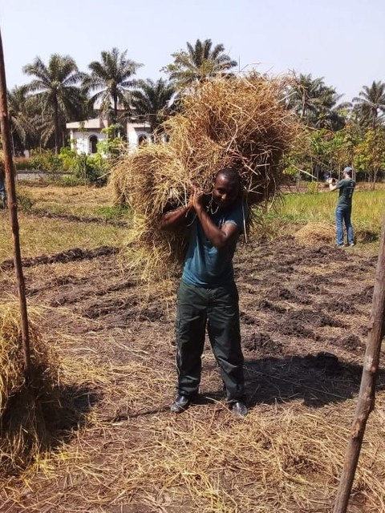
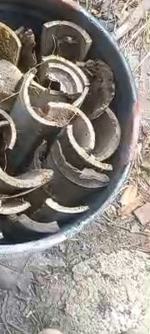
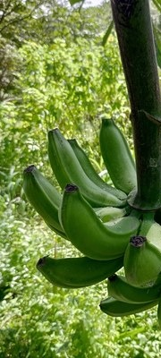
“I apply compost regularly around young trees and whenever I add new mulch.”
soilfoodweb.com
Notes:
Bridges seamless carousel (no fades): photos straddle the seams. Background assets/collage/boubacar-bridges/ (drawn by code, brand colours). Main photo: carrying-mulch.jpg. Bridge to next slide: banana-bunch.jpg. His words from his email to Allison, 30 Sep 2026.

Slide 6

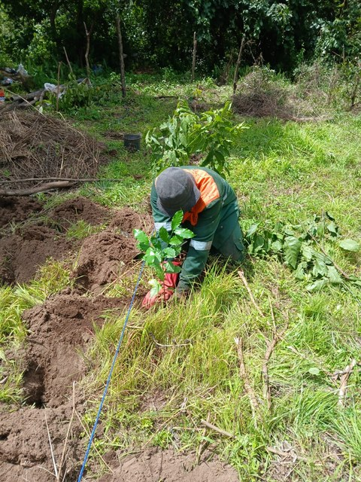
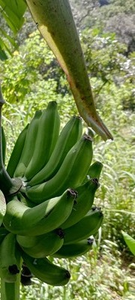
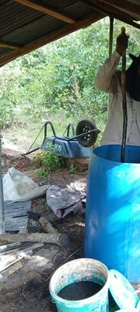
What he grows together:
coffee, cacao, bananas, citrus, and pineapple.
soilfoodweb.com
Notes:
Bridges seamless carousel (no fades): photos straddle the seams. Background assets/collage/boubacar-bridges/ (drawn by code, brand colours). Main photo: planting-seedling-in-agroforest.jpeg. Bridge to next slide: barrel-brew-under-shelter.jpeg.

Slide 7

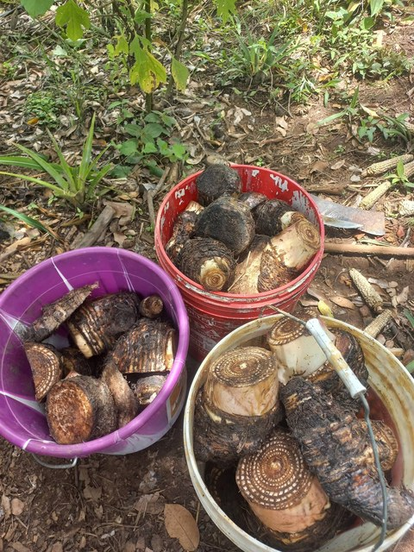
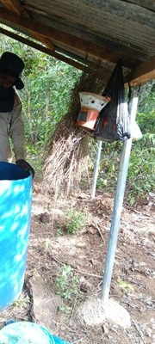
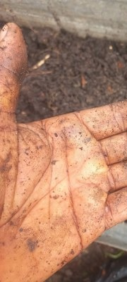
“My compost includes plant residues, animal manure when available, biochar activated with fish hydrolysate and compost tea, and local organic materials.”
soilfoodweb.com
Notes:
Bridges seamless carousel (no fades): photos straddle the seams. Background assets/collage/boubacar-bridges/ (drawn by code, brand colours). Main photo: buckets-of-tubers.jpg. Bridge to next slide: boubacar-hand-compost-worm.jpg. His words from his email to Allison, 30 Sep 2026.

Slide 8

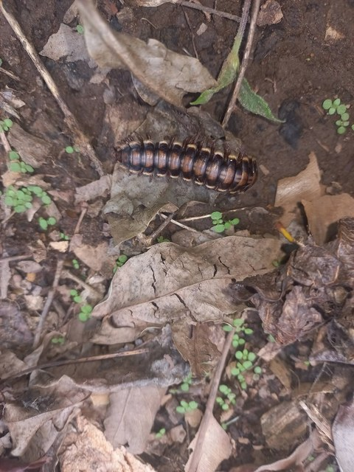
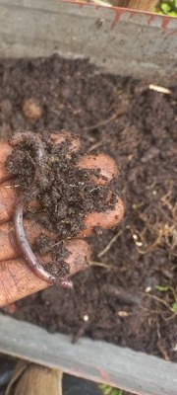
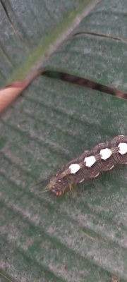
What he's seeing:
more earthworms, more mushrooms, active decomposition, and better soil structure.
soilfoodweb.com
Notes:
Bridges seamless carousel (no fades): photos straddle the seams. Background assets/collage/boubacar-bridges/ (drawn by code, brand colours). Main photo: millipede-leaf-litter.jpg. Bridge to next slide: caterpillar-on-leaf.jpg.

Slide 9

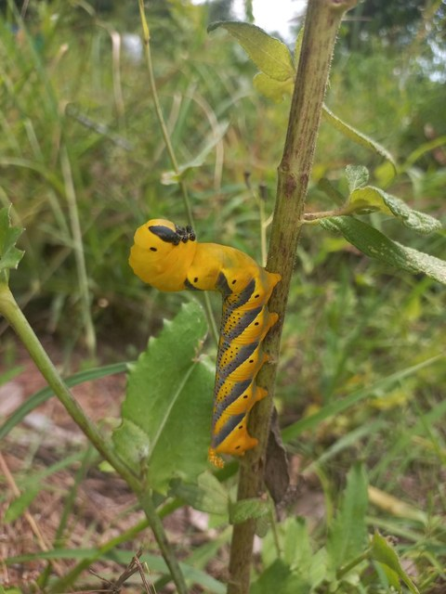
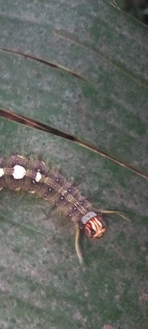
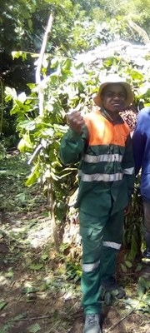
“I can already see signs of healthier soil in the field, including more earthworms, mushrooms, and active decomposition.”
soilfoodweb.com
Notes:
Bridges seamless carousel (no fades): photos straddle the seams. Background assets/collage/boubacar-bridges/ (drawn by code, brand colours). Main photo: yellow-caterpillar-on-stem.jpg. Bridge to next slide: two-men-at-shade-house.jpeg. His words from his email to Allison, 30 Sep 2026.

Slide 10

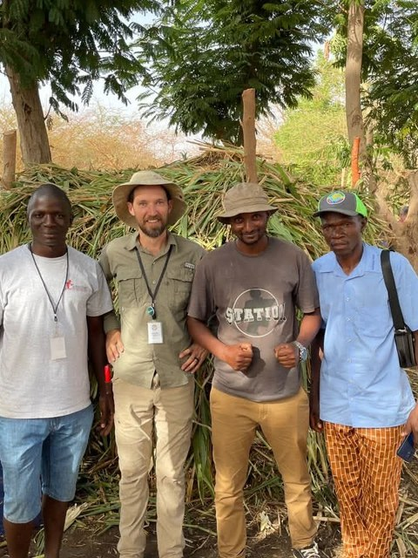
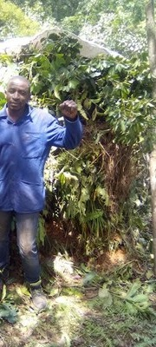
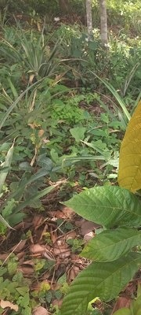
“Your training changed the way I see agriculture. I now believe that agriculture is biology, not chemical fertilizer.”
soilfoodweb.com
Notes:
Bridges seamless carousel (no fades): photos straddle the seams. Background assets/collage/boubacar-bridges/ (drawn by code, brand colours). Main photo: group-of-five-farmers.jpeg. Bridge to next slide: young-tree-yellow-new-leaves.jpg. His words from his email to Allison, 30 Sep 2026.

Slide 11
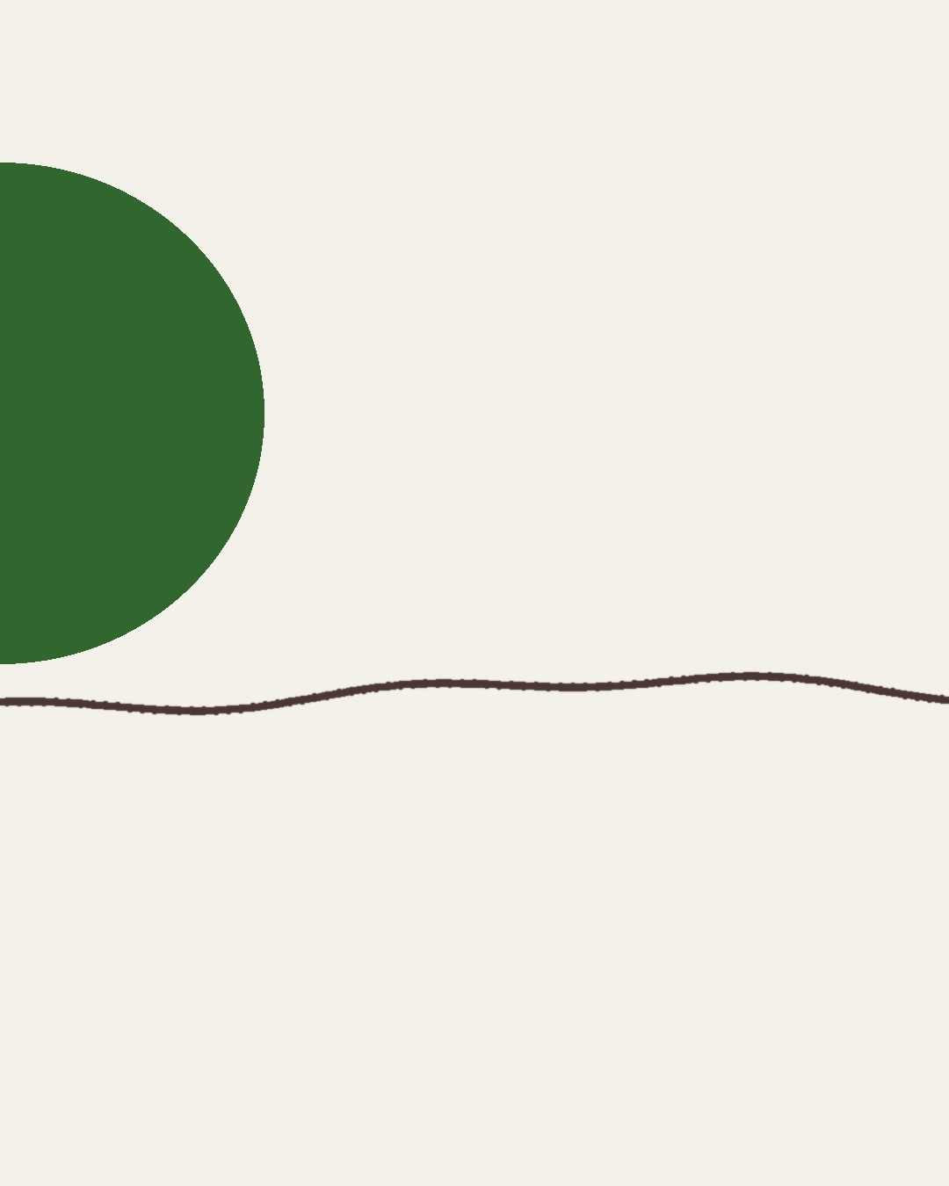
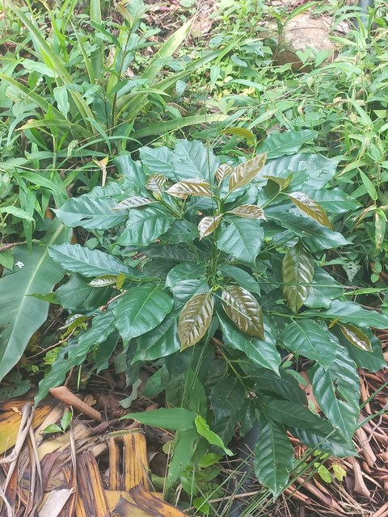
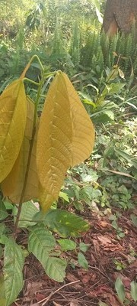
“My dream is to restore degraded land in the Fouta Djallon and help my community learn living-soil practices.”
Subscribe on YouTube: @boubacartidianediallo
Notes:
Bridges seamless carousel (no fades): photos straddle the seams. Background assets/collage/boubacar-bridges/ (drawn by code, brand colours). Main photo: young-coffee-plant.jpg. His words from his email to Allison, 30 Sep 2026.

