Slide 1
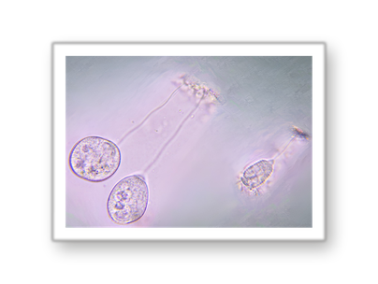
Save this
[COPY: Allison] [Number] things to check before [task]
[COPY: Allison] Who this is for, and when.
@soilfoodwebschool
Notes:
POST: Fri 9 Oct 2026 | Numbered checklist
Cover. Fill [Number] and [task] in the headline. Keep the Save this label.

Slide 2
1 OF 5
1
[COPY: Allison] Item 1: one action.
ICON
@soilfoodwebschool
Notes:
POST: Fri 9 Oct 2026 | Numbered checklist
Item 1. One line. If a biological reason exists, say it. Keep to what the source supports.

Slide 3
2 OF 5
2
[COPY: Allison] Item 2: one action.
ICON
@soilfoodwebschool
Notes:
POST: Fri 9 Oct 2026 | Numbered checklist
Item 2. One line. If a biological reason exists, say it. Keep to what the source supports.

Slide 4
3 OF 5
3
[COPY: Allison] Item 3: one action.
ICON
@soilfoodwebschool
Notes:
POST: Fri 9 Oct 2026 | Numbered checklist
Item 3. One line. If a biological reason exists, say it. Keep to what the source supports.

Slide 5
4 OF 5
4
[COPY: Allison] Item 4: one action.
ICON
@soilfoodwebschool
Notes:
POST: Fri 9 Oct 2026 | Numbered checklist
Item 4. One line. If a biological reason exists, say it. Keep to what the source supports.

Slide 6
5 OF 5
5
[COPY: Allison] Item 5: one action.
ICON
@soilfoodwebschool
Notes:
POST: Fri 9 Oct 2026 | Numbered checklist
Item 5. One line. If a biological reason exists, say it. Keep to what the source supports.

Slide 7
QUICK REFERENCE
[COPY: Allison] [Number] things to check before [task]
[COPY: Allison] Item 1
1
[COPY: Allison] Item 2
2
[COPY: Allison] Item 3
3
[COPY: Allison] Item 4
4
[COPY: Allison] Item 5
5
@soilfoodwebschool
Notes:
POST: Fri 9 Oct 2026 | Numbered checklist
Quick reference. Same five items, shortened to fit. Keep it screenshot-friendly.

