Slide 1


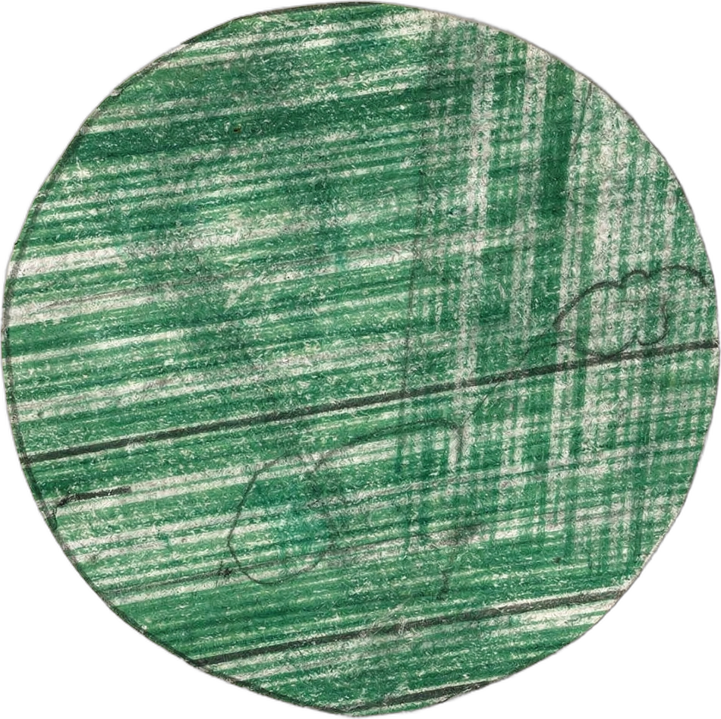

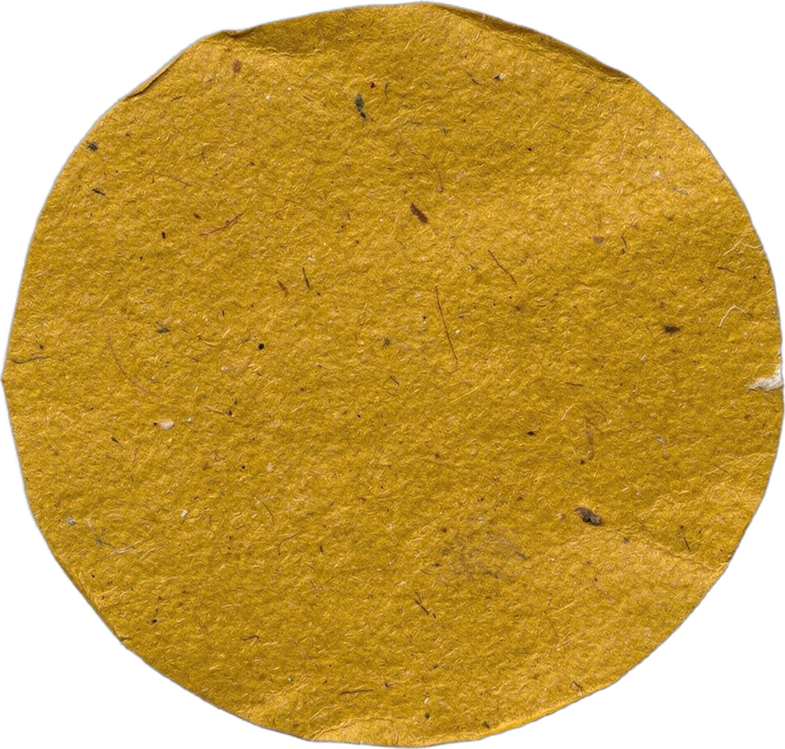


1/10
WORLD ANIMAL DAY
Whose poop goes in your compost?
Happy World Animal Day, aka Animal Poop Day. 💩
LOGO
Notes:
Cover. Sunday, October 4. World Animal Day: Whose poop goes in the compost? CTA: none. Link: none. Idea: Stina (SLU). Source: Rynk et al., On-Farm Composting Handbook (NRAES-54), 1992; US EPA 40 CFR Part 503; CDC, Toxocariasis and Toxoplasmosis fact sheets [VERIFY with Wes].

Slide 2
2/10
The rule: plant-eaters' manure is compost gold.
Meat-eaters' poop carries parasites that can infect people.
Easy and low risk
Hot compost it first
Keep it out of food compost
Notes:
The rule. Plant-eaters vs meat-eaters. Legend for the traffic-light dots. Source: Rynk et al., On-Farm Composting Handbook (NRAES-54), 1992; US EPA 40 CFR Part 503; CDC, Toxocariasis and Toxoplasmosis fact sheets [VERIFY with Wes].

Slide 3
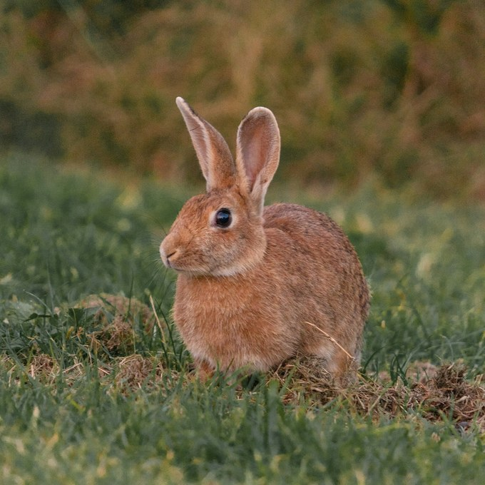
3/10
Photo: Adrian Pereira on Unsplash
Rabbit
EASY AND LOW RISK
Small dry pellets, rich in nitrogen, low odor. The easiest manure there is.
Notes:
Rabbit. Photo (rabbit): Adrian Pereira on Unsplash, https://unsplash.com/@adrianluisp10?utm_source=sfw_social&utm_medium=referral. Source: Rynk et al., On-Farm Composting Handbook (NRAES-54), 1992; US EPA 40 CFR Part 503; CDC, Toxocariasis and Toxoplasmosis fact sheets [VERIFY with Wes].

Slide 4
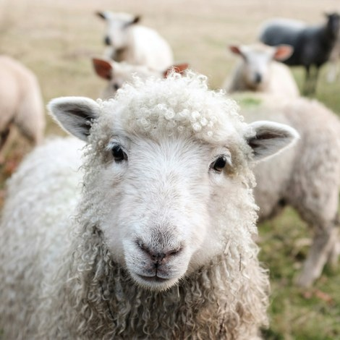
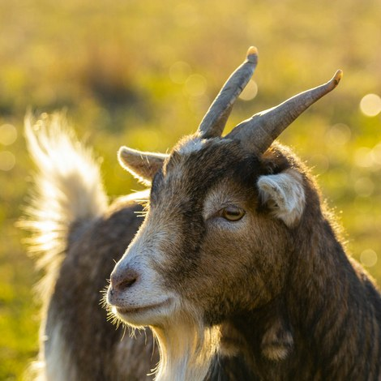
4/10
Photo: Sam Carter on Unsplash
Photo: Maxime Agnelli on Unsplash
Goat and sheep
EASY AND LOW RISK
Dry pellets, C:N around 16:1. Mix with bedding and compost.
Notes:
Goat and sheep. Photo (goat): Maxime Agnelli on Unsplash, https://unsplash.com/@maxa?utm_source=sfw_social&utm_medium=referral. Photo (sheep): Sam Carter on Unsplash, https://unsplash.com/@samdc?utm_source=sfw_social&utm_medium=referral. Source: Rynk et al., On-Farm Composting Handbook (NRAES-54), 1992; US EPA 40 CFR Part 503; CDC, Toxocariasis and Toxoplasmosis fact sheets [VERIFY with Wes].

Slide 5
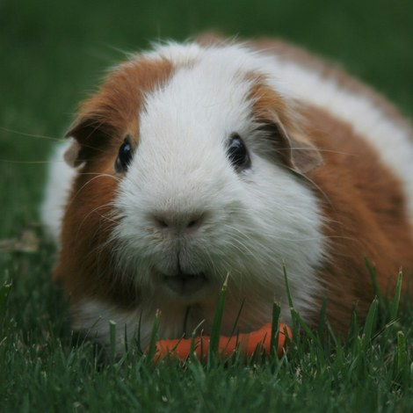
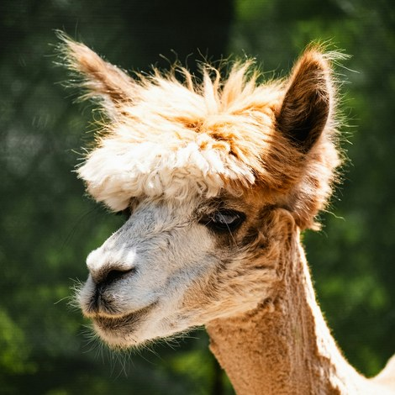
5/10
Photo: Jack Catalano on Unsplash
Photo: Maksim Samuilionak on Unsplash
Alpaca, llama and guinea pig
EASY AND LOW RISK
Low-odor pellets. Guinea pig bedding composts right along with them.
Notes:
Alpaca, llama and guinea pig. Photo (alpaca): Maksim Samuilionak on Unsplash, https://unsplash.com/@maksim_taawy?utm_source=sfw_social&utm_medium=referral. Photo (guinea-pig): Jack Catalano on Unsplash, https://unsplash.com/@jrcatalano?utm_source=sfw_social&utm_medium=referral. No llama photo; the alpaca stands in for alpaca and llama. Source: Rynk et al., On-Farm Composting Handbook (NRAES-54), 1992; US EPA 40 CFR Part 503; CDC, Toxocariasis and Toxoplasmosis fact sheets [VERIFY with Wes].

Slide 6
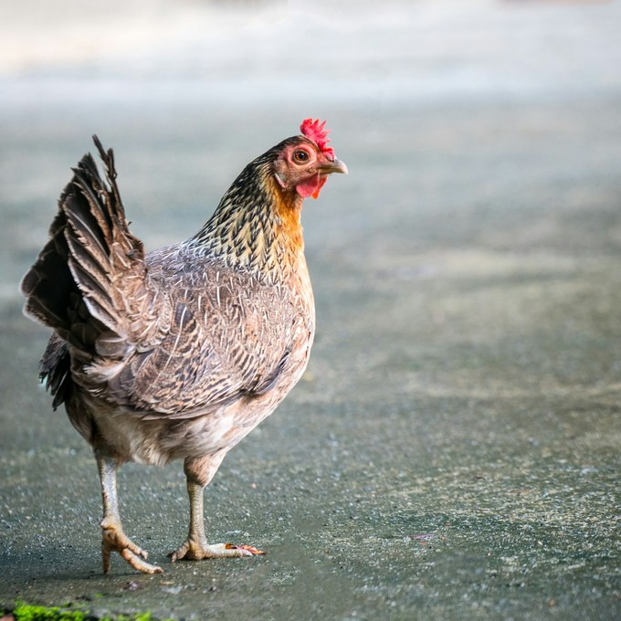
6/10
Photo: sippakorn yamkasikorn on Unsplash
Chicken
HOT COMPOST IT FIRST
The hottest manure: C:N around 7:1, very high in nitrogen. Add lots of woody carbon or ammonia escapes.
Notes:
Chicken. Photo (chicken): sippakorn yamkasikorn on Unsplash, https://unsplash.com/@sippakorn?utm_source=sfw_social&utm_medium=referral. Source: Rynk et al., On-Farm Composting Handbook (NRAES-54), 1992; US EPA 40 CFR Part 503; CDC, Toxocariasis and Toxoplasmosis fact sheets [VERIFY with Wes].

Slide 7
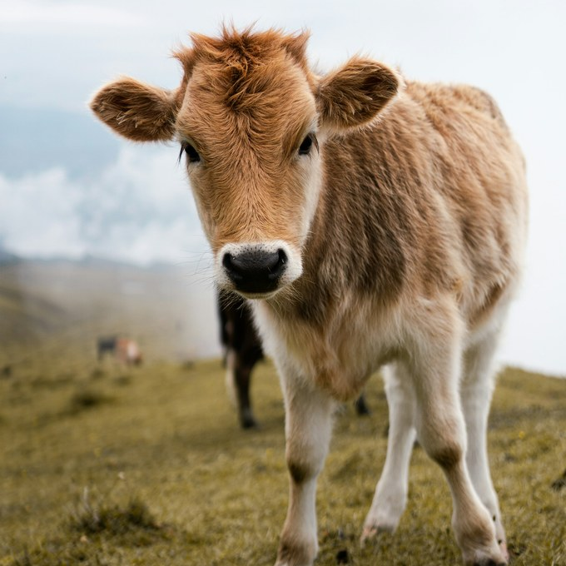
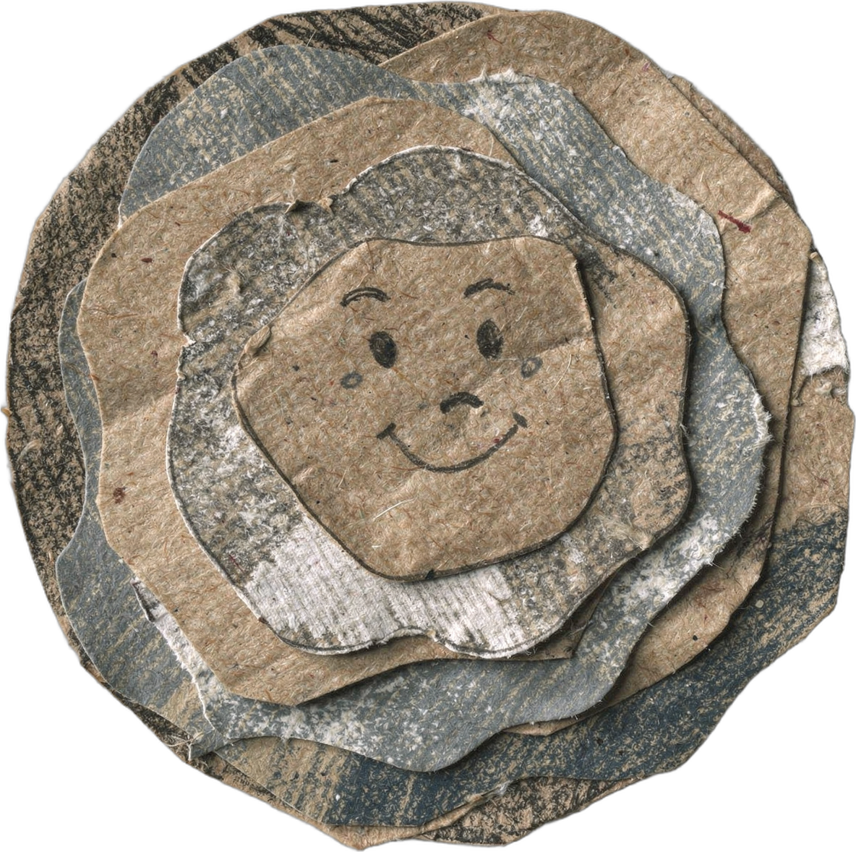
7/10
Photo: Diana Shchurova on Unsplash
Cow
HOT COMPOST IT FIRST
C:N around 19:1, very wet. Add woody material and let it breathe.
Notes:
Cow. Photo (cow): Diana Shchurova on Unsplash, https://unsplash.com/@ladydi1180?utm_source=sfw_social&utm_medium=referral. Source: Rynk et al., On-Farm Composting Handbook (NRAES-54), 1992; US EPA 40 CFR Part 503; CDC, Toxocariasis and Toxoplasmosis fact sheets [VERIFY with Wes].

Slide 8
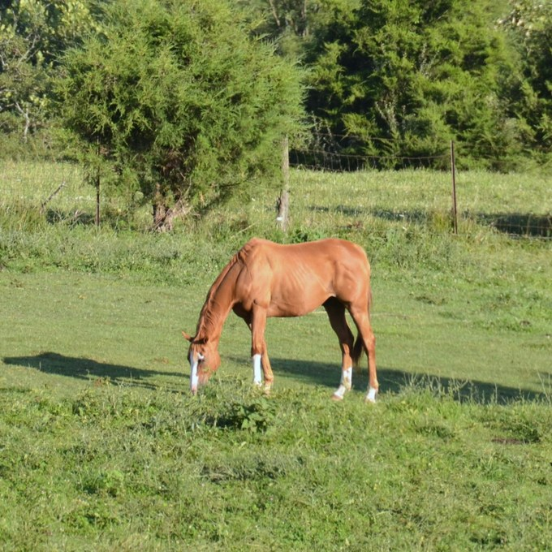
8/10
Photo: Roger Starnes Sr on Unsplash
Horse
HOT COMPOST IT FIRST
C:N around 25:1 with bedding, drier. Weed seeds survive unless the pile gets hot.
Notes:
Horse. Photo (horse): Roger Starnes Sr on Unsplash, https://unsplash.com/@rstar50?utm_source=sfw_social&utm_medium=referral. Source: Rynk et al., On-Farm Composting Handbook (NRAES-54), 1992; US EPA 40 CFR Part 503; CDC, Toxocariasis and Toxoplasmosis fact sheets [VERIFY with Wes].

Slide 9
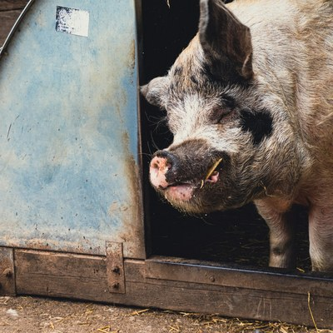
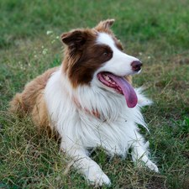
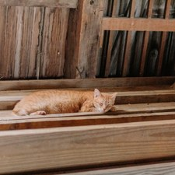
9/10
Pig
HOT COMPOST IT FIRST
C:N around 14:1. Pigs share parasites and bacteria with people, so the pile must reach 55°C.
Photo: Pauline Bernfeld on Unsplash
Dog and cat
KEEP IT OUT OF FOOD COMPOST
Dog poop can carry roundworm and cat poop can carry Toxoplasma. Keep both out of any compost for food.
Photo: iridial on Unsplash
Photo: Sean Foster on Unsplash
Notes:
Pig, then dog and cat. Photo (pig): Pauline Bernfeld on Unsplash, https://unsplash.com/@pizbern?utm_source=sfw_social&utm_medium=referral. Photo (dog): iridial on Unsplash, https://unsplash.com/@iridial_?utm_source=sfw_social&utm_medium=referral. Photo (cat): Sean Foster on Unsplash, https://unsplash.com/@fosterious?utm_source=sfw_social&utm_medium=referral. Source: Rynk et al., On-Farm Composting Handbook (NRAES-54), 1992; US EPA 40 CFR Part 503; CDC, Toxocariasis and Toxoplasmosis fact sheets [VERIFY with Wes].

Slide 10
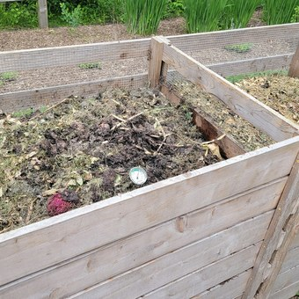
10/10
THE TAKEAWAY
Any 🟡 manure needs a thermal pile balanced to roughly 25 to 30:1 and held at 55 to 68°C before it goes near food crops.
Photo: Frank Thiemonge on Unsplash
LOGO
Sources: Rynk et al., On-Farm Composting Handbook (NRAES-54), 1992; US EPA 40 CFR Part 503; CDC fact sheets on toxocariasis and toxoplasmosis.
Notes:
Takeaway. Photo (compost-4): Frank Thiemonge on Unsplash, https://unsplash.com/@fthiemonge?utm_source=sfw_social&utm_medium=referral. Source: Rynk et al., On-Farm Composting Handbook (NRAES-54), 1992; US EPA 40 CFR Part 503; CDC, Toxocariasis and Toxoplasmosis fact sheets [VERIFY with Wes].

