Slide 1
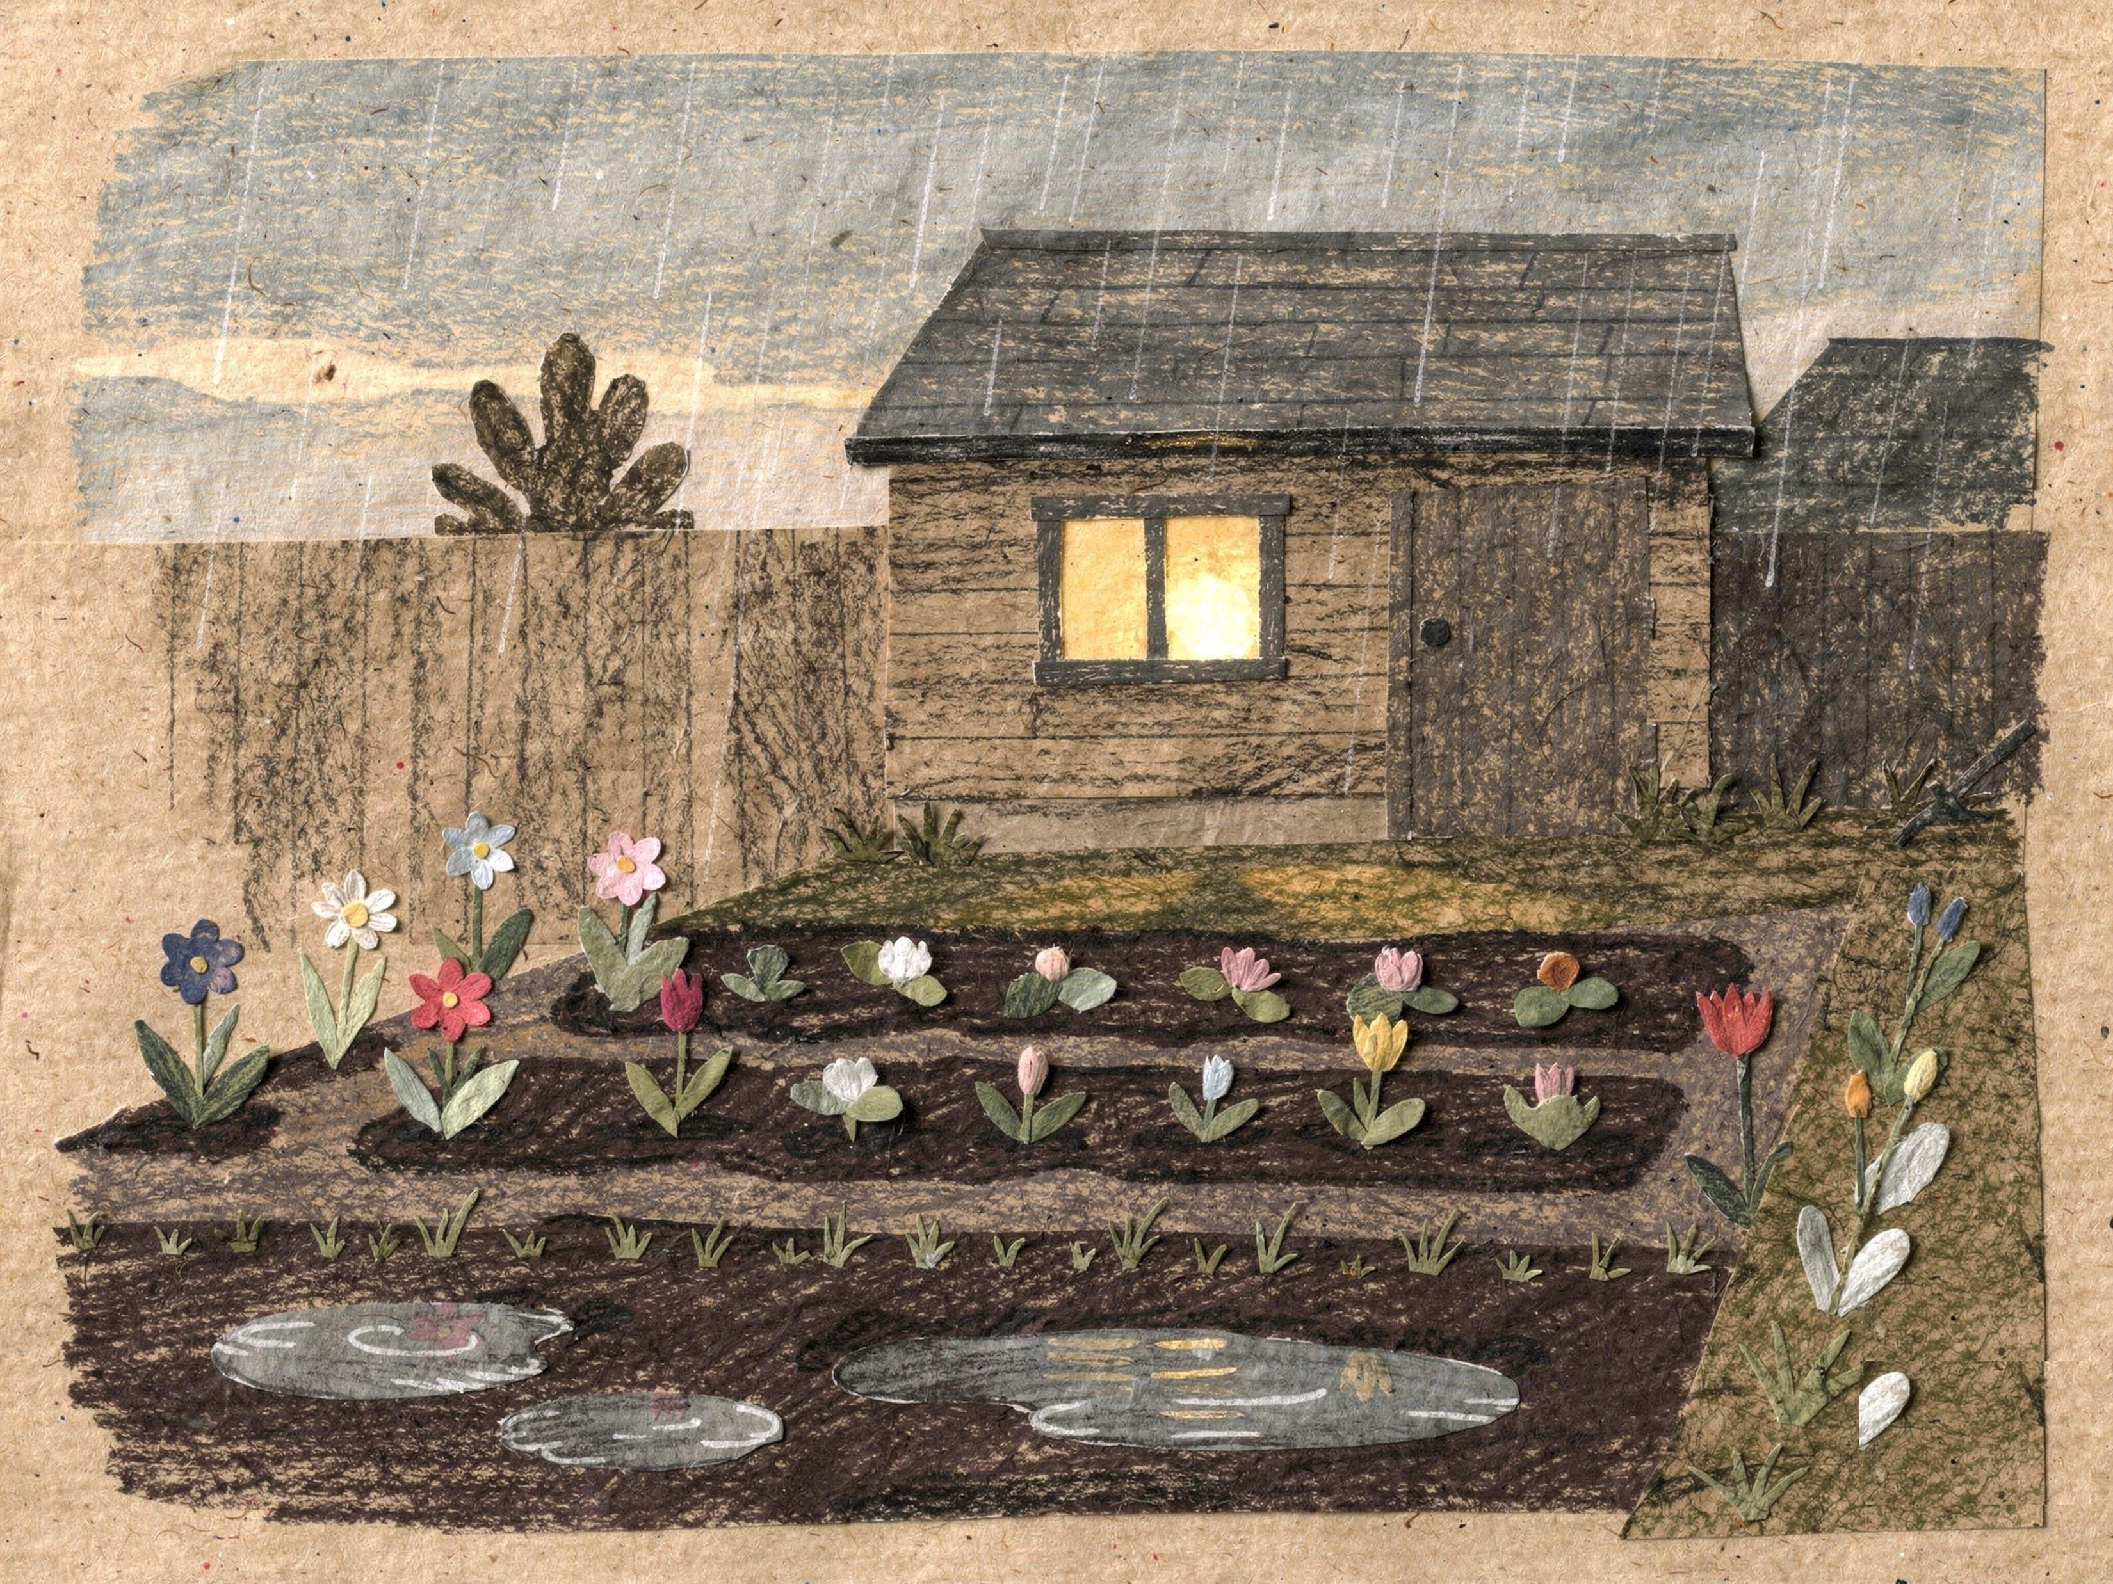

It had rained all afternoon.
1
Notes:
Page 1. The garden after rain, nobody in it yet. PRINT: 10 x 8 in landscape trim, 0.125 in bleed (page 10.25 x 8.25 in), text 0.5 in inside trim, 300 DPI art.

Slide 2
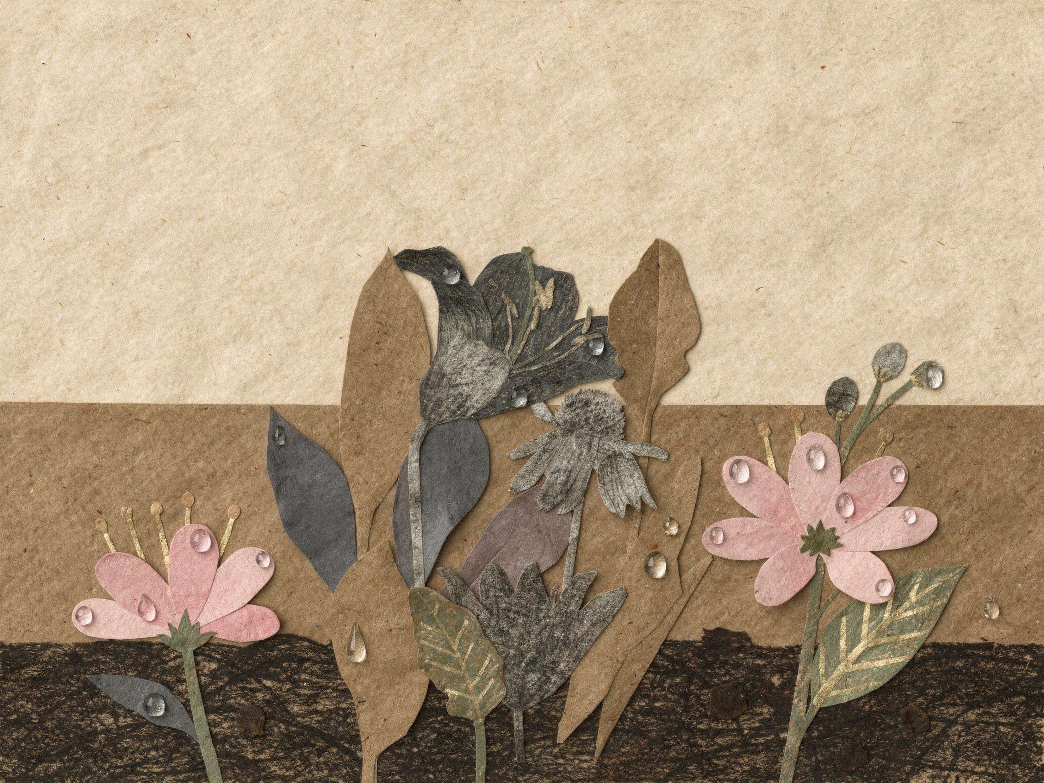
Everything was still dripping.
2
Notes:
Page 2. Close-up: the flowers, still dripping. PRINT: 10 x 8 in landscape trim, 0.125 in bleed (page 10.25 x 8.25 in), text 0.5 in inside trim, 300 DPI art.

Slide 3
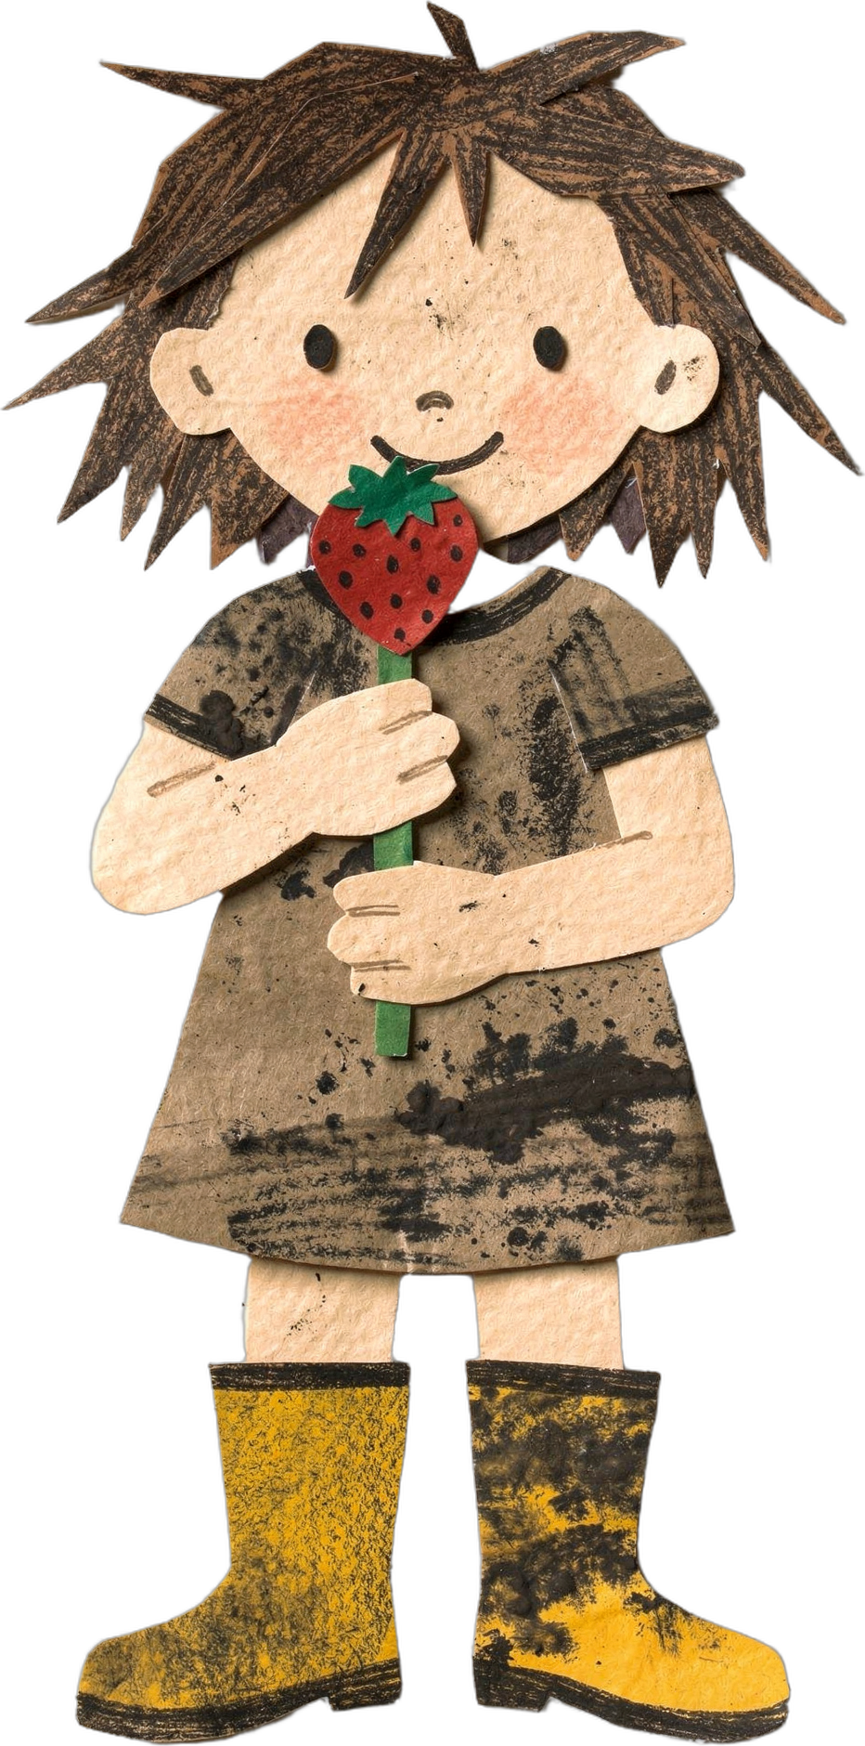
Rose had a strawberry lollipop.
3
Notes:
Page 3. Rose and her strawberry lollipop. PRINT: 10 x 8 in landscape trim, 0.125 in bleed (page 10.25 x 8.25 in), text 0.5 in inside trim, 300 DPI art.

Slide 4
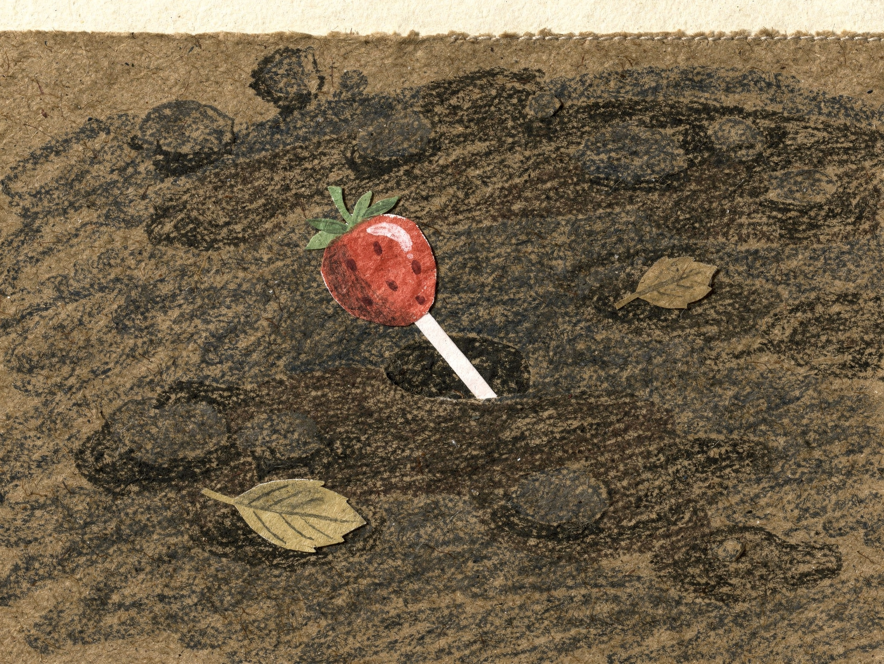

Plop.
4
Notes:
Page 4. Close-up: the lollipop has dropped into the soft soil. PRINT: 10 x 8 in landscape trim, 0.125 in bleed (page 10.25 x 8.25 in), text 0.5 in inside trim, 300 DPI art.

Slide 5
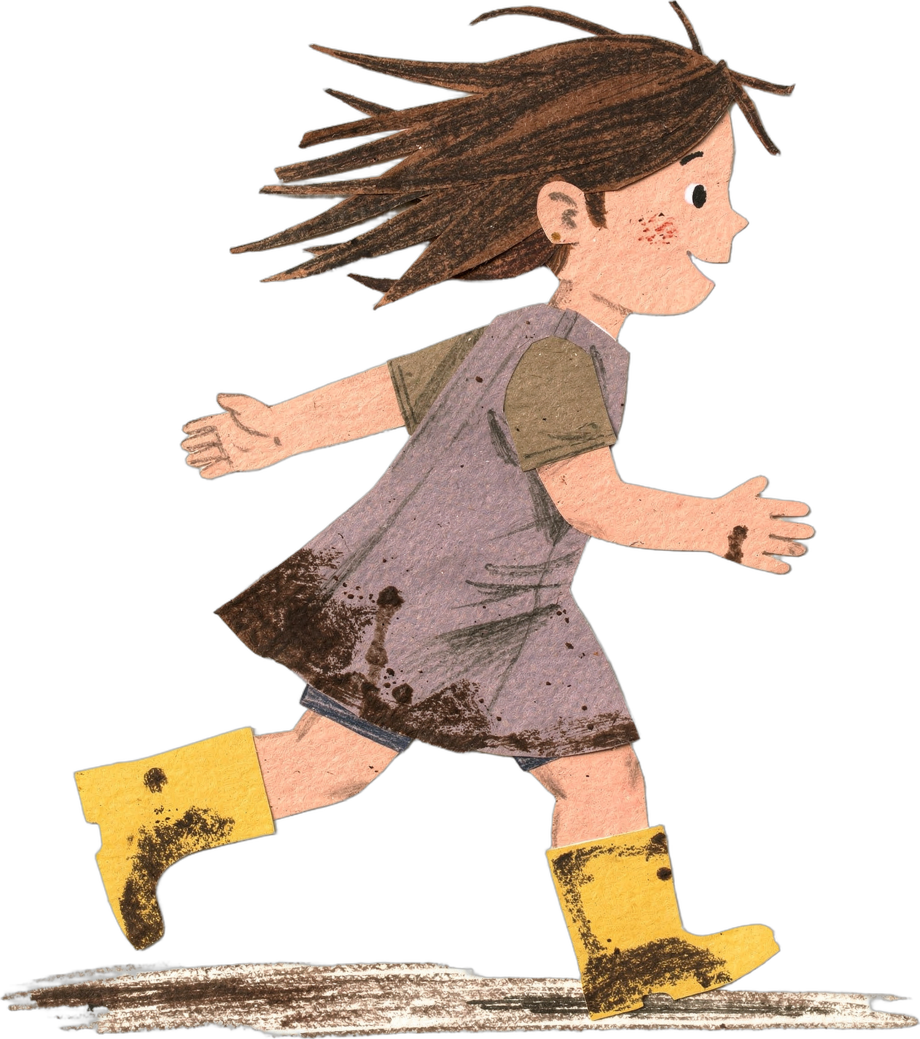
“Rose! Dinner!”
“Night night, dirt!”
5
Notes:
Page 5. Rose runs inside for dinner and says goodnight to the ground. PRINT: 10 x 8 in landscape trim, 0.125 in bleed (page 10.25 x 8.25 in), text 0.5 in inside trim, 300 DPI art.

Slide 6
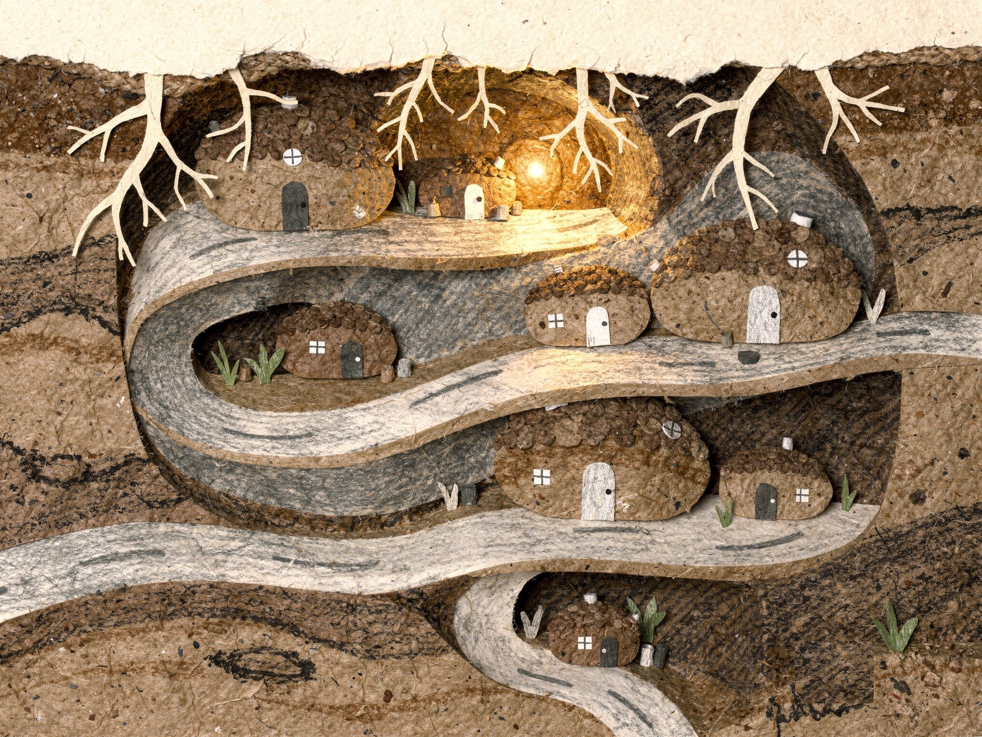
Down below, someone heard her.
6
Notes:
Page 6. Underground: the town under the garden, quiet. Someone heard her. PRINT: 10 x 8 in landscape trim, 0.125 in bleed (page 10.25 x 8.25 in), text 0.5 in inside trim, 300 DPI art.

