Slide 1

PHOTO: wet coffee grounds on soil
1/7
DID YOU KNOW
Coffee grounds make your soil acidic.
Mostly wrong. Here is the chemistry.
Notes:
2A. Cover: Glow strikethrough marks it as a myth.

Slide 2
1
2/7
Hot water pulls most of the acid into your cup. Used grounds are close to neutral.
Notes:
2B.

Slide 3
2
3/7
What stays in the grounds: nitrogen, plus leftover caffeine and tannins.
Notes:
2B.

Slide 4
3
4/7
Caffeine is the coffee plant's own pesticide. It protects young leaves from insects and snails.
Notes:
2B.

Slide 5
4
5/7
So fresh grounds spread on soil can slow seedlings down.
Notes:
2B.

Slide 6
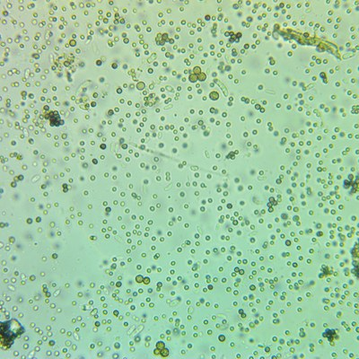
5
6/7
Compost flips it. Soil bacteria break down caffeine. One strain, found in a university flower bed, lives on caffeine alone.
Notes:
2B. Microscopy image: soil sample with bacterial rods (general).

Slide 7
7/7
Grounds go in the compost first, mixed with leaves or cardboard. Then onto the garden.
Save this
Send this
Notes:
2D.

