Slide 1
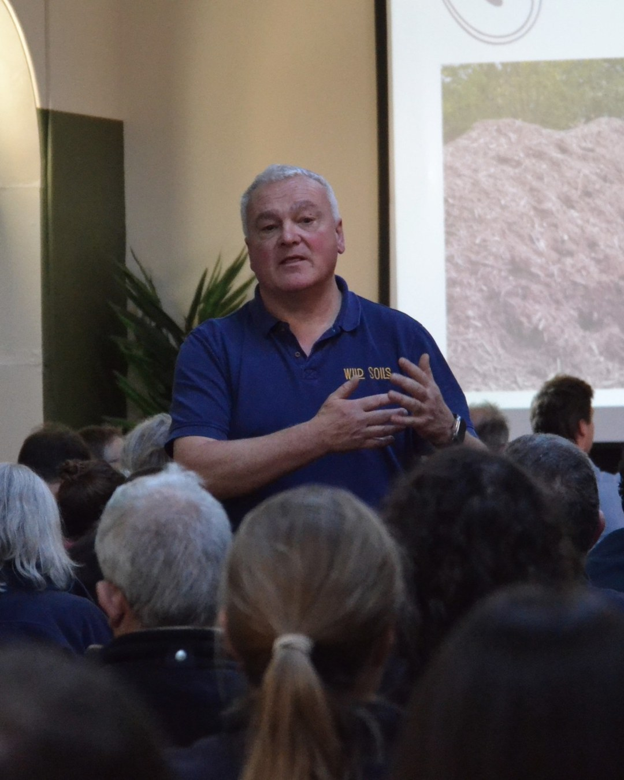

MEET OUR MENTORS
1/2
Nick Padwick
Norfolk, England
Notes:
4C. Photo: Nick speaking (brief asked for Nick with compost windrows: swap if you have it).

Slide 2
2/2
750
tons of compost a year
40 years of farming in the UK, Italy, Spain and Argentina.
Source: [COPY: Allison]
Notes:
5.

