Slide 1
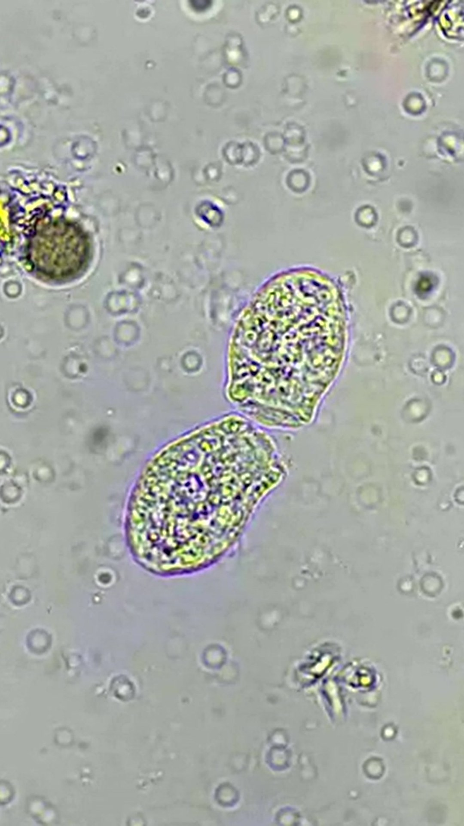
The biggest habitat on Earth is under your feet.
More than half of all species live in soil.
LOGO
Notes:
7. Leave y=1100 to 1450 empty for the poll sticker.

