Slide 1
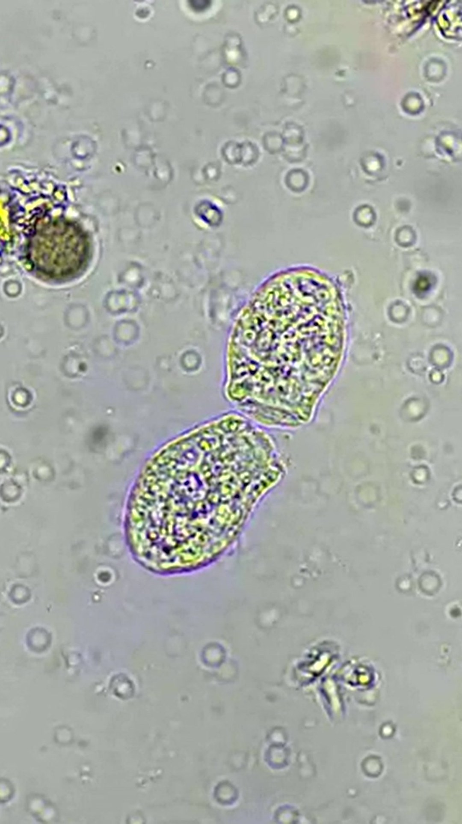
[COPY: Allison] Headline
[COPY: Allison] Line
LOGO
Notes:
7.

