Slide 1
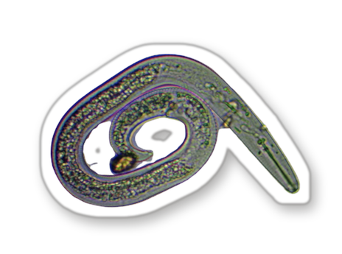
[COPY: Allison] DD Mon YYYY
Place, Region
FIELD NOTES
[COPY: Allison] Trial name, as the graduate titled it
[COPY: Allison] Place
Season and year
Notes:
POST: 12-10-2026 Mon | Field Notes
Cover. Place and season, e.g. 'Spring 2026'. Trial name from the graduate's report.

Slide 2
[COPY: Allison] DD Mon YYYY
Place, Region
THE QUESTION
[COPY: Allison] The question they tested.
Notes:
POST: 12-10-2026 Mon | Field Notes
Slide 2.

Slide 3
[COPY: Allison] DD Mon YYYY
Place, Region
THE METHOD
1
[COPY: Allison] Line 1: the plots.
2
[COPY: Allison] Line 2: the control.
3
[COPY: Allison] Line 3: what was measured.
Notes:
POST: 12-10-2026 Mon | Field Notes
Slide 4 in series: the method. Name the control plot every time.

Slide 4
[COPY: Allison] DD Mon YYYY
Place, Region
THE RESULT
[COPY: Allison] Big number
[Big number]
[COPY: Allison] What it measures, against what.
Control
Trial
[COPY: Allison] Source: who, where, year.
Notes:
POST: 12-10-2026 Mon | Field Notes
The result. One measure, bars from zero, units stated. Report and year in the source line.

Slide 5
[COPY: Allison] DD Mon YYYY
Place, Region
THE SURPRISE
[COPY: Allison] What surprised them, including what disappointed.
Notes:
POST: 12-10-2026 Mon | Field Notes
Series promise: we publish what the trial found, including when results disappoint.

Slide 6
[COPY: Allison] DD Mon YYYY
Place, Region
WHO RAN IT
[PHOTO: Small portrait]
[COPY: Allison] Graduate name
Place
[COPY: Allison] Their ground, their crop, their years.
@soilfoodwebschool
Notes:
POST: 12-10-2026 Mon | Field Notes
Who ran it. Portrait needs written consent.

