Slide 1
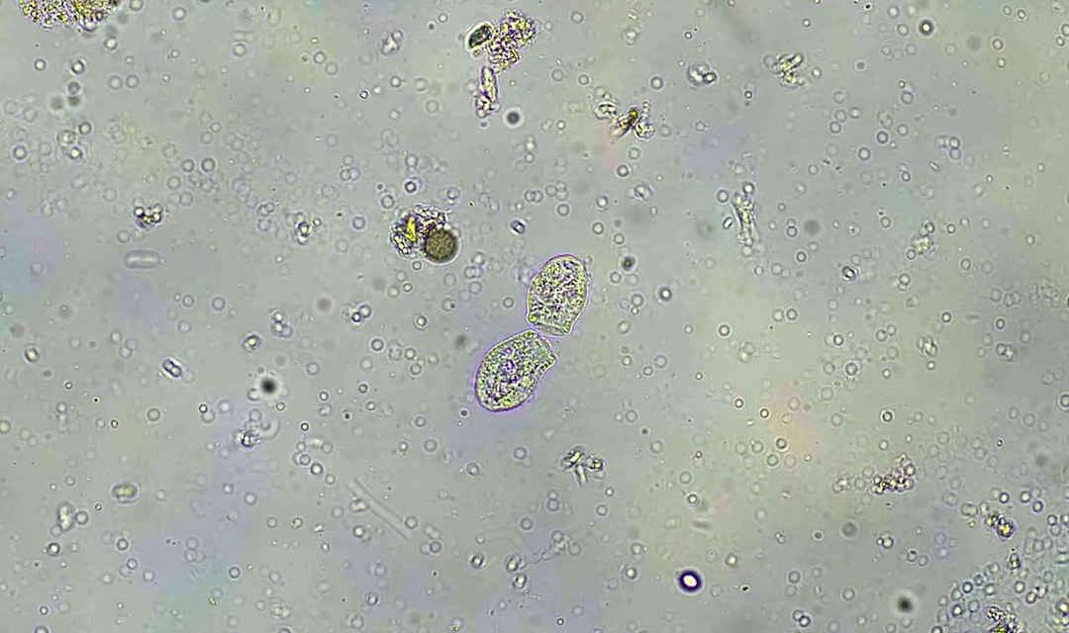
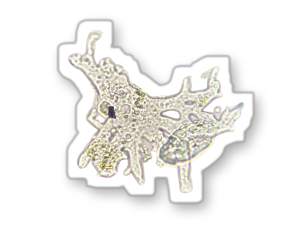
DID YOU KNOW
[COPY: Allison] One surprising fact. Name the organism.
Swipe for the mechanism
Notes:
POST: 16-10-2026 Fri | Did you know #2
Cover. Photo: assets/microscopy/sfw-amoeba-still-wide.jpg (still from the amoeba microscopy loop). Swap to match the fact. Fact must have a named source before posting.

Slide 2
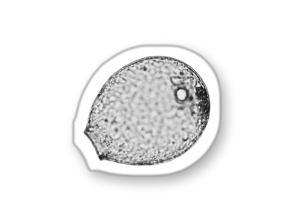
STEP 1
[DIAGRAM: mechanism, step 1]
Label parts in plain words.
[COPY: Allison] Step one, one line.
[COPY: Allison] Source: who, where, year.
@soilfoodwebschool
Notes:
POST: 16-10-2026 Fri | Did you know #2
Mechanism STEP 1. One line only. Diagram: draw it, or use assets/illustration; label parts in plain words.

Slide 3
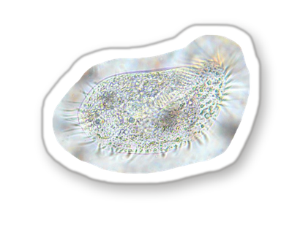
STEP 2
[DIAGRAM: mechanism, step 2]
Label parts in plain words.
[COPY: Allison] Step two, one line.
[COPY: Allison] Source: who, where, year.
@soilfoodwebschool
Notes:
POST: 16-10-2026 Fri | Did you know #2
Mechanism STEP 2. One line only. Diagram: draw it, or use assets/illustration; label parts in plain words.

Slide 4
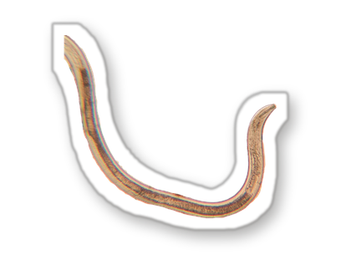
STEP 3
[DIAGRAM: mechanism, step 3]
Label parts in plain words.
[COPY: Allison] Step three, one line.
[COPY: Allison] Source: who, where, year.
@soilfoodwebschool
Notes:
POST: 16-10-2026 Fri | Did you know #2
Mechanism STEP 3. One line only. Diagram: draw it, or use assets/illustration; label parts in plain words.

Slide 5
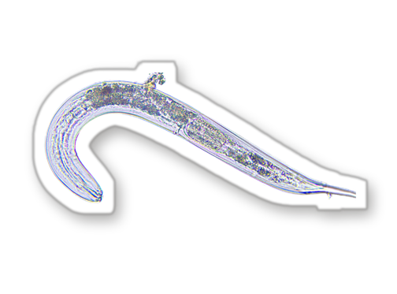
WHY THIS MATTERS FOR YOUR SOIL
[COPY: Allison] One line for their own soil.
[COPY: Allison] One call to action, or none.
@soilfoodwebschool
Notes:
POST: 16-10-2026 Fri | Did you know #2
Close. One line, tied to the reader's own ground.

