Slide 1
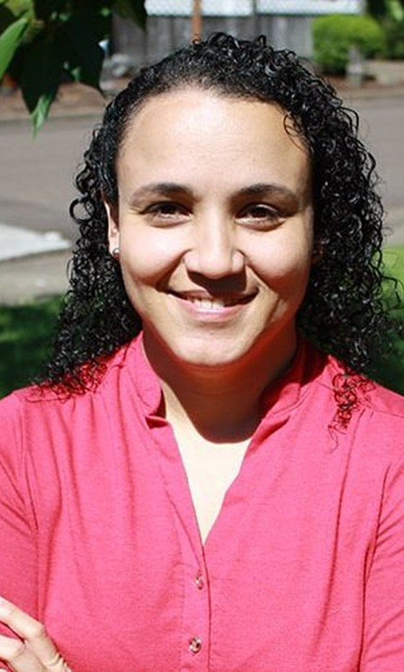

“
[COPY: Allison] Quote in Carla's own words.
Dr. Carla Portugal
Soil Food Web Mentor
Soil Food Web
@soilfoodwebschool
Notes:
Quote card. Photo is only 499 px wide, so it is soft at this size: swap for a larger cut-out photo. Quote must be Carla's own words.

