Slide 1
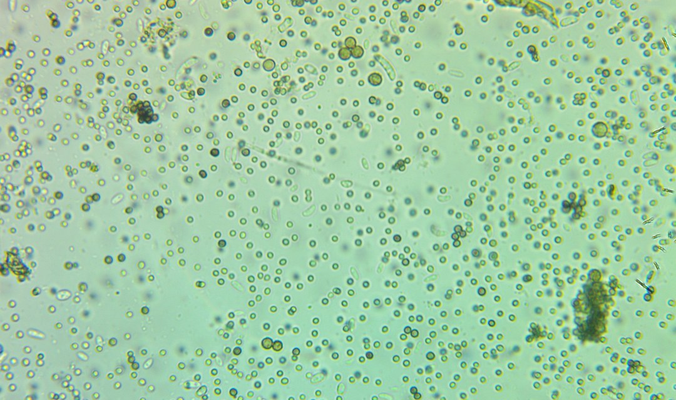

1/5
DID YOU KNOW
[COPY: Allison] Headline, four lines at most.
[COPY: Allison] Small line.
Notes:
2A.

Slide 2
1
2/5
[COPY: Allison] One step, five lines at most.
Notes:
2B.

Slide 3
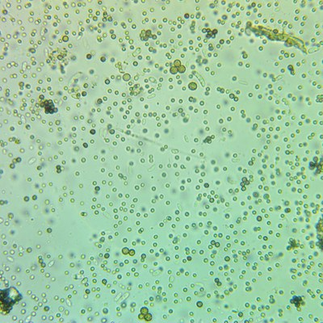
2
3/5
[COPY: Allison] One step with an image.
Notes:
2B.

Slide 4
4/5
?
[COPY: Allison] A question.
Notes:
2C.

Slide 5
5/5
[COPY: Allison] Takeaway line.
[COPY: Allison] Optional second line.
Save this
Send this
Notes:
2D.

