Slide 1

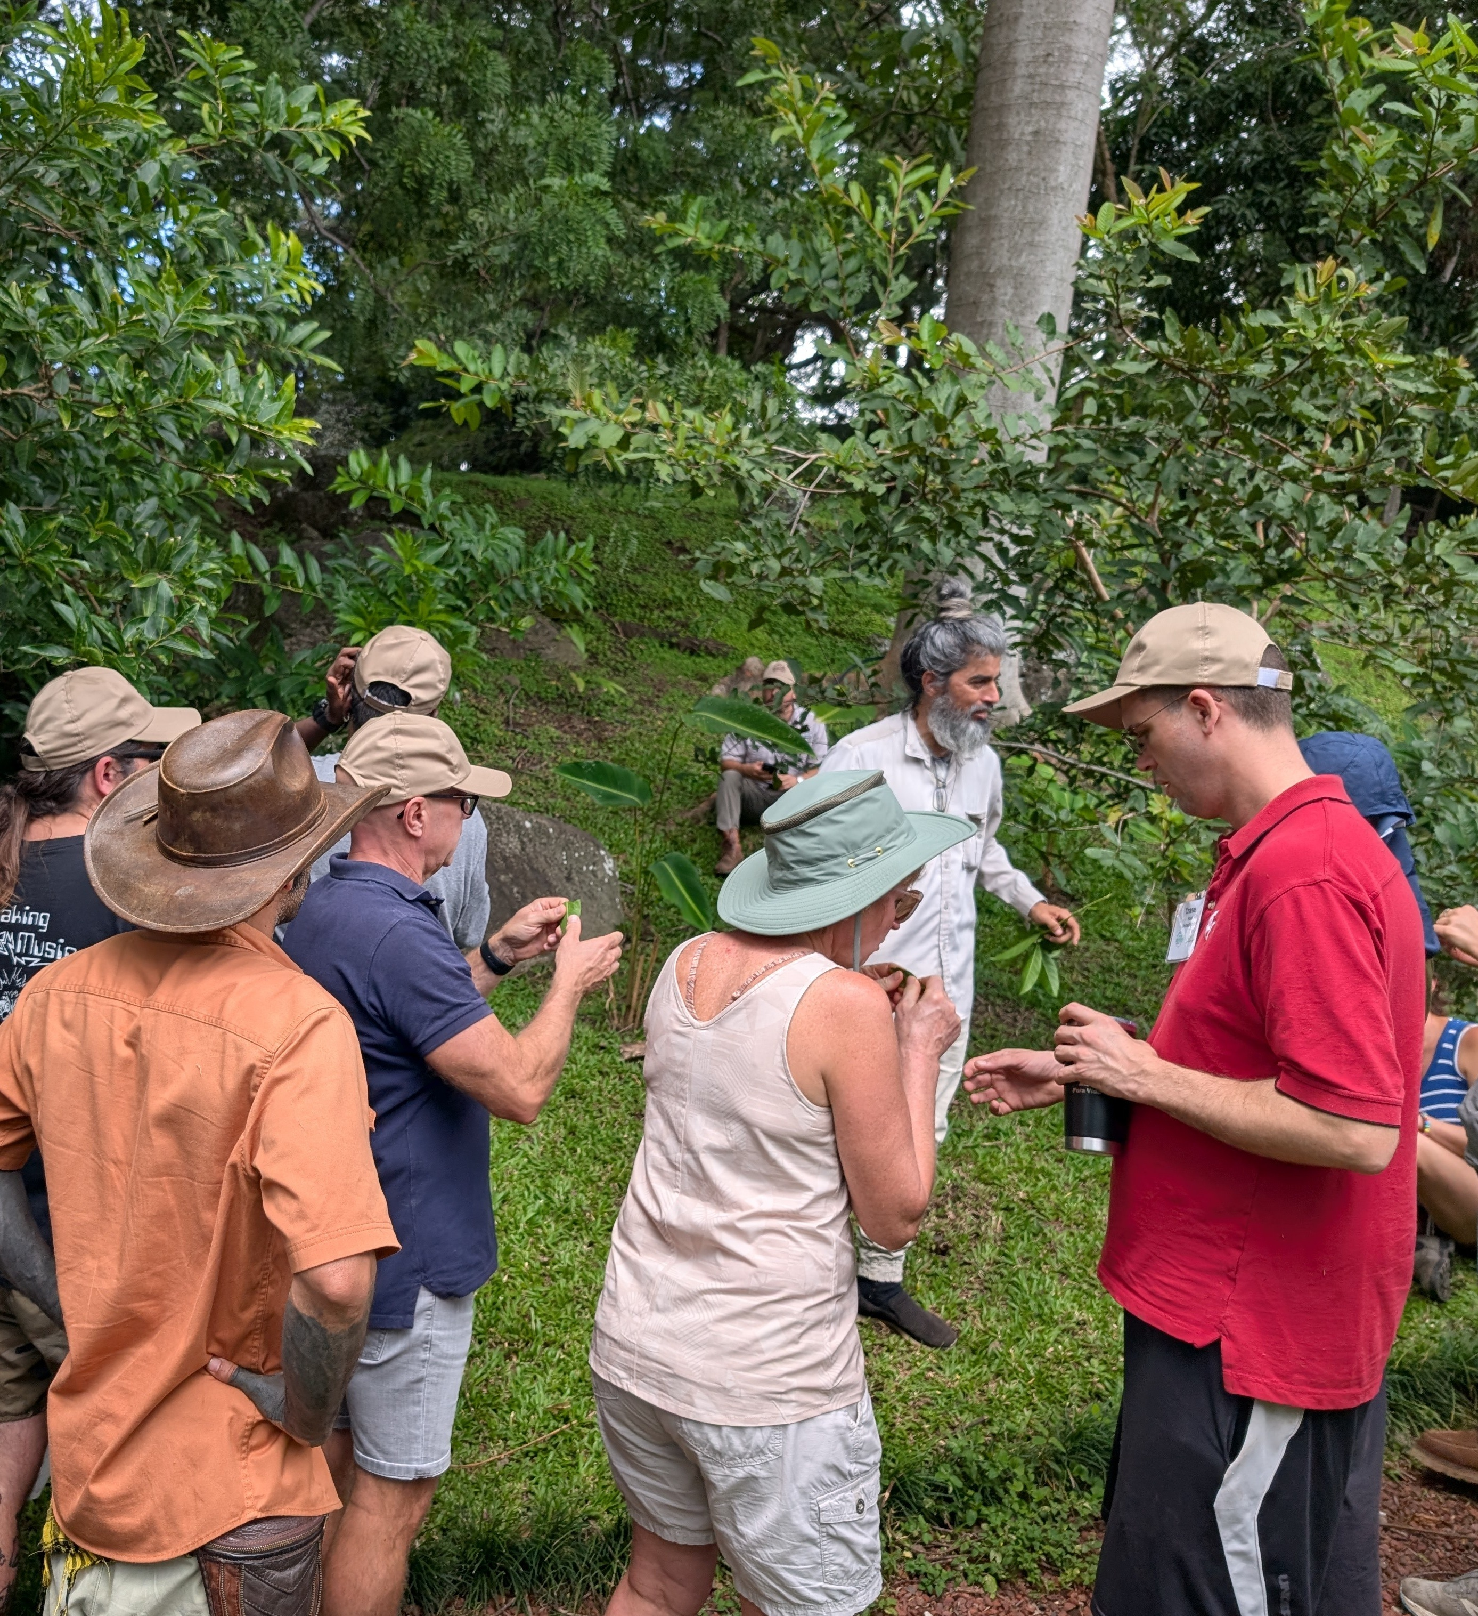
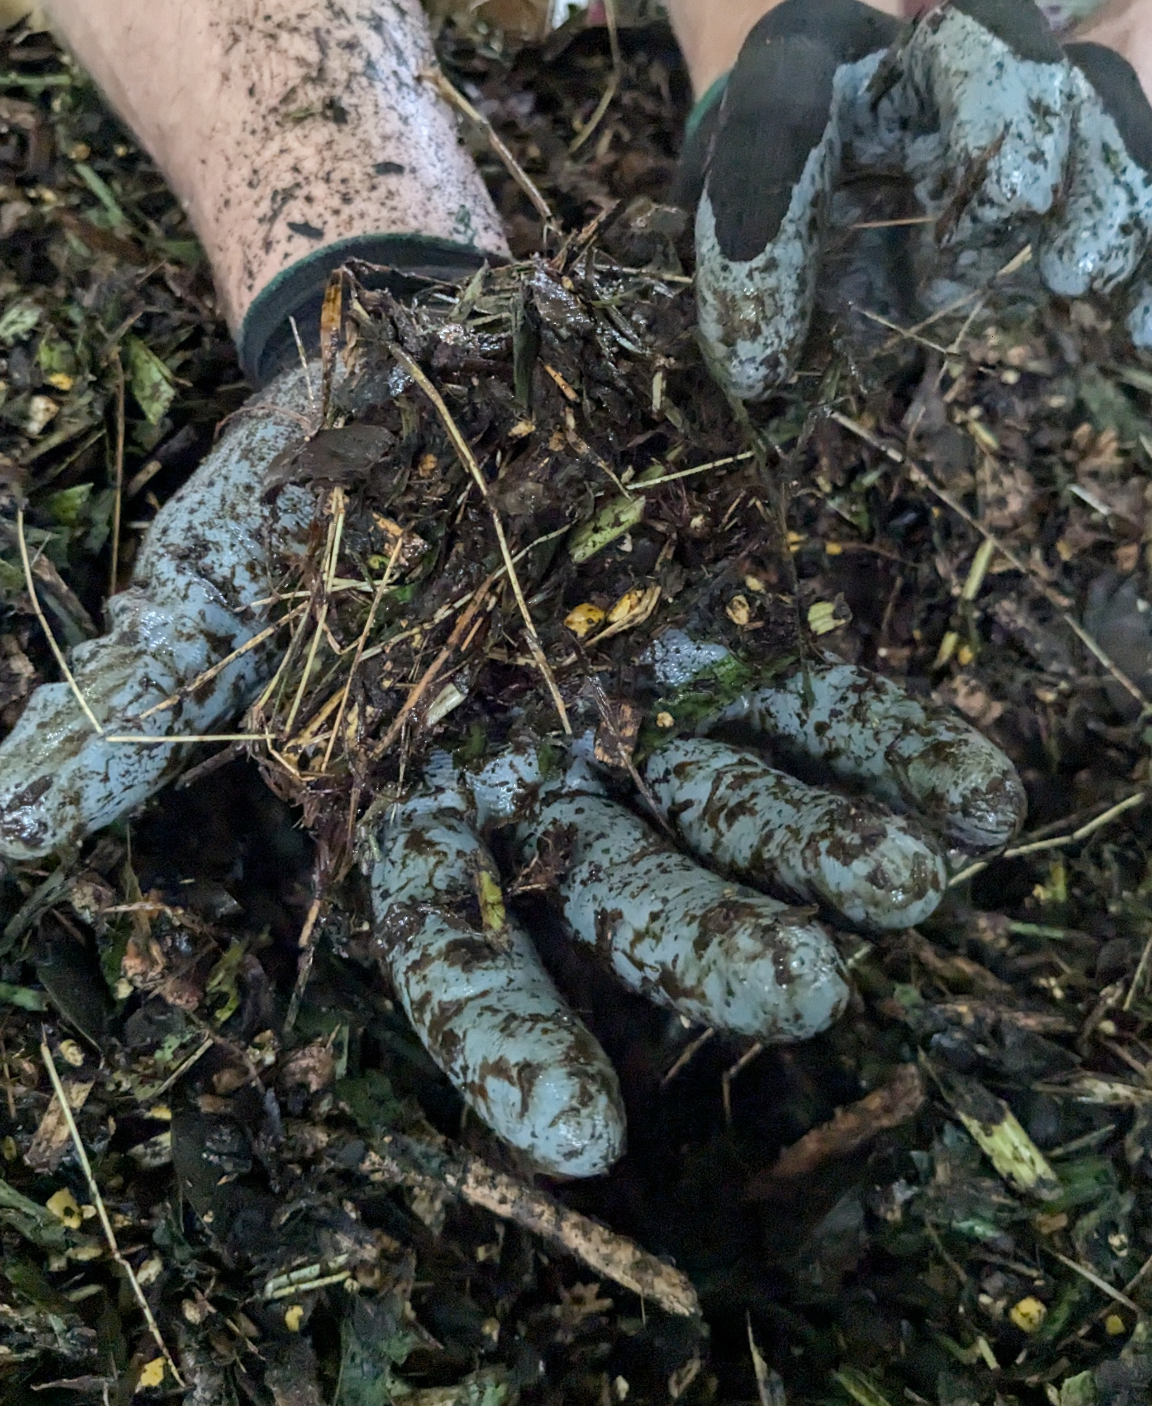
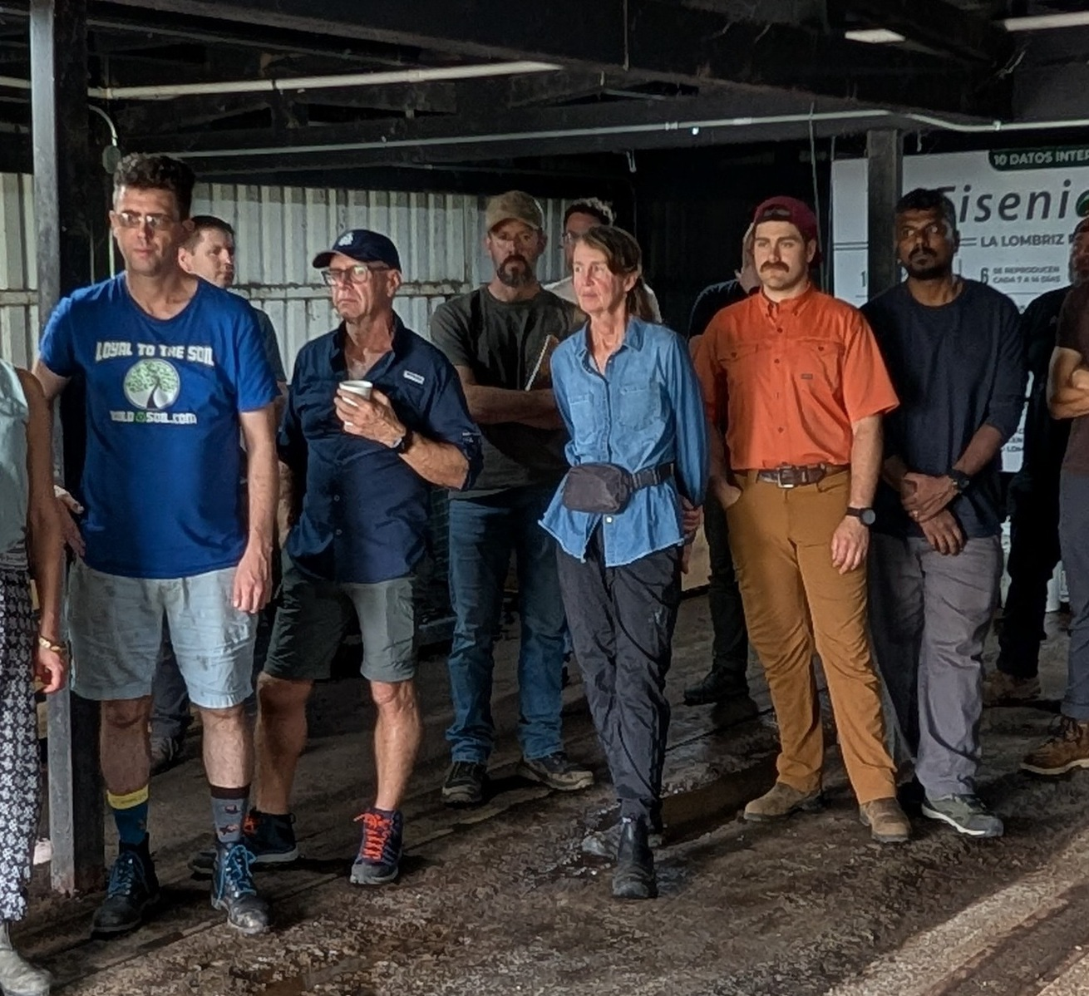

Costa Rica
info session
Tomorrow, 12pm Pacific
on Zoom. Free.
Notes:
Thu 5 Nov 2026 Instagram Story. Add the link sticker in Instagram under the details: https://www.addevent.com/event/r4wt0g3yjd4h. Keep the top 250 px and bottom 250 px free of text (Instagram UI).

