Slide 1
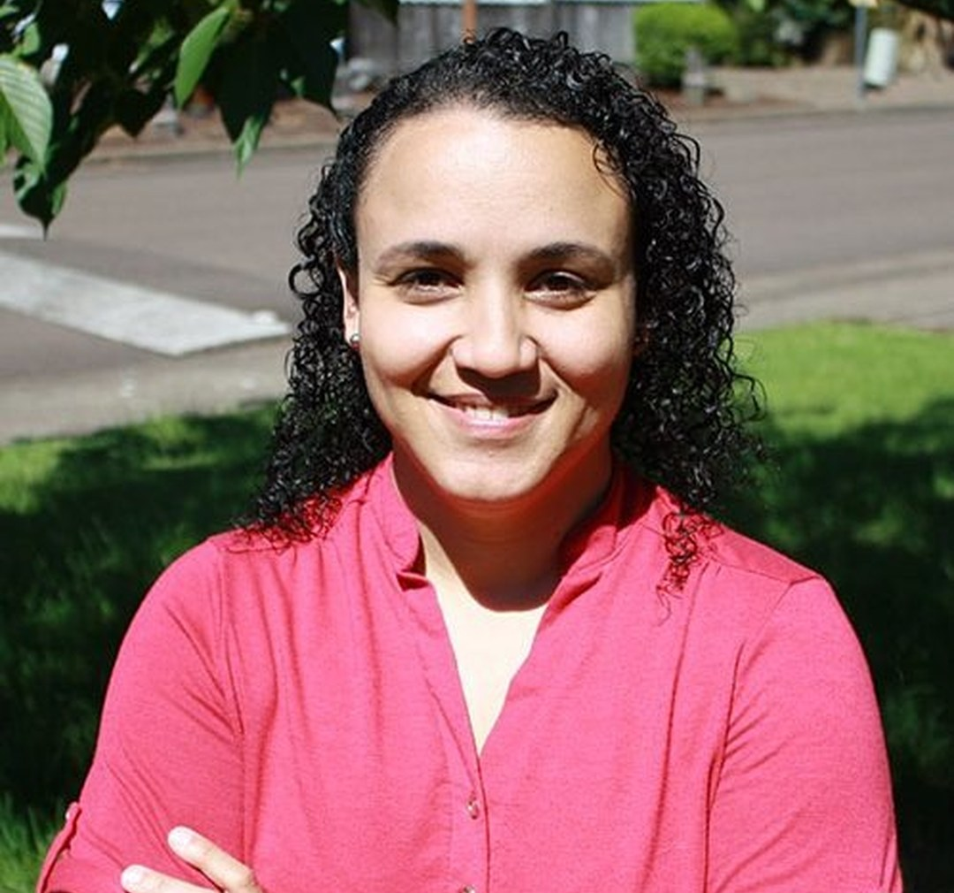
LOGO
LOGO
Dr. Carla Portugal
SCIENCE LEADER
@soilfoodwebschool
Notes:
Banner card. Banner-card alternative for the Teachers' Day mentors. Replace the two LOGO circles with the School logo and the second mark.

Slide 2
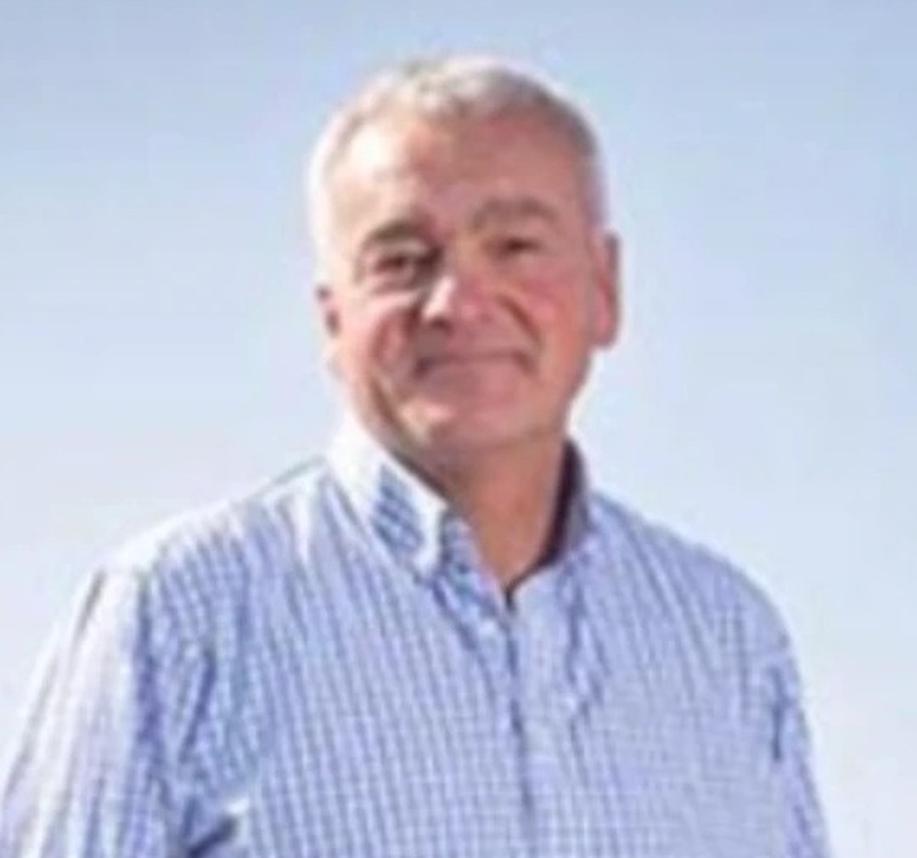
LOGO
LOGO
Nick Padwick
FARMER, NORFOLK
@soilfoodwebschool
Notes:
Banner card. Banner-card alternative for the Teachers' Day mentors. Replace the two LOGO circles with the School logo and the second mark.

Slide 3
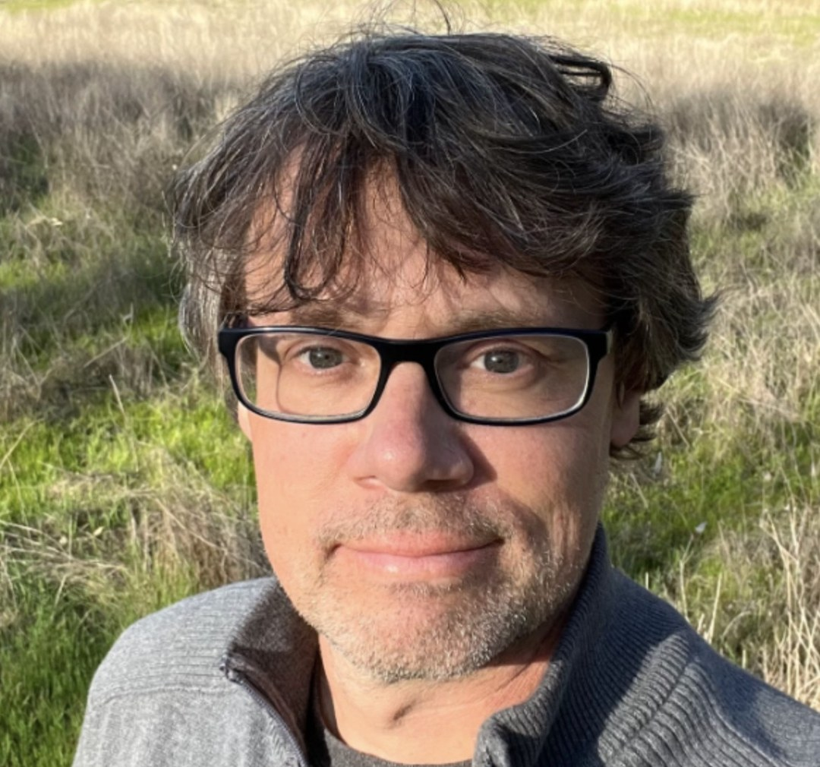
LOGO
LOGO
Wes Sander
MICROSCOPY
@soilfoodwebschool
Notes:
Banner card. Banner-card alternative for the Teachers' Day mentors. Replace the two LOGO circles with the School logo and the second mark.

Slide 4
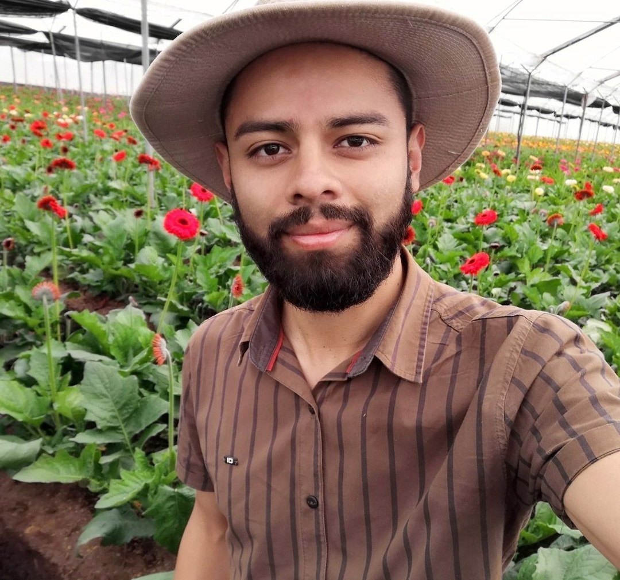
LOGO
LOGO
Gerald Ramírez
COMPOST EXTRACTS AND TEAS
@soilfoodwebschool
Notes:
Banner card. Banner-card alternative for the Teachers' Day mentors. Replace the two LOGO circles with the School logo and the second mark.

Slide 5
PHOTO: Dr. Caterina Capri, portrait
LOGO
LOGO
Dr. Caterina Capri
ADVANCED PROGRAMS
@soilfoodwebschool
Notes:
Banner card. Banner-card alternative for the Teachers' Day mentors. Replace the two LOGO circles with the School logo and the second mark.

