Slide 1

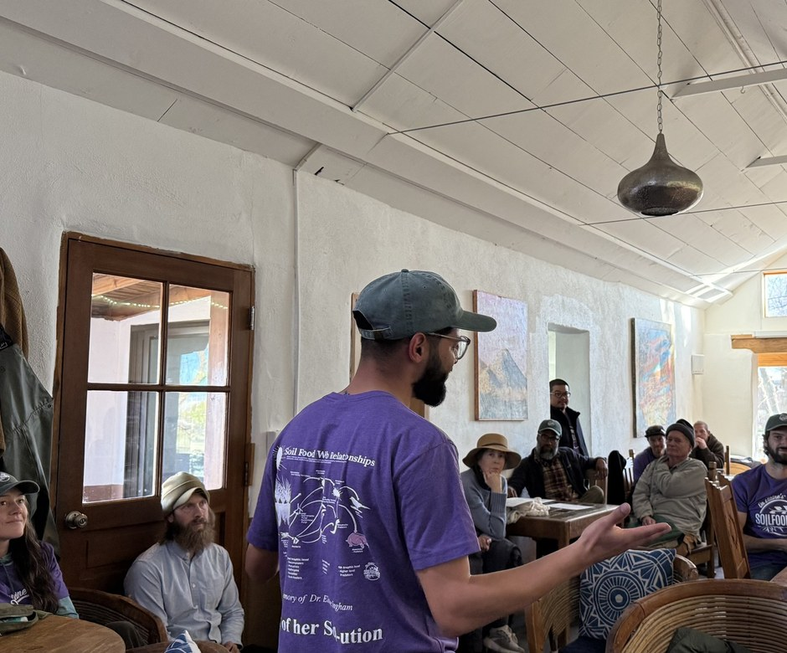


Meet our mentors
Gerald Ramirez
AP Mentor
Notes:
Photo: assets/mentors-teachers-day/gerald-teaching.jpg (Gerald teaching a workshop). Confirm it is the Costa Rica workshop, March 2025, demonstrating liquid amendments [VERIFY]. Earlier posts spell his name Ramírez [VERIFY]. Stickers are drawn shapes.

Slide 2

Meet our mentors
Dr. Caterina Capri
Advanced Programs Instructor
Notes:
[PHOTO NEEDED: Caterina headshot from Allison] Stickers are drawn shapes.

