Slide 1



Foundation
Courses +
Compost
Intensive
Course
Fall 2026 Bundle,
until 30 November
Link in bio
Notes:
Wed 4 Nov 2026, Instagram + LinkedIn. Fall 2026 Enrollment Special: Foundation Courses + Compost Intensive Course. Slide 1: Cover. Fonts: Montserrat Bold (headline), Montserrat Regular (details). Illustrations are AI watercolor, never presented as SFW photos or microscopy. No prices, no discounts, no codes.

Slide 2
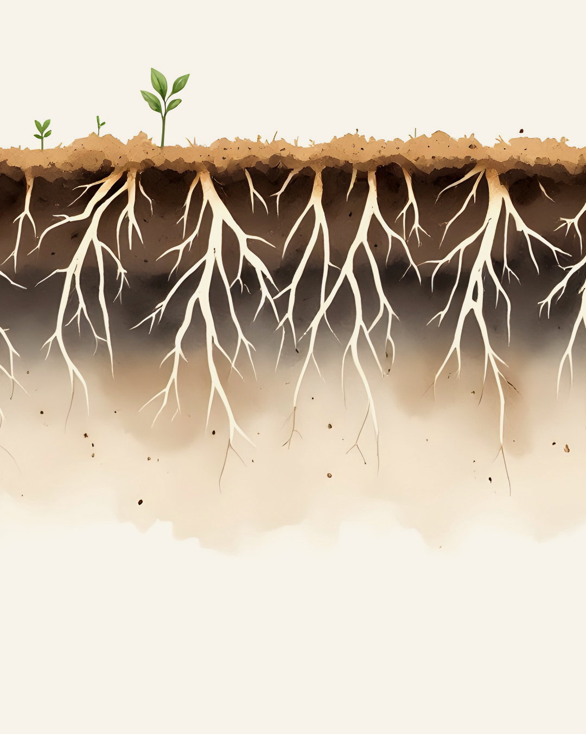
What’s in the bundle
4 Foundation Courses,
start today
Compost Intensive: 10 weeks,
live with a mentor
Pick your cohort:
January, May or August 2027
2 batches of compost to keep
Dr. Elaine’s webinar archive
Link in bio
Notes:
Wed 4 Nov 2026, Instagram + LinkedIn. Fall 2026 Enrollment Special: Foundation Courses + Compost Intensive Course. Slide 2: What's in it. Fonts: Montserrat Bold (headline), Montserrat Regular (details). Illustrations are AI watercolor, never presented as SFW photos or microscopy. No prices, no discounts, no codes.

