Slide 1
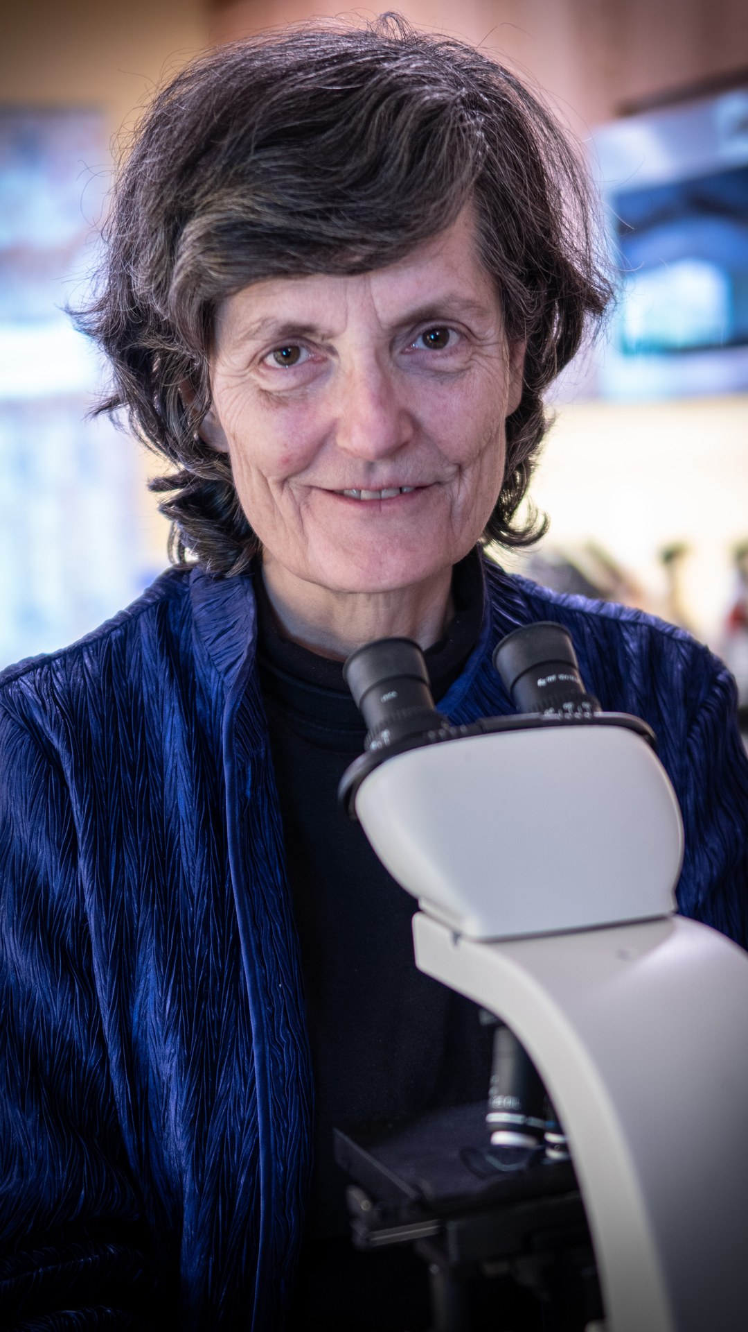

WORLD SOIL DAY · 5 DECEMBER
You've been infected
Notes:
Template 6 reel cover, Legacy Purple. Photo: assets/photo/dr-elaine-ingham-with-microscope.jpg (Foundation library). Sources: Dr. Elaine Ingham, "How to Build Great Soil, Part 1", Diego Footer, 30:04: https://www.youtube.com/watch?v=ErMHR6Mc4Bk&t=1804s. World Soil Day, FAO: https://www.fao.org/world-soil-day. [TAG @Evan] Using the 30:04 to 30:24 clip needs Diego Footer's permission. Backup: photo of Elaine from our library (used here, slow zoom). Credit line for every quote: Dr. Elaine Ingham, "How to Build Great Soil, Part 1", Diego Footer. Short quotes with credit are fine; video clips and long excerpts need Evan to check with Diego first. Caption needs review by Allison (AI-generated by Linnea).

Slide 2
“Now that you've listened to me, you've been infected.” Dr. Elaine Ingham
Notes:
Template 6 caption card 1, 64 pt Montserrat Bold Cream on Legacy Purple. Credit line for every quote: Dr. Elaine Ingham, "How to Build Great Soil, Part 1", Diego Footer. Short quotes with credit are fine; video clips and long excerpts need Evan to check with Diego first. Caption needs review by Allison (AI-generated by Linnea).

Slide 3
“You will go forth and explain this to other people.”
Notes:
Template 6 caption card 2, 64 pt Montserrat Bold Cream on Legacy Purple. Credit line for every quote: Dr. Elaine Ingham, "How to Build Great Soil, Part 1", Diego Footer. Short quotes with credit are fine; video clips and long excerpts need Evan to check with Diego first. Caption needs review by Allison (AI-generated by Linnea).

Slide 4
One viewer's answer: we've been inoculated. 🦠
Notes:
Template 6 caption card 3, 64 pt Montserrat Bold Cream on Legacy Purple. Credit line for every quote: Dr. Elaine Ingham, "How to Build Great Soil, Part 1", Diego Footer. Short quotes with credit are fine; video clips and long excerpts need Evan to check with Diego first. Caption needs review by Allison (AI-generated by Linnea).

Slide 5
Happy World Soil Day. Pass it on. 💜
Notes:
Template 6 caption card 4, 64 pt Montserrat Bold Cream on Legacy Purple. Credit line for every quote: Dr. Elaine Ingham, "How to Build Great Soil, Part 1", Diego Footer. Short quotes with credit are fine; video clips and long excerpts need Evan to check with Diego first. Caption needs review by Allison (AI-generated by Linnea).

