Slide 1
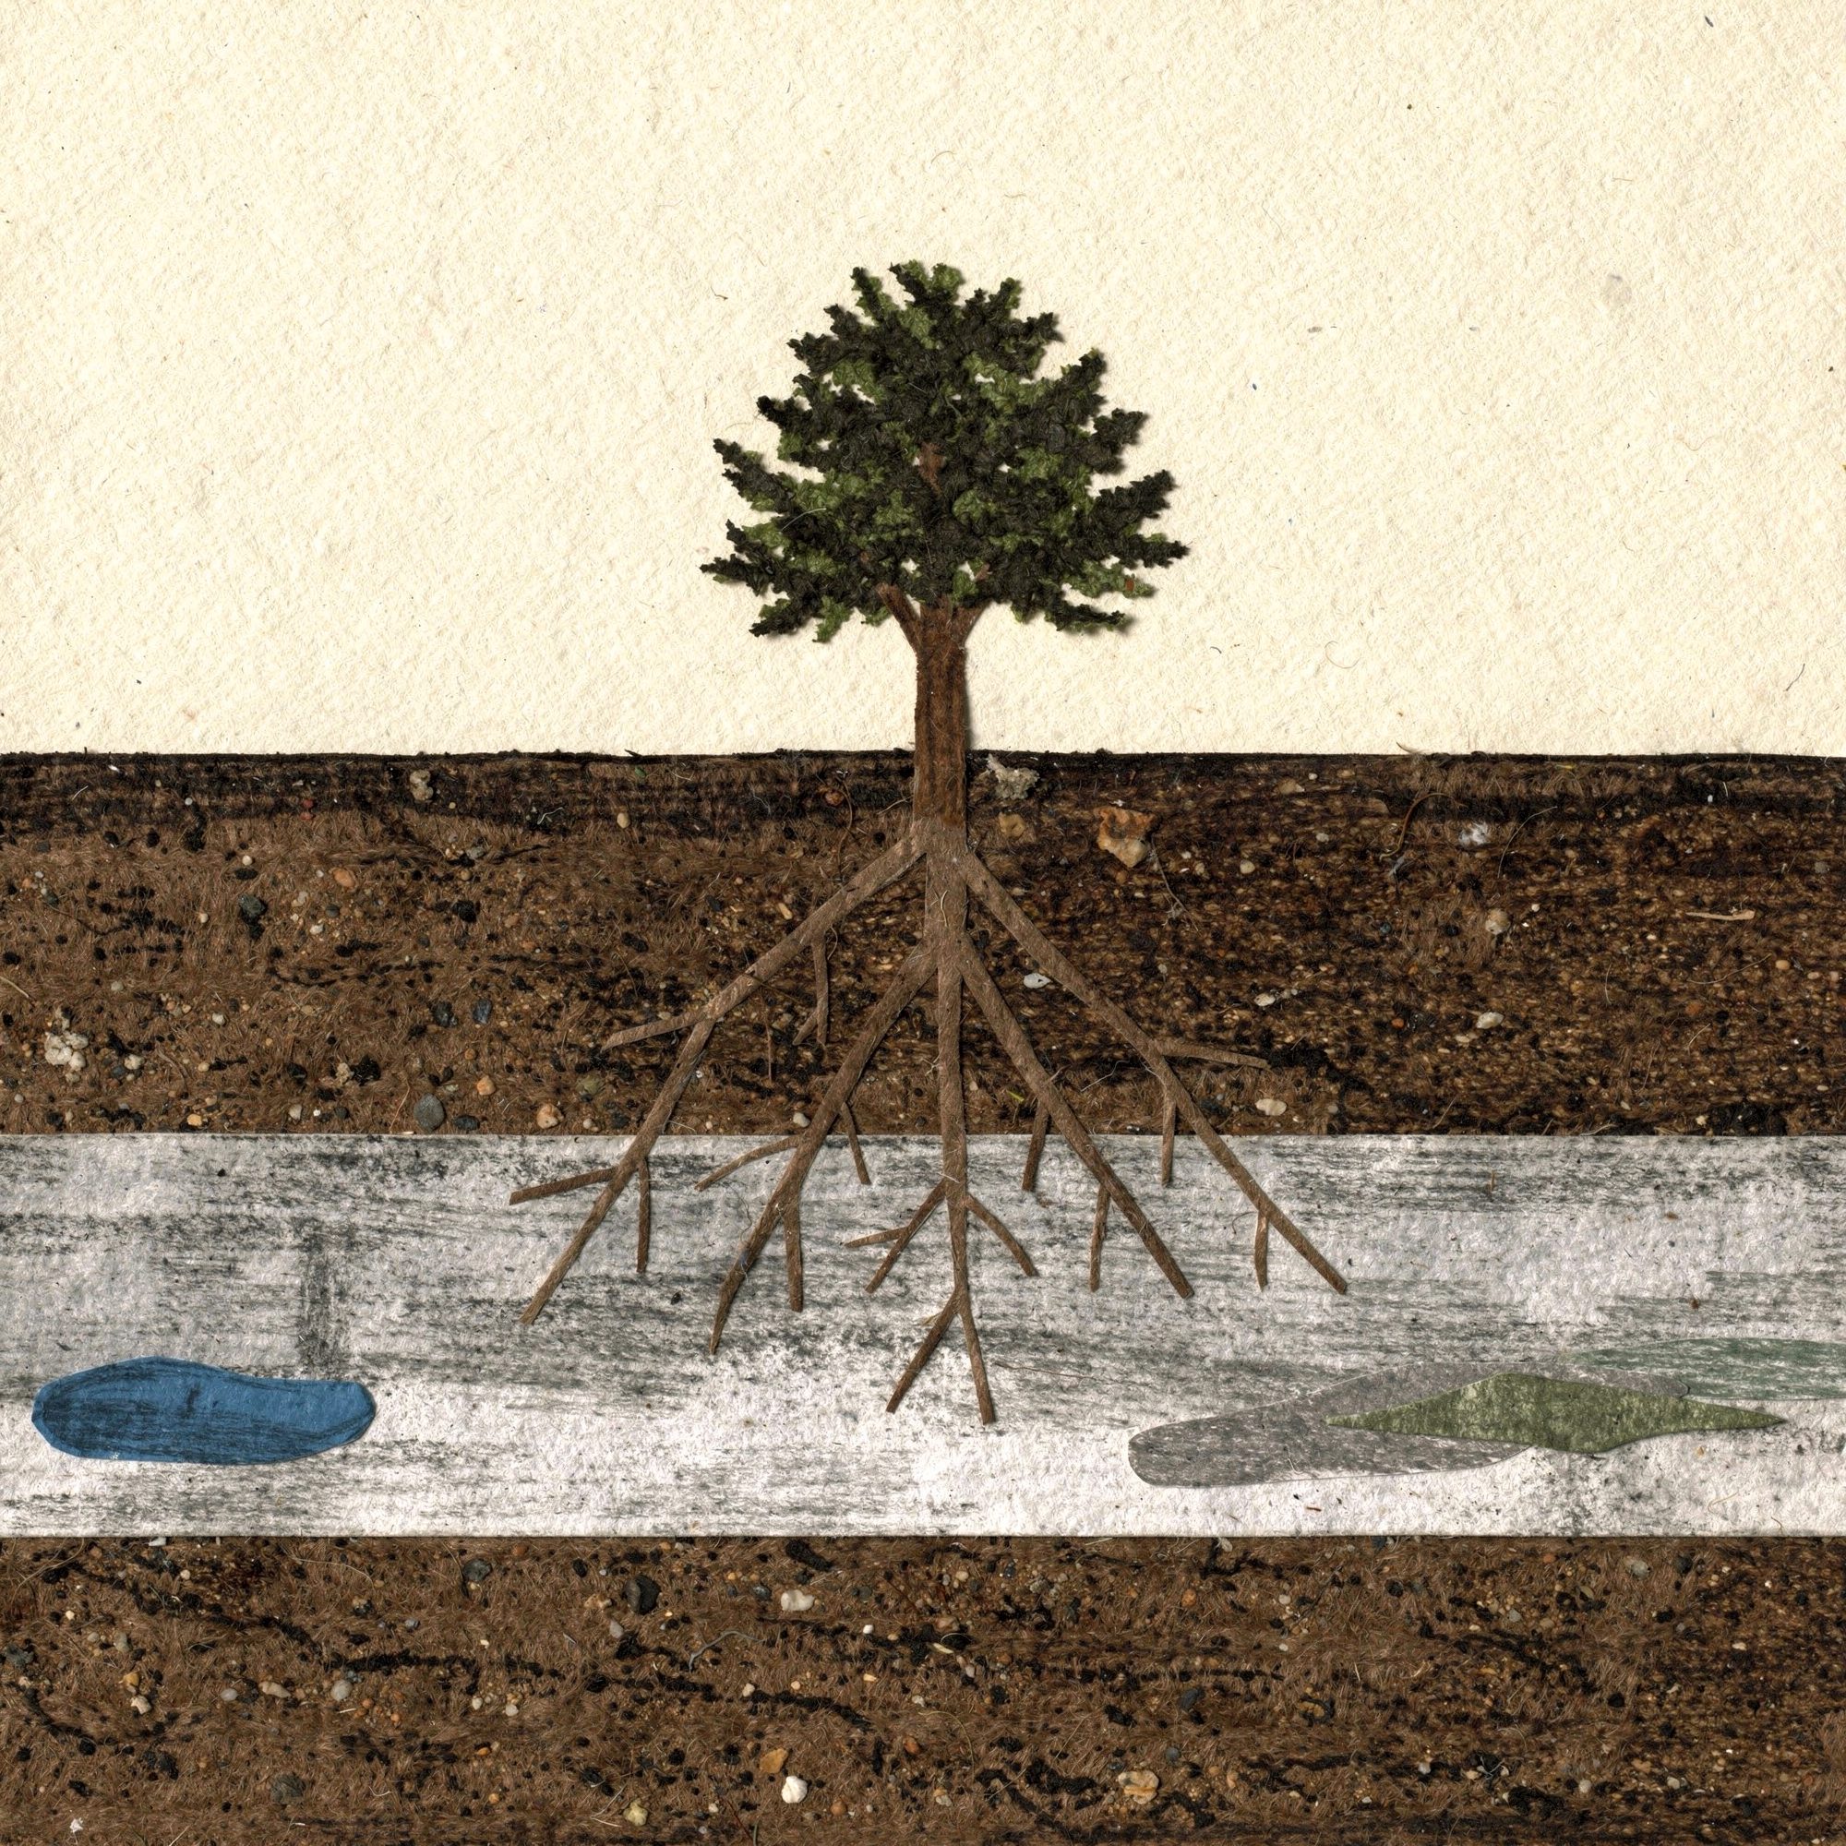

DR. ELAINE INGHAM · HOW TO BUILD GREAT SOIL
Myth: “Tree roots grow two or three feet down, then sideways.”
Dr. Elaine Ingham, How to Build Great Soil, Part 1, 2:54 and 3:26
Notes:
Template 2 myth-buster, Glow strikethrough. Collage: tree-compaction. Sources: Dr. Elaine Ingham, "How to Build Great Soil, Part 1", Diego Footer, 2:54: https://www.youtube.com/watch?v=ErMHR6Mc4Bk&t=174s; Dr. Elaine Ingham, "How to Build Great Soil, Part 1", Diego Footer, 3:26: https://www.youtube.com/watch?v=ErMHR6Mc4Bk&t=206s. [VERIFY with Wes] Root depth also varies by species and wind exposure; Wes to confirm the wording on slide 3. Credit line for every quote: Dr. Elaine Ingham, "How to Build Great Soil, Part 1", Diego Footer. Short quotes with credit are fine; video clips and long excerpts need Evan to check with Diego first. Caption needs review by Allison (AI-generated by Linnea).

Slide 2
DR. ELAINE INGHAM · HOW TO BUILD GREAT SOIL
In healthy soil, brassicas, grasses, shrubs and trees root deeper and deeper.
Dr. Elaine Ingham, How to Build Great Soil, Part 1, 2:54 and 3:26
soilfoodweb.com
Notes:
Template 3. Same collage, highlight ring on the part this slide talks about. Credit line for every quote: Dr. Elaine Ingham, "How to Build Great Soil, Part 1", Diego Footer. Short quotes with credit are fine; video clips and long excerpts need Evan to check with Diego first. Caption needs review by Allison (AI-generated by Linnea).

Slide 3
DR. ELAINE INGHAM · HOW TO BUILD GREAT SOIL
Roots that turn sideways at two or three feet usually hit a compaction layer.
Dr. Elaine Ingham, How to Build Great Soil, Part 1, 2:54 and 3:26
soilfoodweb.com
Notes:
Template 3. Same collage, highlight ring on the part this slide talks about. Credit line for every quote: Dr. Elaine Ingham, "How to Build Great Soil, Part 1", Diego Footer. Short quotes with credit are fine; video clips and long excerpts need Evan to check with Diego first. Caption needs review by Allison (AI-generated by Linnea).

Slide 4
DR. ELAINE INGHAM · HOW TO BUILD GREAT SOIL
Water stops where soil density changes, so it pools on top of the compacted layer.
Dr. Elaine Ingham, How to Build Great Soil, Part 1, 2:54 and 3:26
soilfoodweb.com
Notes:
Template 3. Same collage, highlight ring on the part this slide talks about. Credit line for every quote: Dr. Elaine Ingham, "How to Build Great Soil, Part 1", Diego Footer. Short quotes with credit are fine; video clips and long excerpts need Evan to check with Diego first. Caption needs review by Allison (AI-generated by Linnea).

Slide 5
DR. ELAINE INGHAM · HOW TO BUILD GREAT SOIL
Oxygen moves through water far slower than through air. That zone goes anaerobic, and anaerobic microbes make compounds that harm roots.
Dr. Elaine Ingham, How to Build Great Soil, Part 1, 2:54 and 3:26
soilfoodweb.com
Notes:
Template 3. Same collage, highlight ring on the part this slide talks about. Credit line for every quote: Dr. Elaine Ingham, "How to Build Great Soil, Part 1", Diego Footer. Short quotes with credit are fine; video clips and long excerpts need Evan to check with Diego first. Caption needs review by Allison (AI-generated by Linnea).

Slide 6
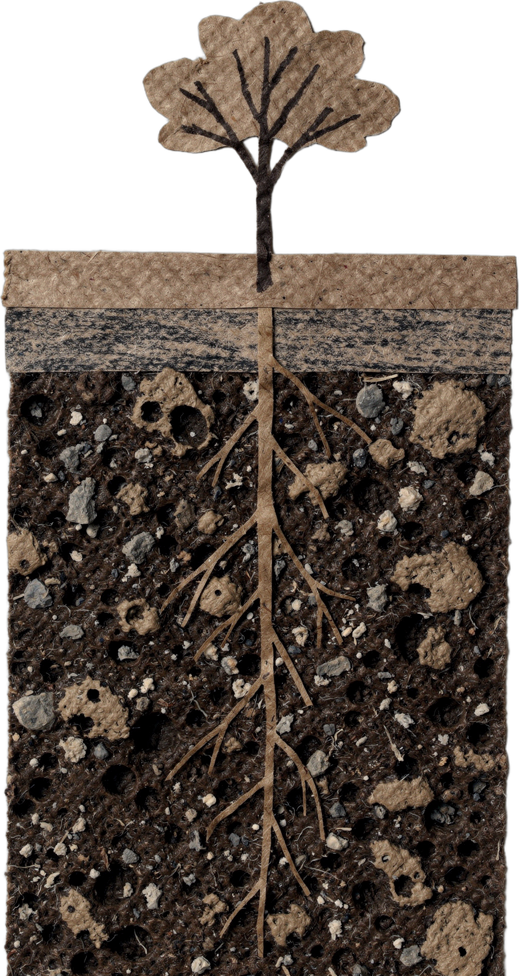

DR. ELAINE INGHAM · HOW TO BUILD GREAT SOIL
The fix: break the compaction, add biologically complete compost, and let bacteria and fungi build pores that stay open.
Dr. Elaine Ingham, How to Build Great Soil, Part 1, 2:54 and 3:26
Notes:
Template 3. Collage: tree-deep-roots. Credit line for every quote: Dr. Elaine Ingham, "How to Build Great Soil, Part 1", Diego Footer. Short quotes with credit are fine; video clips and long excerpts need Evan to check with Diego first. Caption needs review by Allison (AI-generated by Linnea).

