Slide 1
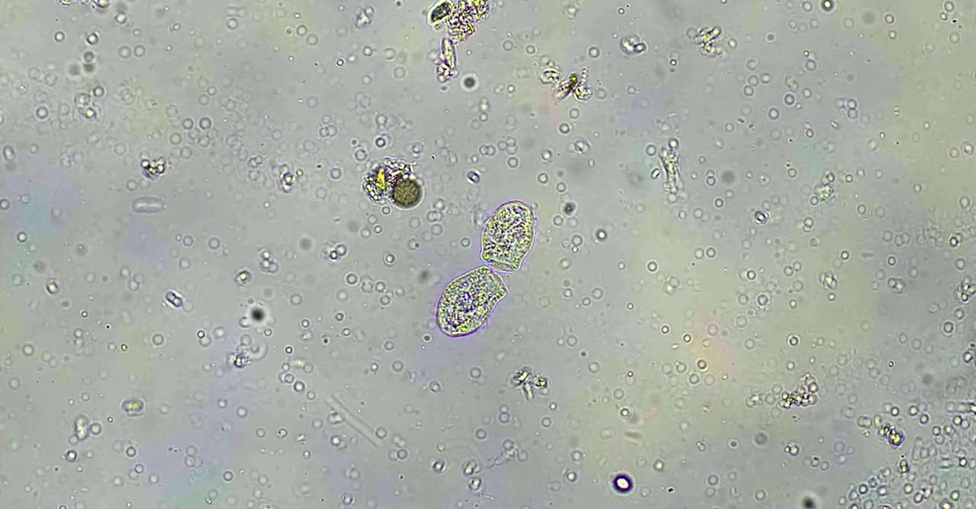

Notes:
LinkedIn image, no text on the image. Sources: Dr. Elaine Ingham, "How to Build Great Soil, Part 1", Diego Footer, 16:32: https://www.youtube.com/watch?v=ErMHR6Mc4Bk&t=992s; Dr. Elaine Ingham, "How to Build Great Soil, Part 1", Diego Footer, 24:30: https://www.youtube.com/watch?v=ErMHR6Mc4Bk&t=1470s. Clarholm, "Interactions of bacteria, protozoa and plants leading to mineralization of soil nitrogen", Soil Biology and Biochemistry, 1985: https://scholar.google.com/scholar?q=Clarholm+1985+Interactions+of+bacteria+protozoa+and+plants+leading+to+mineralization+of+soil+nitrogen. Photo: assets/microscopy/sfw-amoeba-still-wide.jpg, the closest library image: amoebae among bacteria-sized particles. No library image shows fungal hyphae in the same field; replace when one is supplied (Wes). Credit line for every quote: Dr. Elaine Ingham, "How to Build Great Soil, Part 1", Diego Footer. Short quotes with credit are fine; video clips and long excerpts need Evan to check with Diego first. Caption needs review by Allison (AI-generated by Linnea).

