Slide 1
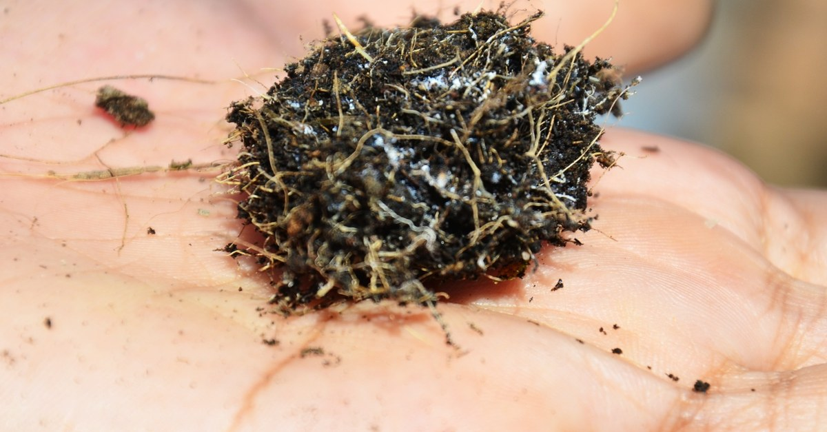

Notes:
LinkedIn image, no text on the image. Sources: Dr. Elaine Ingham, "How to Build Great Soil, Part 1", Diego Footer, 13:48: https://www.youtube.com/watch?v=ErMHR6Mc4Bk&t=828s; Dr. Elaine Ingham, "How to Build Great Soil, Part 1", Diego Footer, 14:23: https://www.youtube.com/watch?v=ErMHR6Mc4Bk&t=863s. [VERIFY with Wes] Name the desert project before the oasis line runs as fact; until then it stays attributed to Elaine. Photo: assets/photo/hand-soil-roots-fungi.jpg (Foundation library), a hand holding an aggregated soil crumb with roots. Credit line for every quote: Dr. Elaine Ingham, "How to Build Great Soil, Part 1", Diego Footer. Short quotes with credit are fine; video clips and long excerpts need Evan to check with Diego first. Caption needs review by Allison (AI-generated by Linnea).

