Slide 1

DR. ELAINE INGHAM · HOW TO BUILD GREAT SOIL
3.
18.
42.
Dr. Elaine Ingham, How to Build Great Soil, Part 1, 20:53, 21:50 and 24:30
Notes:
Template 5 big number: 3, 18 and 42 stacked, growing. Sources: Dr. Elaine Ingham, "How to Build Great Soil, Part 1", Diego Footer, 20:53: https://www.youtube.com/watch?v=ErMHR6Mc4Bk&t=1253s; Dr. Elaine Ingham, "How to Build Great Soil, Part 1", Diego Footer, 21:50: https://www.youtube.com/watch?v=ErMHR6Mc4Bk&t=1310s; Dr. Elaine Ingham, "How to Build Great Soil, Part 1", Diego Footer, 24:30: https://www.youtube.com/watch?v=ErMHR6Mc4Bk&t=1470s. [VERIFY with Wes] Most textbooks list 17 essential elements. The 42 stays attributed to Elaine. Credit line for every quote: Dr. Elaine Ingham, "How to Build Great Soil, Part 1", Diego Footer. Short quotes with credit are fine; video clips and long excerpts need Evan to check with Diego first. Caption needs review by Allison (AI-generated by Linnea).

Slide 2
DR. ELAINE INGHAM · HOW TO BUILD GREAT SOIL
3
1950s: plant scientists taught three essential nutrients. Nitrogen, phosphorus, potassium.
Dr. Elaine Ingham, How to Build Great Soil, Part 1, 20:53, 21:50 and 24:30
soilfoodweb.com
Notes:
Template 5 big number. Credit line for every quote: Dr. Elaine Ingham, "How to Build Great Soil, Part 1", Diego Footer. Short quotes with credit are fine; video clips and long excerpts need Evan to check with Diego first. Caption needs review by Allison (AI-generated by Linnea).

Slide 3
DR. ELAINE INGHAM · HOW TO BUILD GREAT SOIL
18
By the time Dr. Elaine reached high school, the count was 18.
Dr. Elaine Ingham, How to Build Great Soil, Part 1, 20:53, 21:50 and 24:30
soilfoodweb.com
Notes:
Template 5 big number. Credit line for every quote: Dr. Elaine Ingham, "How to Build Great Soil, Part 1", Diego Footer. Short quotes with credit are fine; video clips and long excerpts need Evan to check with Diego first. Caption needs review by Allison (AI-generated by Linnea).

Slide 4
DR. ELAINE INGHAM · HOW TO BUILD GREAT SOIL
42
Today, the plant physiologists she talked to count 42.
Dr. Elaine Ingham, How to Build Great Soil, Part 1, 20:53, 21:50 and 24:30
soilfoodweb.com
Notes:
Template 5 big number. Credit line for every quote: Dr. Elaine Ingham, "How to Build Great Soil, Part 1", Diego Footer. Short quotes with credit are fine; video clips and long excerpts need Evan to check with Diego first. Caption needs review by Allison (AI-generated by Linnea).

Slide 5
DR. ELAINE INGHAM · HOW TO BUILD GREAT SOIL
Too much of one throws off the others. Bulk sulfur, and the plant struggles to take up the rest.
Dr. Elaine Ingham, How to Build Great Soil, Part 1, 20:53, 21:50 and 24:30
soilfoodweb.com
Notes:
Template 3. Type only. Credit line for every quote: Dr. Elaine Ingham, "How to Build Great Soil, Part 1", Diego Footer. Short quotes with credit are fine; video clips and long excerpts need Evan to check with Diego first. Caption needs review by Allison (AI-generated by Linnea).

Slide 6
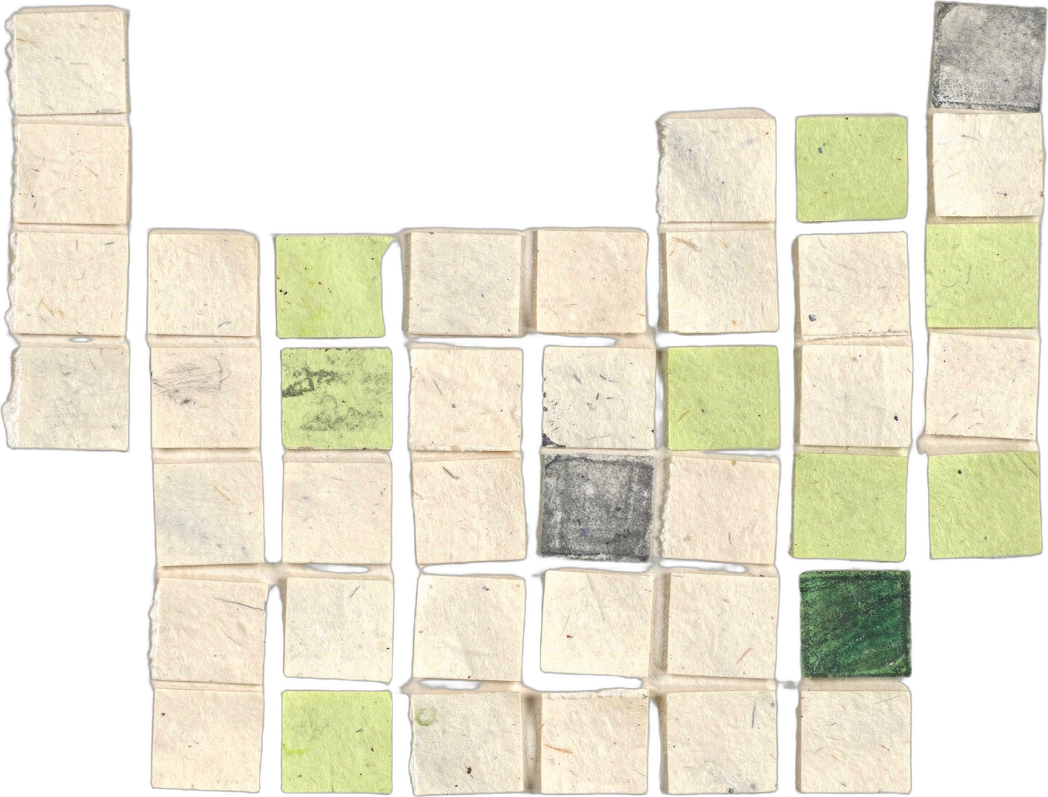

DR. ELAINE INGHAM · HOW TO BUILD GREAT SOIL
Her rule: Goldilocks. Enough, and never too much. Soil life delivers the amounts the plant asks for.
Dr. Elaine Ingham, How to Build Great Soil, Part 1, 20:53, 21:50 and 24:30
Notes:
Template 3. Collage: periodic-table (a few squares in Glow). Credit line for every quote: Dr. Elaine Ingham, "How to Build Great Soil, Part 1", Diego Footer. Short quotes with credit are fine; video clips and long excerpts need Evan to check with Diego first. Caption needs review by Allison (AI-generated by Linnea).

