Slide 1
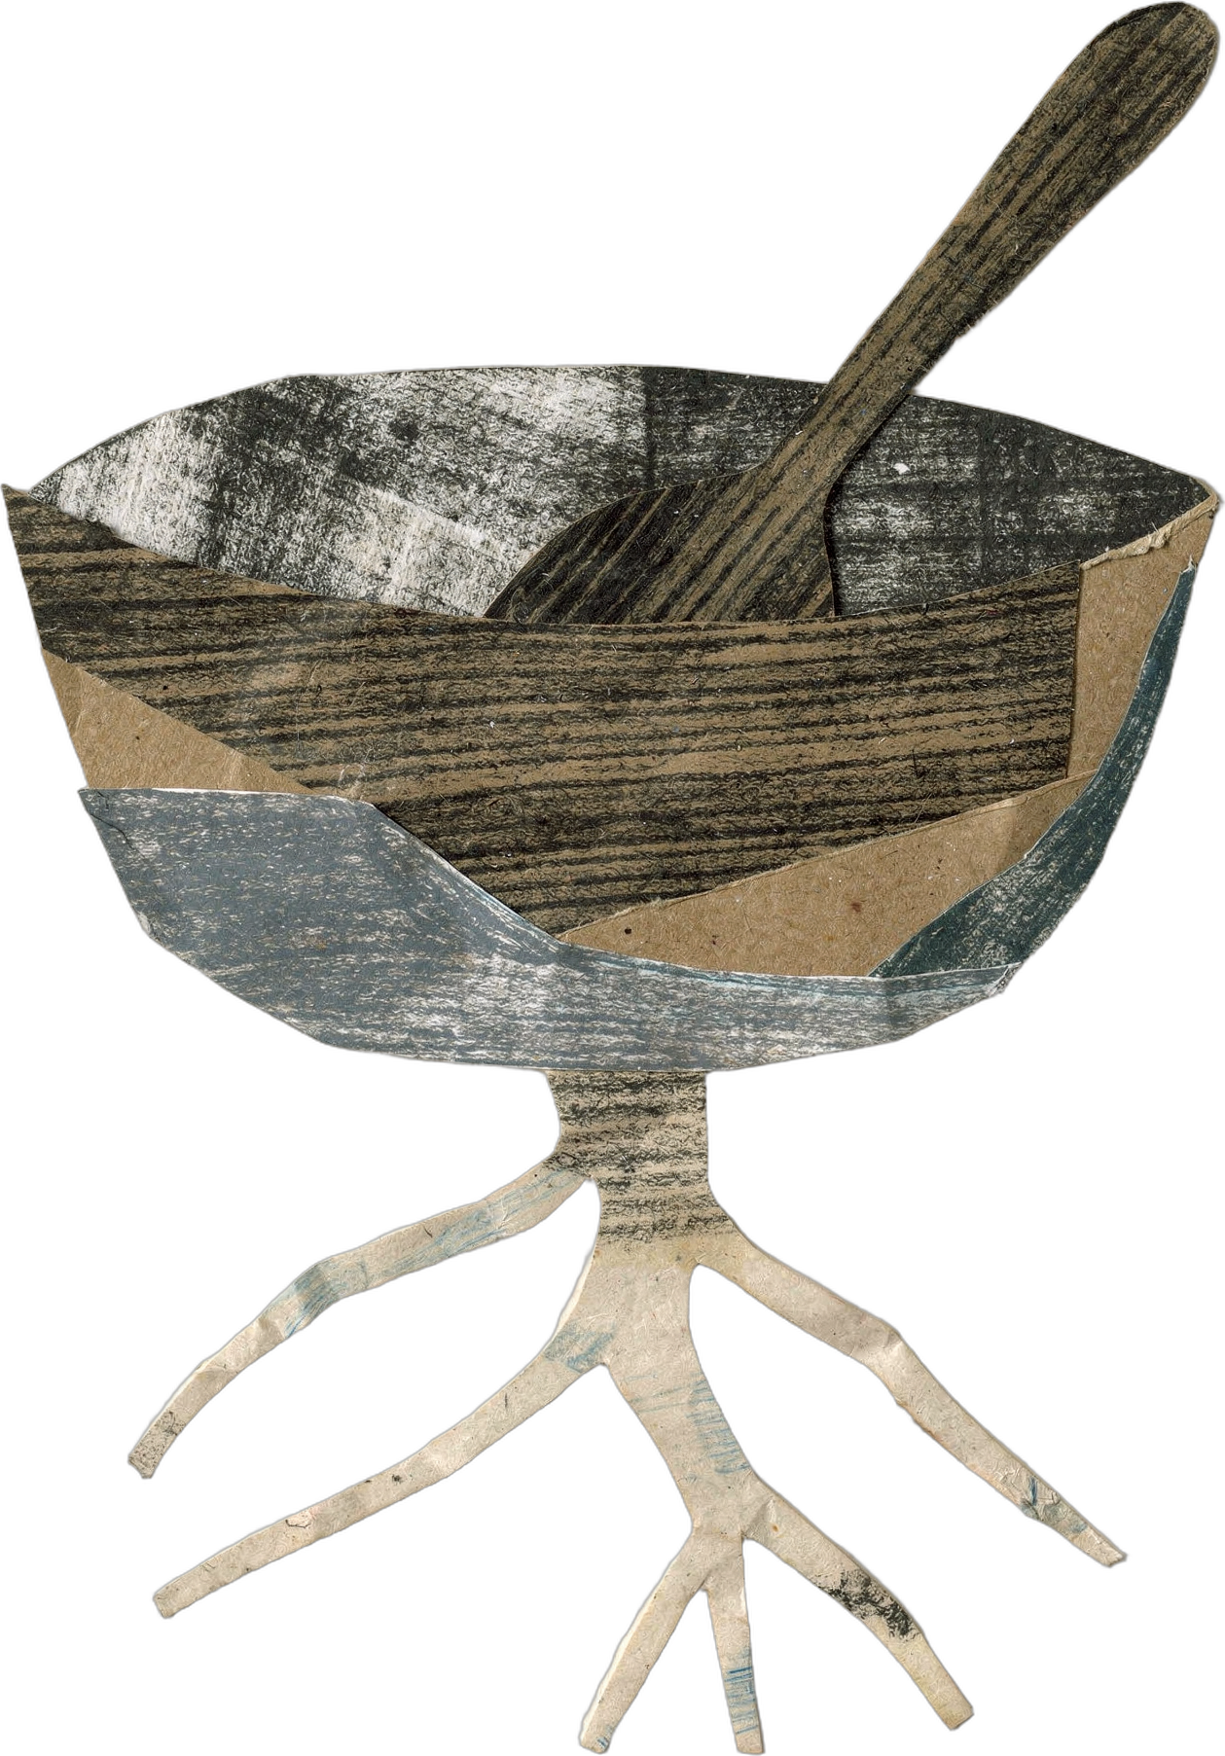

DR. ELAINE INGHAM · HOW TO BUILD GREAT SOIL
Dr. Elaine's challenge: go to your kitchen and bake me an exudate. 🧁
Dr. Elaine Ingham, How to Build Great Soil, Part 1, 12:33 and 13:11
Notes:
Template 3. Template 3, styled like a recipe card. Sources: Dr. Elaine Ingham, "How to Build Great Soil, Part 1", Diego Footer, 12:33: https://www.youtube.com/watch?v=ErMHR6Mc4Bk&t=753s; Dr. Elaine Ingham, "How to Build Great Soil, Part 1", Diego Footer, 13:11: https://www.youtube.com/watch?v=ErMHR6Mc4Bk&t=791s. Collage: mixing-bowl-root. Credit line for every quote: Dr. Elaine Ingham, "How to Build Great Soil, Part 1", Diego Footer. Short quotes with credit are fine; video clips and long excerpts need Evan to check with Diego first. Caption needs review by Allison (AI-generated by Linnea).

Slide 2
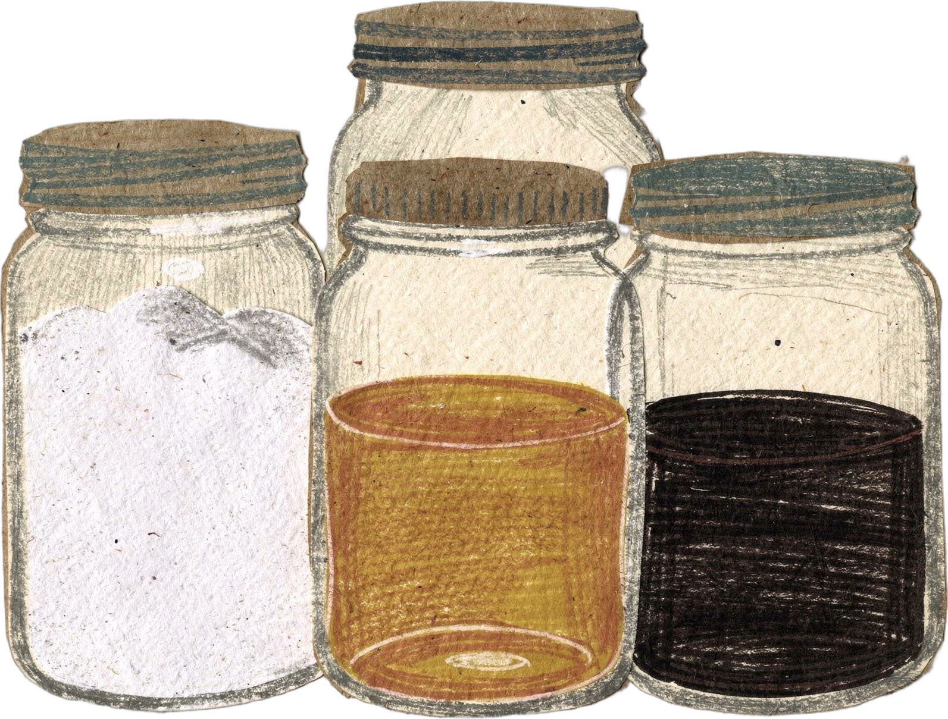
DR. ELAINE INGHAM · HOW TO BUILD GREAT SOIL
Mostly sugar. White sugar, brown sugar, honey, syrup, molasses.
Dr. Elaine Ingham, How to Build Great Soil, Part 1, 12:33 and 13:11
soilfoodweb.com
Notes:
Template 3. Template 3, styled like a recipe card. Collage: sugar-jars. Credit line for every quote: Dr. Elaine Ingham, "How to Build Great Soil, Part 1", Diego Footer. Short quotes with credit are fine; video clips and long excerpts need Evan to check with Diego first. Caption needs review by Allison (AI-generated by Linnea).

Slide 3
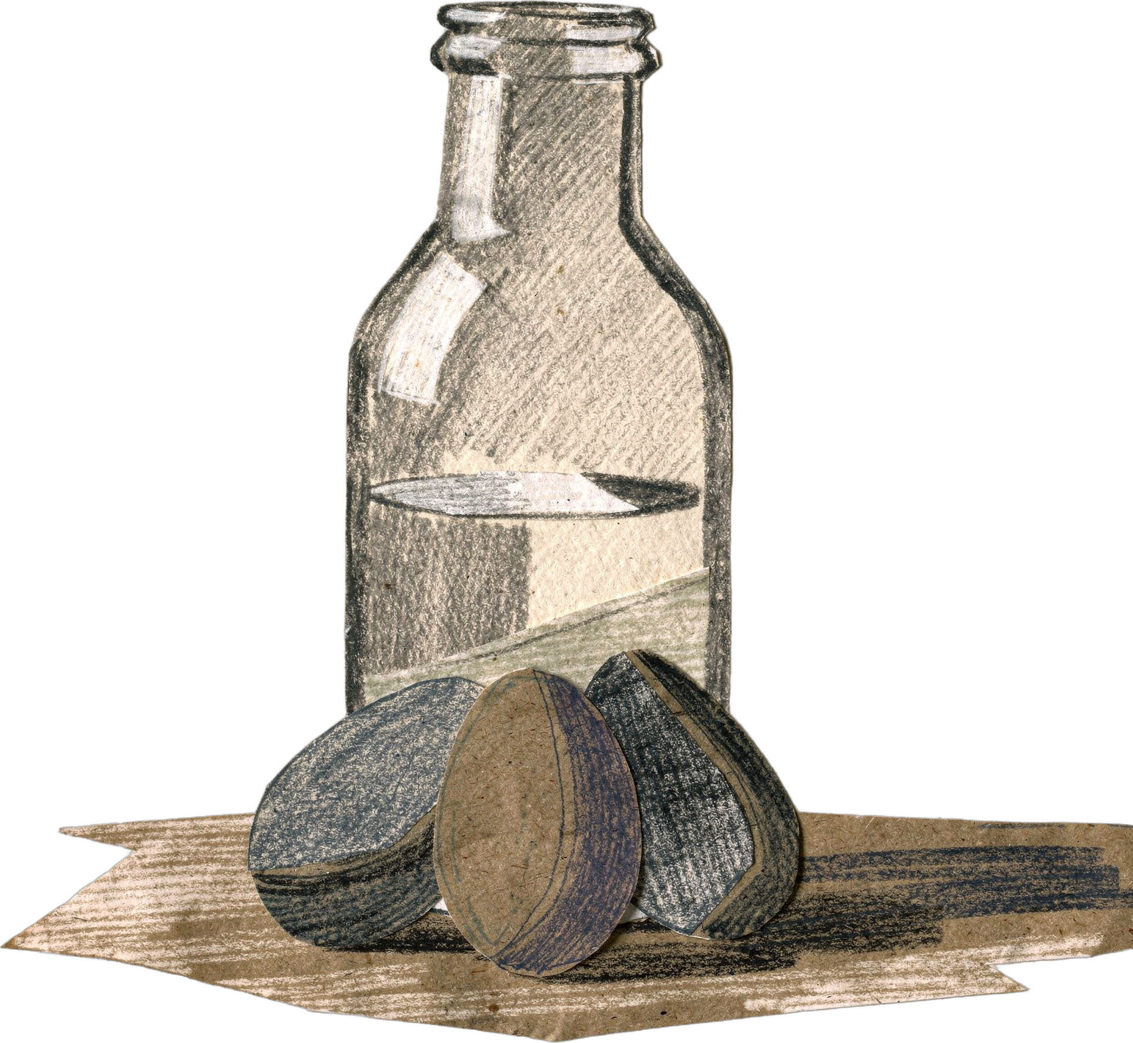
DR. ELAINE INGHAM · HOW TO BUILD GREAT SOIL
A little protein. Milk, eggs.
Dr. Elaine Ingham, How to Build Great Soil, Part 1, 12:33 and 13:11
soilfoodweb.com
Notes:
Template 3. Template 3, styled like a recipe card. Collage: eggs-milk. Credit line for every quote: Dr. Elaine Ingham, "How to Build Great Soil, Part 1", Diego Footer. Short quotes with credit are fine; video clips and long excerpts need Evan to check with Diego first. Caption needs review by Allison (AI-generated by Linnea).

Slide 4
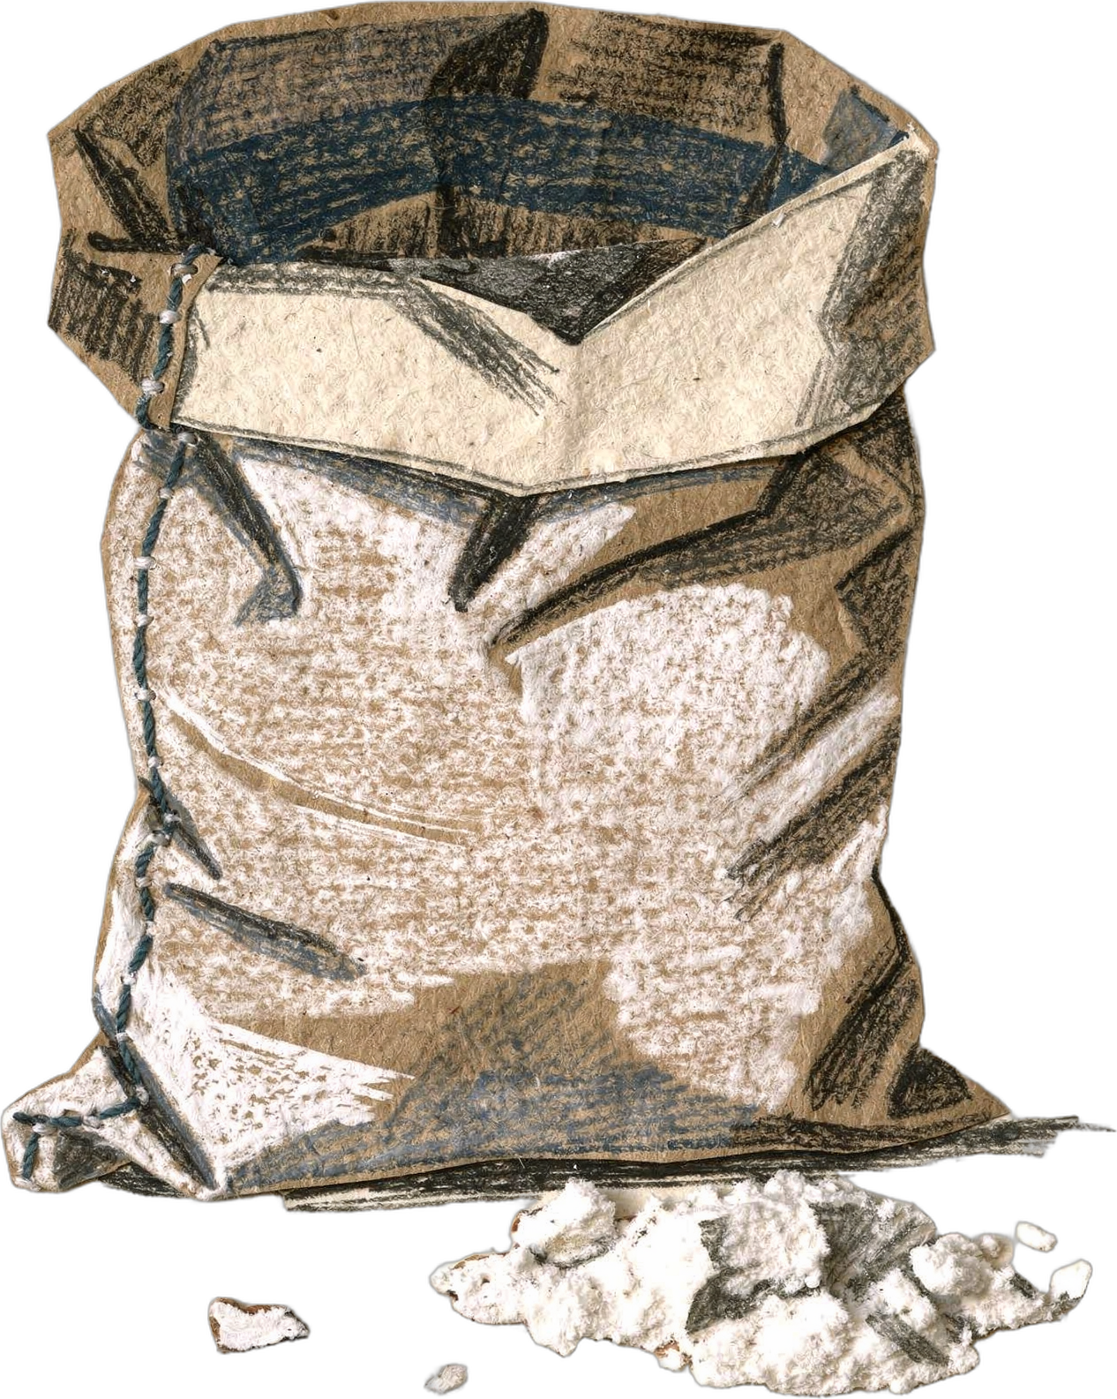
DR. ELAINE INGHAM · HOW TO BUILD GREAT SOIL
A little carbohydrate. Flour.
Dr. Elaine Ingham, How to Build Great Soil, Part 1, 12:33 and 13:11
soilfoodweb.com
Notes:
Template 3. Template 3, styled like a recipe card. Collage: flour-sack. Credit line for every quote: Dr. Elaine Ingham, "How to Build Great Soil, Part 1", Diego Footer. Short quotes with credit are fine; video clips and long excerpts need Evan to check with Diego first. Caption needs review by Allison (AI-generated by Linnea).

Slide 5
DR. ELAINE INGHAM · HOW TO BUILD GREAT SOIL
Brown, complex sugars lean fungal. White sugar leans bacterial. The recipe decides who comes to eat.
Dr. Elaine Ingham, How to Build Great Soil, Part 1, 12:33 and 13:11
soilfoodweb.com
Notes:
Template 3. Template 3, styled like a recipe card. Type only. Credit line for every quote: Dr. Elaine Ingham, "How to Build Great Soil, Part 1", Diego Footer. Short quotes with credit are fine; video clips and long excerpts need Evan to check with Diego first. Caption needs review by Allison (AI-generated by Linnea).

Slide 6
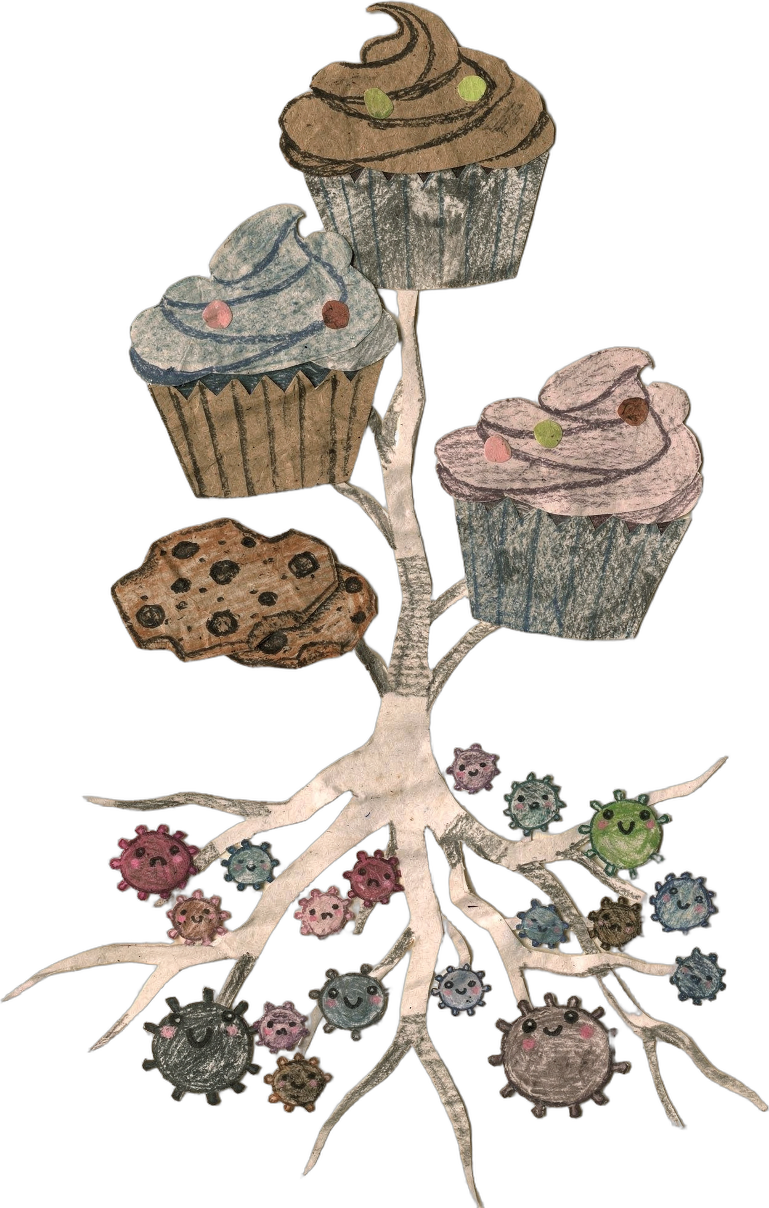
DR. ELAINE INGHAM · HOW TO BUILD GREAT SOIL
Roots bake many recipes at once, each one for the microbes doing a job the plant needs done.
Dr. Elaine Ingham, How to Build Great Soil, Part 1, 12:33 and 13:11
Notes:
Template 3. Template 3, styled like a recipe card. Collage: cupcakes-root-microbes. Credit line for every quote: Dr. Elaine Ingham, "How to Build Great Soil, Part 1", Diego Footer. Short quotes with credit are fine; video clips and long excerpts need Evan to check with Diego first. Caption needs review by Allison (AI-generated by Linnea).

