Slide 1
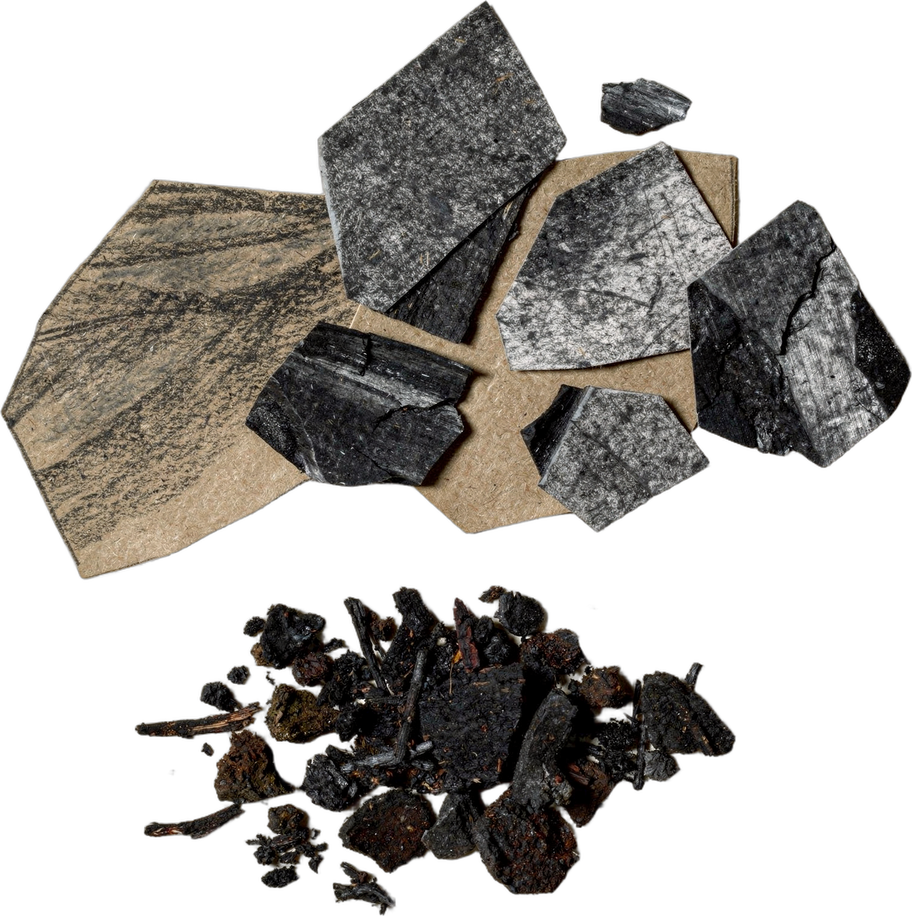

Notes:
LinkedIn image, no text on the image. Sources: Dr. Elaine Ingham, "How to Build Great Soil, Part 1", Diego Footer, 1:28: https://www.youtube.com/watch?v=ErMHR6Mc4Bk&t=88s. [VERIFY with Wes] Confirm SFW's recommended way to charge biochar before the last paragraph runs. Library: Boubacar's biochar stills are 360 px wide, too small for 1200 x 627, so a cut-paper collage of biochar beside compost is used (biochar-compost). Credit line for every quote: Dr. Elaine Ingham, "How to Build Great Soil, Part 1", Diego Footer. Short quotes with credit are fine; video clips and long excerpts need Evan to check with Diego first. Caption needs review by Allison (AI-generated by Linnea).

