Slide 1
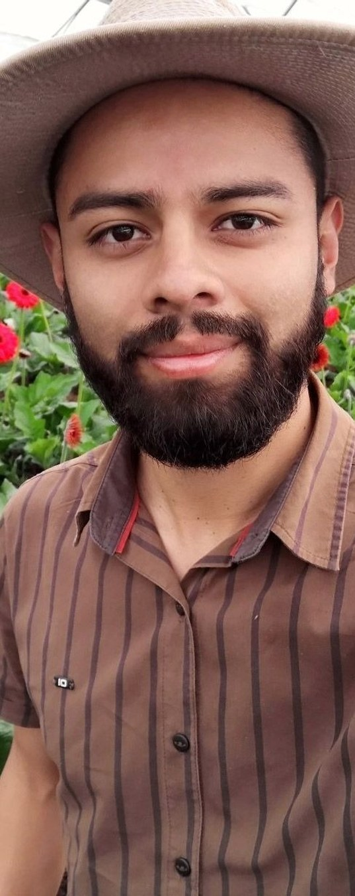
PHOTO: Dr. Caterina Capri, portrait
MEET OUR MENTORS
1/3
Gerald Ramirez
Dr. Caterina Capri
Compost extracts and teas
Advanced Programs
Notes:
4C.

Slide 2
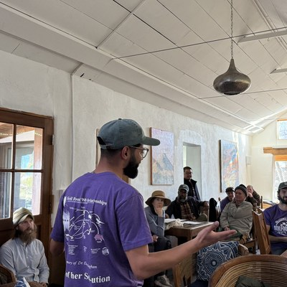
2/3
Gerald teaches liquid amendments: compost extracts and teas that carry living biology from compost out to the field.
[COPY: Allison] Step 1
[COPY: Allison] Step 2
[COPY: Allison] Step 3
Notes:
2B. Small image: Gerald teaching (other people in frame: check consent).

Slide 3
3/3
Caterina co-wrote research on how living cover crops protect soil, control weeds and build biological diversity.
Notes:
2B.

