Slide 1
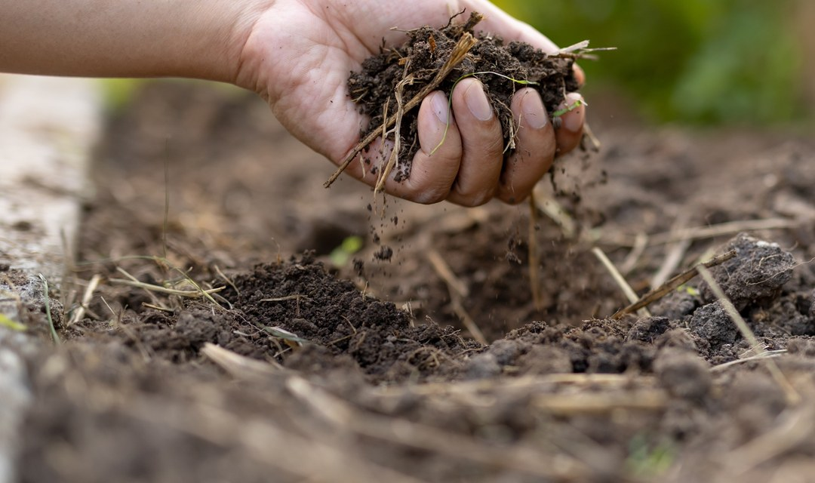
1/5
CARBON
3 ways to keep carbon in your soil. No lab needed.
LOGO
Notes:
2A.

Slide 2
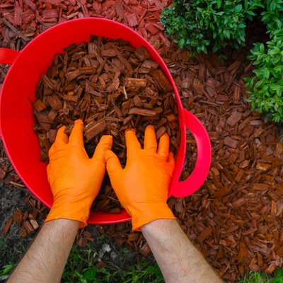
1
2/5
Keep it covered. Bare soil loses carbon to sun, wind and rain. Mulch or plant it.
Notes:
2B.

Slide 3
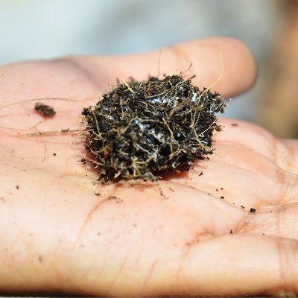
2
3/5
Keep roots in the ground. Living roots feed carbon to fungi and bacteria all year.
Notes:
2B.

Slide 4
3
4/5
Dig less. Every turn of the soil breaks up the fungal networks that hold carbon in place.
PHOTO: microscopy: fungal strands
Notes:
2B.

Slide 5
5/5
Soil holds more carbon than the air and all the world's plants combined.
Save this
Send this
LOGO
Notes:
2D.

