Slide 1
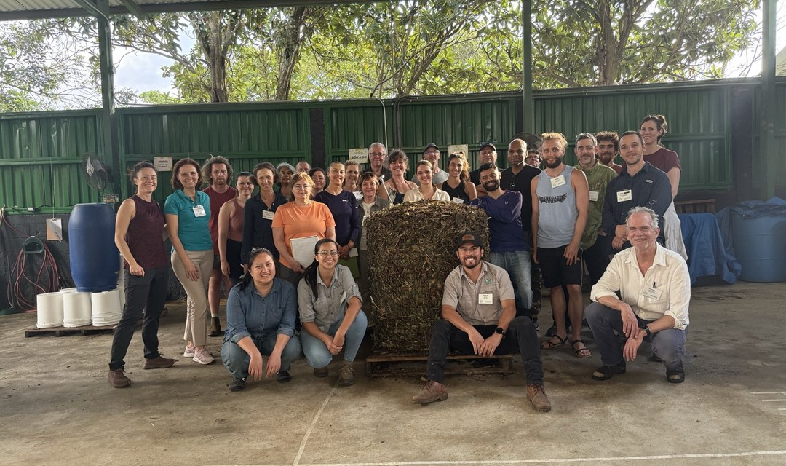
1/5
OUR FIRST YEAR
We turned 1!
LOGO
Notes:
2A.

Slide 2
2/5
[COPY: Allison] number
[N]
scholarships awarded
Source: [COPY: Allison]
Notes:
5.

Slide 3
3/5
[COPY: Allison] number
[N]
countries with students
Source: [COPY: Allison]
Notes:
5.

Slide 4
4/5
[COPY: Allison] milestone 3
[N]
[COPY: Allison] milestone
Source: [COPY: Allison]
Notes:
5.

Slide 5
5/5
Year two: more scholarships, more countries, more living soil.
Donate: link in bio
LOGO
Notes:
8.

