Slide 1
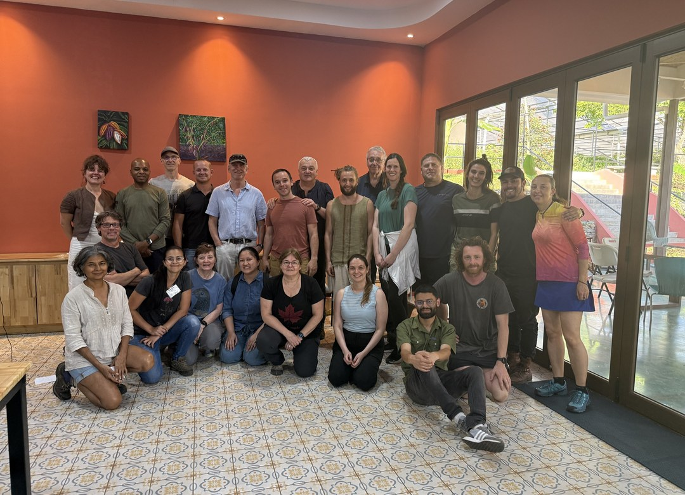

OCTOBER 5
Happy World Teachers' Day
Thank you to the mentors who teach our students to see soil.
Notes:
Option 1, slide 1: mentors' workshop group photo (assets/mentors-teachers-day/group-mentors-workshop.jpg). Mentor photos: Linnea's Drive folder (5 Oct 2026) and assets/mentors-teachers-day/; written consent per the folder README.

Slide 2














OUR MENTORS
Happy World Teachers' Day
Tommy Tapper
Loida Vasquez
Carla Portugal
Wesley Sander
Casey Williams
Brian Daubenspeck
Isadora Shmidt
Ayşen Üstünay
Dora Tkalec
Gerald Ramírez
Elena Kalli
Ib Borup Pedersen
Nick Padwick
Delvin Solkinson
soilfoodweb.com
Notes:
Option 1, slide 2: all fourteen mentors. Mentor photos: Linnea's Drive folder (5 Oct 2026) and assets/mentors-teachers-day/; written consent per the folder README.

