Slide 1
1/7
Happy World Teachers' Day. Collect them all.
Notes:
4B.

Slide 2

2/7
LOGO
BASED IN
[COPY: Allison]
TEACHING SINCE
[COPY: Allison]
ASK ME ABOUT
[COPY: Allison]
FAVORITE ORGANISM
[COPY: Allison]
DR. CARLA PORTUGAL
Science Leader
soilfoodweb.com
Notes:
4A.

Slide 3
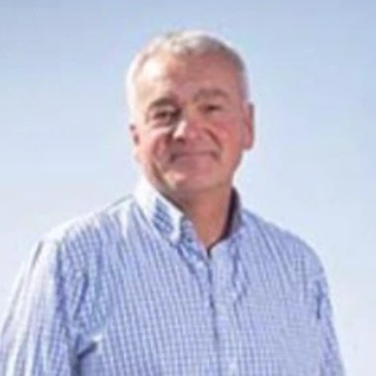
3/7
LOGO
BASED IN
[COPY: Allison]
TEACHING SINCE
[COPY: Allison]
ASK ME ABOUT
[COPY: Allison]
FAVORITE ORGANISM
[COPY: Allison]
NICK PADWICK
Farmer, Norfolk
soilfoodweb.com
Notes:
4A.

Slide 4

4/7
LOGO
BASED IN
[COPY: Allison]
TEACHING SINCE
[COPY: Allison]
ASK ME ABOUT
[COPY: Allison]
FAVORITE ORGANISM
[COPY: Allison]
WES SANDER
Microscopy
soilfoodweb.com
Notes:
4A.

Slide 5

5/7
LOGO
BASED IN
[COPY: Allison]
TEACHING SINCE
[COPY: Allison]
ASK ME ABOUT
[COPY: Allison]
FAVORITE ORGANISM
[COPY: Allison]
GERALD RAMIREZ
Compost extracts and teas
soilfoodweb.com
Notes:
4A.

Slide 6
6/7
PHOTO: Dr. Caterina Capri, square headshot
LOGO
BASED IN
[COPY: Allison]
TEACHING SINCE
[COPY: Allison]
ASK ME ABOUT
[COPY: Allison]
FAVORITE ORGANISM
[COPY: Allison]
DR. CATERINA CAPRI
Advanced Programs
soilfoodweb.com
Notes:
4A.

Slide 7
7/7
Thank you to every mentor who teaches our students to see soil.
Notes:
4B.

