Slide 1

OCTOBER 5
Happy World Teachers' Day
Meet our fourteen mentors.
Swipe →
Notes:
Slide 1: bunting, balloons and stars (PowerPoint shapes), big logo. Mentor photos: Linnea's Drive folder (5 Oct 2026) and assets/mentors-teachers-day/; written consent per the folder README.

Slide 2


Ib Borup Pederson
Advanced Programs Mentor
Brian Daubenspeck
Advanced Programs Mentor
Manages orchards in California, after years in New Mexico. Favourite microbes: the small underdogs.
Notes:
Mentors: Ib Borup Pederson, Brian Daubenspeck. About lines: drafts from the team notes; confirm with each mentor (05-10-2026-mon-ig-teachers-day-mentors.md). Mentor photos: Linnea's Drive folder (5 Oct 2026) and assets/mentors-teachers-day/; written consent per the folder README.

Slide 3

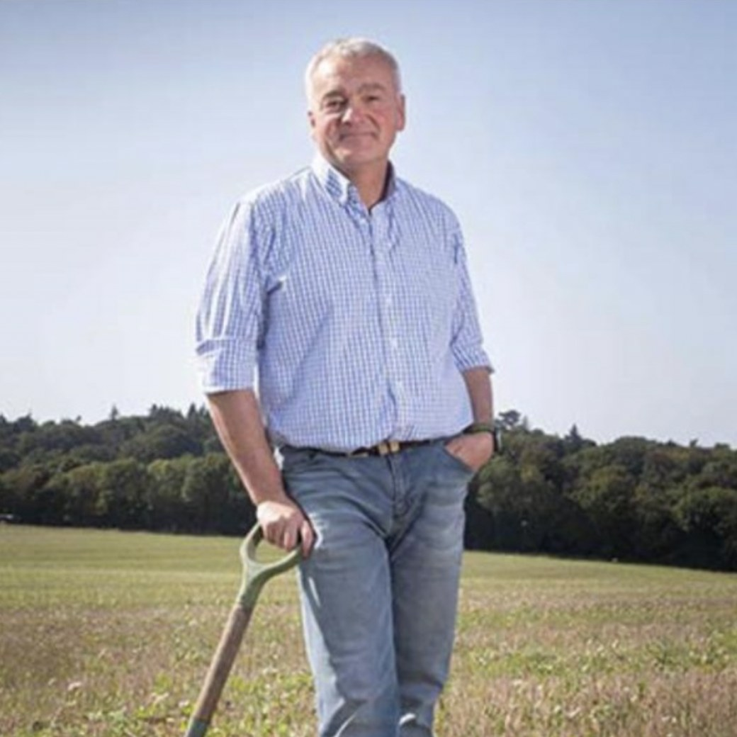
Elena Kalli
Advanced Programs Admin
Nick Padwick
Advanced Programs Mentor
“I make 750 tons of compost a year. Biology works at any scale.”
Notes:
Mentors: Elena Kalli, Nick Padwick. About lines: drafts from the team notes; confirm with each mentor (05-10-2026-mon-ig-teachers-day-mentors.md). Mentor photos: Linnea's Drive folder (5 Oct 2026) and assets/mentors-teachers-day/; written consent per the folder README.

Slide 4


Dr. Carla Portugal
Science Lead & Mentor
“Bare soil erodes. Living roots and cover hold the aggregates together.”
Gerald Ramirez
Advanced Programs Mentor
“Extracts pull organisms off the compost into solution, so you can apply biology across a whole field.”
Notes:
Mentors: Carla Portugal, Gerald Ramirez. About lines: drafts from the team notes; confirm with each mentor (05-10-2026-mon-ig-teachers-day-mentors.md). Mentor photos: Linnea's Drive folder (5 Oct 2026) and assets/mentors-teachers-day/; written consent per the folder README.

Slide 5

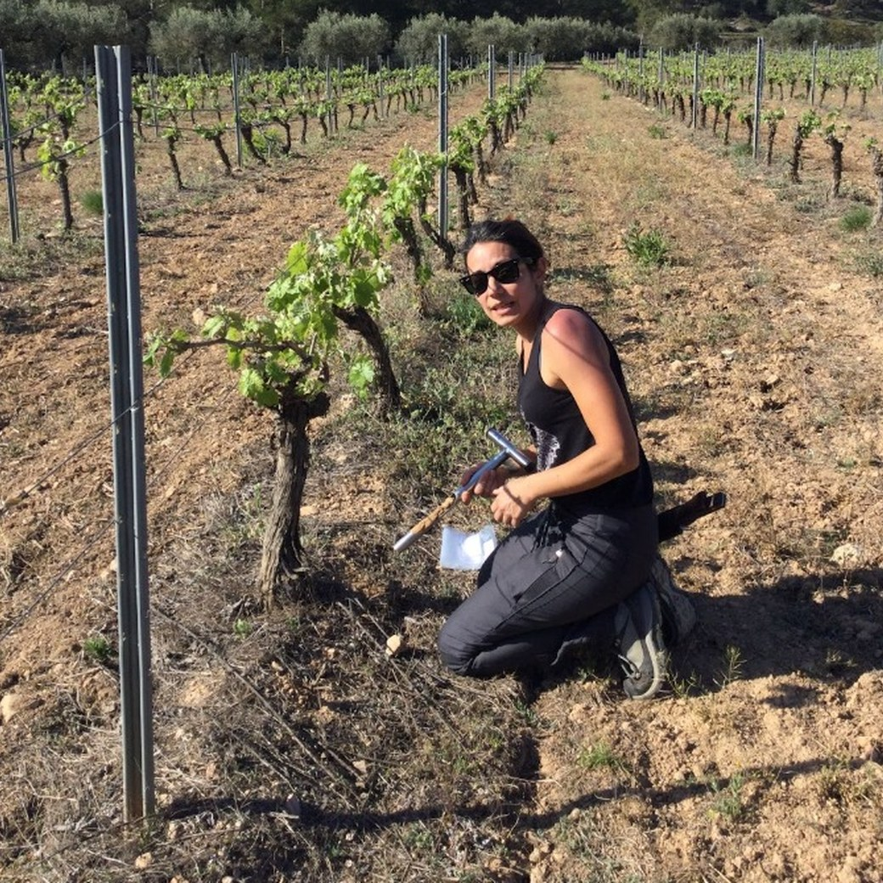
Wesley Sanders
Advanced Programs Mentor
“Compost can look finished and still lack the biology you need. Check it under the microscope before you apply it.”
Isadora Schmidt
Advanced Programs Mentor
From Florianópolis, Brazil, now living in Spain. Favourite: lichens, though she loves all her microbes equally.
Notes:
Mentors: Wesley Sanders, Isadora Schmidt. About lines: drafts from the team notes; confirm with each mentor (05-10-2026-mon-ig-teachers-day-mentors.md). Mentor photos: Linnea's Drive folder (5 Oct 2026) and assets/mentors-teachers-day/; written consent per the folder README.

Slide 6

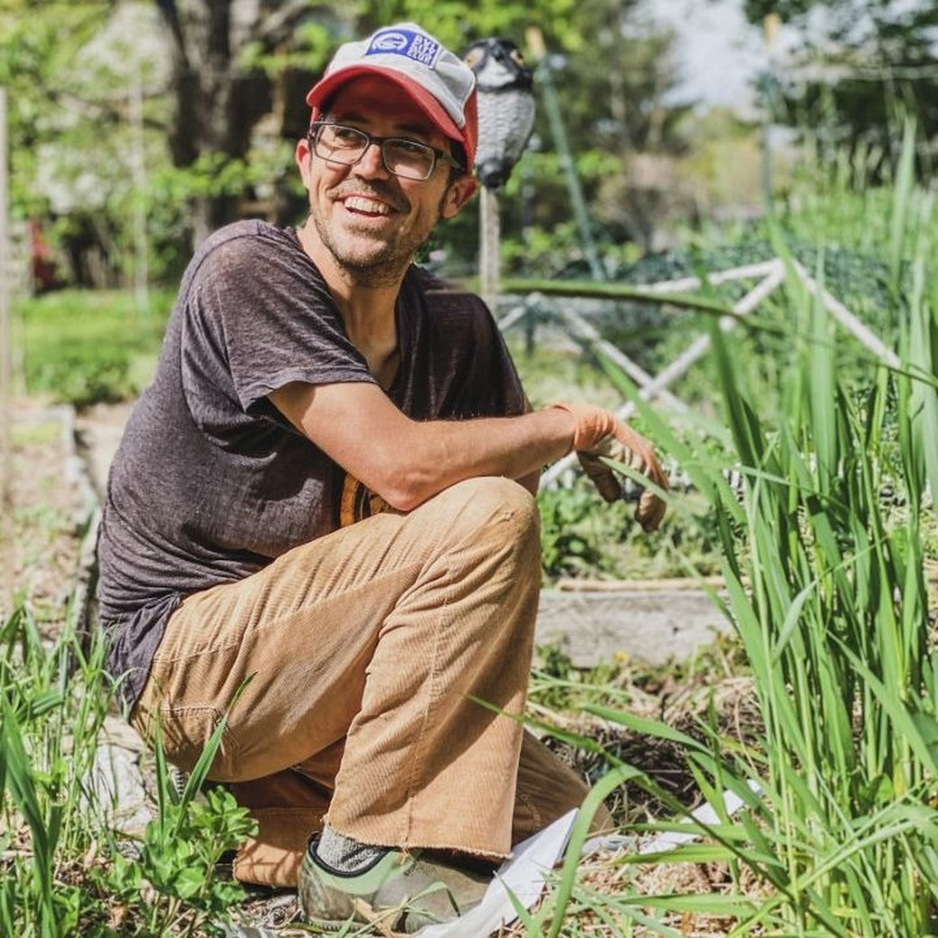
Delvin Solkinson
Permaculture Lead Teacher
Tommy Tepper
Director of Education & Mentor
Notes:
Mentors: Delvin Solkinson, Tommy Tepper. About lines: drafts from the team notes; confirm with each mentor (05-10-2026-mon-ig-teachers-day-mentors.md). Mentor photos: Linnea's Drive folder (5 Oct 2026) and assets/mentors-teachers-day/; written consent per the folder README.

Slide 7
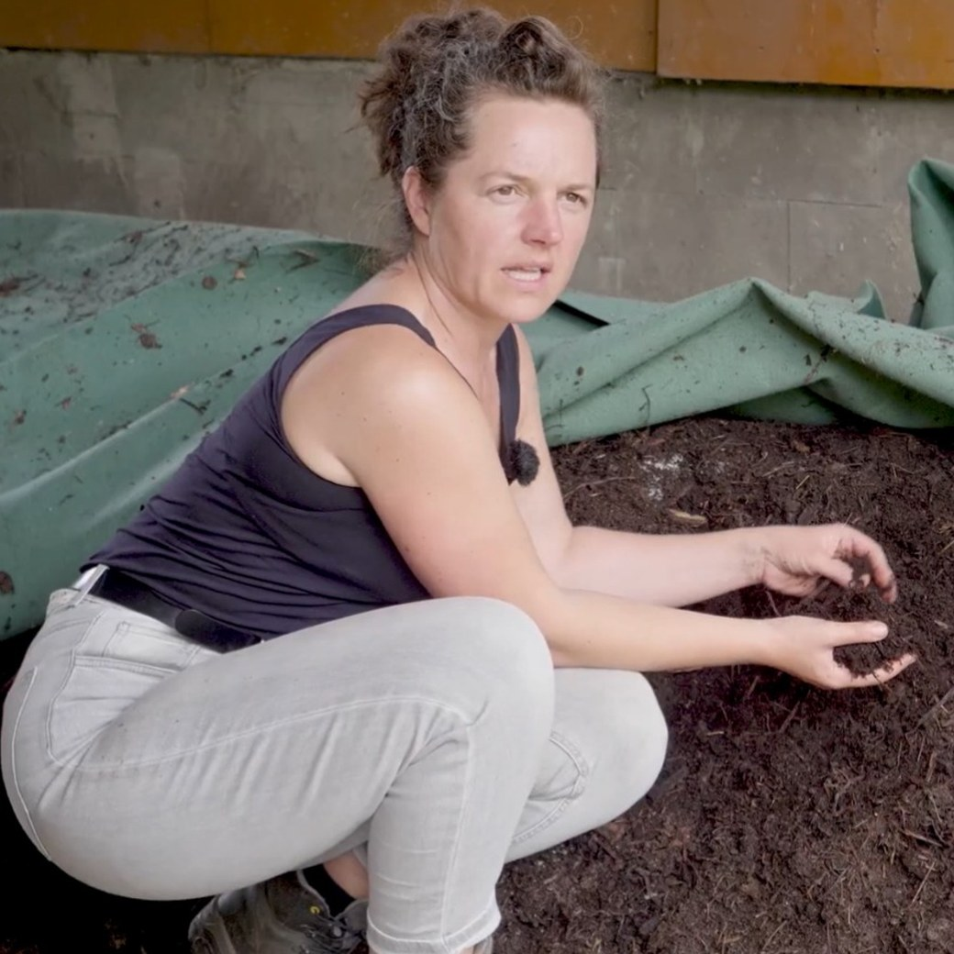
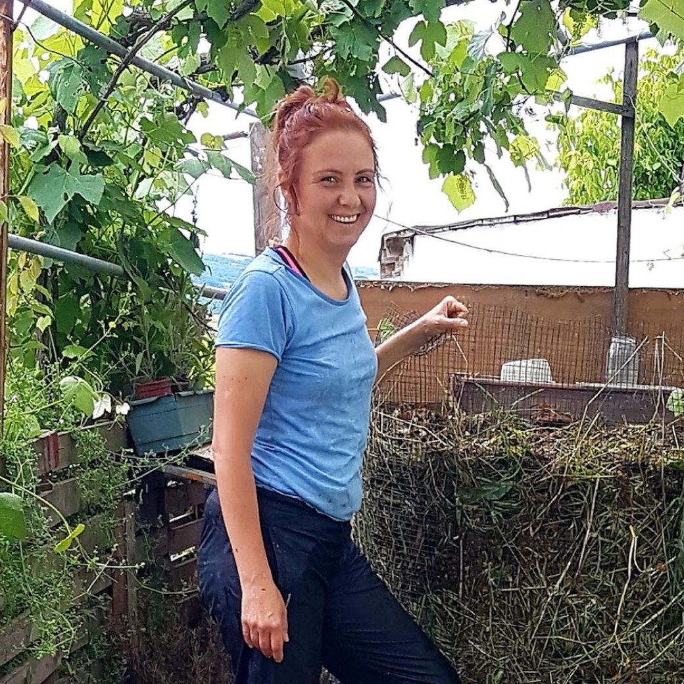
Dora Tkalec
Advanced Programs Mentor
Aysen Ustunay
Advanced Programs Mentor
Favourite microbe: flagellates. She loves watching them as babies, running around.
Notes:
Mentors: Dora Tkalec, Aysen Ustunay. About lines: drafts from the team notes; confirm with each mentor (05-10-2026-mon-ig-teachers-day-mentors.md). Mentor photos: Linnea's Drive folder (5 Oct 2026) and assets/mentors-teachers-day/; written consent per the folder README.

Slide 8
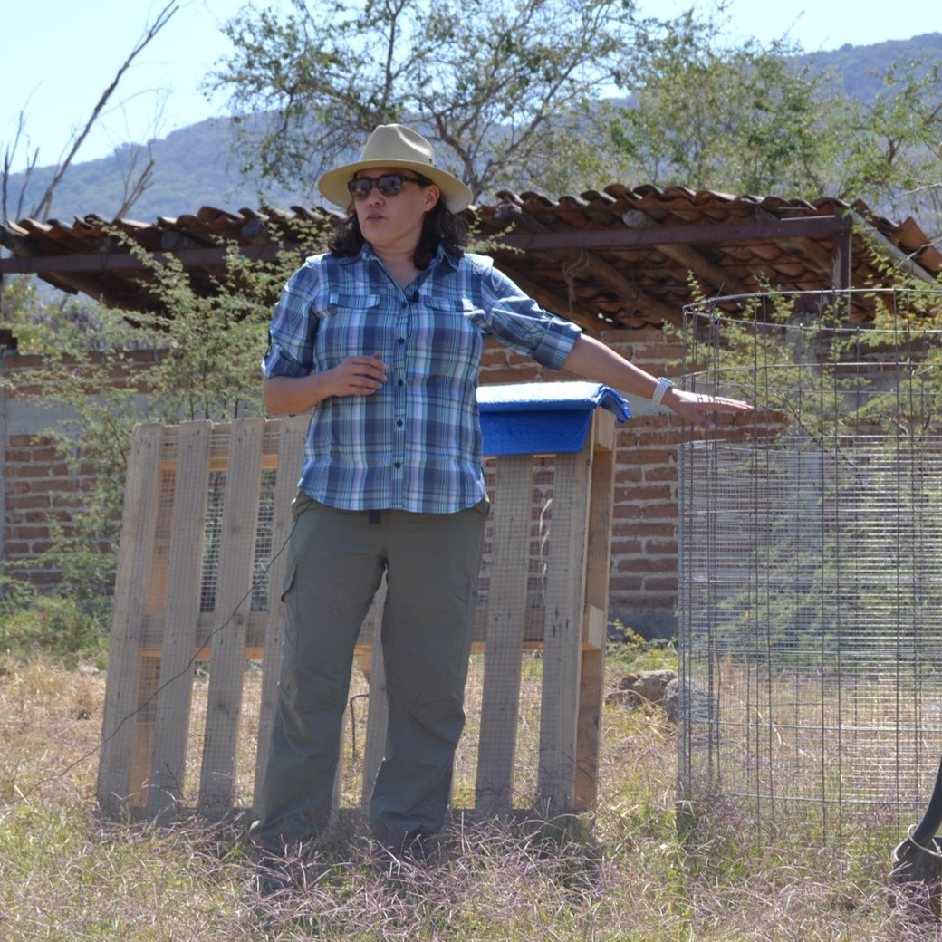

Loida Vasquez
Advanced Programs Lead & Mentor
Casey Williams
Advanced Programs Mentor
Around ten years of farming and gardening. A long-time student, now teaching. Favourite microbe: rotifers.
Notes:
Mentors: Loida Vasquez, Casey Williams. About lines: drafts from the team notes; confirm with each mentor (05-10-2026-mon-ig-teachers-day-mentors.md). Mentor photos: Linnea's Drive folder (5 Oct 2026) and assets/mentors-teachers-day/; written consent per the folder README.

Slide 9














Ib Borup Pederson
Brian Daubenspeck
Elena Kalli
Nick Padwick
Carla Portugal
Gerald Ramirez
Wesley Sanders
Isadora Schmidt
Delvin Solkinson
Tommy Tepper
Dora Tkalec
Aysen Ustunay
Loida Vasquez
Casey Williams
Notes:
All fourteen in a grid, alphabetical. Mentor photos: Linnea's Drive folder (5 Oct 2026) and assets/mentors-teachers-day/; written consent per the folder README.

Slide 10
OCTOBER 5
Happy World Teachers' Day
soilfoodweb.com
Notes:
Closing: bunting, balloons and a big logo. Line to confirm with Linnea.

