Slide 1




OCTOBER 5
Happy World Teachers' Day
Thank you to our instructors and education staff.
Swipe →
Notes:
Cover. Photos: Linnea's Drive folder (5 Oct 2026). Compost: assets/photo/hand-of-compost.jpg. Soil strip: Replicate flat-lay, assets/collage/cutouts/soil-flatlay-border.png. Pressed sprig: Evie S. on Unsplash.

Slide 2
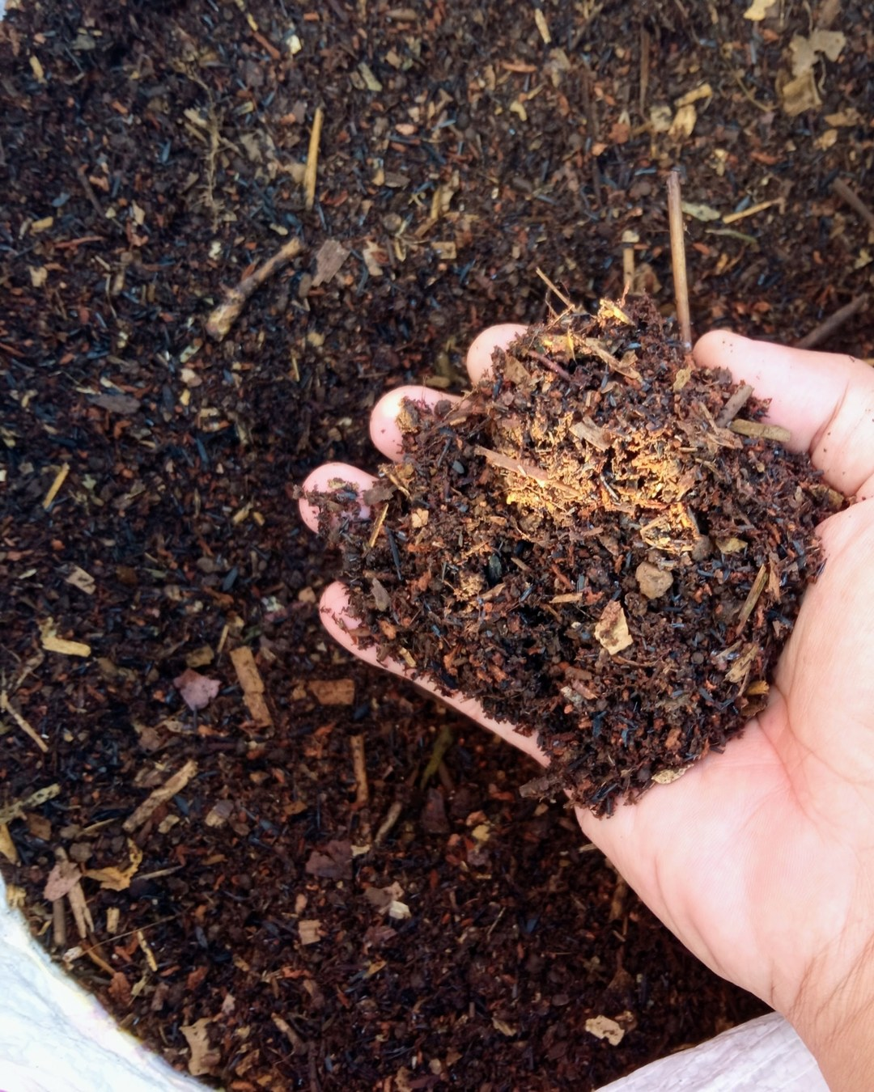

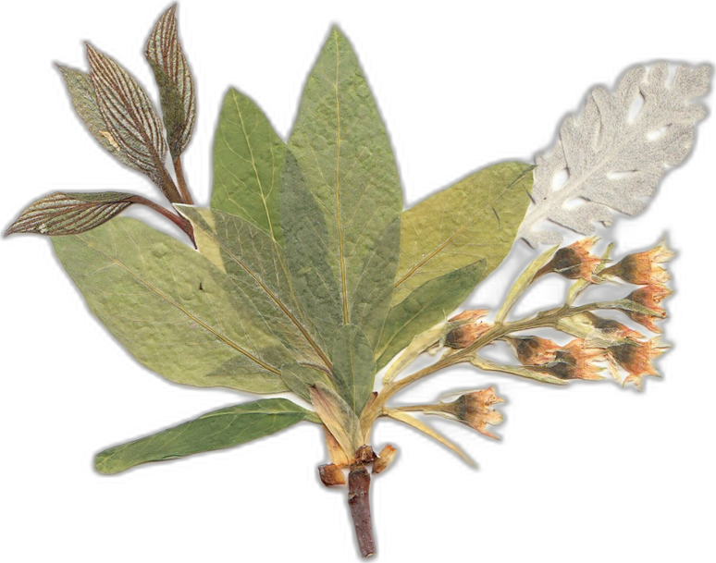

Ib Borup Pedersen
Farmer, Mentor & Consultant
Brian Daubenspeck
Mentor & Consultant
Notes:
People (soil background): Ib Borup Pedersen, Brian Daubenspeck. Photos: Linnea's Drive folder (5 Oct 2026). Compost: assets/photo/hand-of-compost.jpg. Soil strip: Replicate flat-lay, assets/collage/cutouts/soil-flatlay-border.png. Pressed sprig: Evie S. on Unsplash.

Slide 3


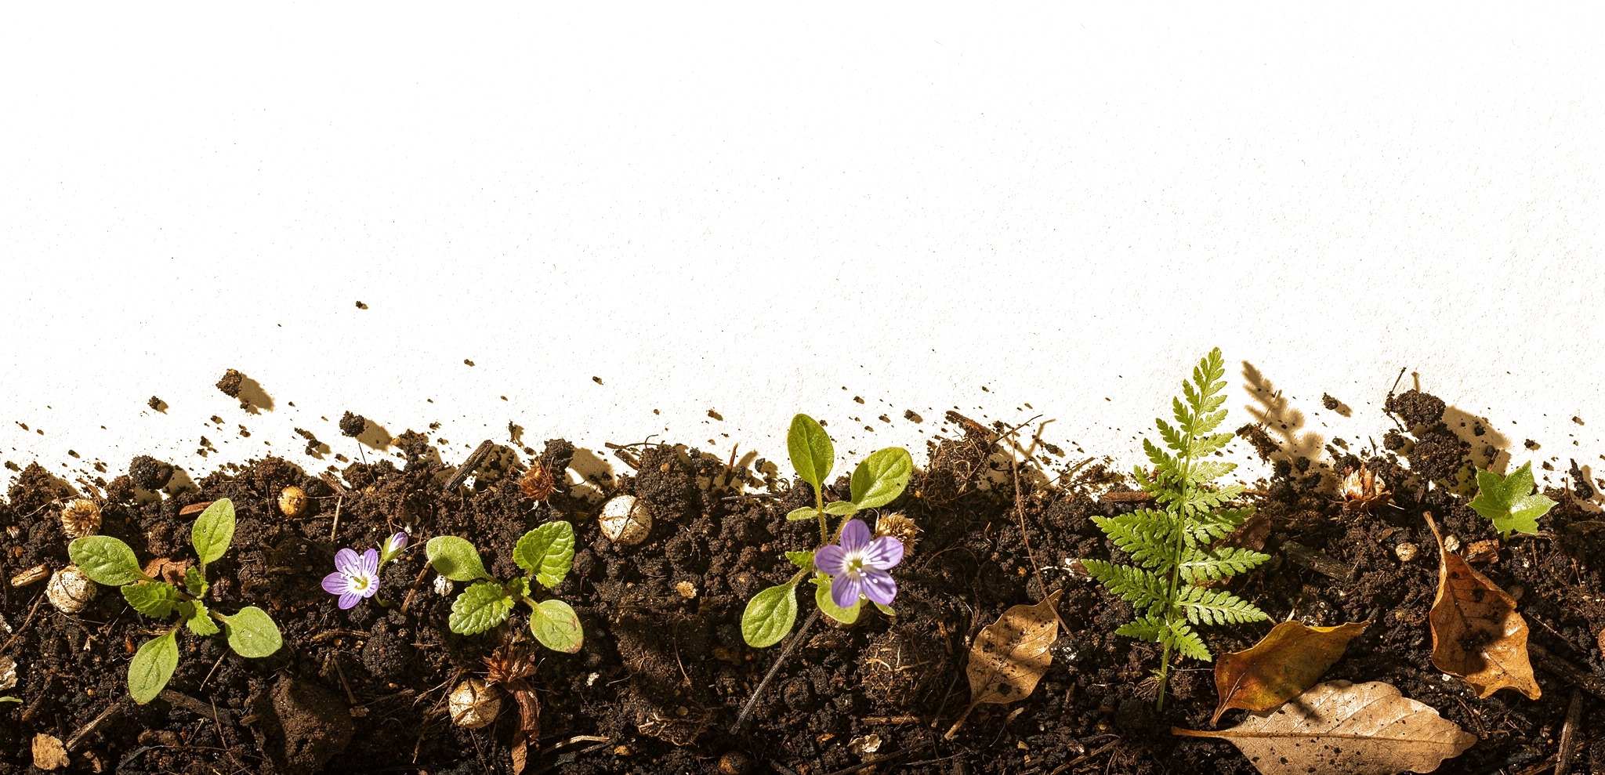
Elena Kalli
School Administration Officer
Nick Padwick
Farmer, Mentor & Consultant
Notes:
People (sage background): Elena Kalli, Nick Padwick. Photos: Linnea's Drive folder (5 Oct 2026). Compost: assets/photo/hand-of-compost.jpg. Soil strip: Replicate flat-lay, assets/collage/cutouts/soil-flatlay-border.png. Pressed sprig: Evie S. on Unsplash.

Slide 4


Dr. Carla Ribeiro Machado e Portugal
Mentor & Science Lead
Gerald Ramírez
Mentor
Notes:
People (dark background): Carla Ribeiro Machado e Portugal, Gerald Ramírez. Photos: Linnea's Drive folder (5 Oct 2026). Compost: assets/photo/hand-of-compost.jpg. Soil strip: Replicate flat-lay, assets/collage/cutouts/soil-flatlay-border.png. Pressed sprig: Evie S. on Unsplash.

Slide 5


Kavi Reddy
Permaculture Instructor
Wesley Sander
Mentor & Consultant
Notes:
People (soil background): Kavi Reddy, Wesley Sander. Photos: Linnea's Drive folder (5 Oct 2026). Compost: assets/photo/hand-of-compost.jpg. Soil strip: Replicate flat-lay, assets/collage/cutouts/soil-flatlay-border.png. Pressed sprig: Evie S. on Unsplash.

Slide 6

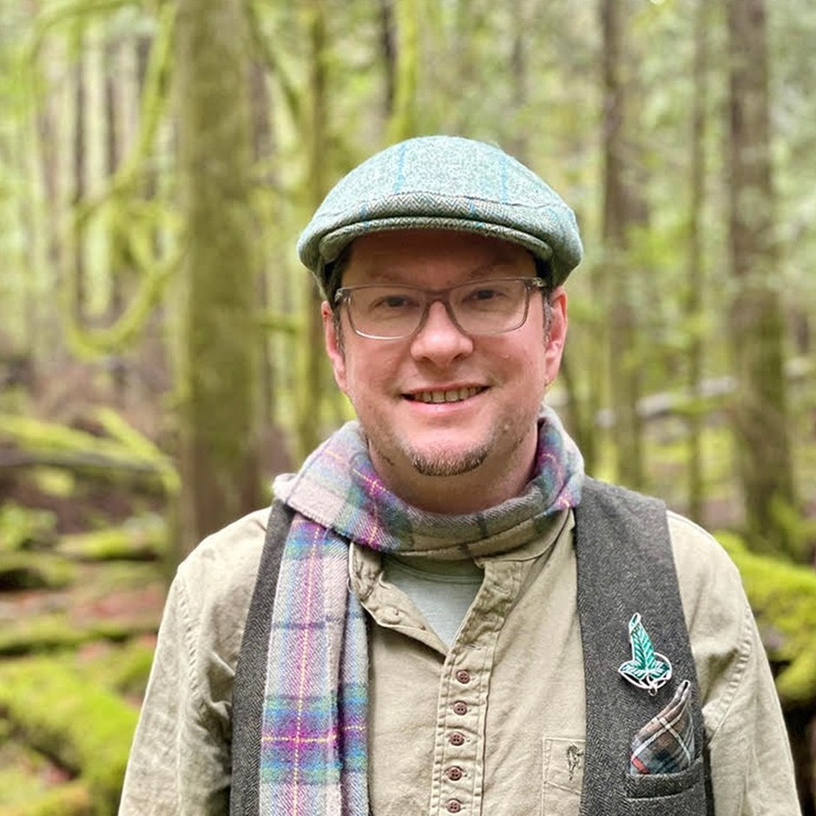
Isadora Schmidt
Mentor & Consultant
Delvin Solkinson
Graham Bell Legacy PDC Permaculture Lead Instructor
Notes:
People (sage background): Isadora Schmidt, Delvin Solkinson. Photos: Linnea's Drive folder (5 Oct 2026). Compost: assets/photo/hand-of-compost.jpg. Soil strip: Replicate flat-lay, assets/collage/cutouts/soil-flatlay-border.png. Pressed sprig: Evie S. on Unsplash.

Slide 7


Tommy Tepper
Education Department Director & Mentor
Dora Tkalec
Mentor & Consultant
Notes:
People (dark background): Tommy Tepper, Dora Tkalec. Photos: Linnea's Drive folder (5 Oct 2026). Compost: assets/photo/hand-of-compost.jpg. Soil strip: Replicate flat-lay, assets/collage/cutouts/soil-flatlay-border.png. Pressed sprig: Evie S. on Unsplash.

Slide 8


Ayşen Üstünay
Mentor & Consultant
Loida Vasquez
Advanced Programs Lead & Mentor
Notes:
People (soil background): Ayşen Üstünay, Loida Vasquez. Photos: Linnea's Drive folder (5 Oct 2026). Compost: assets/photo/hand-of-compost.jpg. Soil strip: Replicate flat-lay, assets/collage/cutouts/soil-flatlay-border.png. Pressed sprig: Evie S. on Unsplash.

Slide 9

Casey Williams
Mentor & Consultant
Thank you to all our instructors and education staff.
Notes:
People (sage background): Casey Williams. Photos: Linnea's Drive folder (5 Oct 2026). Compost: assets/photo/hand-of-compost.jpg. Soil strip: Replicate flat-lay, assets/collage/cutouts/soil-flatlay-border.png. Pressed sprig: Evie S. on Unsplash.

Slide 10














Happy World Teachers' Day
Ib Borup Pedersen
Brian Daubenspeck
Elena Kalli
Nick Padwick
Carla Portugal
Gerald Ramírez
Kavi Reddy
Wesley Sander
Isadora Schmidt
Delvin Solkinson
Tommy Tepper
Dora Tkalec
Ayşen Üstünay
Loida Vasquez
Casey Williams
Notes:
Everyone in one grid. Photos: Linnea's Drive folder (5 Oct 2026). Compost: assets/photo/hand-of-compost.jpg. Soil strip: Replicate flat-lay, assets/collage/cutouts/soil-flatlay-border.png. Pressed sprig: Evie S. on Unsplash.

