Slide 1

Paper-cut field notes
The Soil Food Web Foundation collage library

Slide 2
Soil food web creatures
1 pieces

Slide 3
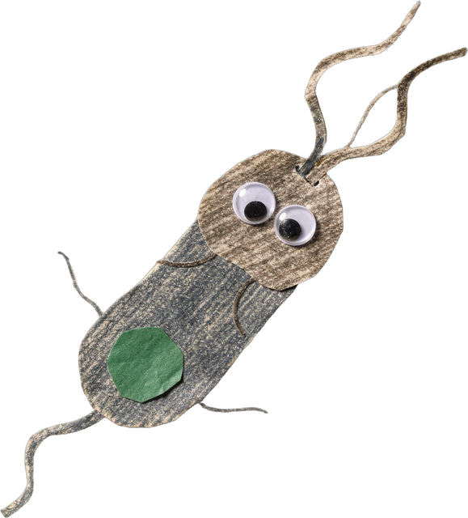
SOIL FOOD WEB CREATURES
Rod-shaped bacterium (bacillus)
Notes:
Piece: assets/collage/cutouts/critter-bacillus-1.png. Made with flux-2-pro and style-reference.png (tools/collage_generate.py).

Slide 4
Soil life
9 pieces

Slide 5
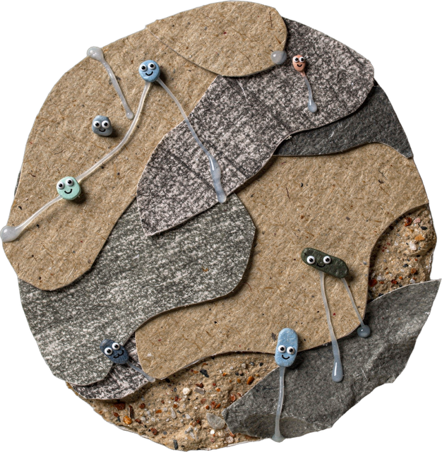
SOIL LIFE
Bacteria on a sand grain
Notes:
Piece: assets/collage/cutouts/bacteria-sand-grain-1.png. Made with flux-2-pro and style-reference.png (tools/collage_generate.py).

Slide 6
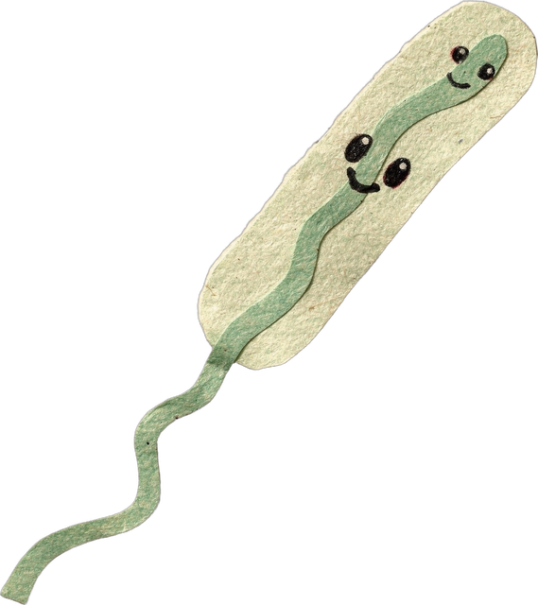
SOIL LIFE
Bacterium
Notes:
Piece: assets/collage/cutouts/cute-bacterium-1.png. Made with flux-2-pro and style-reference.png (tools/collage_generate.py).

Slide 7
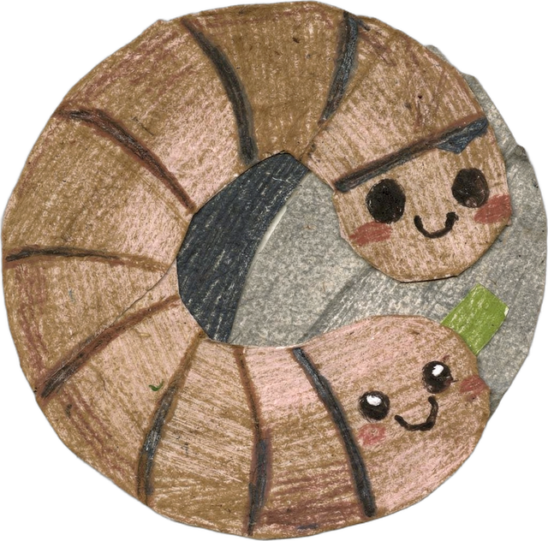
SOIL LIFE
Earthworm
Notes:
Piece: assets/collage/cutouts/earthworm-paper-1.png. Made with flux-2-pro and style-reference.png (tools/collage_generate.py).

Slide 8
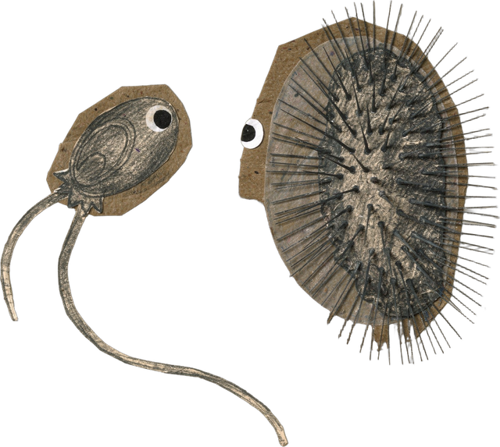
SOIL LIFE
Flagellate and ciliate
Notes:
Piece: assets/collage/cutouts/flagellate-ciliate-1.png. Made with flux-2-pro and style-reference.png (tools/collage_generate.py).

Slide 9
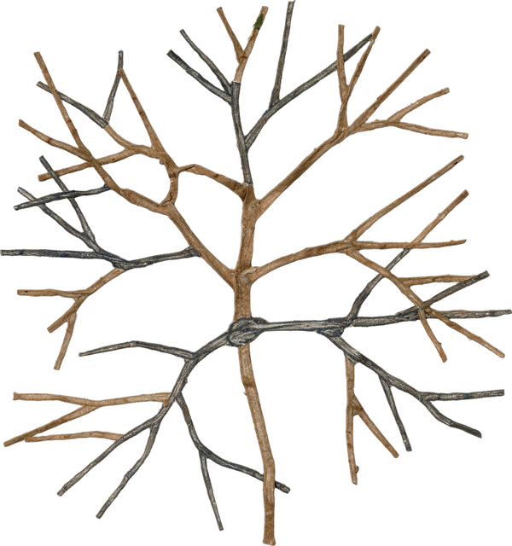
SOIL LIFE
Fungal hyphae
Notes:
Piece: assets/collage/cutouts/fungal-hyphae-1.png. Made with flux-2-pro and style-reference.png (tools/collage_generate.py).

Slide 10
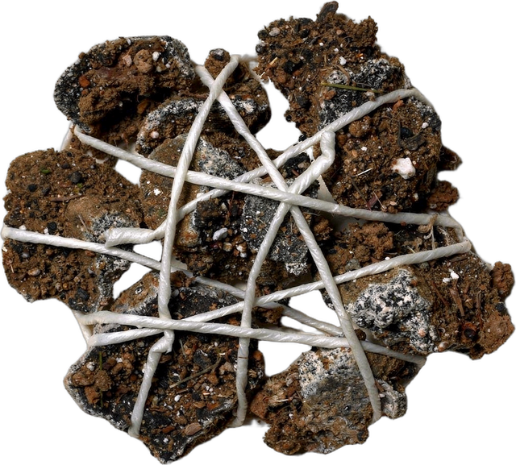
SOIL LIFE
Fungi tying soil crumbs
Notes:
Piece: assets/collage/cutouts/fungi-tie-crumbs-1.png. Made with flux-2-pro and style-reference.png (tools/collage_generate.py).

Slide 11
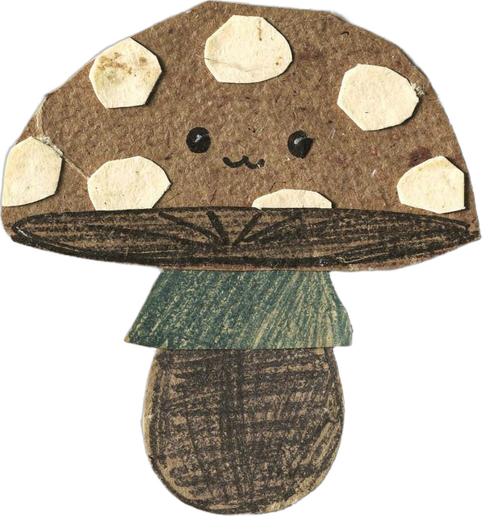
SOIL LIFE
Mushroom
Notes:
Piece: assets/collage/cutouts/mushroom-paper-1.png. Made with flux-2-pro and style-reference.png (tools/collage_generate.py).

Slide 12
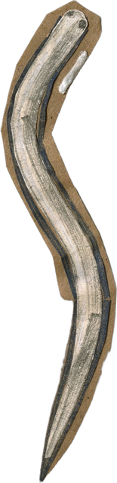
SOIL LIFE
Nematode
Notes:
Piece: assets/collage/cutouts/nematode-1.png. Made with flux-2-pro and style-reference.png (tools/collage_generate.py).

Slide 13
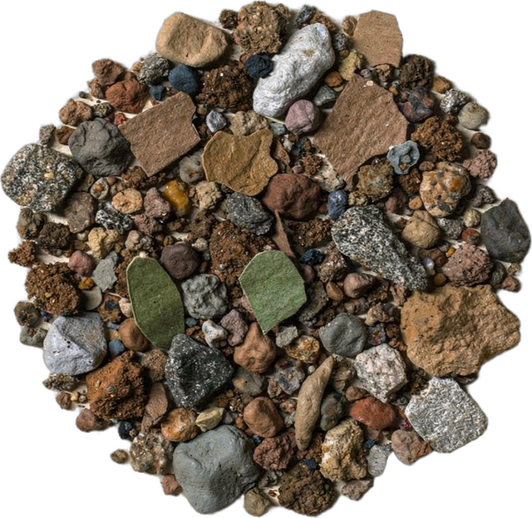
SOIL LIFE
Soil crumb (micro aggregate)
Notes:
Piece: assets/collage/cutouts/soil-crumb-1.png. Made with flux-2-pro and style-reference.png (tools/collage_generate.py).

Slide 14
Plants and roots
12 pieces

Slide 15
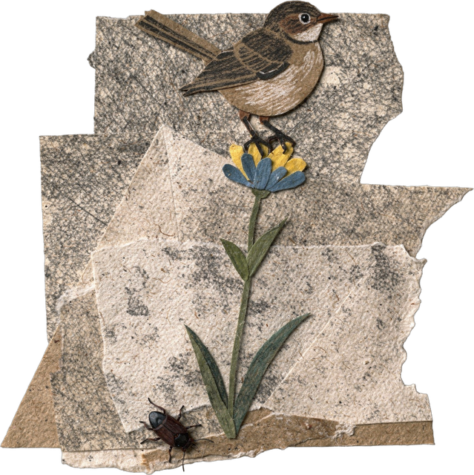
PLANTS AND ROOTS
Bird, beetle and wildflower
Notes:
Piece: assets/collage/cutouts/bird-beetle-wildflower-1.png. Made with flux-2-pro and style-reference.png (tools/collage_generate.py).

Slide 16
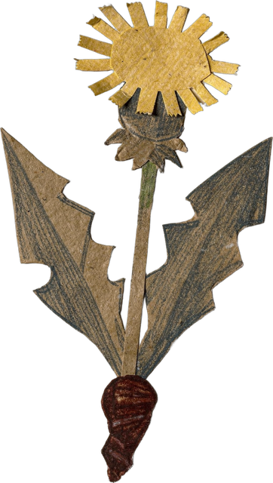
PLANTS AND ROOTS
Dandelion, short root
Notes:
Piece: assets/collage/cutouts/dandelion-short-root-1.png. Made with flux-2-pro and style-reference.png (tools/collage_generate.py).

Slide 17
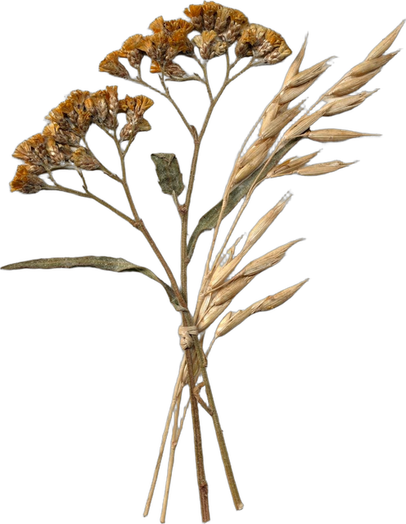
PLANTS AND ROOTS
Dried flowers
Notes:
Piece: assets/collage/cutouts/dried-flowers-1-1.png. Made with flux-2-pro and style-reference.png (tools/collage_generate.py).

Slide 18
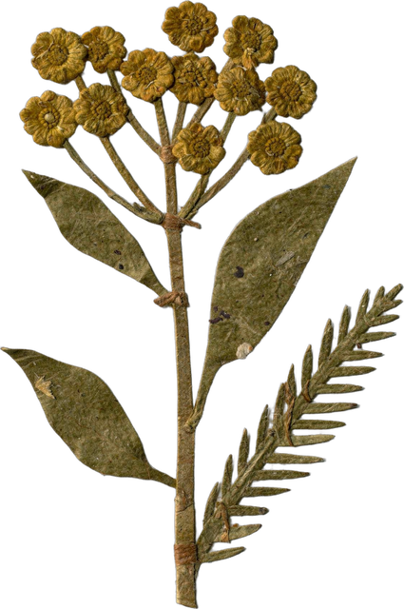
PLANTS AND ROOTS
Dried flower sprig
Notes:
Piece: assets/collage/cutouts/dried-flowers-2-1.png. Made with flux-2-pro and style-reference.png (tools/collage_generate.py).

Slide 19
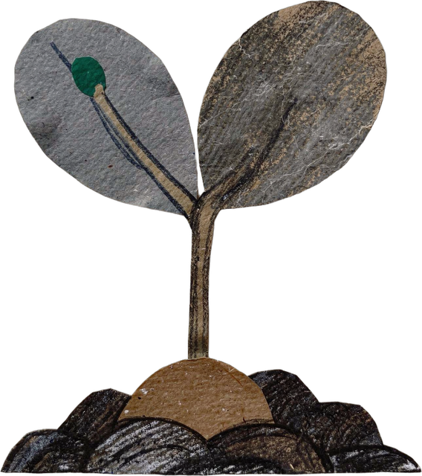
PLANTS AND ROOTS
Happy seedling
Notes:
Piece: assets/collage/cutouts/happy-seedling-1.png. Made with flux-2-pro and style-reference.png (tools/collage_generate.py).

Slide 20
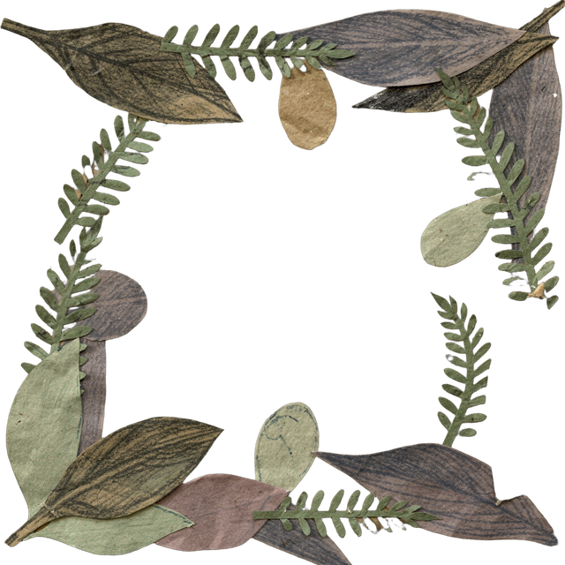
PLANTS AND ROOTS
Leaf frame
Notes:
Piece: assets/collage/cutouts/leaf-frame-1.png. Made with flux-2-pro and style-reference.png (tools/collage_generate.py).

Slide 21
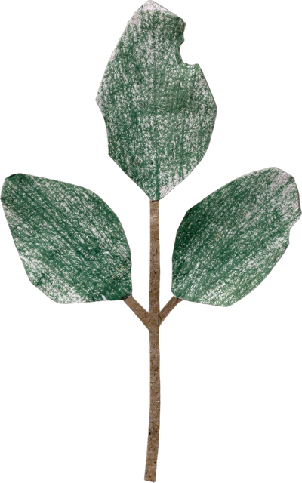
PLANTS AND ROOTS
Leaf sprig
Notes:
Piece: assets/collage/cutouts/leaf-sprig-paper-1.png. Made with flux-2-pro and style-reference.png (tools/collage_generate.py).

Slide 22
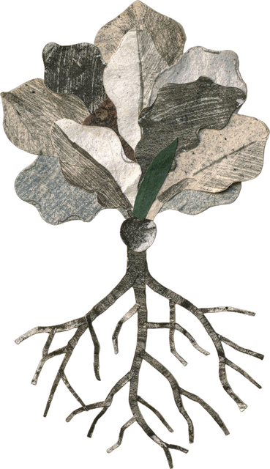
PLANTS AND ROOTS
Lettuce, long root
Notes:
Piece: assets/collage/cutouts/lettuce-long-root-1.png. Made with flux-2-pro and style-reference.png (tools/collage_generate.py).

Slide 23
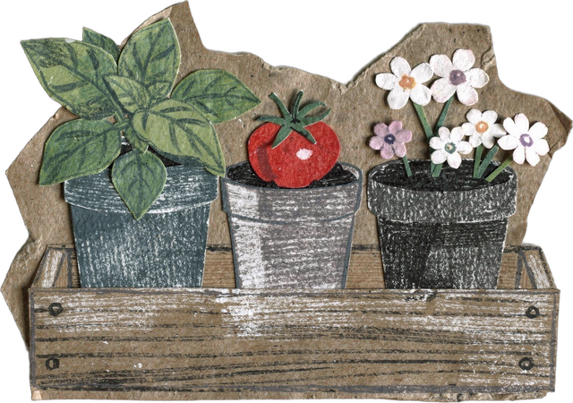
PLANTS AND ROOTS
Seedling tray
Notes:
Piece: assets/collage/cutouts/seedling-tray-1.png. Made with flux-2-pro and style-reference.png (tools/collage_generate.py).

Slide 24
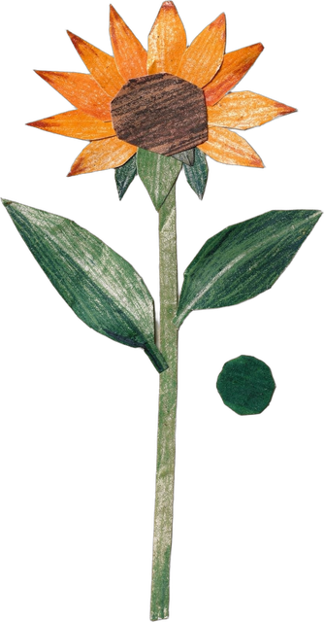
PLANTS AND ROOTS
Tithonia
Notes:
Piece: assets/collage/cutouts/tithonia-flower-1.png. Made with flux-2-pro and style-reference.png (tools/collage_generate.py).

Slide 25
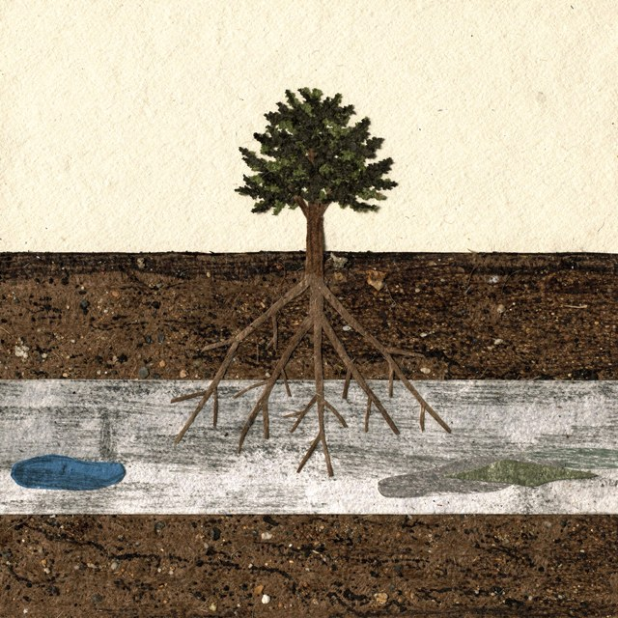
PLANTS AND ROOTS
Tree on a compacted layer
Notes:
Piece: assets/collage/originals/tree-compaction-1.png. Made with flux-2-pro and style-reference.png (tools/collage_generate.py).

Slide 26
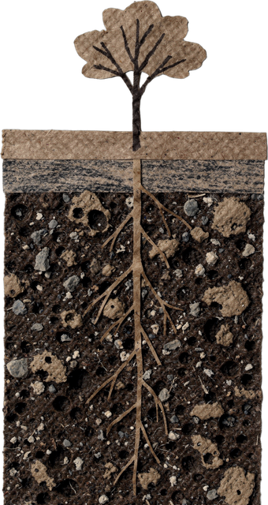
PLANTS AND ROOTS
Tree with deep roots
Notes:
Piece: assets/collage/cutouts/tree-deep-roots-1.png. Made with flux-2-pro and style-reference.png (tools/collage_generate.py).

Slide 27
Kitchen and exudates
7 pieces

Slide 28
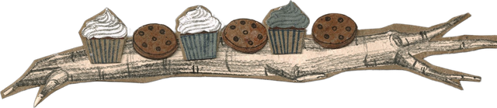
KITCHEN AND EXUDATES
Cupcakes and cookies on a root
Notes:
Piece: assets/collage/cutouts/cupcakes-cookies-root-1.png. Made with flux-2-pro and style-reference.png (tools/collage_generate.py).

Slide 29
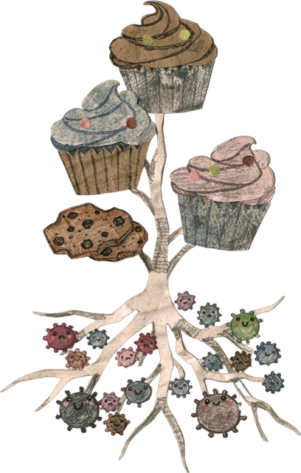
KITCHEN AND EXUDATES
Cupcakes, a root and microbes
Notes:
Piece: assets/collage/cutouts/cupcakes-root-microbes-1.png. Made with flux-2-pro and style-reference.png (tools/collage_generate.py).

Slide 30
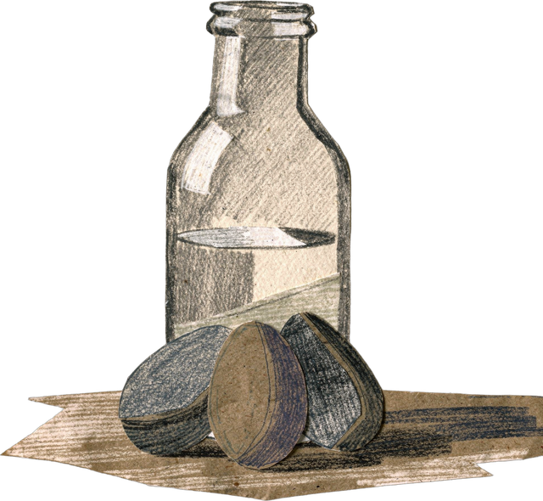
KITCHEN AND EXUDATES
Eggs and milk
Notes:
Piece: assets/collage/cutouts/eggs-milk-1.png. Made with flux-2-pro and style-reference.png (tools/collage_generate.py).

Slide 31
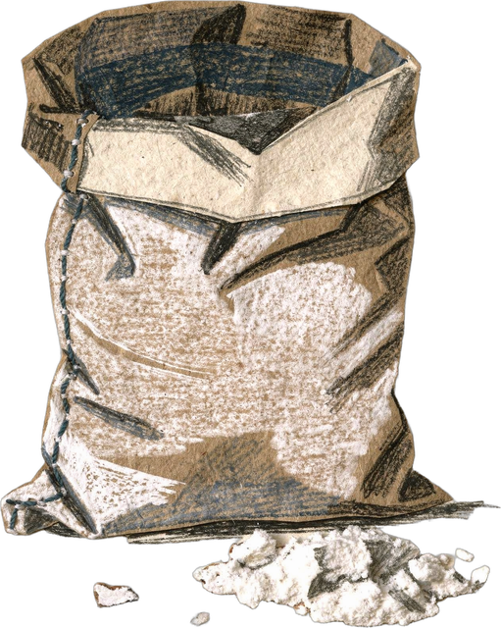
KITCHEN AND EXUDATES
Flour sack
Notes:
Piece: assets/collage/cutouts/flour-sack-1.png. Made with flux-2-pro and style-reference.png (tools/collage_generate.py).

Slide 32
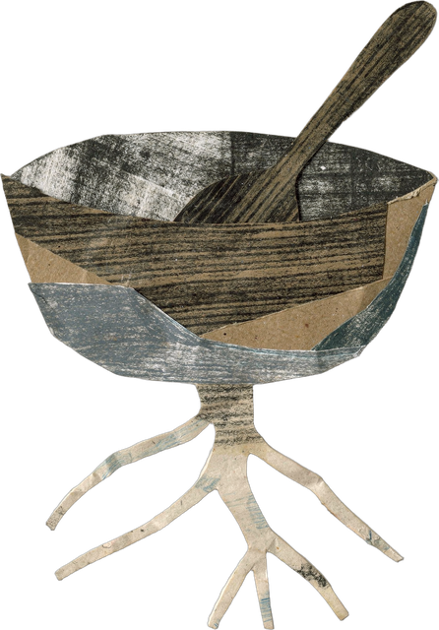
KITCHEN AND EXUDATES
Mixing bowl on a root
Notes:
Piece: assets/collage/cutouts/mixing-bowl-root-1.png. Made with flux-2-pro and style-reference.png (tools/collage_generate.py).

Slide 33
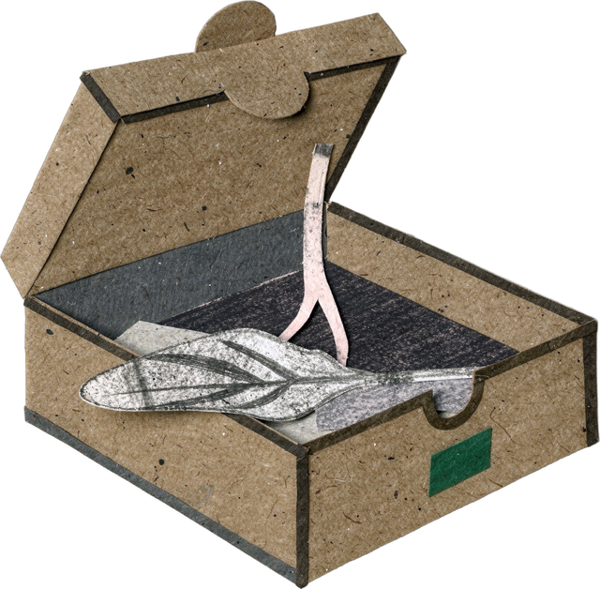
KITCHEN AND EXUDATES
Pizza box with a root
Notes:
Piece: assets/collage/cutouts/pizza-box-root-1.png. Made with flux-2-pro and style-reference.png (tools/collage_generate.py).

Slide 34
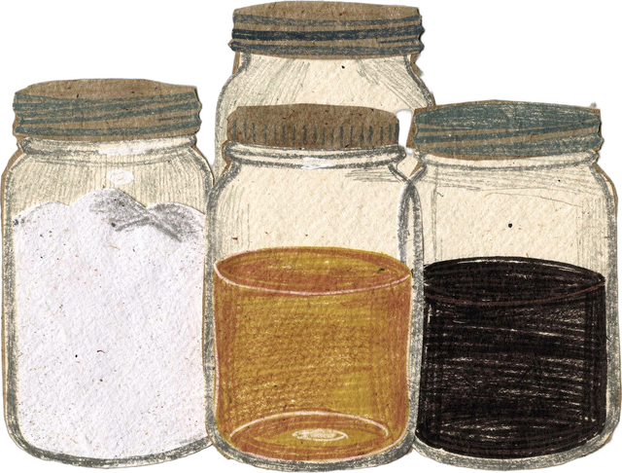
KITCHEN AND EXUDATES
Sugar, honey and molasses
Notes:
Piece: assets/collage/cutouts/sugar-jars-1.png. Made with flux-2-pro and style-reference.png (tools/collage_generate.py).

Slide 35
Farm and food
9 pieces

Slide 36
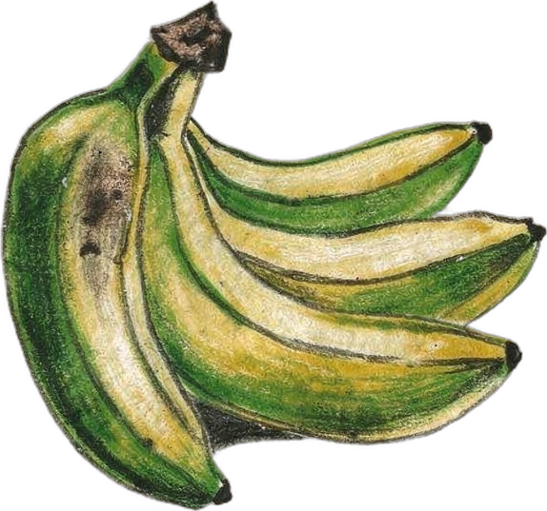
FARM AND FOOD
Bananas
Notes:
Piece: assets/collage/cutouts/banana-bunch-1.png. Made with flux-2-pro and style-reference.png (tools/collage_generate.py).

Slide 37
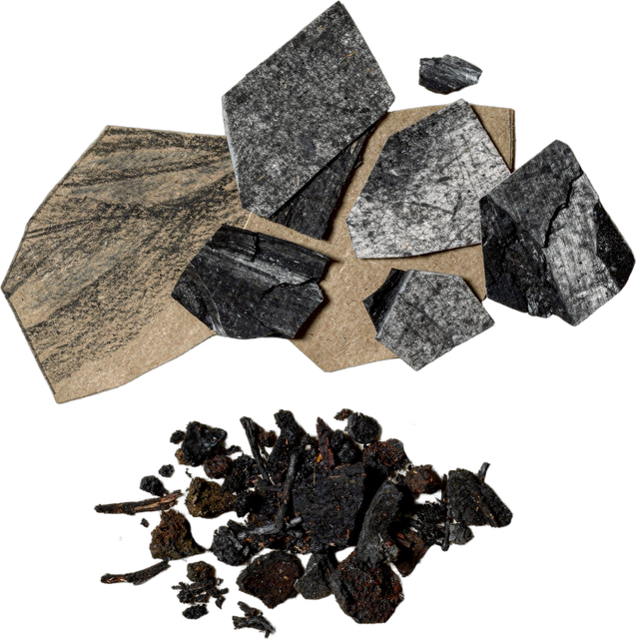
FARM AND FOOD
Biochar and compost
Notes:
Piece: assets/collage/cutouts/biochar-compost-1.png. Made with flux-2-pro and style-reference.png (tools/collage_generate.py).

Slide 38
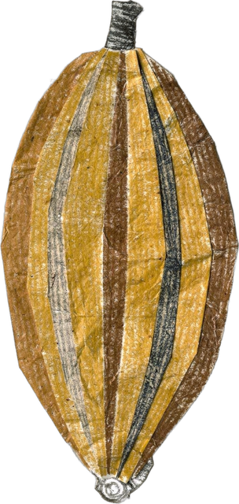
FARM AND FOOD
Cacao pod
Notes:
Piece: assets/collage/cutouts/cacao-pod-1.png. Made with flux-2-pro and style-reference.png (tools/collage_generate.py).

Slide 39
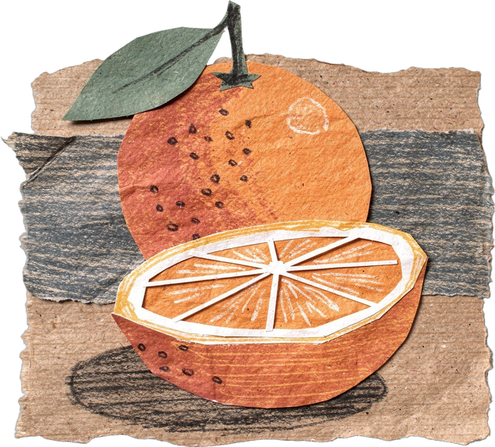
FARM AND FOOD
Orange
Notes:
Piece: assets/collage/cutouts/citrus-orange-1.png. Made with flux-2-pro and style-reference.png (tools/collage_generate.py).

Slide 40
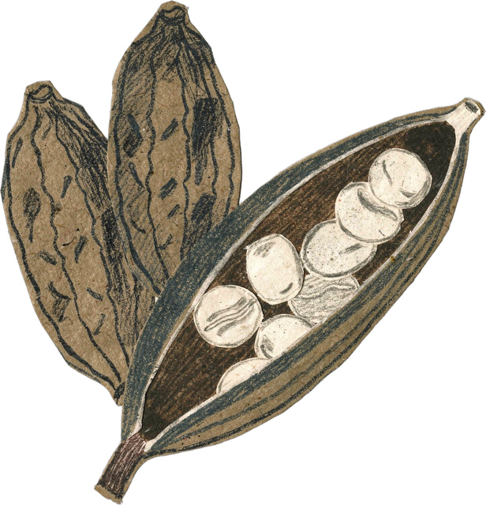
FARM AND FOOD
Cocoa beans
Notes:
Piece: assets/collage/cutouts/cocoa-beans-1.png. Made with flux-2-pro and style-reference.png (tools/collage_generate.py).

Slide 41
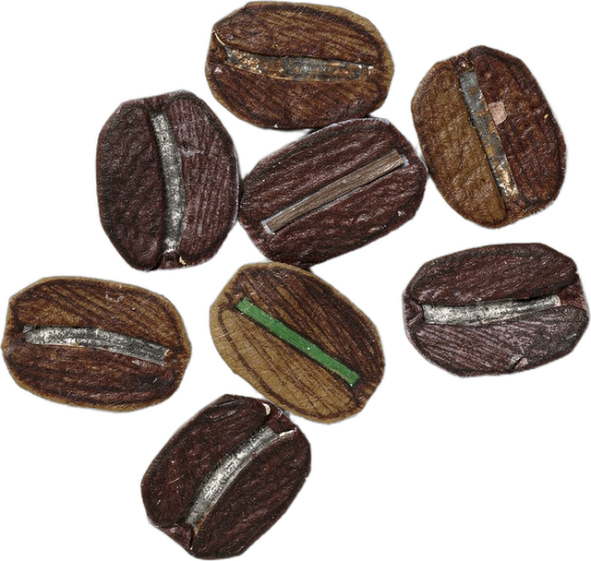
FARM AND FOOD
Coffee beans
Notes:
Piece: assets/collage/cutouts/coffee-beans-paper-1.png. Made with flux-2-pro and style-reference.png (tools/collage_generate.py).

Slide 42
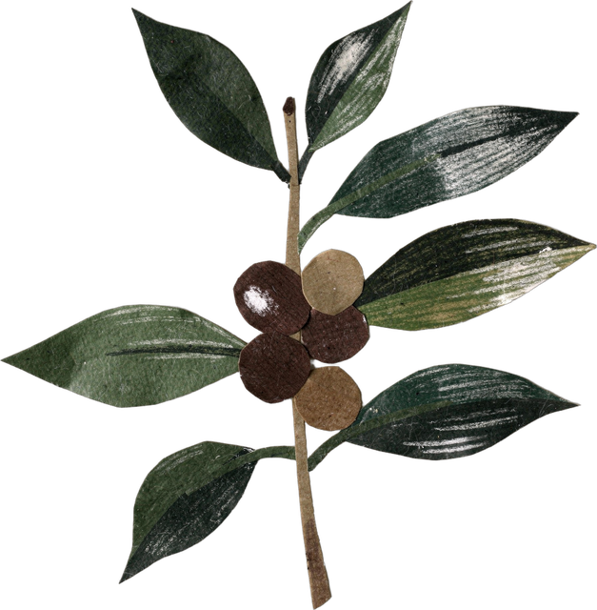
FARM AND FOOD
Coffee cherries
Notes:
Piece: assets/collage/cutouts/coffee-cherries-branch-1.png. Made with flux-2-pro and style-reference.png (tools/collage_generate.py).

Slide 43

FARM AND FOOD
Coffee cup
Notes:
Piece: assets/collage/cutouts/coffee-cup-paper-1.png. Made with flux-2-pro and style-reference.png (tools/collage_generate.py).

Slide 44
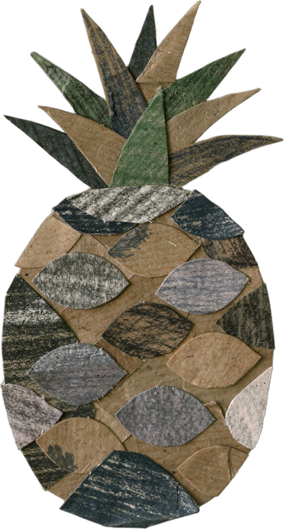
FARM AND FOOD
Pineapple
Notes:
Piece: assets/collage/cutouts/pineapple-1.png. Made with flux-2-pro and style-reference.png (tools/collage_generate.py).

Slide 45
Places and things
9 pieces

Slide 46
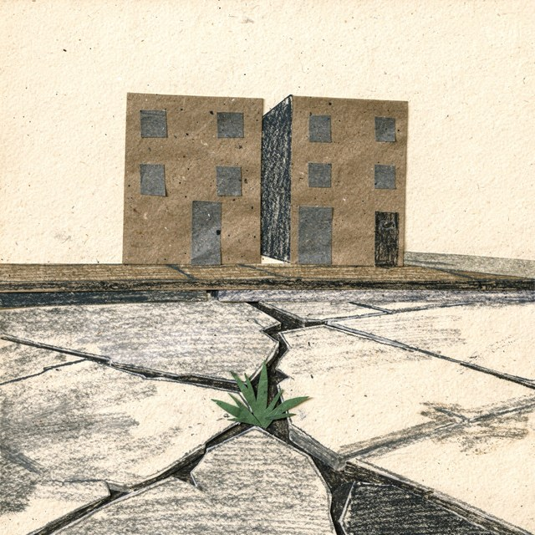
PLACES AND THINGS
Weed in a cracked sidewalk
Notes:
Piece: assets/collage/originals/city-block-weed-1.png. Made with flux-2-pro and style-reference.png (tools/collage_generate.py).

Slide 47
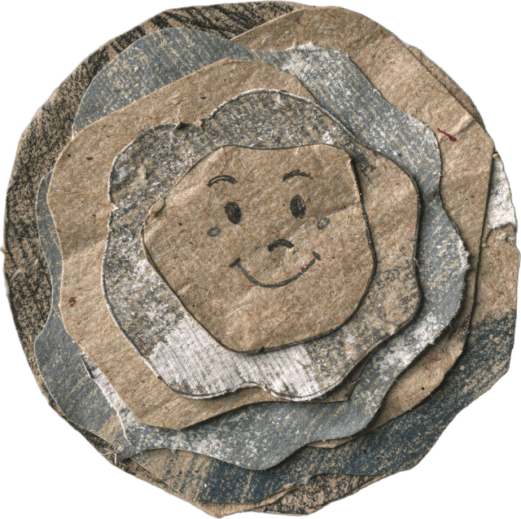
PLACES AND THINGS
Cow pat
Notes:
Piece: assets/collage/cutouts/cow-poop-sticker-1.png. Made with flux-2-pro and style-reference.png (tools/collage_generate.py).

Slide 48
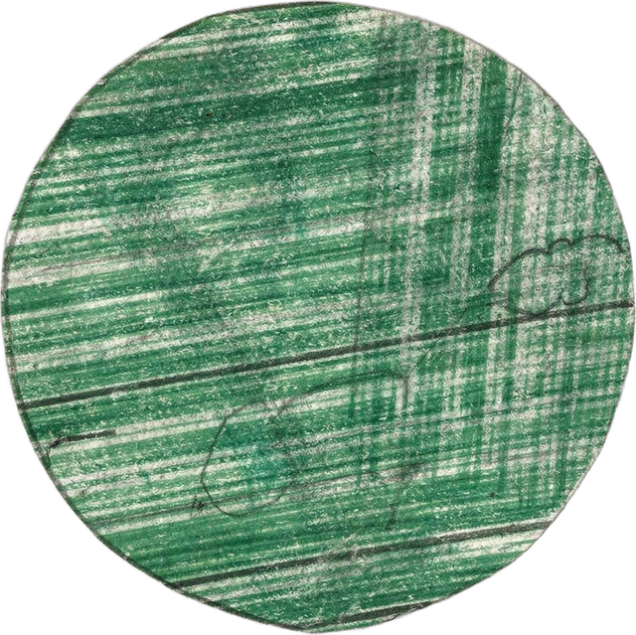
PLACES AND THINGS
Green dot
Notes:
Piece: assets/collage/cutouts/dot-green-1.png. Made with flux-2-pro and style-reference.png (tools/collage_generate.py).

Slide 49
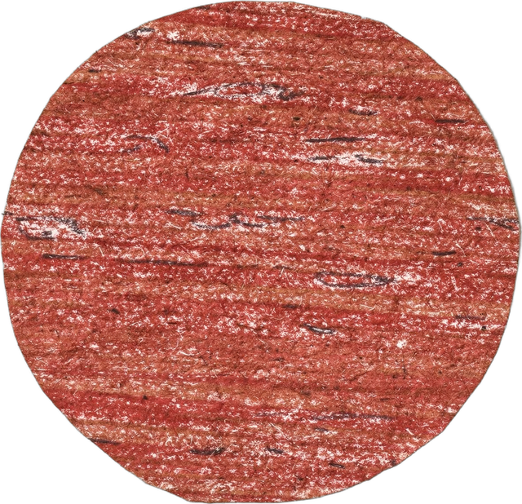
PLACES AND THINGS
Red dot
Notes:
Piece: assets/collage/cutouts/dot-red-1.png. Made with flux-2-pro and style-reference.png (tools/collage_generate.py).

Slide 50
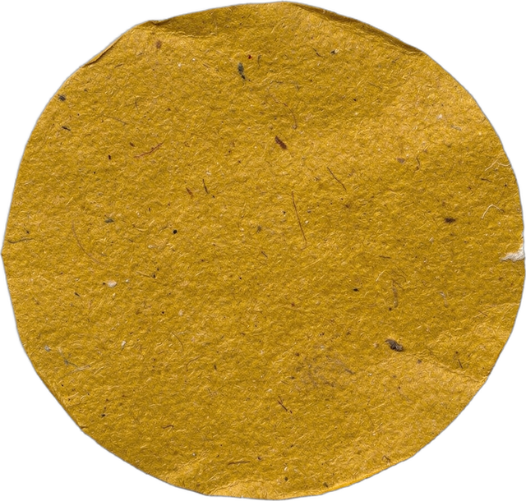
PLACES AND THINGS
Yellow dot
Notes:
Piece: assets/collage/cutouts/dot-yellow-1.png. Made with flux-2-pro and style-reference.png (tools/collage_generate.py).

Slide 51
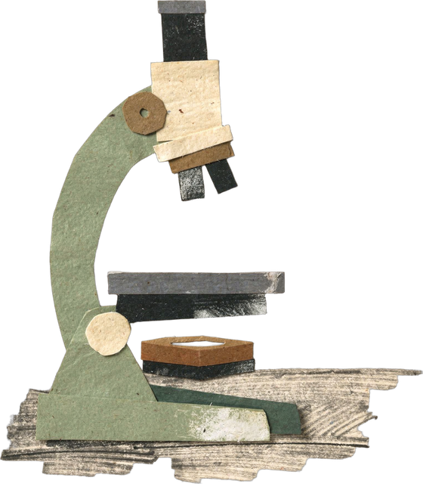
PLACES AND THINGS
Microscope
Notes:
Piece: assets/collage/cutouts/microscope-paper-1.png. Made with flux-2-pro and style-reference.png (tools/collage_generate.py).

Slide 52
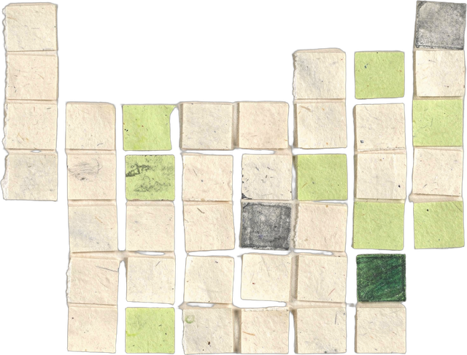
PLACES AND THINGS
Periodic table
Notes:
Piece: assets/collage/cutouts/periodic-table-1.png. Made with flux-2-pro and style-reference.png (tools/collage_generate.py).

Slide 53
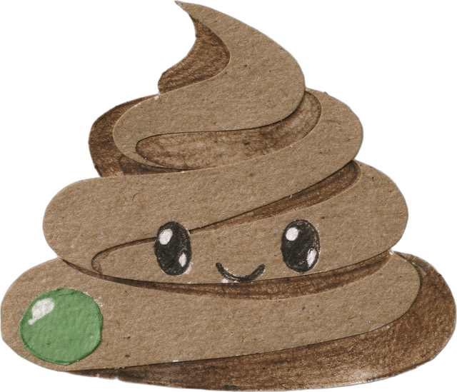
PLACES AND THINGS
Poop
Notes:
Piece: assets/collage/cutouts/poop-sticker-1.png. Made with flux-2-pro and style-reference.png (tools/collage_generate.py).

Slide 54
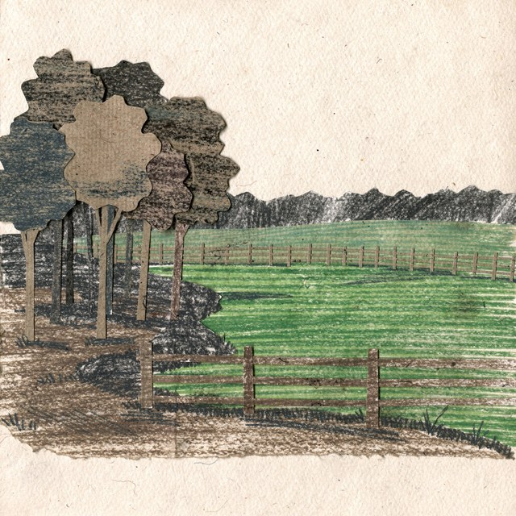
PLACES AND THINGS
Woodlot and pasture
Notes:
Piece: assets/collage/originals/woodlot-pasture-1.png. Made with flux-2-pro and style-reference.png (tools/collage_generate.py).

