Slide 1
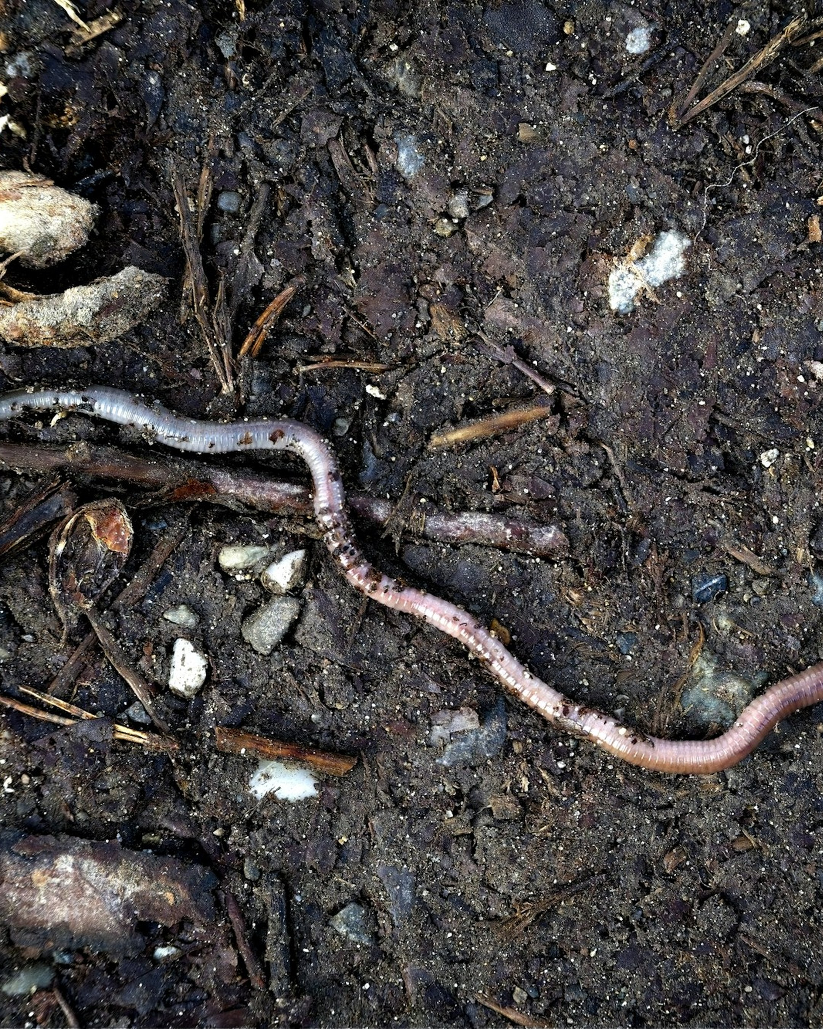
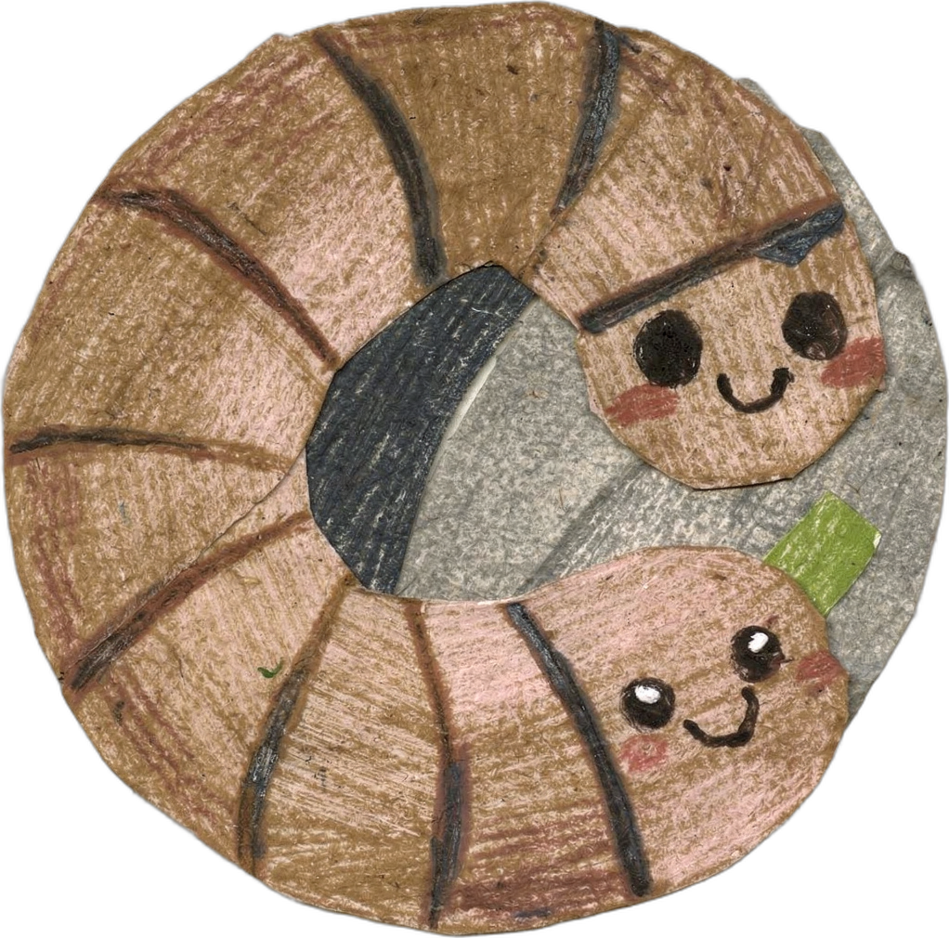
SOIL FOOD WEB
WORLD EARTHWORM DAY · OCTOBER 21
How do worms work their magic?
Photo: Julian Zwengel on Unsplash
Notes:
Slide 1: cover. Photos: Unsplash, credits in assets/unsplash-earthworm/CREDITS.md. Words: October 2026 Social Media Planning Doc.

Slide 2
SOIL FOOD WEB
Anecic earthworm
Anecic earthworms dig vertical burrows that can reach 1 to 2 meters deep to break up compaction.
Notes:
Slide 2: earthworm cut out on white. Photos: Unsplash, credits in assets/unsplash-earthworm/CREDITS.md. Words: October 2026 Social Media Planning Doc.

Slide 3
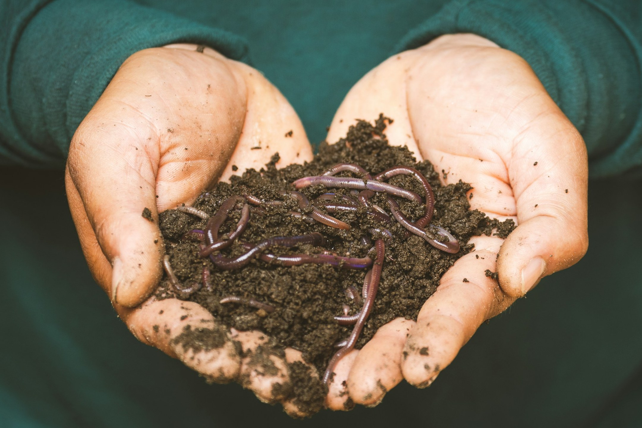
SOIL FOOD WEB
They spread microbes around as they move by lining the walls with mucus and casts, rich in nutrients and microbes.
Photo: sippakorn yamkasikorn on Unsplash
Notes:
Slide 3. Photos: Unsplash, credits in assets/unsplash-earthworm/CREDITS.md. Words: October 2026 Social Media Planning Doc.

Slide 4

SOIL FOOD WEB
Their channels let rain soak in fast without causing the ground to go anaerobic.
Photo: Roman Synkevych on Unsplash
Notes:
Slide 4. Photos: Unsplash, credits in assets/unsplash-earthworm/CREDITS.md. Words: October 2026 Social Media Planning Doc.

Slide 5
SOIL FOOD WEB
How to care for them?
Notes:
Slide 5: question tile. Photos: Unsplash, credits in assets/unsplash-earthworm/CREDITS.md. Words: October 2026 Social Media Planning Doc.

Slide 6
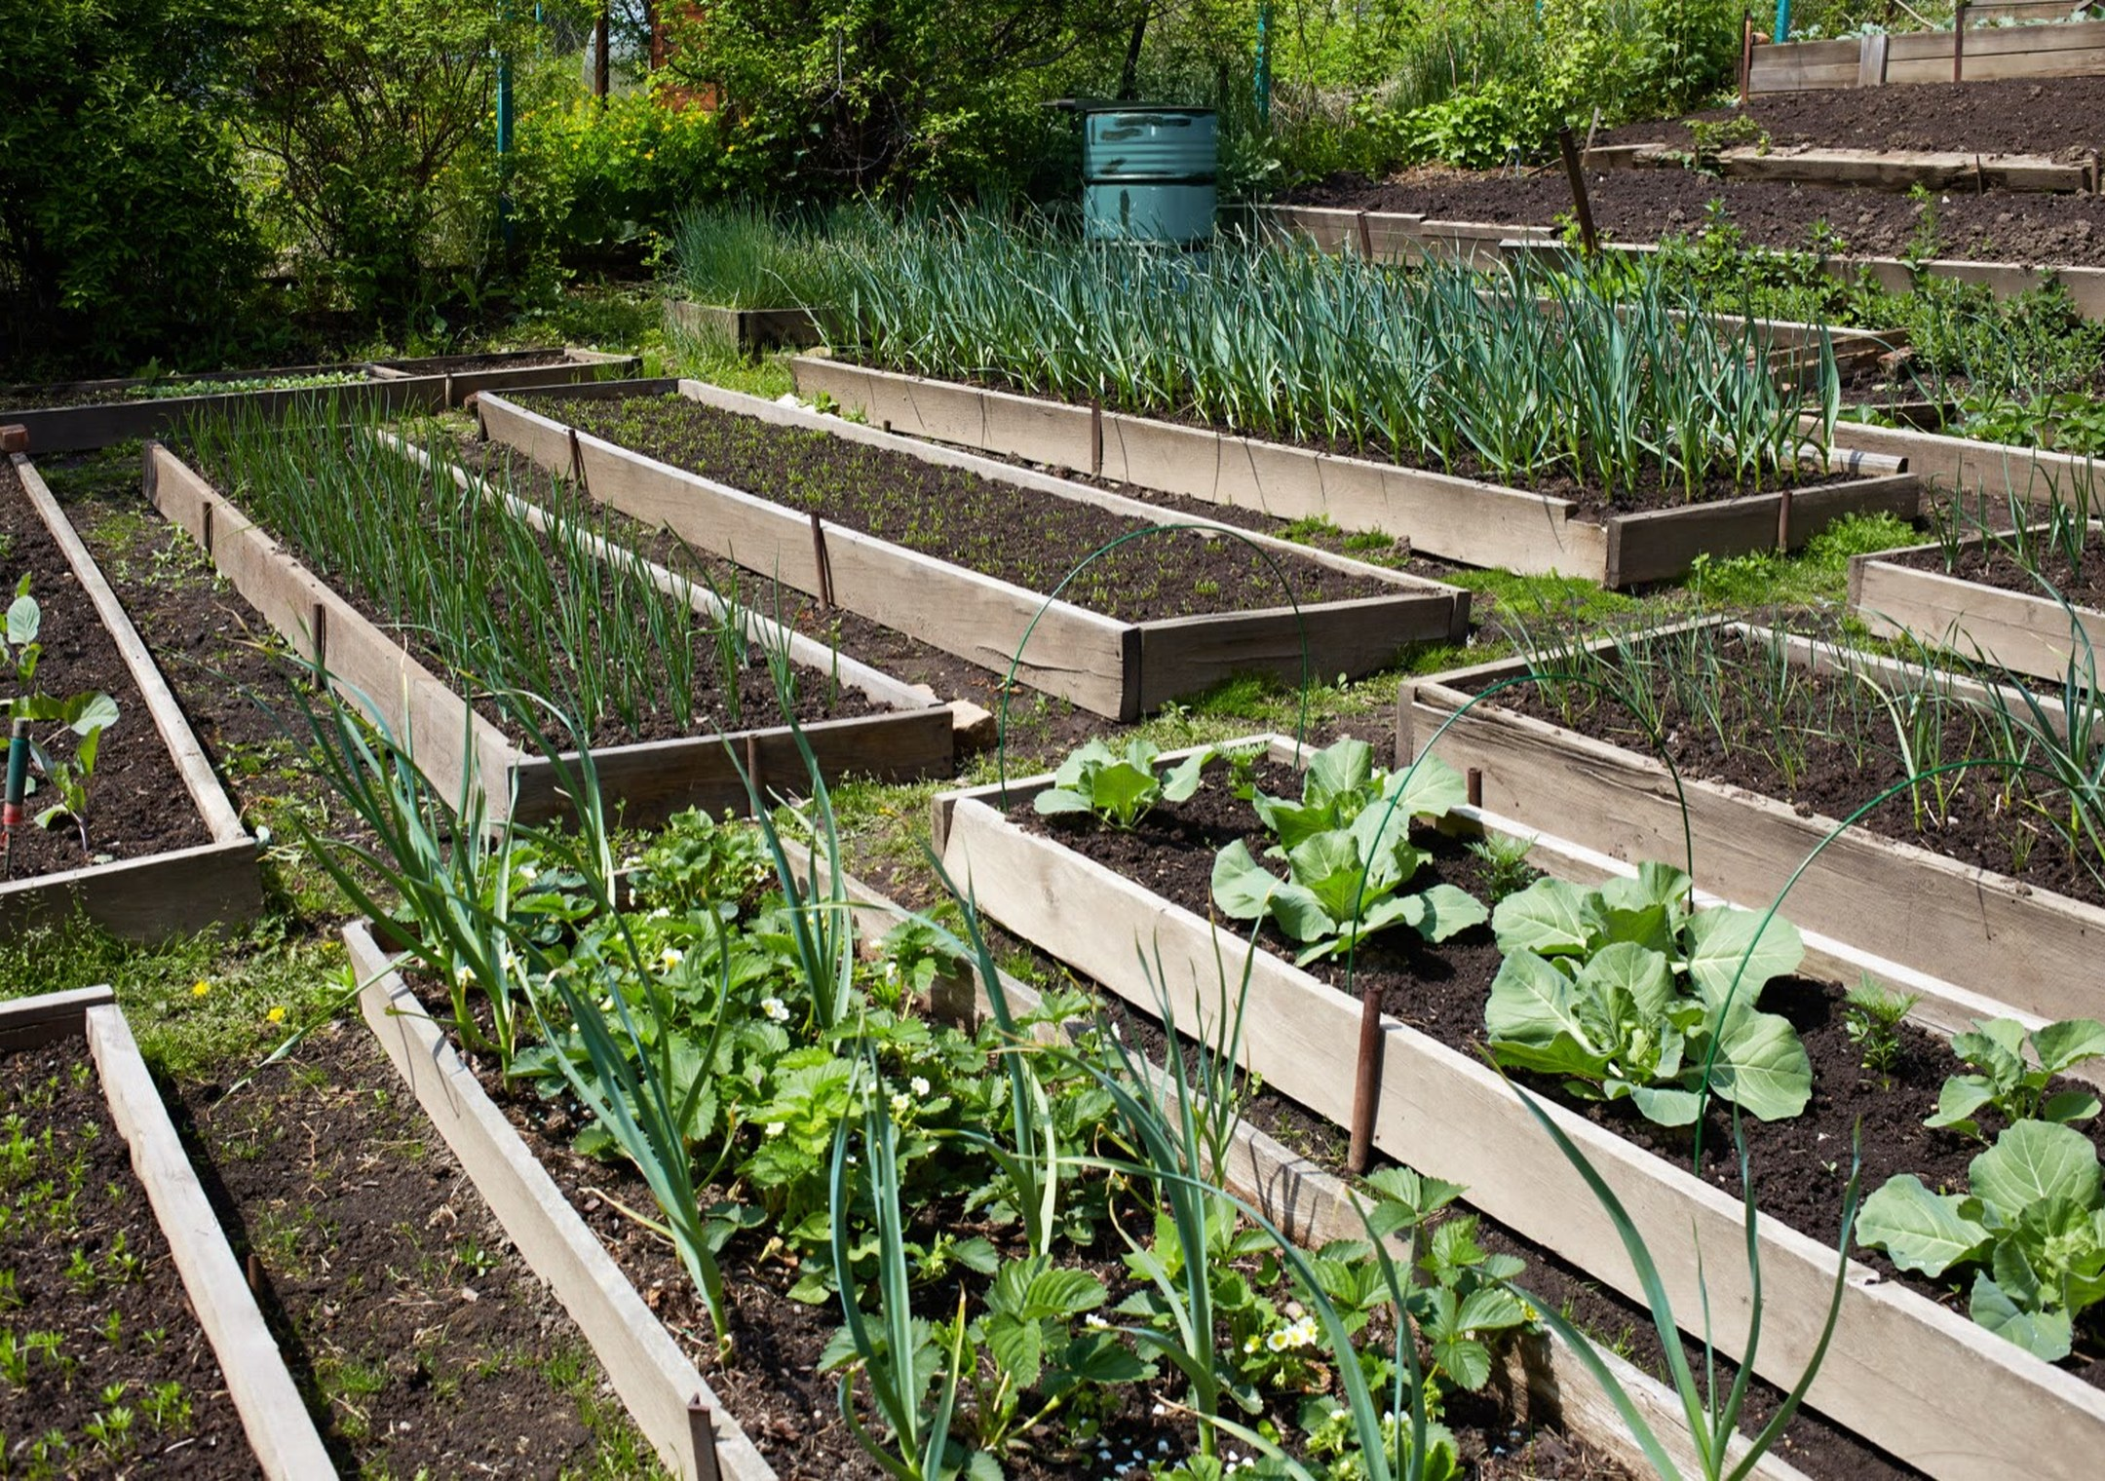
SOIL FOOD WEB
Digging cuts the burrows. No‑dig keeps the plumbing intact.
Photo: SFW library
Notes:
Slide 6. Photos: Unsplash, credits in assets/unsplash-earthworm/CREDITS.md. Words: October 2026 Social Media Planning Doc.

Slide 7


SOIL FOOD WEB
Add organic matter (Or simply don’t remove it)
Photo: Annie Spratt on Unsplash
Notes:
Slide 7. Photos: Unsplash, credits in assets/unsplash-earthworm/CREDITS.md. Words: October 2026 Social Media Planning Doc.

