Slide 1
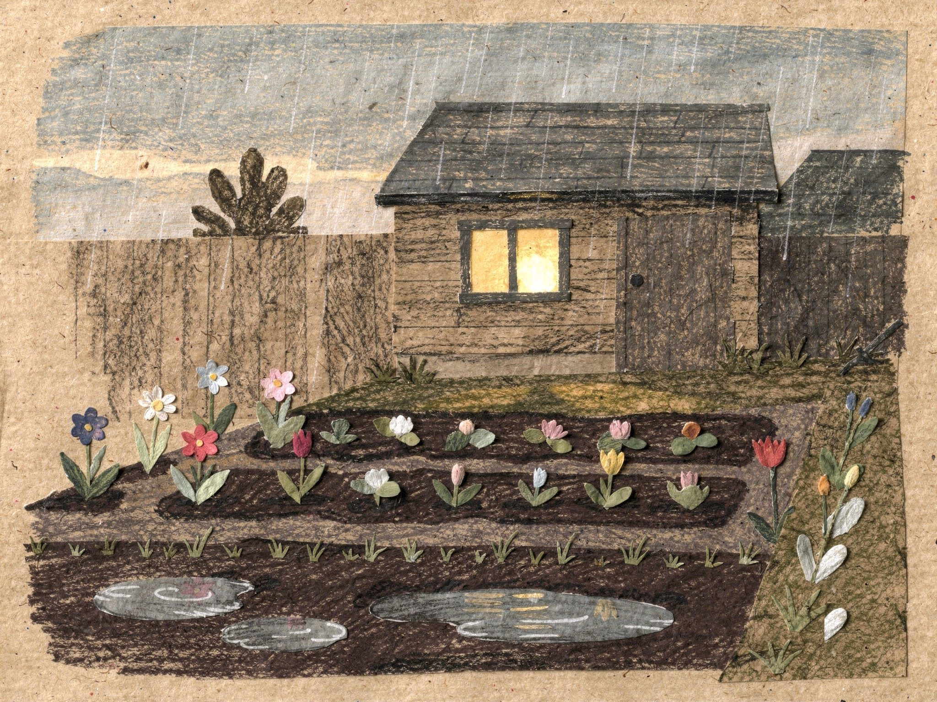
Under Rose's Garden
Book 1: The Lollipop
Notes:
Title page. PRINT: 10 x 8 in landscape trim, 0.125 in bleed (page 10.25 x 8.25 in), text 0.5 in inside trim, 300 DPI art.

Slide 2
For ...
Notes:
Dedication page (left blank for Linnea to fill in). PRINT: 10 x 8 in landscape trim, 0.125 in bleed (page 10.25 x 8.25 in), text 0.5 in inside trim, 300 DPI art.

Slide 3
It had rained all afternoon.
1
Notes:
Page 1. The garden after rain, nobody in it yet. PRINT: 10 x 8 in landscape trim, 0.125 in bleed (page 10.25 x 8.25 in), text 0.5 in inside trim, 300 DPI art.

Slide 4
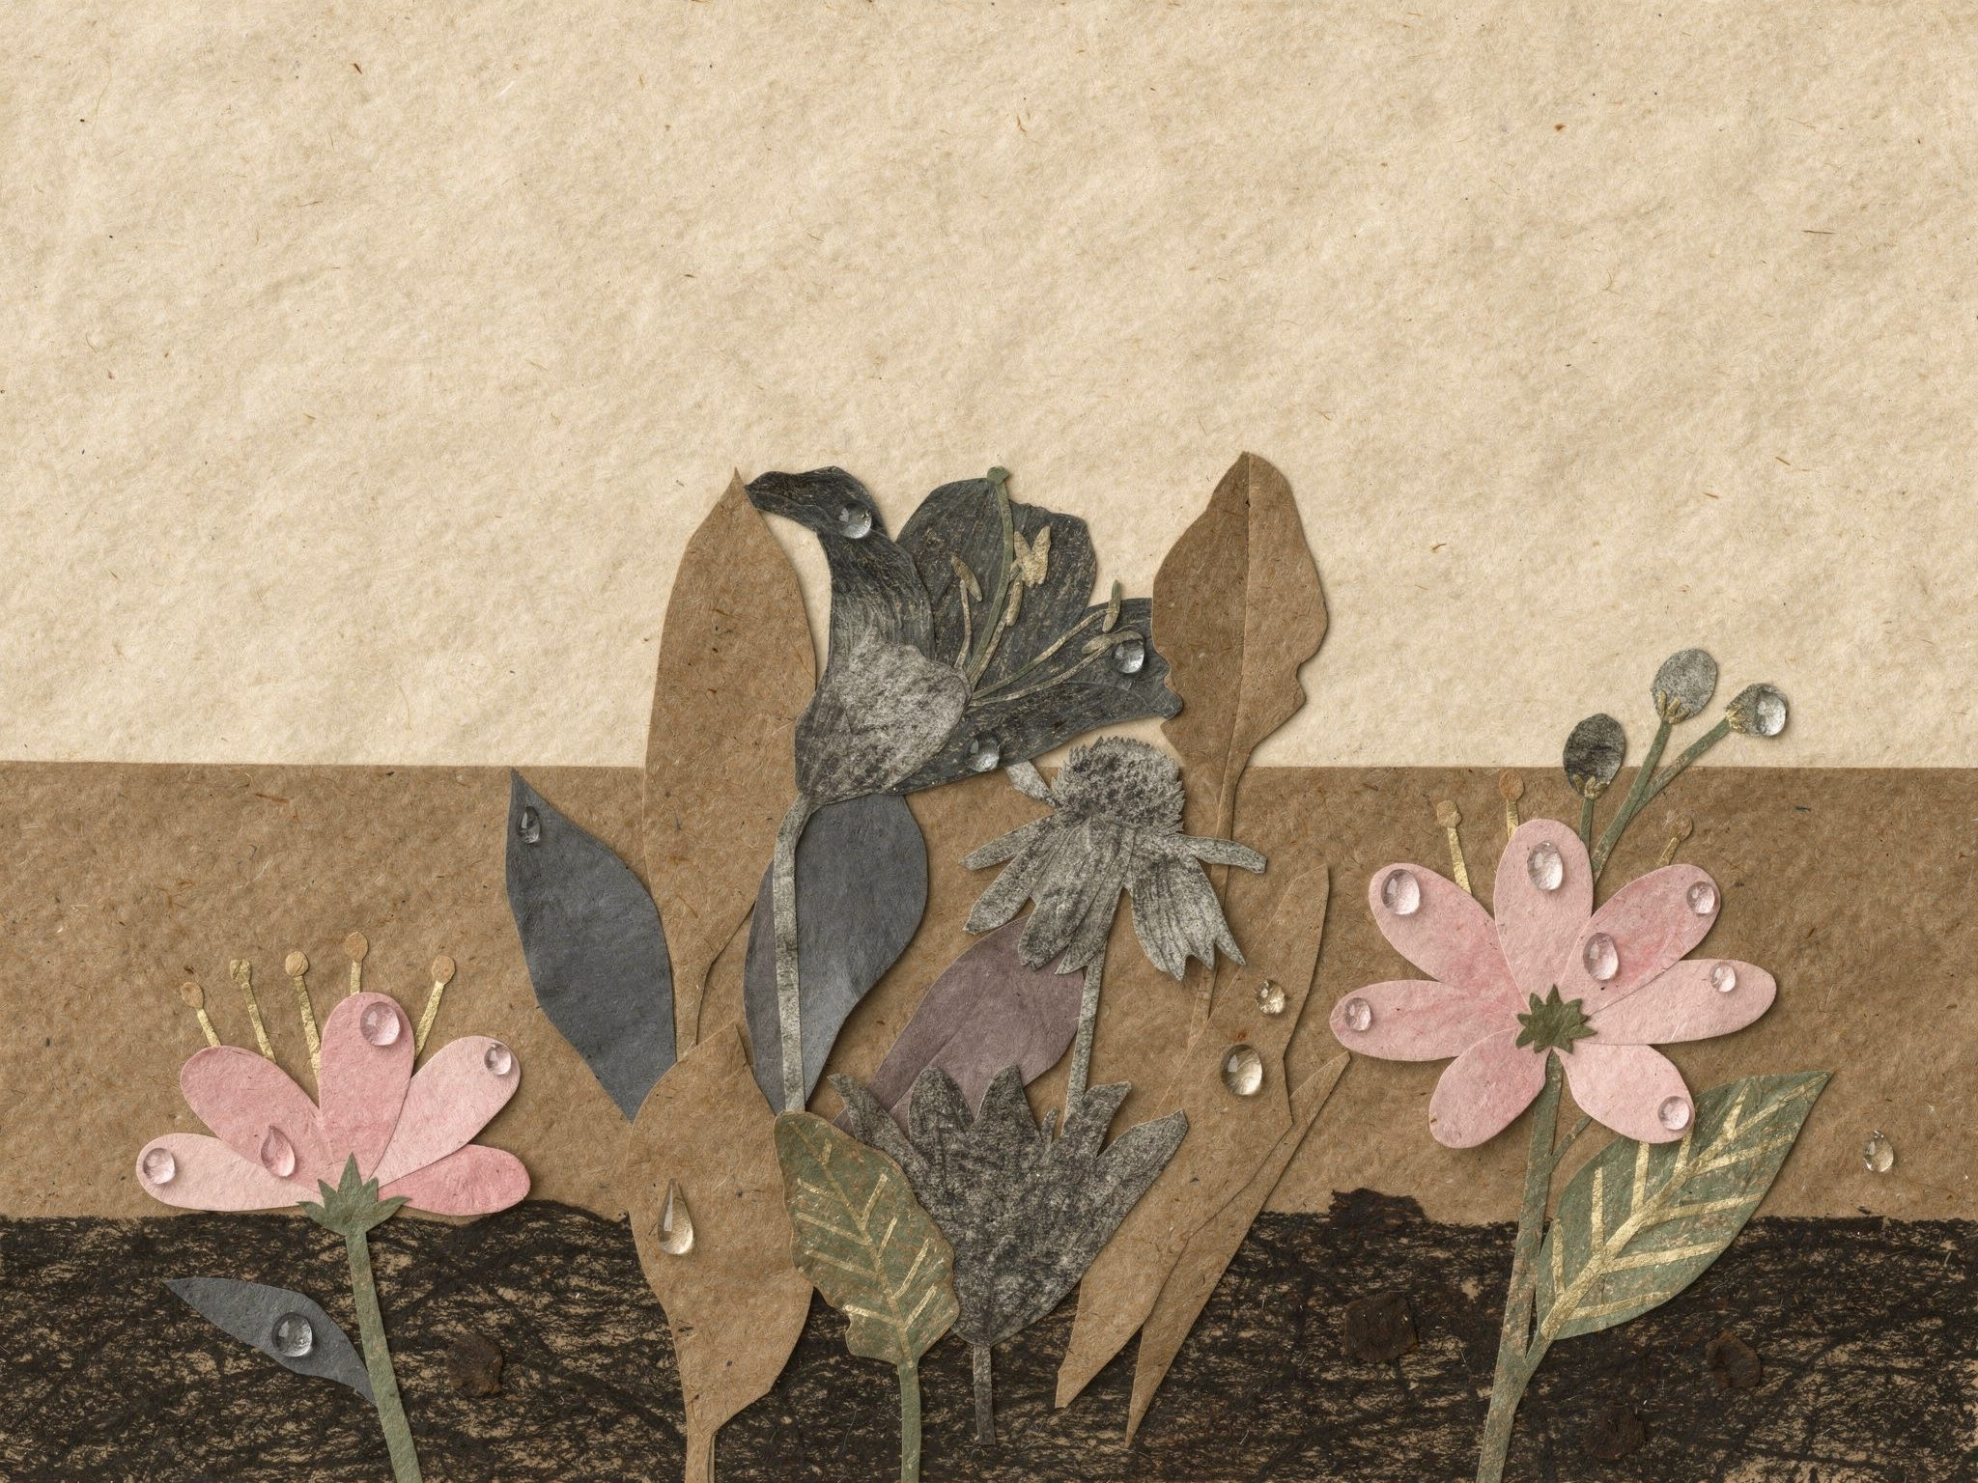
Everything was still dripping.
2
Notes:
Page 2. Close-up: the flowers, still dripping. PRINT: 10 x 8 in landscape trim, 0.125 in bleed (page 10.25 x 8.25 in), text 0.5 in inside trim, 300 DPI art.

Slide 5
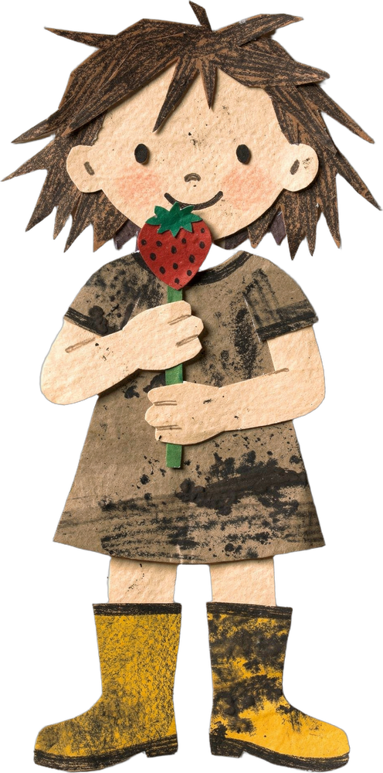
Rose had a strawberry lollipop.
3
Notes:
Page 3. Rose and her strawberry lollipop. PRINT: 10 x 8 in landscape trim, 0.125 in bleed (page 10.25 x 8.25 in), text 0.5 in inside trim, 300 DPI art.

Slide 6
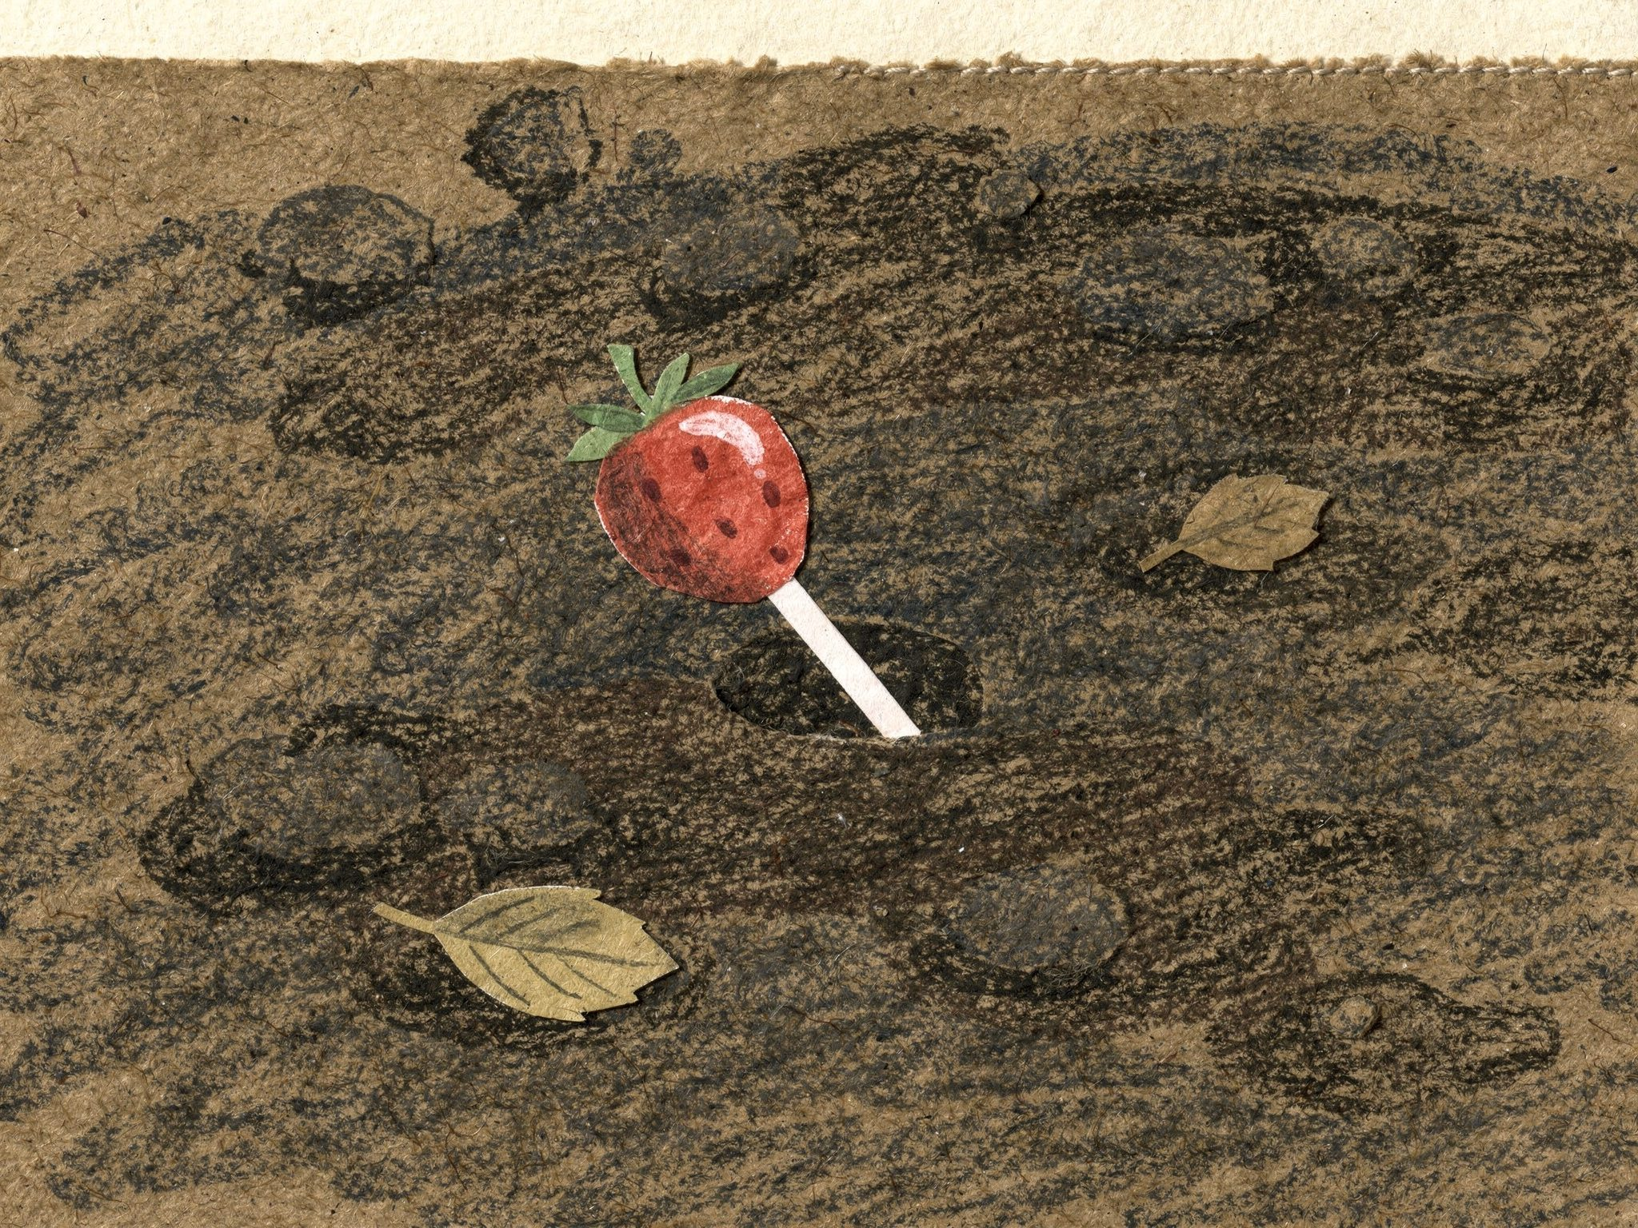

Plop.
4
Notes:
Page 4. Close-up: the lollipop has dropped into the soft soil. PRINT: 10 x 8 in landscape trim, 0.125 in bleed (page 10.25 x 8.25 in), text 0.5 in inside trim, 300 DPI art.

Slide 7
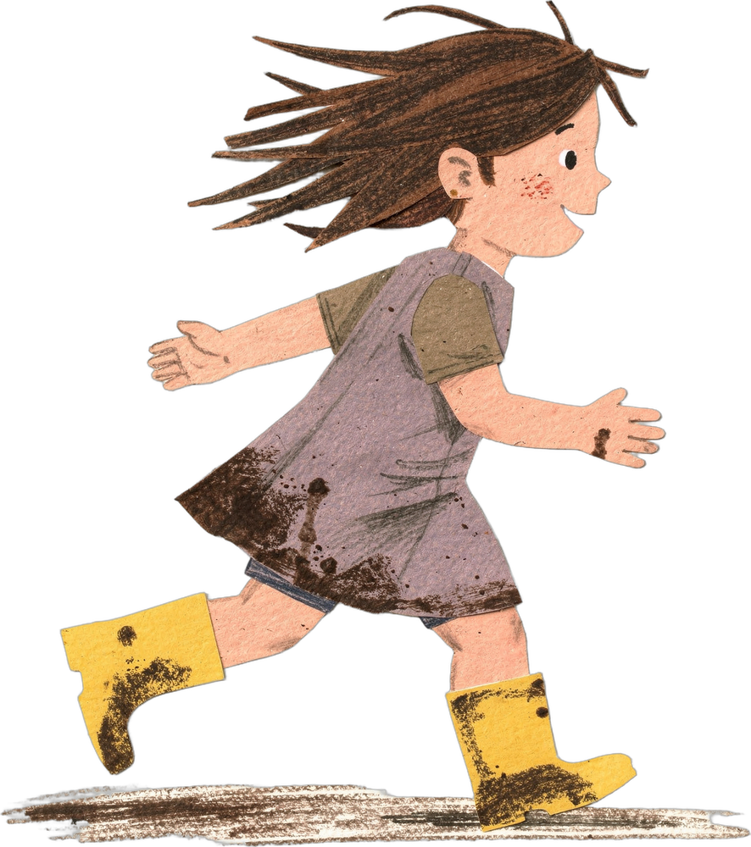
“Rose! Dinner!”
“Night night, dirt!”
5
Notes:
Page 5. Rose runs inside for dinner and says goodnight to the ground. PRINT: 10 x 8 in landscape trim, 0.125 in bleed (page 10.25 x 8.25 in), text 0.5 in inside trim, 300 DPI art.

Slide 8
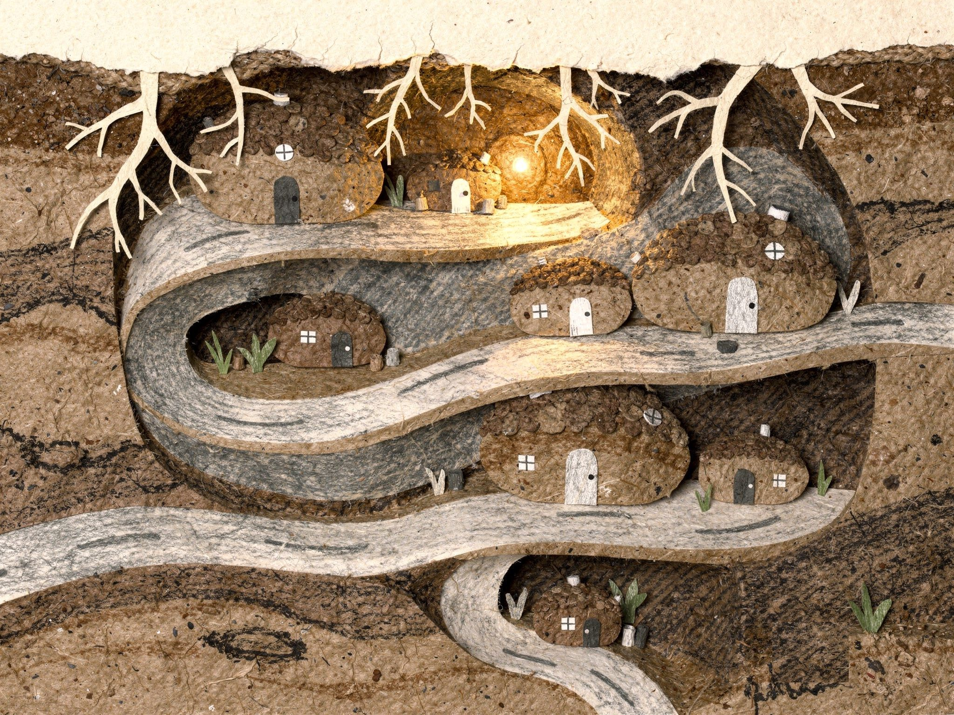
Down below, someone heard her.
6
Notes:
Page 6. Underground: the town under the garden, quiet. Someone heard her. PRINT: 10 x 8 in landscape trim, 0.125 in bleed (page 10.25 x 8.25 in), text 0.5 in inside trim, 300 DPI art.

Slide 9
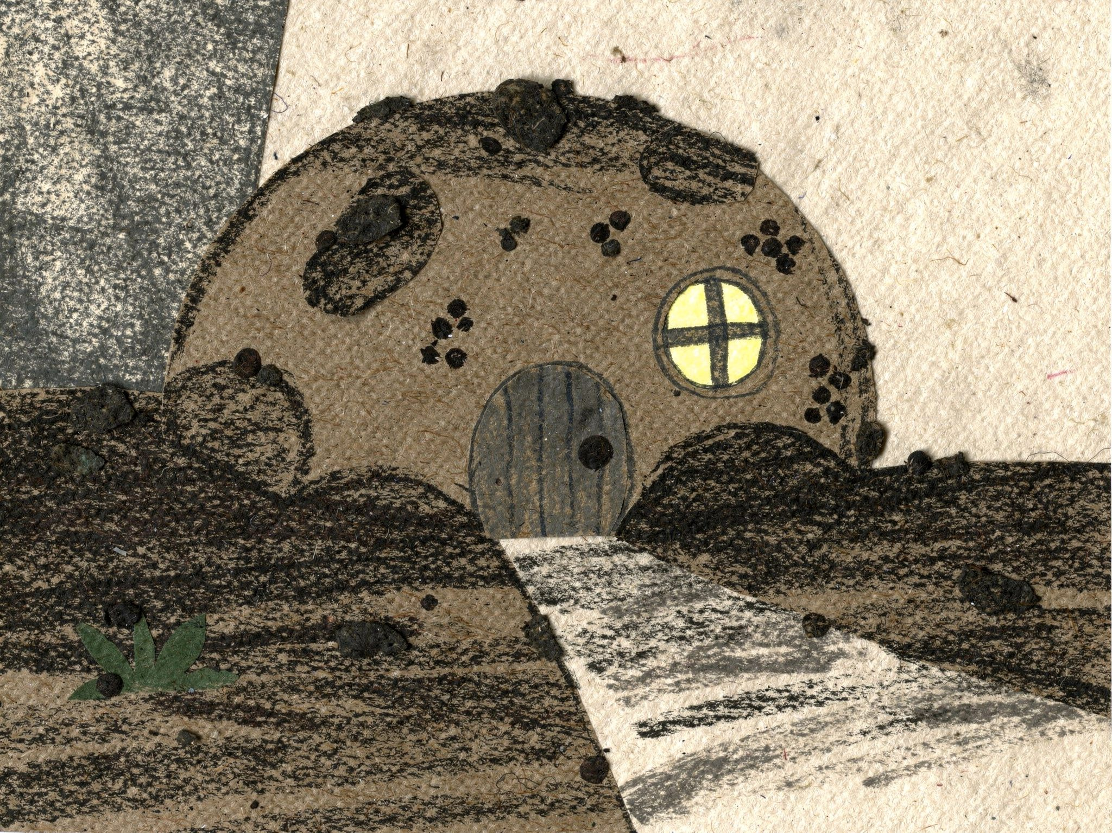
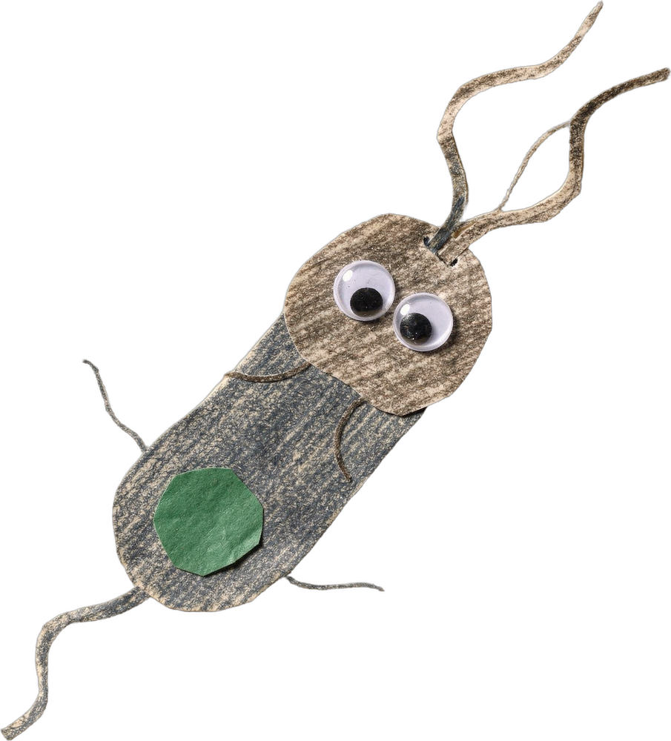
This is Barry. He lives in a crumb house.
7
Notes:
Page 7. Barry's crumb house, Barry outside it. PRINT: 10 x 8 in landscape trim, 0.125 in bleed (page 10.25 x 8.25 in), text 0.5 in inside trim, 300 DPI art.

Slide 10
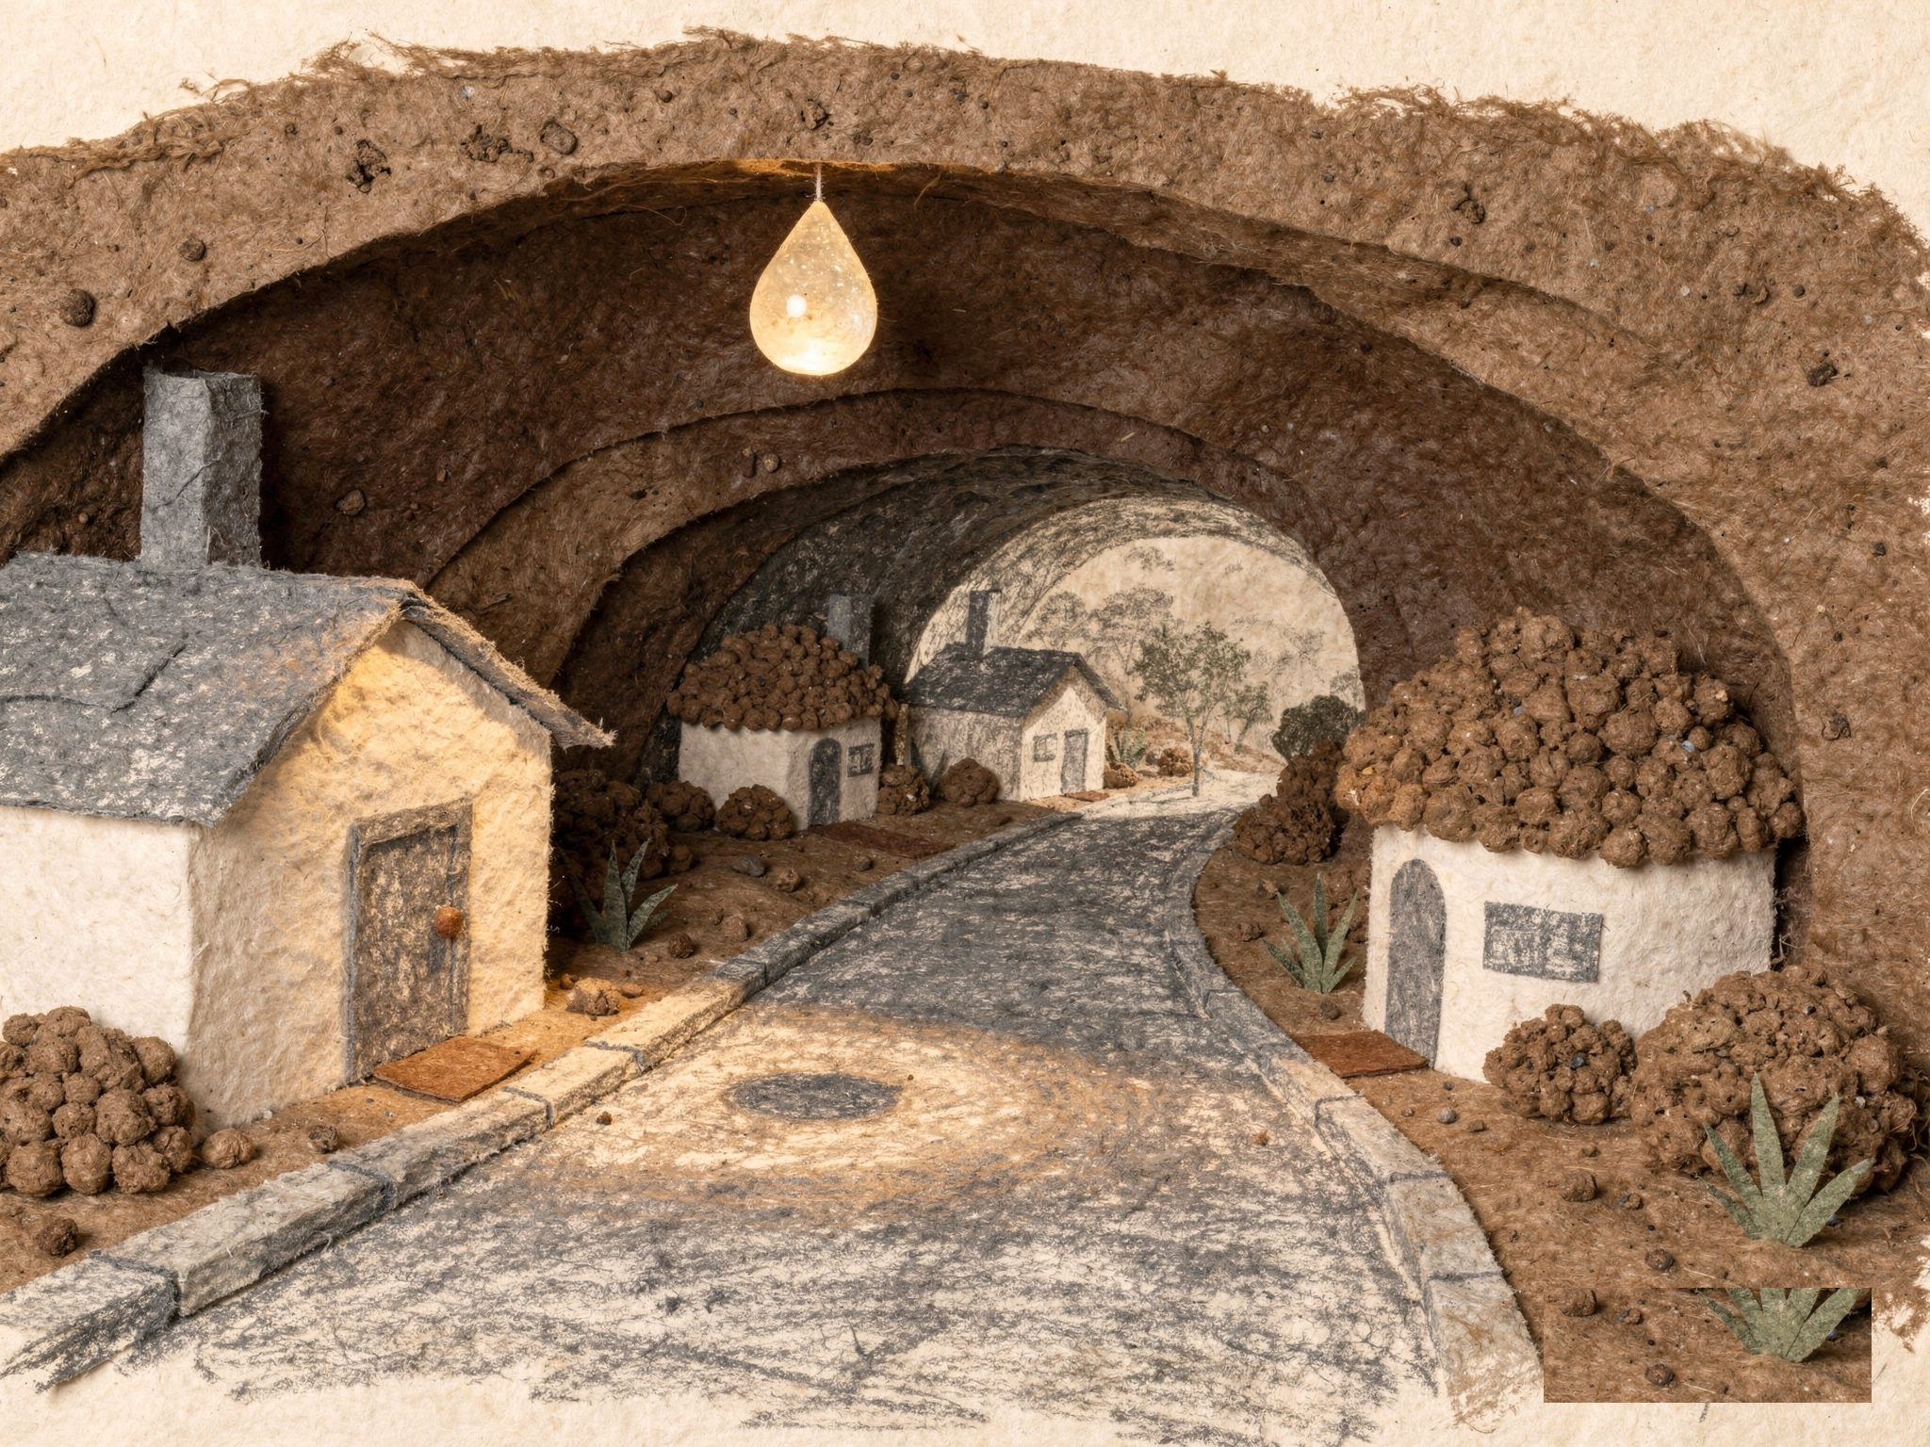
Drip.
8
Notes:
Page 8. A single pale sugar drop hangs from the ceiling. PRINT: 10 x 8 in landscape trim, 0.125 in bleed (page 10.25 x 8.25 in), text 0.5 in inside trim, 300 DPI art.

Slide 11
Barry had a taste.
“Sugar!”
9
Notes:
Page 9. Barry under the drop, tasting it. PRINT: 10 x 8 in landscape trim, 0.125 in bleed (page 10.25 x 8.25 in), text 0.5 in inside trim, 300 DPI art.

Slide 12
And then there were two Barrys.
10
Notes:
Page 10. Barry has split into two Barrys (two copies of the same cut-out). PRINT: 10 x 8 in landscape trim, 0.125 in bleed (page 10.25 x 8.25 in), text 0.5 in inside trim, 300 DPI art.

Slide 13
“Which Barry am I?” asked Barry.
11
Notes:
Page 11. Four Barrys on the street. PRINT: 10 x 8 in landscape trim, 0.125 in bleed (page 10.25 x 8.25 in), text 0.5 in inside trim, 300 DPI art.

Slide 14
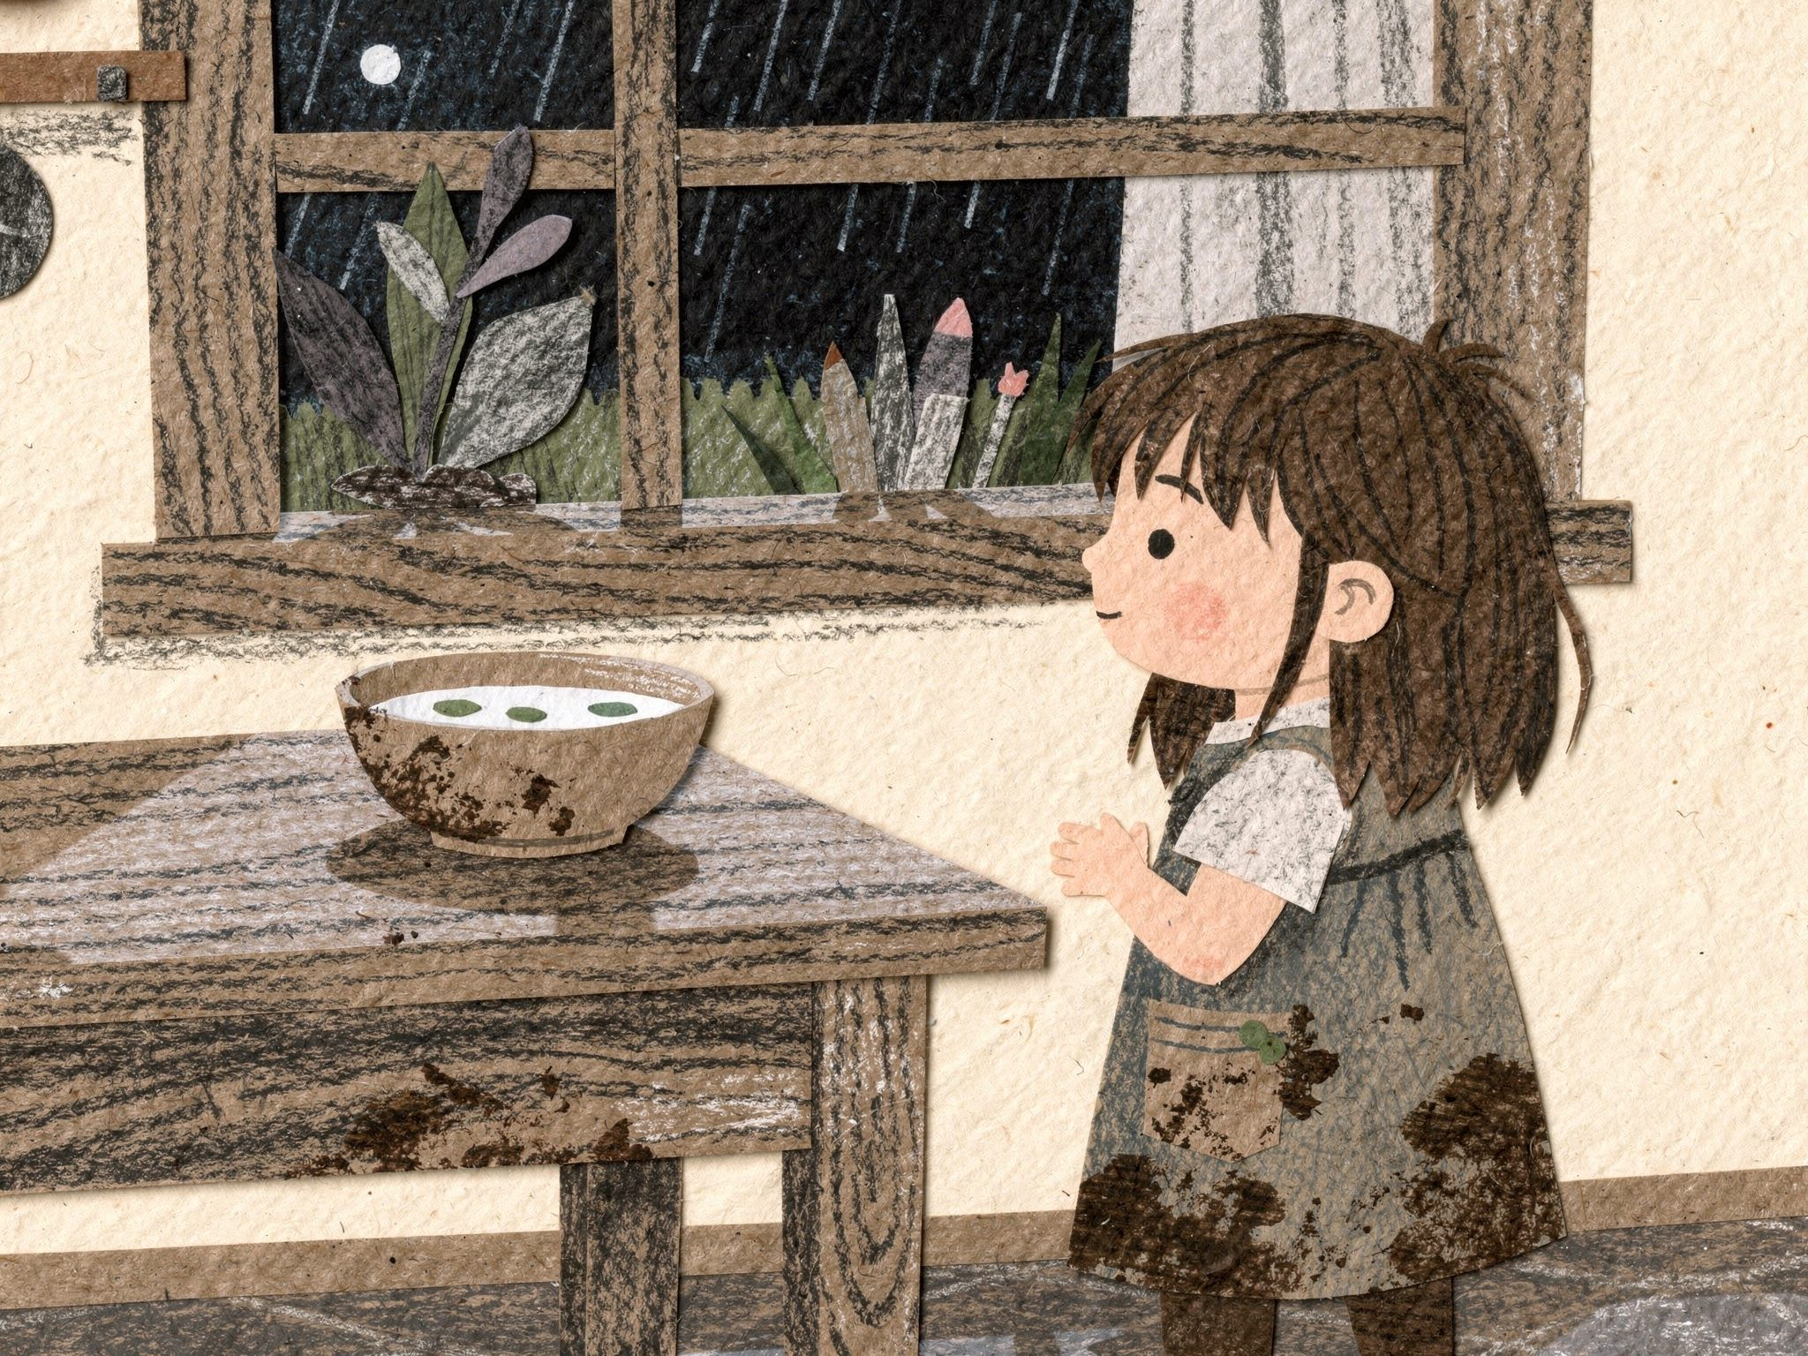
Up above, Rose was having her soup.
12
Notes:
Page 12. Cut away, above ground: Rose at dinner, looking out at the rainy garden. PRINT: 10 x 8 in landscape trim, 0.125 in bleed (page 10.25 x 8.25 in), text 0.5 in inside trim, 300 DPI art.

Slide 15
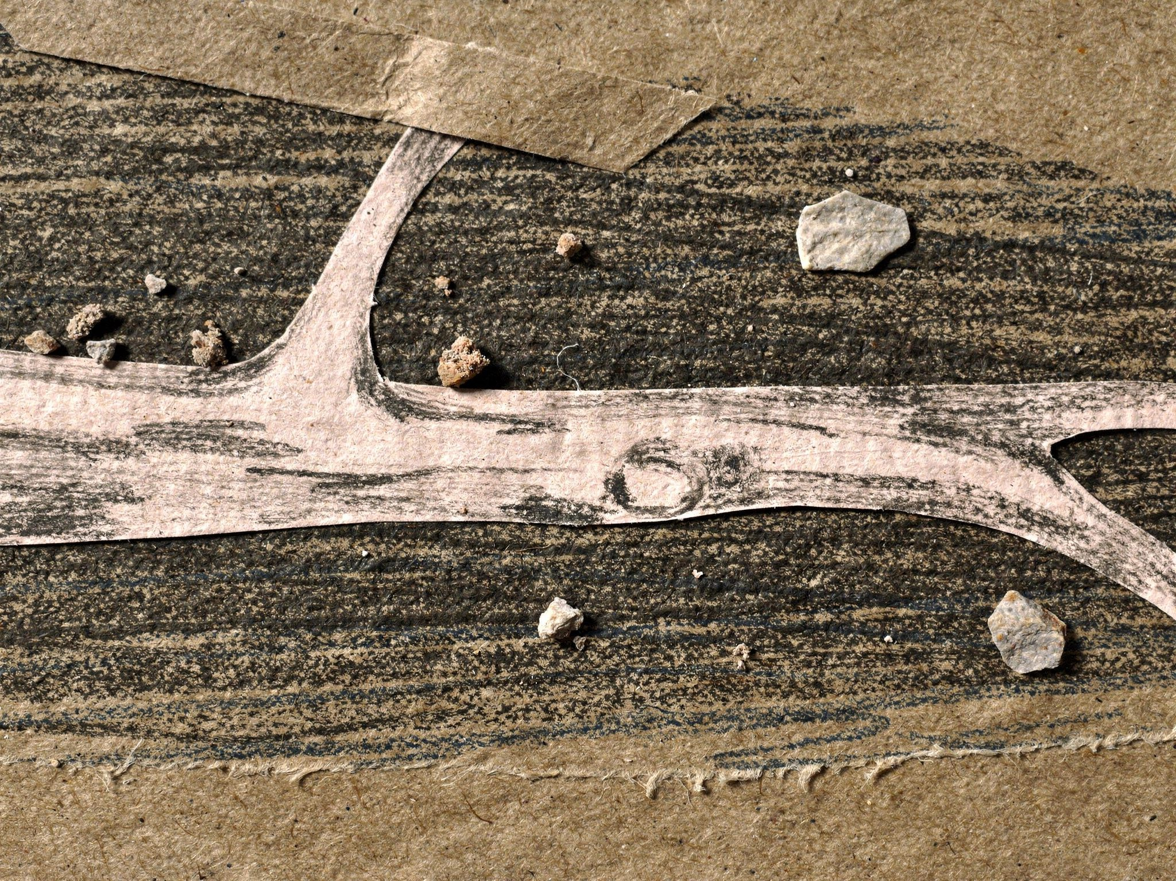
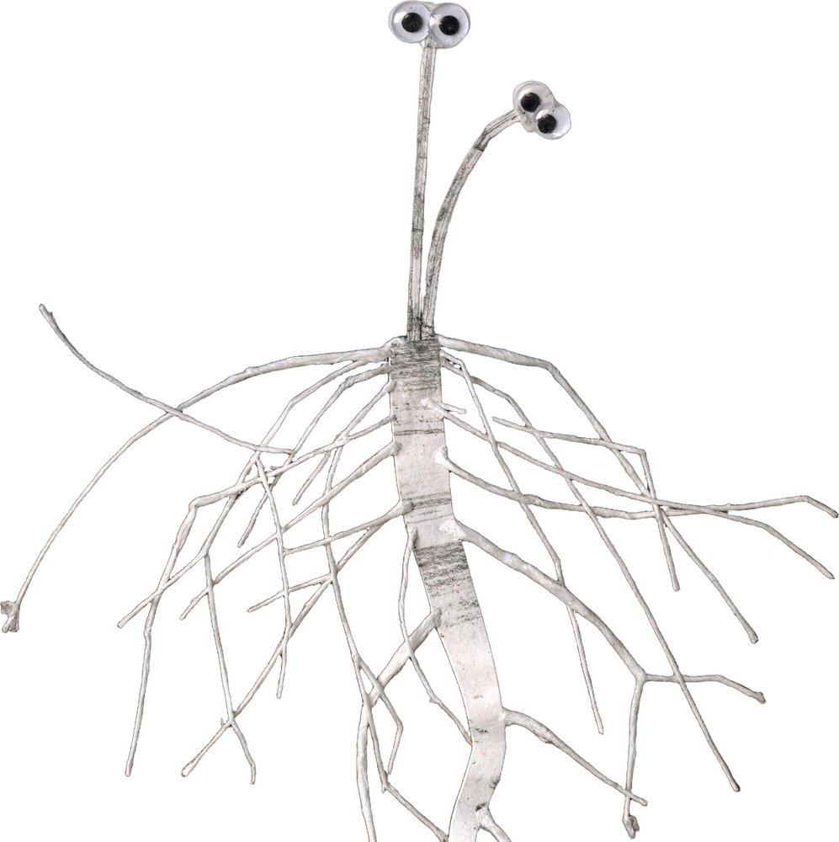
Myco the postman carried the news.
13
Notes:
Page 13. Myco the postman on a root road (critter-mycorrhiza v2). PRINT: 10 x 8 in landscape trim, 0.125 in bleed (page 10.25 x 8.25 in), text 0.5 in inside trim, 300 DPI art.

Slide 16
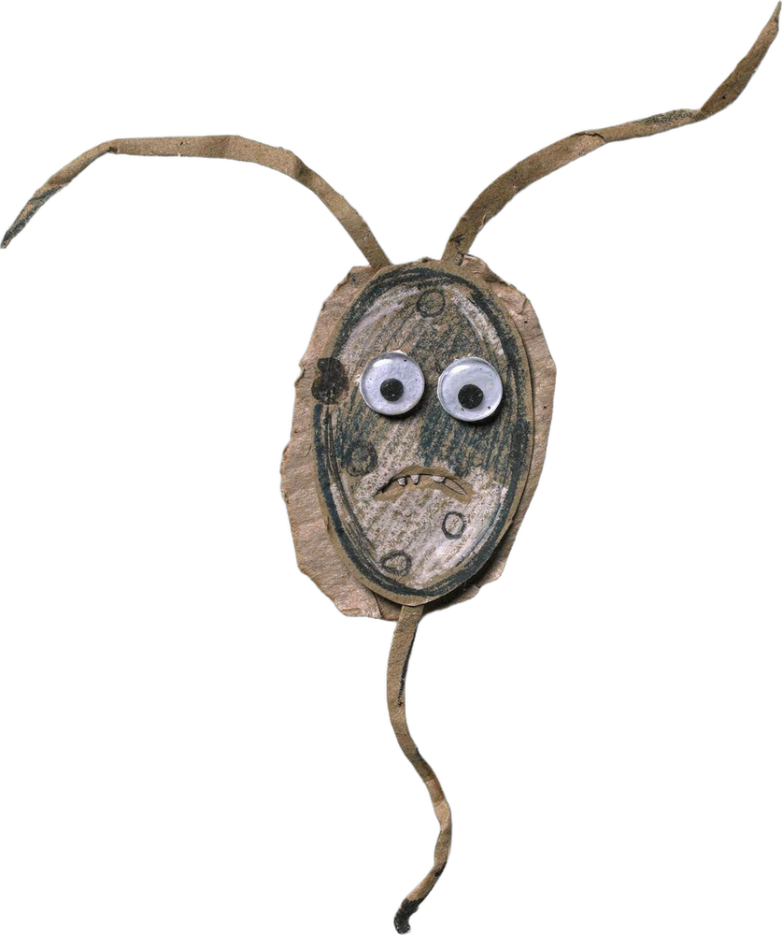
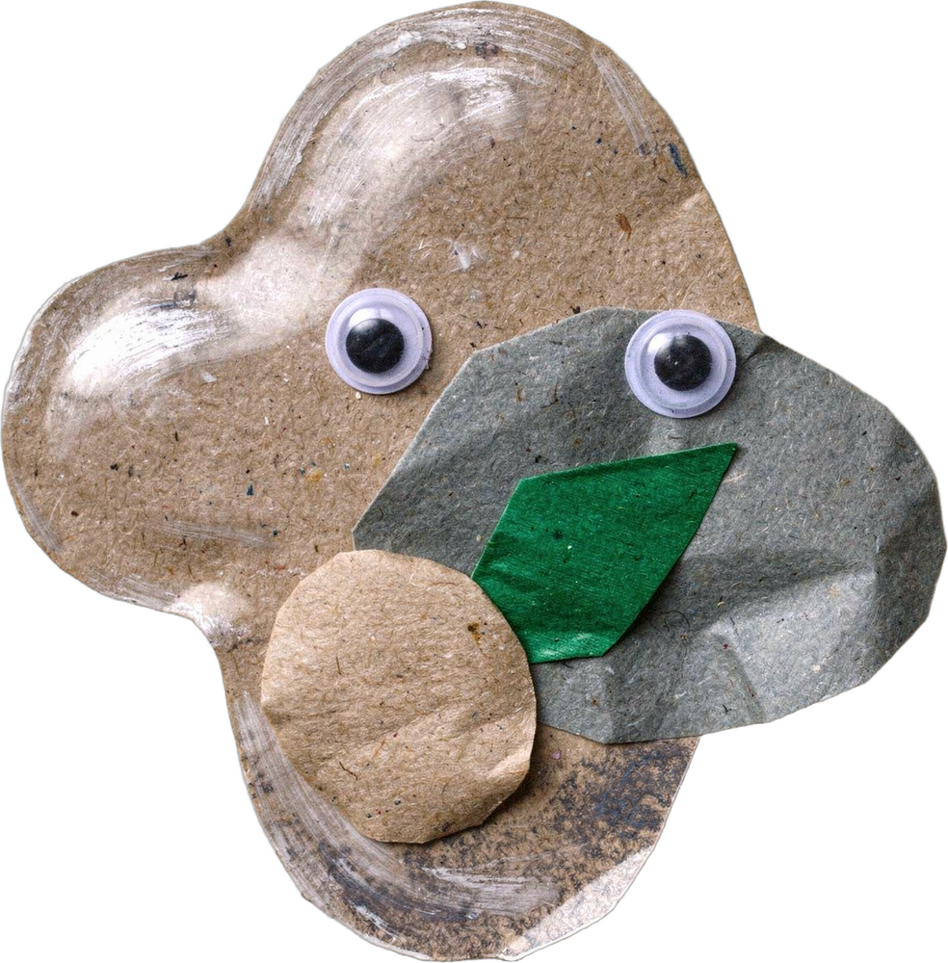
Pip came zooming. Ama came drifting.
14
Notes:
Page 14. Pip and Ama arrive. PRINT: 10 x 8 in landscape trim, 0.125 in bleed (page 10.25 x 8.25 in), text 0.5 in inside trim, 300 DPI art.

Slide 17
It turned into a party.
15
Notes:
Page 15. Everyone together on the street: four Barrys, Pip, Ama and Myco. PRINT: 10 x 8 in landscape trim, 0.125 in bleed (page 10.25 x 8.25 in), text 0.5 in inside trim, 300 DPI art.

Slide 18
Then something much bigger began to come down.
16
Notes:
Page 16. The sugar drop again, quiet. Cliffhanger: the lollipop stick is coming (next pages). PRINT: 10 x 8 in landscape trim, 0.125 in bleed (page 10.25 x 8.25 in), text 0.5 in inside trim, 300 DPI art.

Slide 19
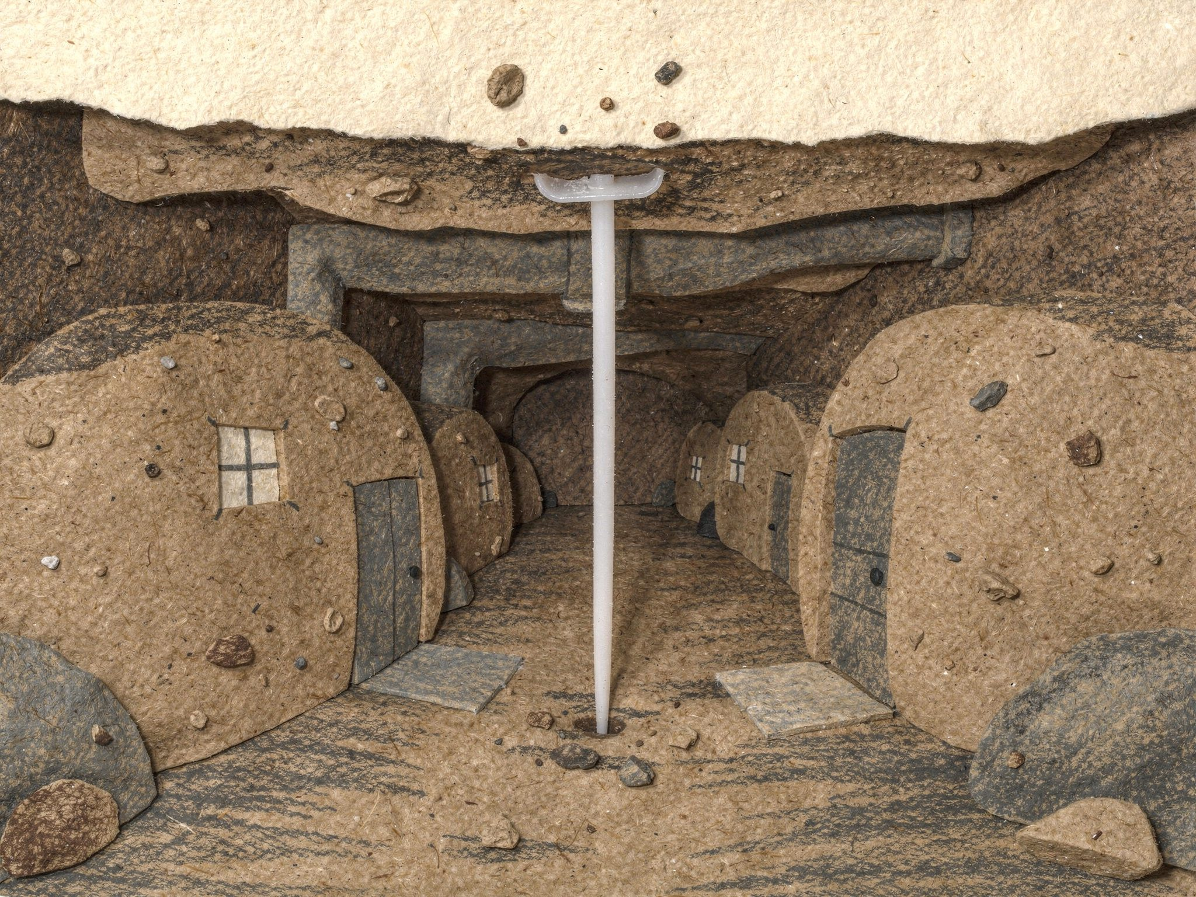
It was a stick.
17
Notes:
Page 17. The lollipop stick has come down into the street. The candy has melted away. PRINT: 10 x 8 in landscape trim, 0.125 in bleed (page 10.25 x 8.25 in), text 0.5 in inside trim, 300 DPI art.

Slide 20
Barry took a bite.
Nothing happened.
18
Notes:
Page 18. Barry tries to eat it. PRINT: 10 x 8 in landscape trim, 0.125 in bleed (page 10.25 x 8.25 in), text 0.5 in inside trim, 300 DPI art.

Slide 21
Pip gave it a poke.
Nothing happened.
19
Notes:
Page 19. Pip pokes it. PRINT: 10 x 8 in landscape trim, 0.125 in bleed (page 10.25 x 8.25 in), text 0.5 in inside trim, 300 DPI art.

Slide 22
Myco wrapped his arms around it.
There was nothing to trade.
20
Notes:
Page 20. Myco wraps his arms around it, looking for something to trade. PRINT: 10 x 8 in landscape trim, 0.125 in bleed (page 10.25 x 8.25 in), text 0.5 in inside trim, 300 DPI art.

Slide 23
“We can eat anything that was once alive,” said Myco.
21
Notes:
Page 21. Myco begins to explain. True science: soil life breaks food down with enzymes that fit things that were once alive. PRINT: 10 x 8 in landscape trim, 0.125 in bleed (page 10.25 x 8.25 in), text 0.5 in inside trim, 300 DPI art.

Slide 24
“Leaves. Apples. Bread. Sugar.
We have a key for each of them.”
22
Notes:
Page 22. The keys image: each kind of food has a key that unlocks it. PRINT: 10 x 8 in landscape trim, 0.125 in bleed (page 10.25 x 8.25 in), text 0.5 in inside trim, 300 DPI art.

Slide 25
“But this is plastic.
Nobody down here has a key for it.”
23
Notes:
Page 23. True science: plastic is long chains the soil's enzymes mostly cannot unlock. It does not rot away; it slowly breaks into tiny bits (microplastics) and lasts hundreds of years. PRINT: 10 x 8 in landscape trim, 0.125 in bleed (page 10.25 x 8.25 in), text 0.5 in inside trim, 300 DPI art.

Slide 26
Pip tried to say hello to Ama.
Maybe tomorrow.
24
Notes:
Page 24. Pip and Ama. Pip's crush: one small step in every book. PRINT: 10 x 8 in landscape trim, 0.125 in bleed (page 10.25 x 8.25 in), text 0.5 in inside trim, 300 DPI art.

Slide 27
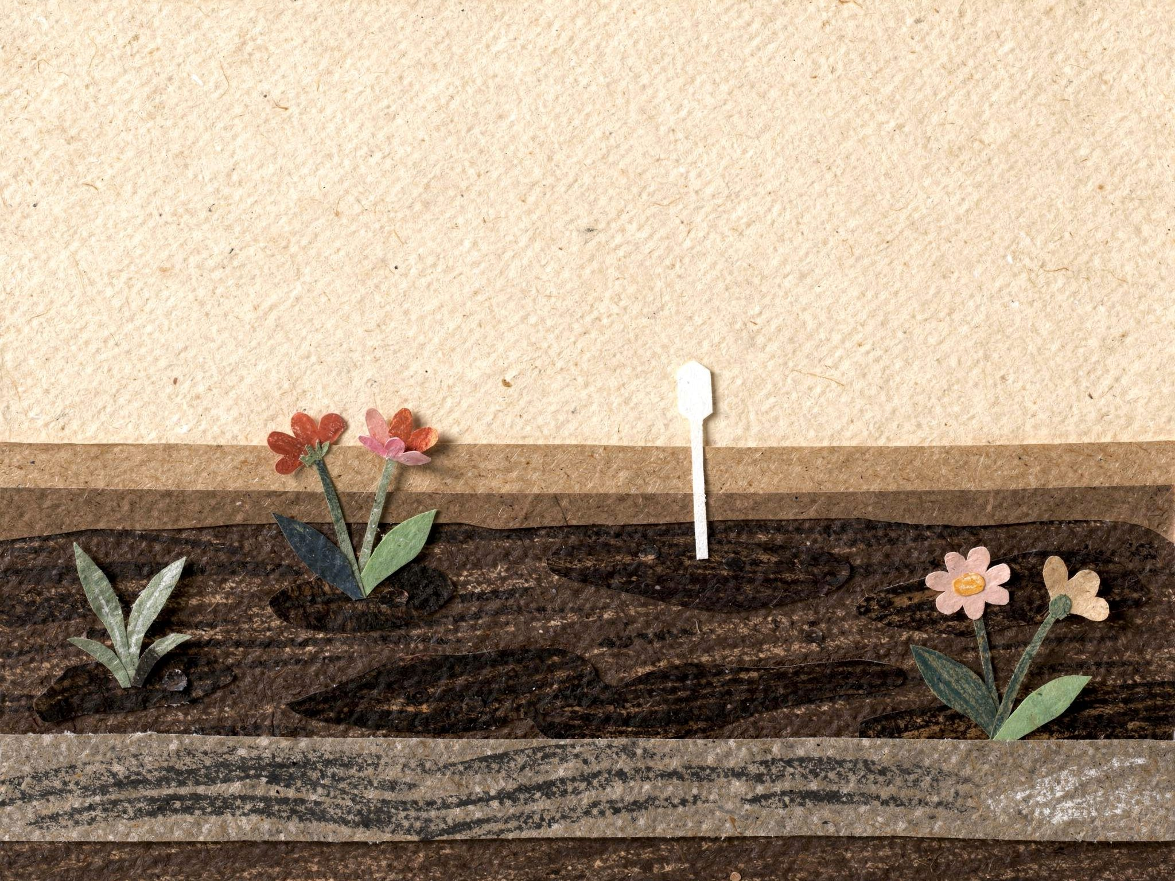
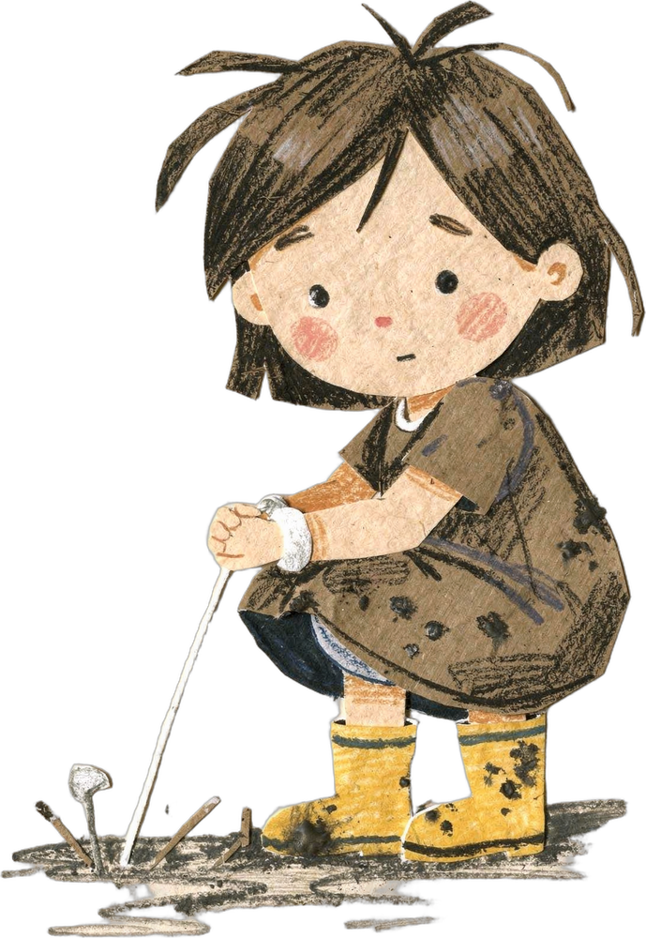
In the morning, Rose found the stick.
She put it in the bin.
25
Notes:
Page 25. Morning, above ground. Rose finds the stick and pulls it out. PRINT: 10 x 8 in landscape trim, 0.125 in bleed (page 10.25 x 8.25 in), text 0.5 in inside trim, 300 DPI art.

Slide 28
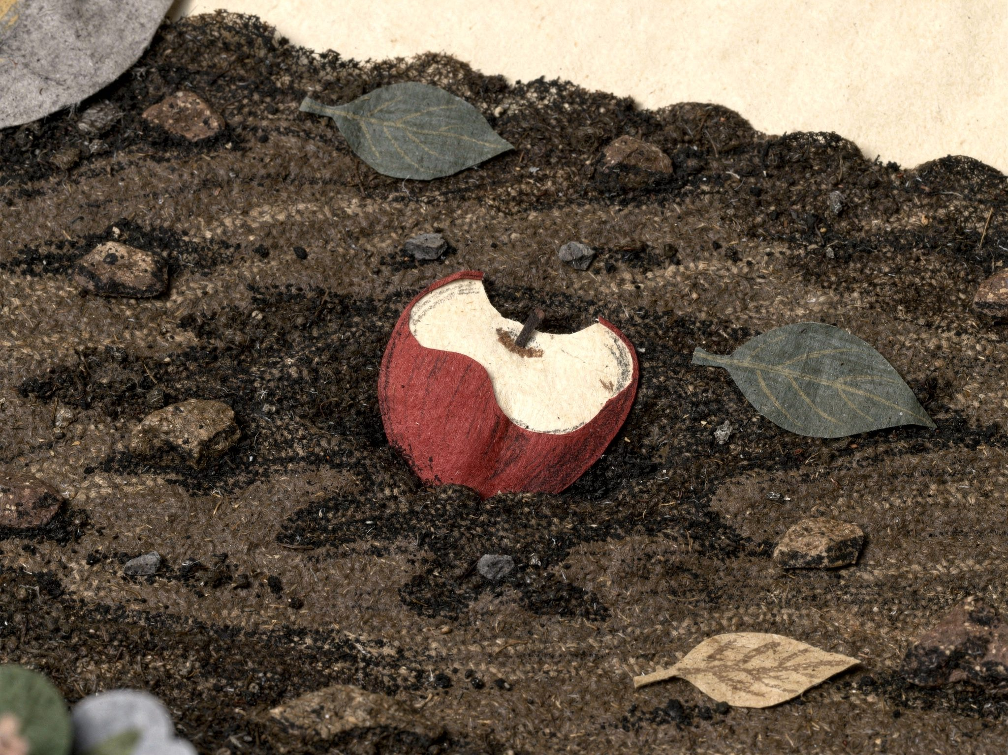
Then she planted an apple core.
“Night night, dirt!”
26
Notes:
Page 26. Rose plants an apple core instead: good food for the soil. PRINT: 10 x 8 in landscape trim, 0.125 in bleed (page 10.25 x 8.25 in), text 0.5 in inside trim, 300 DPI art.

Slide 29
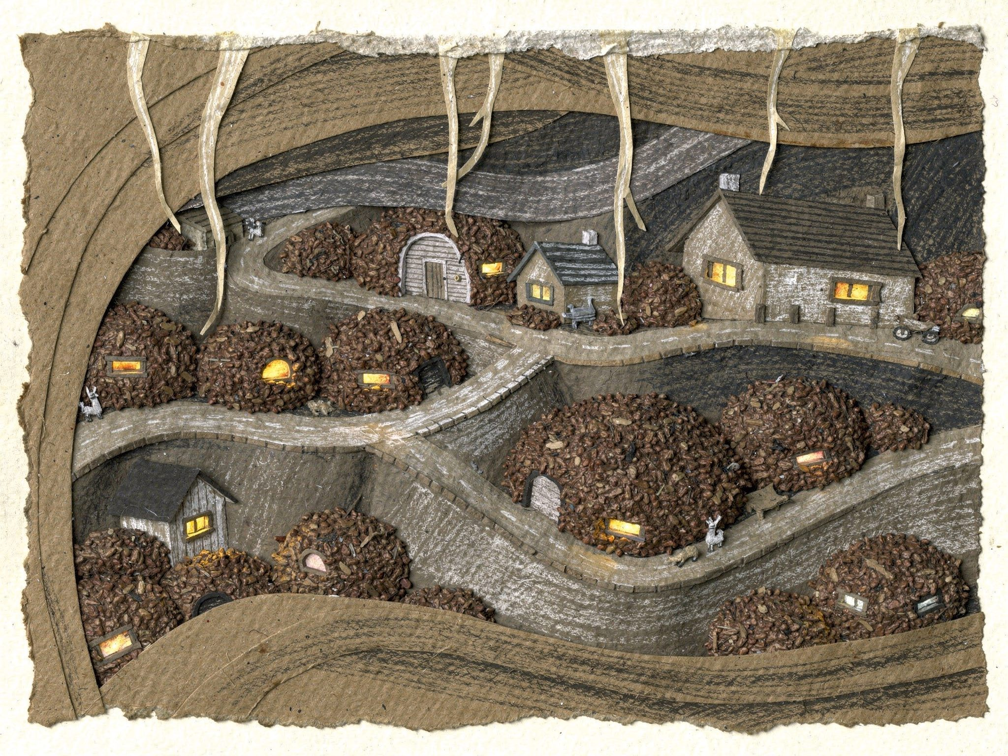
Down below, all the sleepy Barrys said,
“Night night, Rose.”
27
Notes:
Page 27. The town at night; the Barrys answer Rose's goodnight. PRINT: 10 x 8 in landscape trim, 0.125 in bleed (page 10.25 x 8.25 in), text 0.5 in inside trim, 300 DPI art.

Slide 30
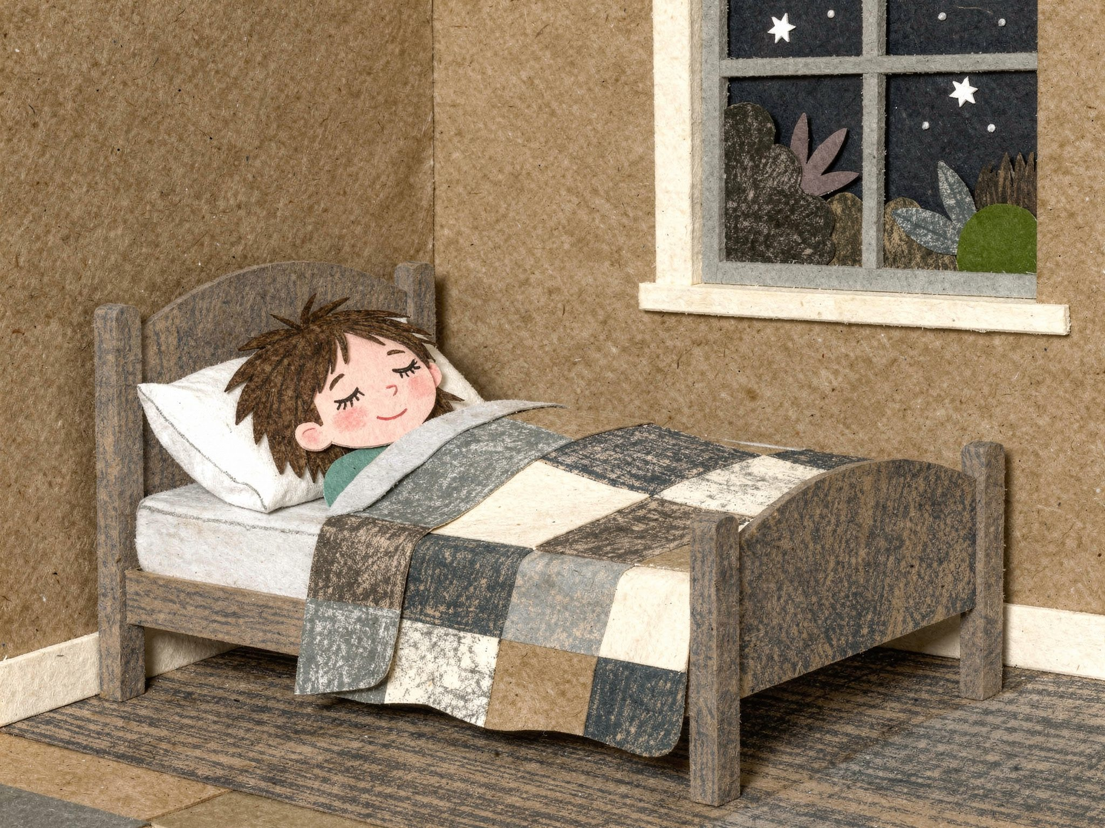
Rose didn't hear them.
But she smiled in her sleep.
28
Notes:
Page 28. Rose asleep. She never knows who answered. PRINT: 10 x 8 in landscape trim, 0.125 in bleed (page 10.25 x 8.25 in), text 0.5 in inside trim, 300 DPI art.

Slide 31
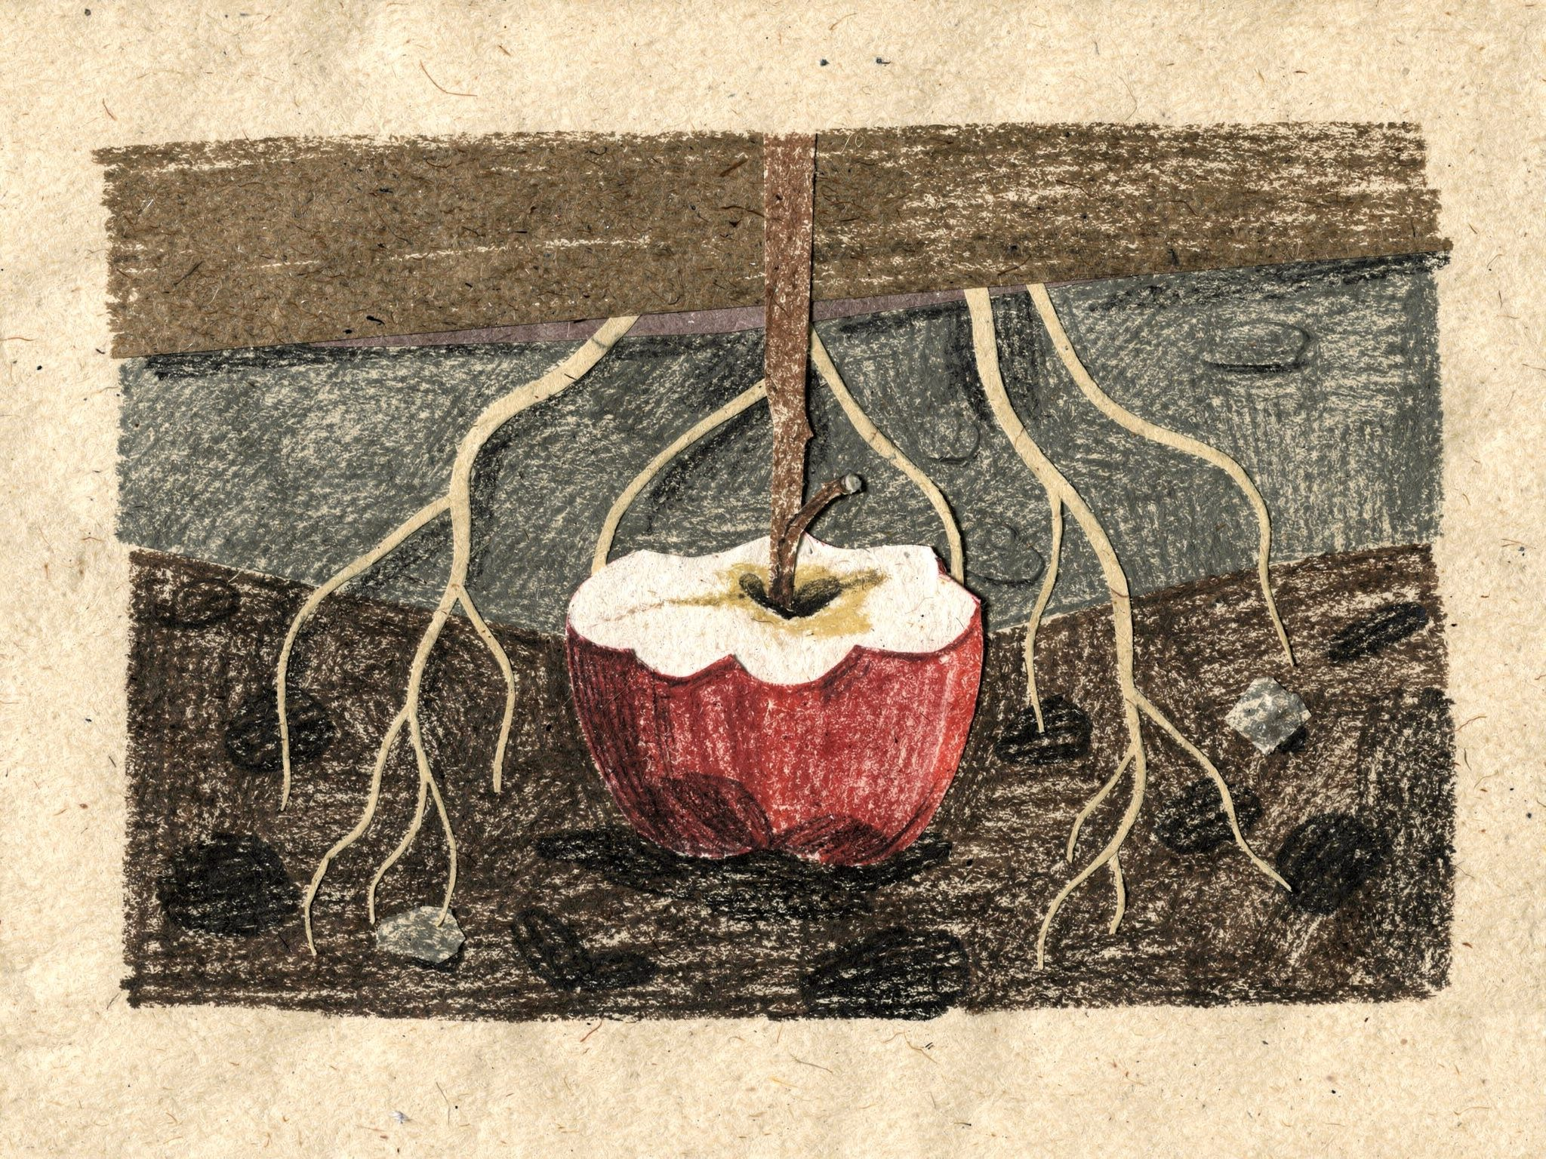
And down in the dark, someone smelled apples.
29
Notes:
Page 29. Last page, and a hint of Book 2 (The Apple Core): roots and fungal threads reach for it. PRINT: 10 x 8 in landscape trim, 0.125 in bleed (page 10.25 x 8.25 in), text 0.5 in inside trim, 300 DPI art.

Slide 32
The End
Notes:
The End. PRINT: 10 x 8 in landscape trim, 0.125 in bleed (page 10.25 x 8.25 in), text 0.5 in inside trim, 300 DPI art.

Slide 33
Appendix
Characters, scenes, story notes and print notes.
Not part of the printed book.
Notes:
Appendix divider. PRINT: 10 x 8 in landscape trim, 0.125 in bleed (page 10.25 x 8.25 in), text 0.5 in inside trim, 300 DPI art.

Slide 34
Rose
About 6. Curious, messy and kind. She talks to the ground (“Night night, dirt!”) and never knows anyone hears her.
Notes:
Appendix, character: Rose, three poses. PRINT: 10 x 8 in landscape trim, 0.125 in bleed (page 10.25 x 8.25 in), text 0.5 in inside trim, 300 DPI art.

Slide 35
Barry the Bacterium
Rod-shaped and always hungry. When he eats sugar he splits into two Barrys, then four. He never knows which Barry he is.
Notes:
Appendix, character: Barry = critter-bacillus. PRINT: 10 x 8 in landscape trim, 0.125 in bleed (page 10.25 x 8.25 in), text 0.5 in inside trim, 300 DPI art.

Slide 36
Myco the mycorrhizal fungus
The town's postman. His long arms reach everywhere and hold hands with the tree roots, trading minerals for the sugars the roots make. In Book 1 he explains plastic.
Notes:
Appendix, character: Myco = critter-mycorrhiza v2. PRINT: 10 x 8 in landscape trim, 0.125 in bleed (page 10.25 x 8.25 in), text 0.5 in inside trim, 300 DPI art.

Slide 37
Pip the Flagellate
Small, fast and nervous, with two long tails. He has a crush on Ama.
Notes:
Appendix, character: Pip. PRINT: 10 x 8 in landscape trim, 0.125 in bleed (page 10.25 x 8.25 in), text 0.5 in inside trim, 300 DPI art.

Slide 38
Ama the Amoeba
Changes shape when she's embarrassed.
Notes:
Appendix, character: Ama. PRINT: 10 x 8 in landscape trim, 0.125 in bleed (page 10.25 x 8.25 in), text 0.5 in inside trim, 300 DPI art.

Slide 39
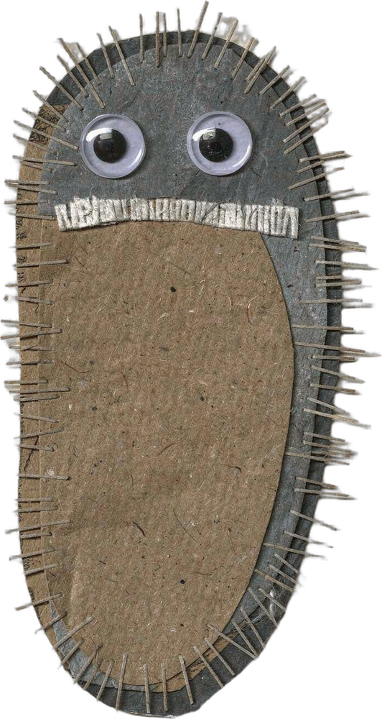
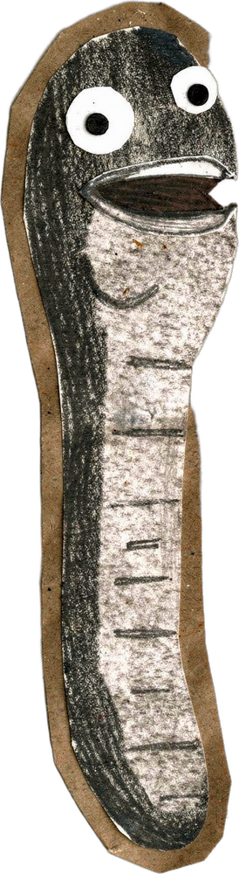
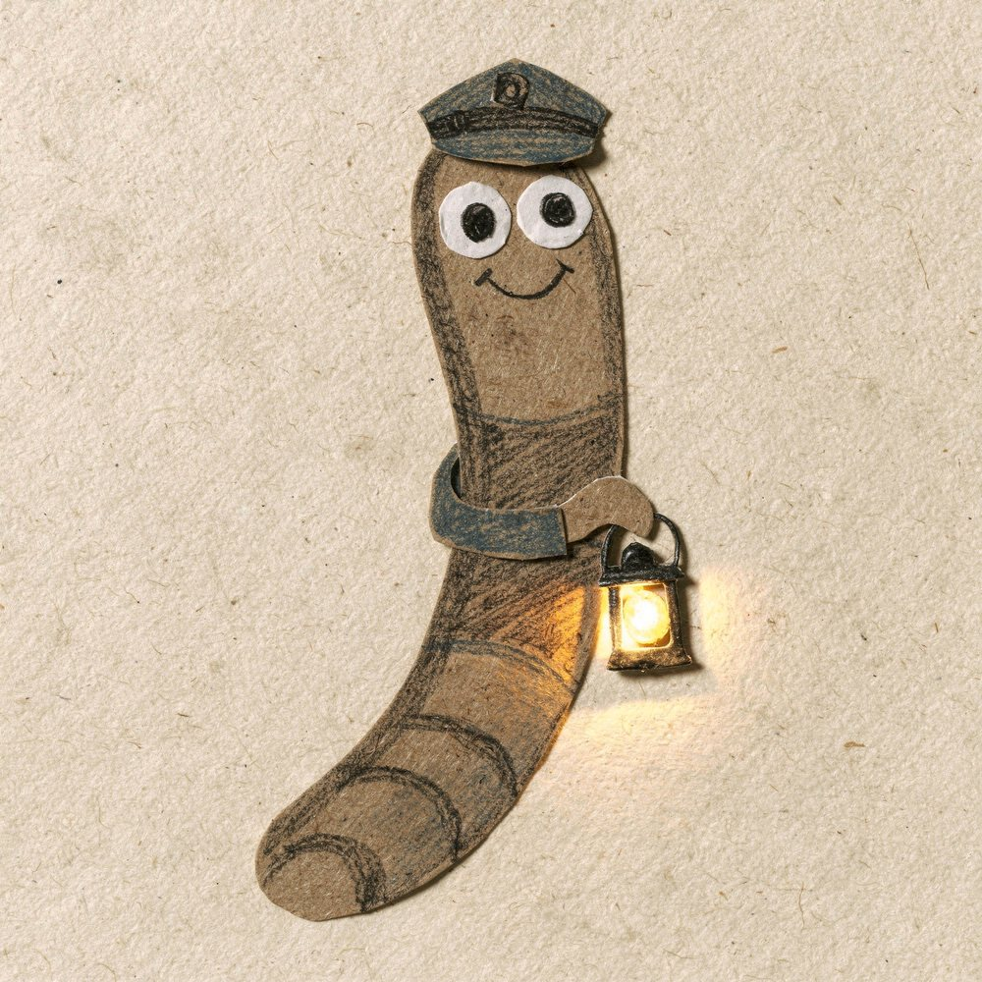
For later books
Ned the Nematode (night watchman), Cilia the Ciliate (arrives when the soil runs out of air), and more of the soil food web.
Notes:
Appendix, character: Ned (book-ned-nematode), Cilia (critter-paramecium), a bacterial-feeding nematode. PRINT: 10 x 8 in landscape trim, 0.125 in bleed (page 10.25 x 8.25 in), text 0.5 in inside trim, 300 DPI art.

Slide 40
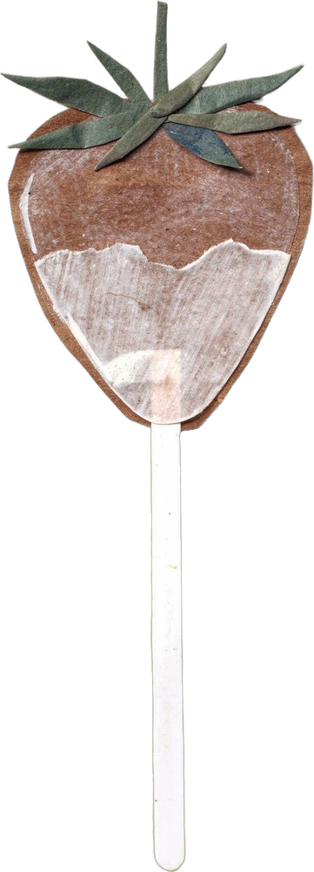
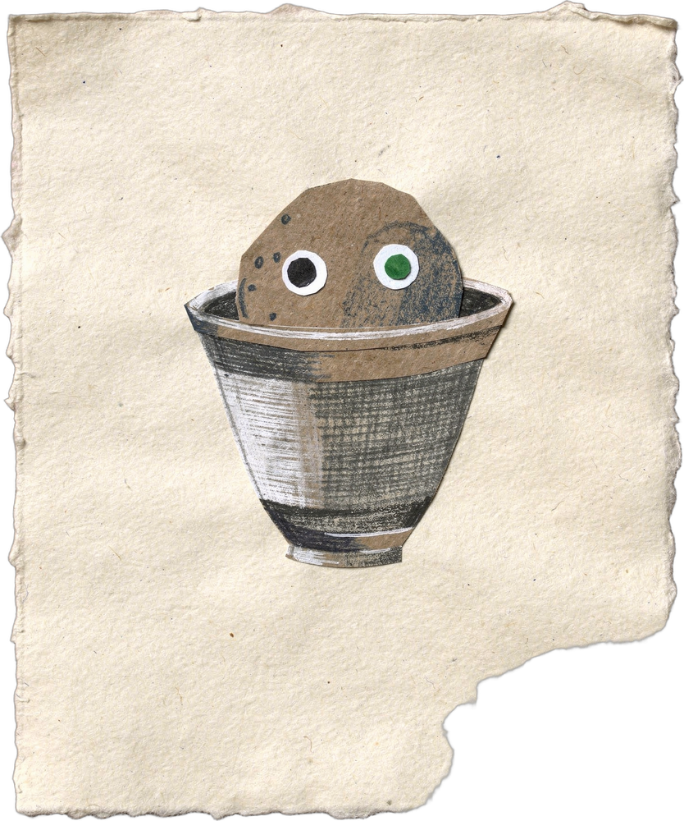
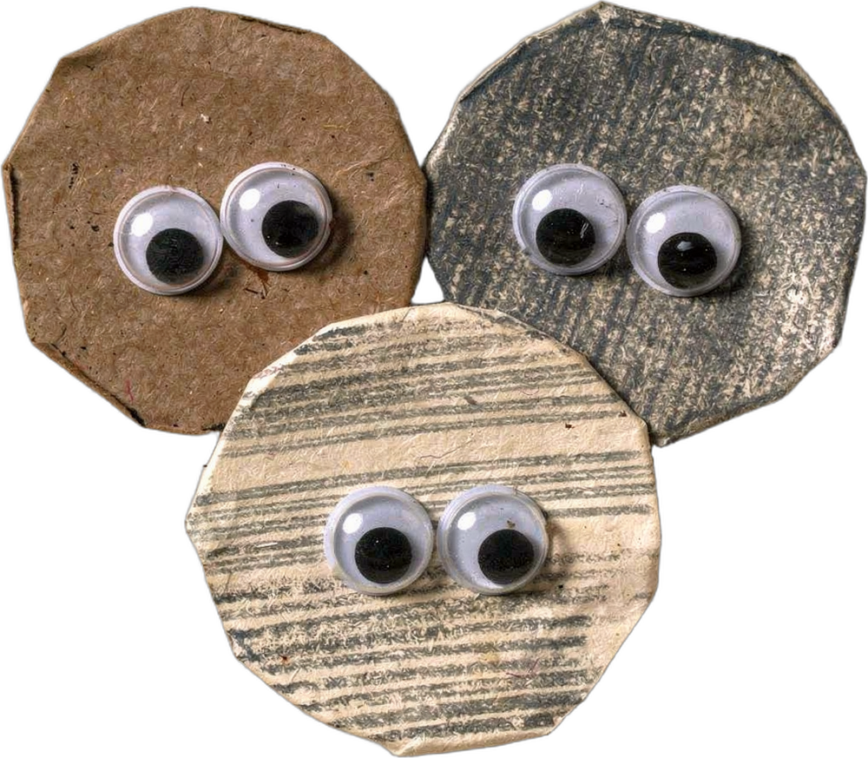
More creatures
From the creature set, for future books.
Notes:
Appendix, character: Cocci, testate amoeba, the lollipop cut-out. PRINT: 10 x 8 in landscape trim, 0.125 in bleed (page 10.25 x 8.25 in), text 0.5 in inside trim, 300 DPI art.

Slide 41
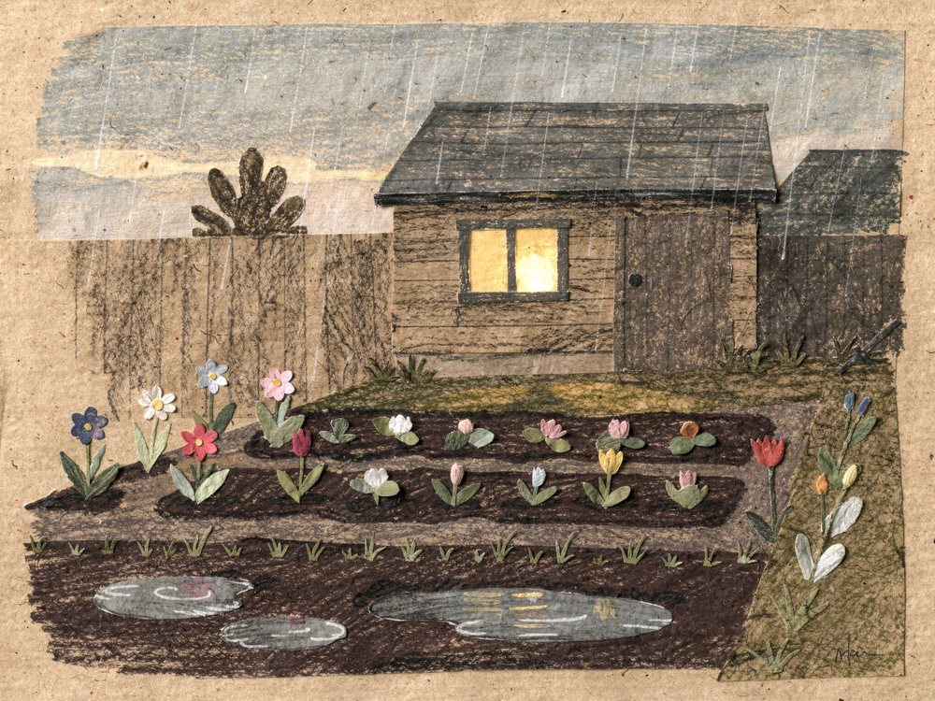


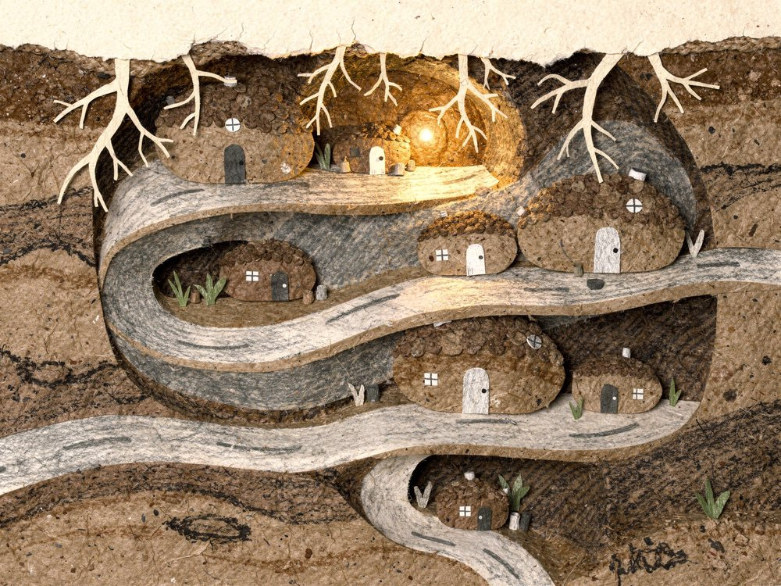
Scene library
garden
flowers
lolly-soil
town
Notes:
Appendix: scene library assets/collage/originals/book-scene-garden-1.png, assets/collage/originals/book-scene-flowers-1.png, assets/collage/originals/book-scene-lollipop-soil-1.png, assets/collage/originals/book-scene-town-1.png PRINT: 10 x 8 in landscape trim, 0.125 in bleed (page 10.25 x 8.25 in), text 0.5 in inside trim, 300 DPI art.

Slide 42
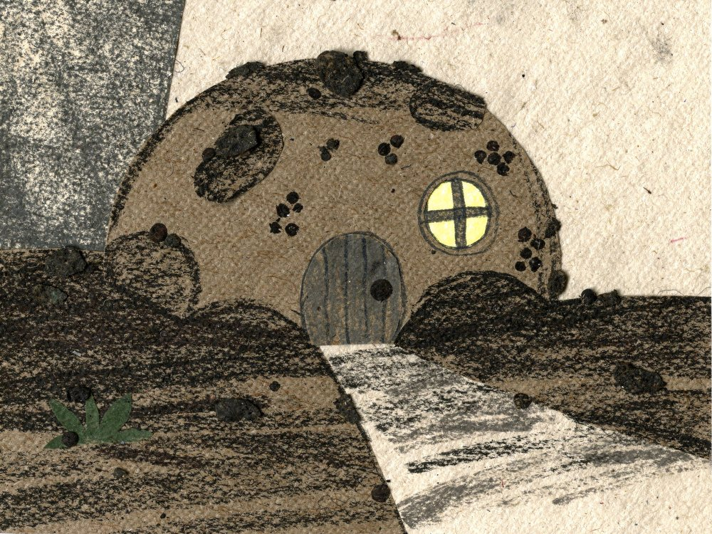

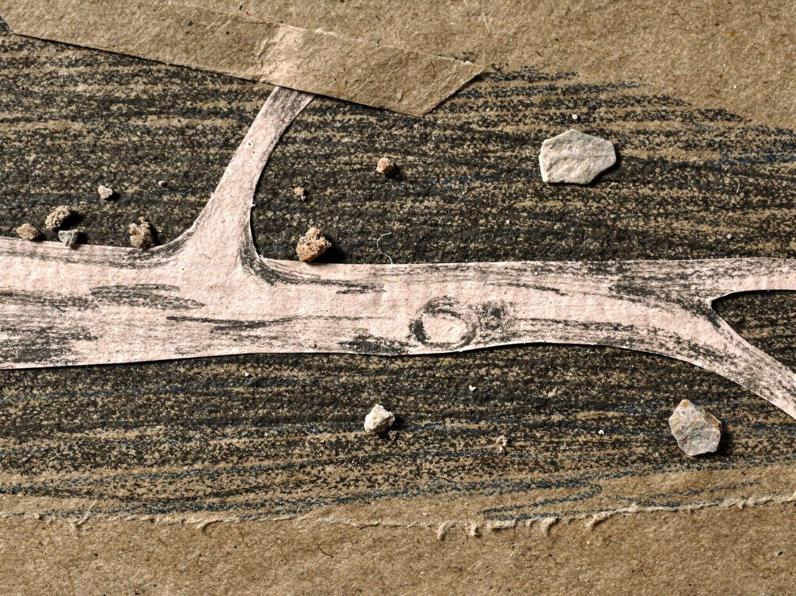

Scene library
house
drop
root-road
dinner
Notes:
Appendix: scene library assets/collage/originals/book-scene-barry-house-1.png, assets/collage/originals/book-scene-sugar-drop-1.png, assets/collage/originals/book-scene-root-road-1.png, assets/collage/originals/book-scene-rose-dinner-1.png PRINT: 10 x 8 in landscape trim, 0.125 in bleed (page 10.25 x 8.25 in), text 0.5 in inside trim, 300 DPI art.

Slide 43

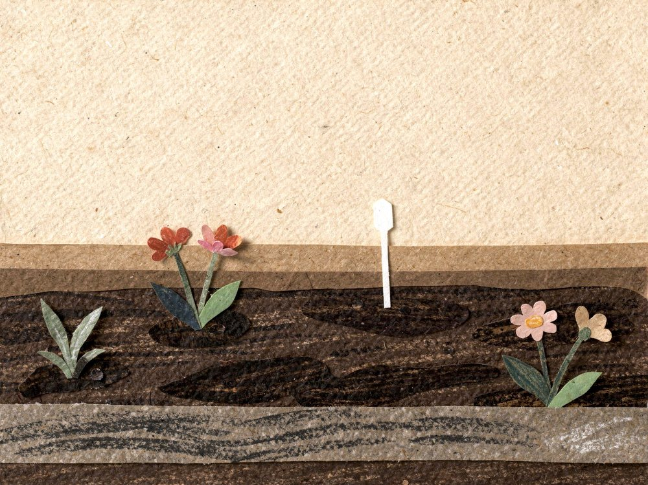
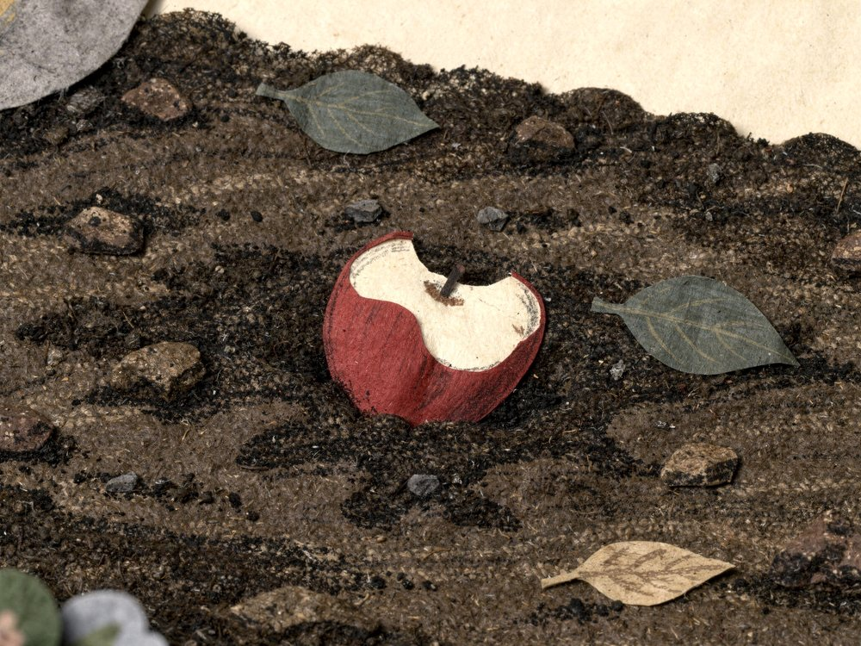

Scene library
stick
morning
apple
night
Notes:
Appendix: scene library assets/collage/originals/book-scene-stick-street-1.png, assets/collage/originals/book-scene-garden-morning-1.png, assets/collage/originals/book-scene-apple-core-1.png, assets/collage/originals/book-scene-town-night-1.png PRINT: 10 x 8 in landscape trim, 0.125 in bleed (page 10.25 x 8.25 in), text 0.5 in inside trim, 300 DPI art.

Slide 44

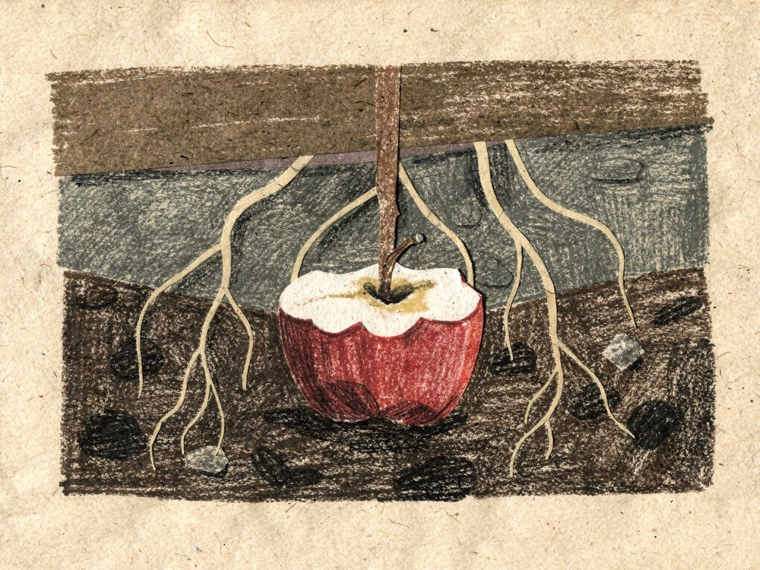
Scene library
bed
apple-below
Notes:
Appendix: scene library assets/collage/originals/book-scene-rose-bed-1.png, assets/collage/originals/book-scene-apple-below-1.png PRINT: 10 x 8 in landscape trim, 0.125 in bleed (page 10.25 x 8.25 in), text 0.5 in inside trim, 300 DPI art.

Slide 45
The world
Above ground is Rose's garden. Below it is a whole town in the soil, lit by a soft brown glow, with tunnels for streets and soil crumbs for houses.
Every story starts with something Rose does up top, and the town lives with the result.
Every book ends with Rose learning one new thing about what the garden likes, without ever knowing who taught her.
Notes:
Appendix: the world. PRINT: 10 x 8 in landscape trim, 0.125 in bleed (page 10.25 x 8.25 in), text 0.5 in inside trim, 300 DPI art.

Slide 46
Running threads and later books
Barry's hunger: how many Barrys there are shows how much food came down.
Pip and Ama: Pip gets one small step closer in each book.
Cilia's warnings: when she arrives, the soil needs air.
Later books: The Apple Core (a happy feast), The Flood (too much water, Cilia arrives), The Spade (Myco's arms are cut and regrow), Spike's Raid (a root-nibbling nematode; Pip is brave), Winter Sleep (the town slows down).
Notes:
Appendix: running threads and later books. PRINT: 10 x 8 in landscape trim, 0.125 in bleed (page 10.25 x 8.25 in), text 0.5 in inside trim, 300 DPI art.

Slide 47
The science behind Book 1
Soil microbes break food down with enzymes that fit things that were once alive: leaves, fruit, bread, sugar. In the book these are the “keys”.
Plastic is made of long chains that soil enzymes mostly cannot unlock. It does not rot away; it slowly breaks into tiny pieces (microplastics) and can last hundreds of years.
Bacteria multiply by splitting in two when they have food, which is why there are more Barrys.
Mycorrhizal fungi trade minerals and water with roots in exchange for sugars.
Notes:
Appendix: the science behind Book 1. PRINT: 10 x 8 in landscape trim, 0.125 in bleed (page 10.25 x 8.25 in), text 0.5 in inside trim, 300 DPI art.

Slide 48
Print notes
Trim size 10 × 8 in landscape. Each slide is 10.25 × 8.25 in: trim plus 0.125 in bleed on every side.
Text and page numbers stay at least 0.5 in inside the trim.
32 book pages (title, dedication, 29 story pages, The End). Picture books are printed in multiples of 8 pages.
The art is about 200 DPI at this size. Upscale the scenes to 300 DPI before sending to a printer.
Remove the appendix before exporting the print file.
Notes:
Appendix: print notes. PRINT: 10 x 8 in landscape trim, 0.125 in bleed (page 10.25 x 8.25 in), text 0.5 in inside trim, 300 DPI art.

