Slide 1

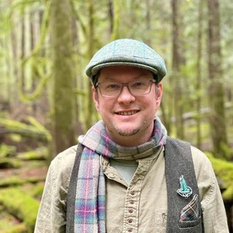





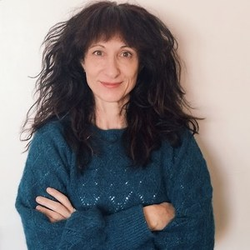







OCTOBER 5
Happy World Teachers' Day
To the mentors who teach our students to see soil.
Notes:
Option 3, slide 1: the fourteen mentors in a ring around the title. Mentor photos: Linnea's Drive folder (5 Oct 2026) and assets/mentors-teachers-day/; written consent per the folder README.

Slide 2
Thank you to every mentor on our team.
Tommy Tepper
Aysen Ustunay
Director of Education & Mentor
Advanced Programs Mentor
Loida Vasquez
Dora Tkalec
Advanced Programs Lead & Mentor
Advanced Programs Mentor
Carla Portugal
Gerald Ramirez
Science Lead & Mentor
Advanced Programs Mentor
Wesley Sanders
Elena Kalli
Advanced Programs Mentor
Advanced Programs Admin
Casey Williams
Ib Borup Pederson
Advanced Programs Mentor
Advanced Programs Mentor
Brian Daubenspeck
Nick Padwick
Advanced Programs Mentor
Advanced Programs Mentor
Isadora Schmidt
Delvin Solkinson
Advanced Programs Mentor
Permaculture Lead Teacher
Notes:
Option 3, slide 2: every mentor by name and role.

