Slide 1
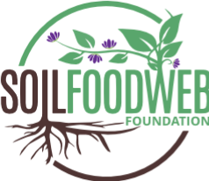
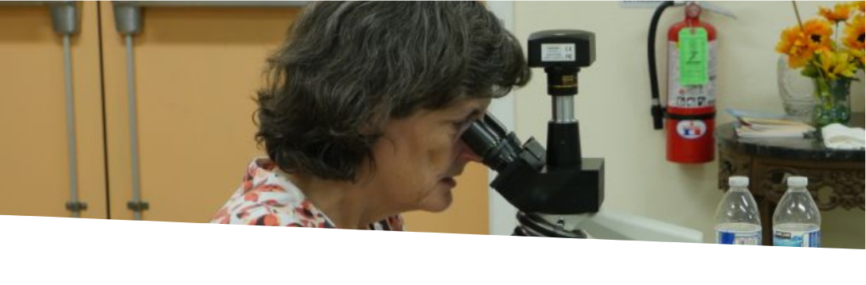
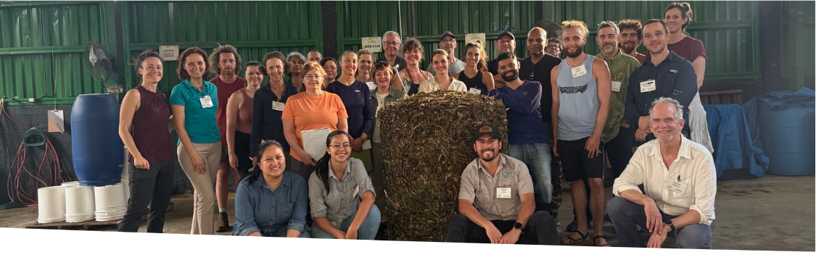
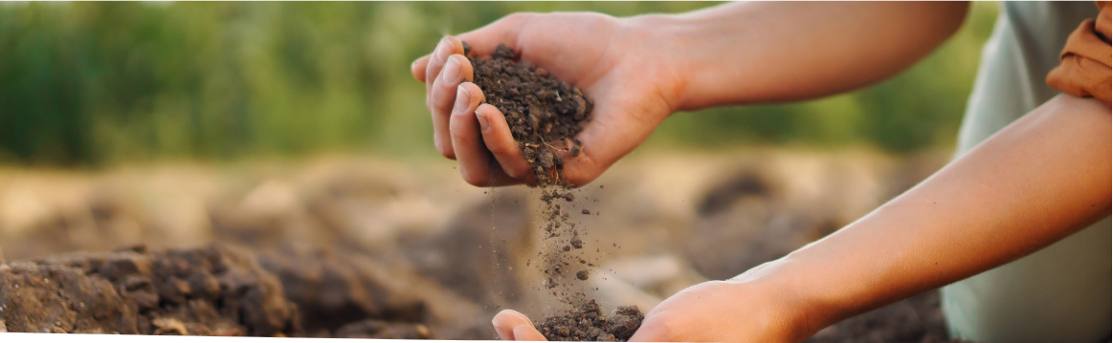










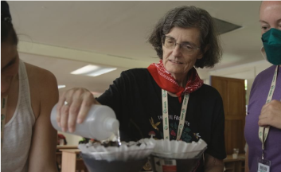


WHY BIOLOGY
COMMUNITY
Soil Food Web
Foundation
Feed the organisms that feed your plants.
Join a global community of Soil Regenerators.
A 501(c)(3) nonprofit
Dr. Elaine Ingham at the microscope.
A workshop group around a finished compost pile.
Grow your own
biology.
Plants don't feed alone.
We believe your food is only as nutritious as your soil is alive.
Bacteria and fungi produce enzymes that break down minerals and organic matter and free the nutrients they contain. When protozoa and nematodes consume those bacteria and fungi, the surplus is released right at the root, in plant-available form.
Farmers, consultants, gardeners and people who care where their food comes from are part of this community. It's easy to find your place in this movement. Reach out to discover opportunities to join us as a student, volunteer, ambassador, donor and partner. As a nonprofit, the best way to support us is to share our message and resources with people who need them.
The soil beneath our farms and forests is alive.
Bacteria produce glues that bind soil particles into microaggregates; fungal hyphae weave those into larger macroaggregates. The result behaves like a sponge, holding water, letting air flow in and resisting erosion.
A web of bacteria, fungi, protozoa, nematodes and microarthropods feeds plants, builds soil, stores carbon and cleans water when it is intact.
Join the free online community
We train farmers, and the people who work with them, to transition from chemical inputs to biology. You'll learn to test your soil, produce your own BioComplete™ compost and liquid amendments, and rebalance the microbial content of your fields. Living soil is the solution, and it is beneath your feet.
These microbes are often lost in land that has been chemically managed or compacted. Biologically complete compost is designed to restore them.
Meet other people in the regenerative agricultural space. Get your questions answered by other practitioners of the Soil Food Web Approach who share the desire to restore the world's soils.
OUR STORY
Dr. Elaine Ingham mapped the Soil Food Web and taught the world to restore it. The Soil Food Web Foundation, established in October 2025, carries her work forward with growers on working land.
sfw.one/brochure-community
EDUCATION
RESEARCH
PRACTICE
COMMUNITY
STUDY
VOLUNTEER
DONATE
HOST
info@soilfoodweb.com · (503) 809-2349
132+
5441 S Macadam Ave Ste N
Portland, Oregon 97239
soilfoodweb.com
Her published record, in full, on our site:
sfw.one/publications
Countries in our student and practitioner community
Soil Food Web Foundation is a 501(c)(3) nonprofit organization, EIN 39-4439236. The Soil Food Web School is a program of the Foundation.
10,000+
Individuals enrolled in our programs
Watch a free webinar
Learn more
45
A live hour with an instructor or a practitioner, every month. The easiest first step.
Curious about the Soil Food Web approach? Visit our website to explore our courses, workshops, and free resources.
Years of soil biology research behind the method
Healing soil.
Feeding humanity.
Restoring the living world.
sfw.one/brochure-webinar
soilfoodweb.com

Slide 2
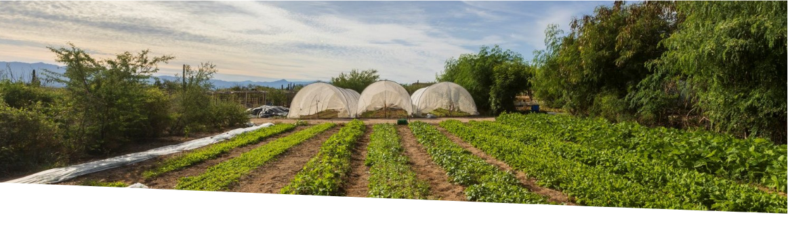
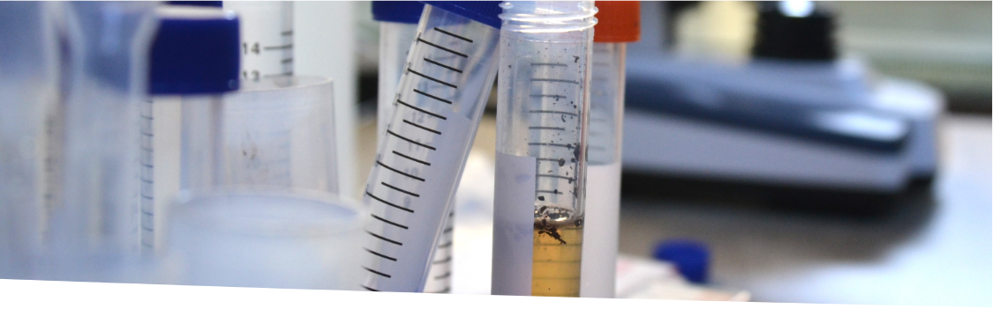
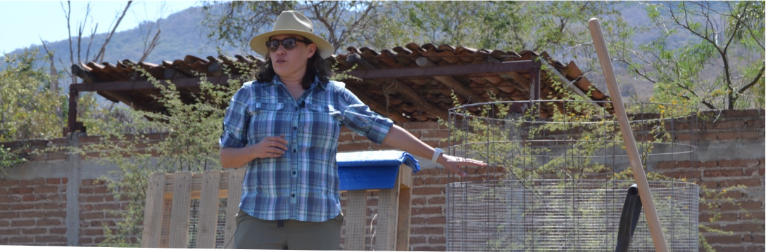



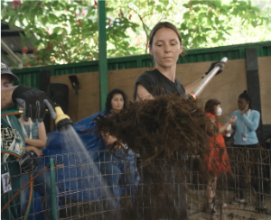
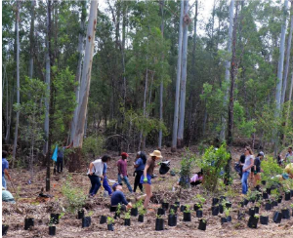
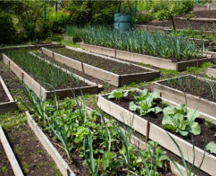




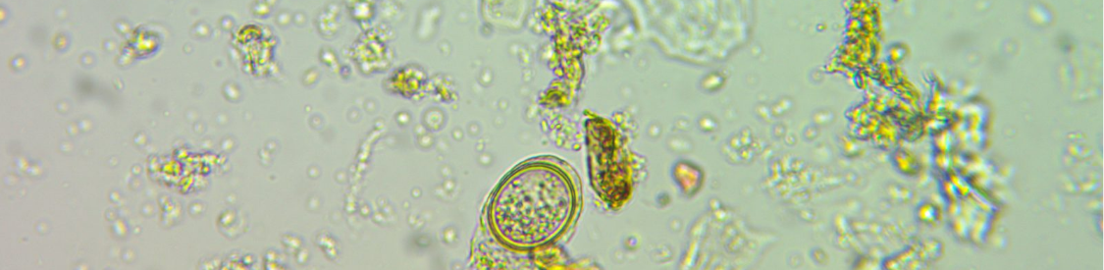







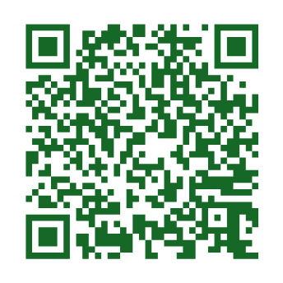
PRACTICE
ON YOUR FARM
LEARN
Growers are implementing this at every scale.
We start with
your soil.
Learn to grow your own soil biology.
Agroecology plots at Rancho Cacachilas.
Soil samples beside the microscope.
A mentor teaching on working land.
Growers like you are cutting inputs and improving soil, and documenting it.
The steps are the same at every scale: look at the biology under a microscope, add what is missing to rebalance the microbial content, then measure again to confirm microbial counts are going in the expected directions.
Everyone starts with the Foundation Courses. Where you go next depends on whether you want to apply your skills to your own land or help other farmers improve their soils.
The basic methodology is universal; the application is based upon locally-sourced materials. Whether you tend a rooftop container or a thousand-acre farm, the principle is the same.
Nick Padwick farms in Norfolk, England. Roberto Silva farms in Piura, Peru. Jenn Sirp grows in California.
What we test before we recommend
Start learning
Diagnostic first. Every recommendation starts with a biological analysis under a microscope.
The Foundation Courses give you the biological literacy to understand what is actually happening in your soil, why it matters, and what you can do about it. They are online, self-paced, take about 150 hours to complete, and are a prerequisite to any Advanced Program.
Measurable. We provide a relative count of various microbes present in your soil or compost sample.
Adaptation and retrofitting. We help you convert your current operations to the Soil Food Web Approach, at any scale.
Go professional
Learn the practical application of the theory you learned in the Foundation Courses through mentor-led Advanced Programs on Soil Microscopy, BioComplete™ Compost Production, and Biological Liquid Amendments and Field Trial.
Find a trained professional near you
Our graduates who complete their certifications to become consultants and lab-technicians are listed in our online directory. Hire an earned title, not a claim.
Learn in person
Accelerator Workshops are immersive, two-week, hands-on intensives where you produce BioComplete™ compost and biological liquid amendments live, hosted with a partner on their land. Gain a year's worth of hands-on experience in one immersive workshop.
Testate amoeba, 40x objective. Photograph: Joy Kaluf. A microbial count names what is present in the sample and their relative numbers: bacteria, fungi, protozoa, nematodes and microarthropods.
What healthy soil biology does
Where it leads
Watch a case study from your crop or region.
Careers in soil biology analysis as SFW Lab-Technicians, and working with farmers and land stewards to implement the Soil Food Web Approach as SFW Consultants.
Hear growers explain in their own words how the Soil Food Web Approach changed their operations through reducing inputs, creating better outputs and improving their bottom lines.
CYCLES
NUTRIENTS
CREATES
SOIL
STRUCTURE
INHIBITS
WEED
PRESSURE
REDUCES
PESTS AND
DISEASE
Apply for a scholarship
The approach is designed to dramatically reduce dependence on chemical inputs.
Cost shouldn't keep anyone from healing soil. Scholarships prioritize applicants in under-resourced regions.
sfw.one/brochure-casestudies
Results shown are from individual sites in specific contexts; outcomes vary with climate, crop and management.
sfw.one/brochure-scholarship

