Slide 1
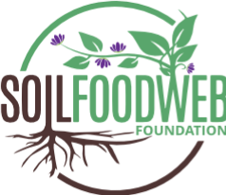
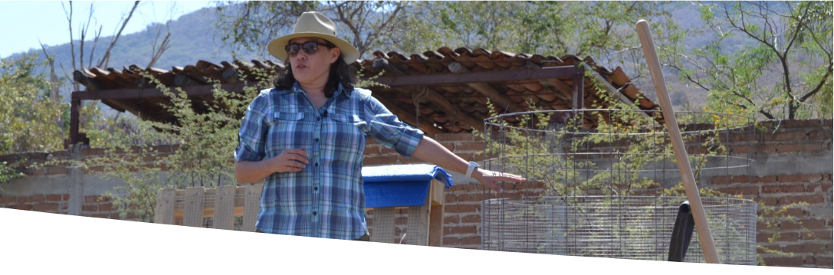
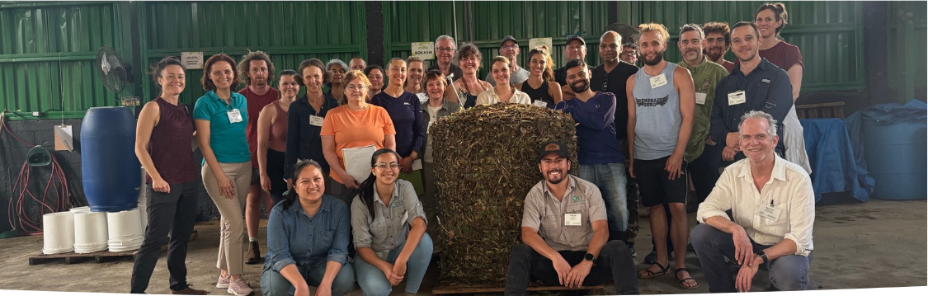
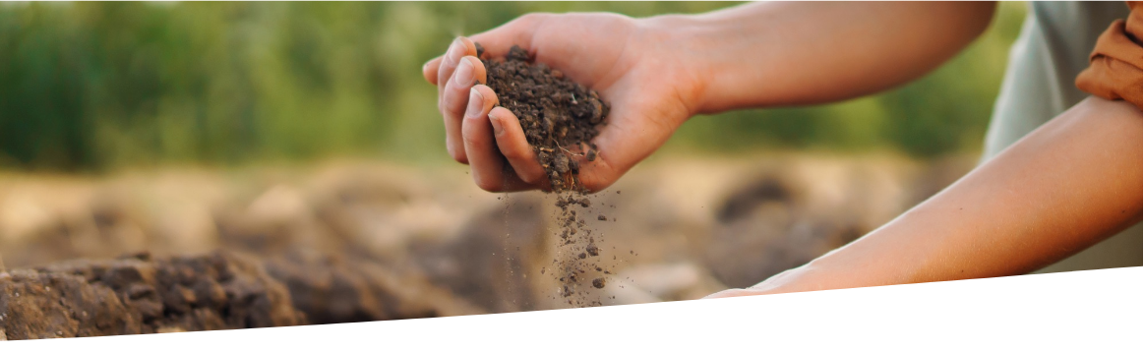


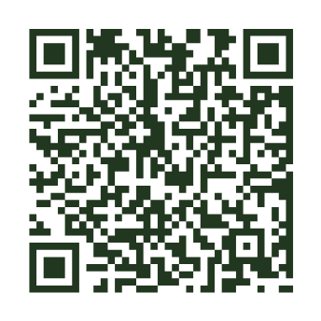













TEACHING
COMMUNITY
Soil Food Web
Foundation
Anyone, anywhere, can learn to restore living soil.
A global community makes this work outlast any one of us.
A 501(c)(3) nonprofit
A mentor teaching on working land.
A workshop group around a finished compost pile.
The soil beneath our farms and forests is alive.
From first curiosity to professional practice. Everyone starts with the Foundation Courses. Where you go next depends on whether you want to grow better yourself, or help others do it.
Curious about the Soil Food Web approach?
Visit our website to explore our courses, workshops, and free resources. Learn how soil biology supports healthy plants and discover ways to get involved.
Foundation Courses
A web of bacteria, fungi, protozoa, nematodes and microarthropods feeds plants, builds soil, stores carbon and cleans water when it is intact.
The science of the soil food web, the organisms and their roles, and how biological amendments are made and applied. Online, self-paced, about 150 hours, and required before any Advanced Program.
Learn more
For forty-five years, Dr. Elaine Ingham mapped the Soil Food Web and taught the world to restore it. We carry her legacy forward: showing what is possible, teaching how to partner with life in the soil, researching why things work or do not, and getting dirty through direct action on working land. Living soil is the solution, and it is beneath your feet.
www.soilfoodweb.com
Advanced Programs
Soil Microscopy, BioComplete™ Compost Production, Biological Liquid Amendments and Field Trial, each with its own mentor. All four together are the full path.
Accelerator Workshops
STUDY
VOLUNTEER
DONATE
HOST
The Advanced Programs worked through as a group on working land, the whole method applied at once. Held periodically, and hosted with a partner on their land. Dates and places go up on the school site.
EDUCATION
RESEARCH
PRACTICE
COMMUNITY
Where it leads
5441 S Macadam Ave Ste N
Portland, Oregon 97239
soilfoodweb.com
132+
All four Advanced Programs together carry the Soil Food Web Consultant title; Soil Microscopy alone, the Lab Technician title. Every program, with its price, is listed at school.soilfoodweb.com
Countries in our student and practitioner community
Soil Food Web Foundation is a 501(c)(3) nonprofit organization, EIN 39-4439236. The Soil Food Web School is a program of the Foundation.
10,000+
Individuals enrolled in our programs
Enroll in the Foundation Courses
Donate
45
Online, self-paced, about 150 hours. Required before any Advanced Program.
Gifts fund open research, scholarships and field projects. Tax-deductible to the extent allowed by law.
Years of pioneering soil biology research behind the method
Healing soil.
Feeding humanity.
Restoring the living world.
sfw.one/brochure-courses
sfw.one/brochure-donate

Slide 2
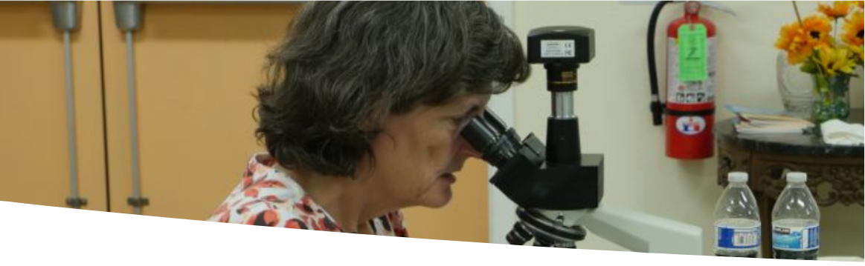
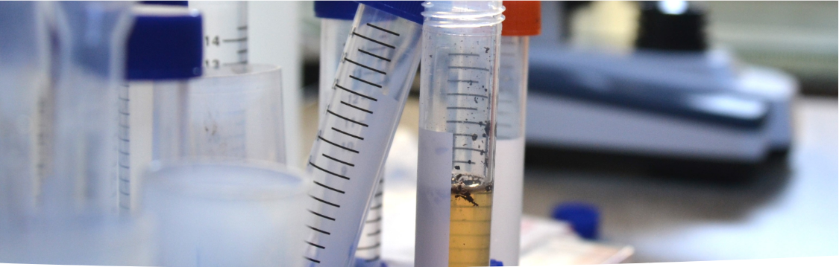
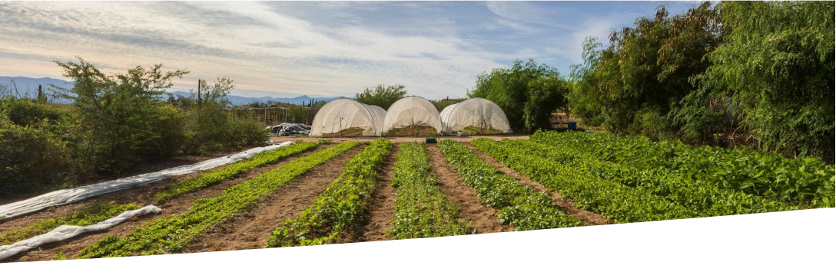





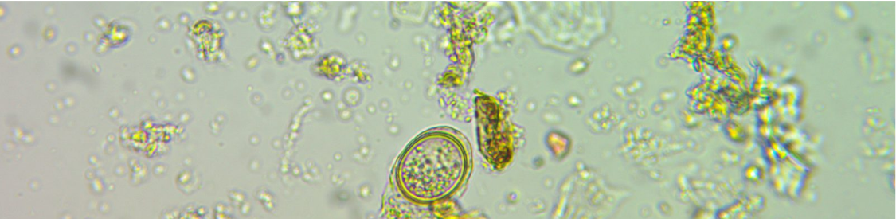
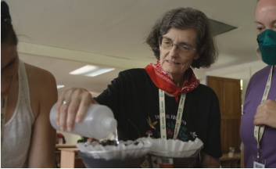

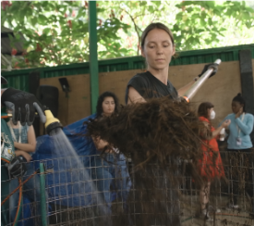
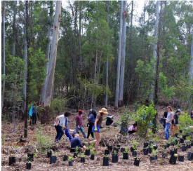
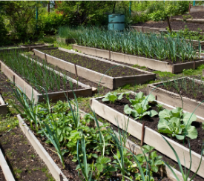





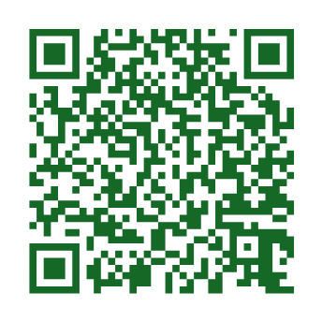
OUR STORY
RESEARCH
PRACTICE
It began with one scientist looking closer.
The science is open, and anyone can test it.
Growers are already doing this, at every scale.
Dr. Elaine Ingham at the microscope.
Soil samples beside the microscope.
Agroecology plots at Rancho Cacachilas.
Dr. Elaine Ingham pioneered research in soil biology across forty-five years and made her science radically accessible, so that anyone anywhere could learn to restore the soil beneath their feet.
Forty-five years of soil biology research, practiced by graduates in more than 132 countries on six continents.
The biology is universal; the practice is local. Every result we publish names the grower who got it and the year they did.
The Foundation was created in 2025 to carry that teaching forward. She passed in February 2026, and the work she started continues through the Foundation, the school inside it, and practitioners in more than 132 countries who bring the same close attention to their own soil.
What the biology does when it is intact
Nick Padwick farms four thousand acres in Norfolk, England. Roberto Silva works a hundred and forty in Piura, Peru. Jenn Sirp grows on a quarter acre in California. They film the work themselves and publish what changed, so nobody has to take our word for it.
NUTRIENT
CYCLING
SOIL
STRUCTURE
WEED
PRESSURE
PESTS AND
DISEASE
She taught at Oregon State from 1986 to 2002, served as the first President of the Soil Ecology Society, and co-authored the USDA's Soil Biology Primer.
The scale runs from that quarter acre to ten thousand acres of corn and soy in Illinois, and a public park on Governors Island in New York. The steps are the same at every size: look at the biology under a microscope, add what is missing, and measure again.
Her published record, in full, on our site:
sfw.one/publications
Testate amoeba, 40x objective. Photograph: Joy Kaluf. A count names what is there: bacteria, fungi, protozoa, nematodes and microarthropods.
We partner with growers to trial the approach where they farm, and to document what happens when they do.
What we test before we recommend
WHY THIS MATTERS FOR CLIMATE
Plants pull carbon from the air and invest much of it in the soil, where it is built into microbial bodies, aggregates and long-lived fungal networks. Biological management also avoids emissions, because less fertilizer has to be made and moved, and the field needs fewer passes.
Measurable. Every recommendation starts with a count, not a guess.
Diagnostic first. We look at your soil before we suggest anything.
Compatible. No need to tear up what you have.
Find a trained professional near you
Each mechanism we teach is established soil biology. How much of any one benefit a field sees depends on climate, crop, starting condition and management. We publish results by site, with the person and the year, and say what one site cannot prove.
Consultants and lab technicians who finished the assessed programs are listed in our own directory.
Watch a free webinar
Watch the case studies
A live hour with an instructor or a practitioner, every month. The easiest first step.
Growers filming their own soil, crop by crop and climate by climate. Start with one that looks like yours.
sfw.one/brochure-webinar
Her publications and the wider research, item by item:
sfw.one/publications
sfw.one/brochure-casestudies

